Slide 1
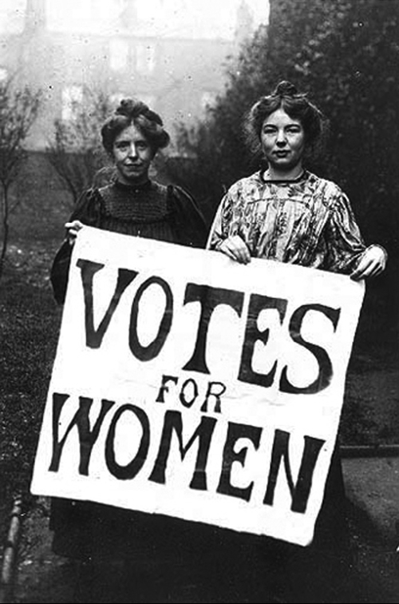
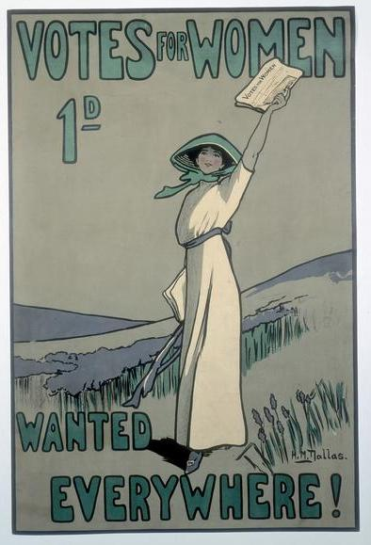
Women's Suffrage in the UK
By
Mike Allen

Slide 2
The Position of Women in 1800 (1)
Women were seen as second class citizens.
Their role was domestic – to marry, support their husbands and produce children.
Spinsters were reviled and pitied.
All Christian religions supported this.
On marriage all property rights went to the husband unless there was a legal pre-nuptial agreement.
Women promised to obey their husbands in the marriage ceremony.
Furthermore, rights to the woman personally - that is, access to her body - were his.

Slide 3
The Position of Women in 1800 (2)
Control of the children were in the husband’s hands.
Divorce was only available via an act of parliament or via church courts.
Many types of work were barred to women including all professions and the civil service.
Working class women worked in factories or as agricultural labourers. Poor women of a middle class background often worked as governesses.
Women who worked were paid less than men – often 50% or less.
Politics was barred to women though some women who owned property (single women and widows) managed to vote before 1832 when it was then stopped.

Slide 4
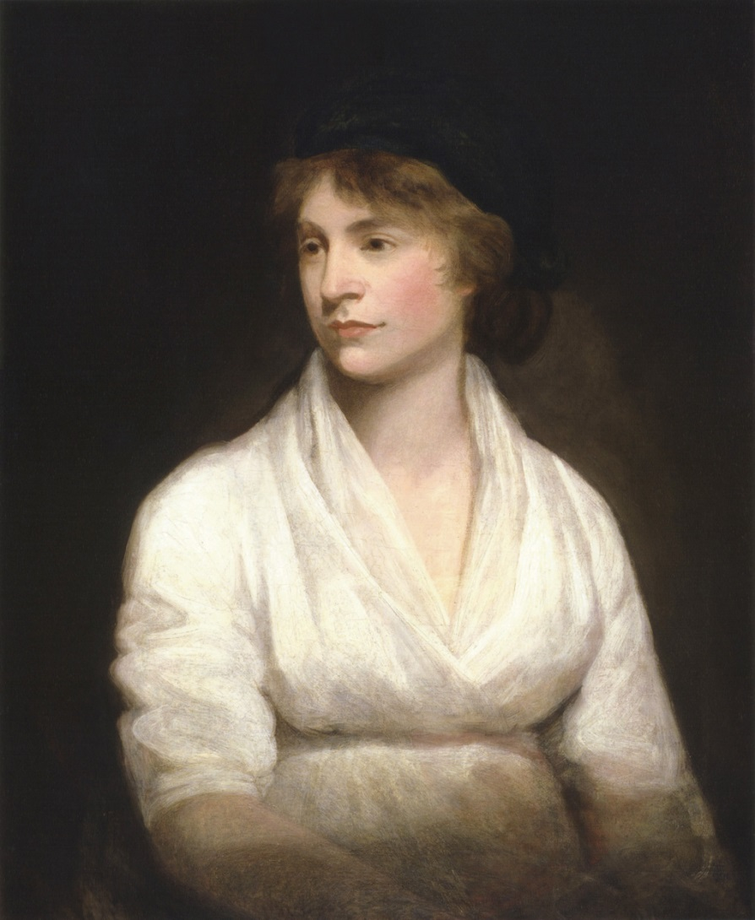
Women’s Rights
Enlightenment thought on individual rights inspired women to aspire to greater rights.
Mary Wollenstonecraft (27 April 1759 – 10 September 1797) born in Spitalfields, London, is often credited as being the founder of English feminism, she was a remarkable woman and author of “Vindication of the Rights of Women” a work in which she articulates that women are not naturally inferior to men but only appear to be as the result of a lack of education.
Jeremy Bentham 1748 – 1832 argued for a complete equality between sexes. In 1818 that he published his work “A Plan for Parliamentary Reform” advocating as part of that plan rights for women.
John Stuart Mill (1806 – 1873) In 1869 he published his book “The Subjection of Women”, which demanded equal rights for women.
The industrial revolution was part of this process.

Slide 5
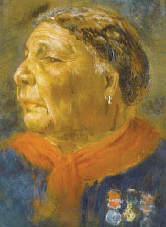
Female pioneers in the 19th Century 1
A number of Women in the 19th century campaigned for a greater role for Women.
Elizabeth Gurney Fry (1780-1845) She was appalled by the treatment of prisoners and made it her duty to make, predominately women prisoners, live better lives while in jail.
Florence Nightingale (1820 — 1910) Her and her group of women were one of the first to serve as nurses for soldiers. They left from Britain directly into the Crimean war in 1854.
Mary Seacole (1805-81) Mary Seacole was a Jamaican-born nurse who helped soldiers during the Crimean War. Her work was praised at the time, but she became even more famous a century later. She went onto the battlefield with “wine, bandages, and food for the wounded or the prisoners.’”(William Howard Russell, 1857)
Josephine Elizabeth Butler (1828 –1906) was especially concerned with the welfare of prostitutes. She was intensely religious as an evangelical Anglican. She led the long campaign for the repeal of the Contagious Diseases Acts 1869 to 1886 because the acts harmed and unfairly imprisoned young women who were suspected of being prostitutes.
Mary Seacole

Slide 6
Female pioneers in the 19th Century 2
Elizabeth Garrett Anderson, (1836 1917) the first Englishwoman to qualify as a physician and surgeon in Britain, the co-founder of the first hospital staffed by women, the first dean of a British medical school, the first female doctor of medicine in France, the first woman in Britain to be elected to a school board and, as Mayor of Aldeburgh, the first female mayor and magistrate in Britain.
Dorothea Beale and her friend Frances Mary Buss created respectively the girls’ public boarding school and the girls’ grammar school. In 1858 Miss Beale took over the recently founded Cheltenham Ladies College and turned it into the model of the high-quality girls’ boarding school. St Leonards and Roedean were founded after 1870 based on its example. Miss Buss’ North London Collegiate School began in 1850 in Camden Town to meet the problem of the lack of education for middle-class girls. She believed in the important of home life in the upbringing of girls and it deliberately remained a day school.
Maria Grey created the first National Union for improving the education of all women classes. This union was known as the Women's Education Union. It was a pressure group for women rights to professional recognition. It founded Maria Grey Training College for female teachers (1878).
There were also famous women writers in Britain in the 19th century. Among them were Jane Austen, the Bronte sisters, Elizabeth Gaskell and George Eliot (Mary Anne Evans). In 1818 Mary Shelley published her novel Frankenstein.

Slide 7
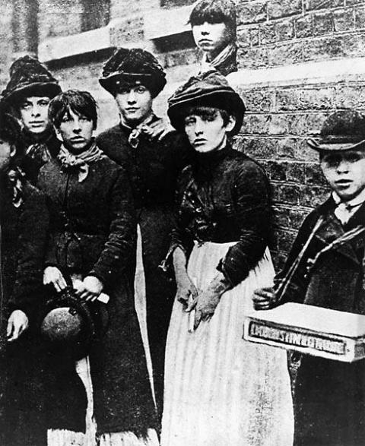
Female pioneers in the 19th Century 3
London Matchgirls strike of 1888 The strike was caused by the poor working conditions in the match factory, including fourteen-hour work days, poor pay, excessive fines and the severe health complications of working with white phosphorus, but was sparked by the dismissal of one of the workers on or about 2 July 1888. Social activist Annie Besant helped organise the strikers and eventually the employer Bryant and May gave in to there demands.

Slide 8
Gradual Improvement in the position of Women 1
1839 - Custody of Infants Act Women of “unblemished character” given access to their children in the event of separation or divorce.
1857 - Matrimonial Causes Act - Divorce Courts Women obtained limited access to divorce, usually on a specific cause other than adultery. Rights of access to children after divorce extended. Women given rights to their property after a legal separation or a protection order given as a result of husband`s desertion.
In 1869 Parliament passed the Municipal Franchise Act. This legislation extended the vote to women rate-payers in local elections. This act also enabled women to serve as Poor Law Guardians. Several suffragists, including Marie Corbett, Emmeline Pankhurst and Charlotte Despard took this opportunity to become involve in local government.
The County Council Act of 1888 also gave them the right to vote in County and Borough Councils.
1870 - Married Women`s Property Act Allowed women to retain £200 of their earnings. The same year the Education Act provided elementary education for girls as well as boys.
1882 - Married Women`s Property Act Allowed women to own and administer their own property.

Slide 9
Gradual Improvement in the position of Women 2
1884 - Married Women`s Property Act Women no longer a `chattel` but an independent and separate person.
1886 - Guardian of Infants Act Women could be made sole guardian of children if husband died.
1894 - Local Government Act Women eligible to vote for parochial councils.
1907 - Qualification of Women (County and Borough Councils) Act Women allowed to become Councillors.

Slide 10
The Women’s Suffrage Movement 1
There were female Chartists and female Chartist societies some of which called for female emancipation but this was never adopted by the national leadership.
In 1865 the Kensington Society was formed. It included Francis Mary Buss, Dorothea Beale, and Elizabeth Garrett.
The women thought it was unfair that women were not allowed to vote in parliamentary elections. They presented a petition with 1,500 signatures to the House of Commons.
John Stuart Mill added an amendment to the 1867 Reform Act that would give women the same political rights as men but it was defeated by 196 votes to 73.
Many women’s suffrage societies were formed around the country.
In 1867 the National Union of Women’s Suffrage societies was formed. It undertook parliamentary campaigns promoting private members bills
Women’s Suffrage was debated almost every year between 1870 and 1884.
After then it declined as private members were allocated less time.
The constitutional, moderate campaign for women’s suffrage were known as suffragists.
There was a set back in 1884-5 with the defeat of women’s suffrage in Parliament.

Slide 11
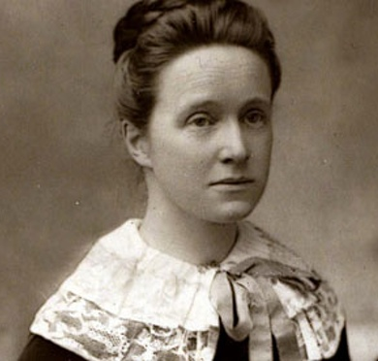
The Women’s Suffrage Movement 2
In the 1880’s the movement divided into 3, split over the affiliation of party organisations.
In 1883, the Primrose League (a Conservative group) were established
In 1886 the Women’s Liberal Federation was formed
In 1897 It reunited with the formation of the National Union of Women’s Suffrage Societies under the presidency of Millicent Fawcett.
She said that women’s suffrage would come about as a result of social, educational and economic changes. She was a Liberal Unionist.
It was non party in character.
Millicent Fawcett in1892

Slide 12
The Women’s Suffrage Movement 3
Suffragists wrote pamphlets, distributed leaflets and posters, sent letters and articles to newspapers, held meetings, organized petitions and lobbied their MPs. By 1914, it had about 500 branches and 53,000 members.
They focussed on initial partial enfranchisement rather than universal female enfranchisement.
Although criticized for not being forceful enough for the government to take notice, recent research suggests that the NUWSS was important in attracting support for the "cause". Membership of the NUWSS remained high in the years leading up to World War I.

Slide 13
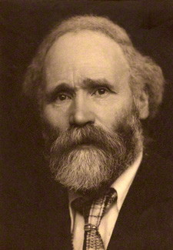
Party Attitudes
Initially hostile the parties gradually came to be sympathetic to female emancipation, though there were die-hard antis in both major parties.
Radicals in the Liberal party were initially more sympathetic.
However the Conservatives became more supportive. Lord Salisbury allowed enfranchisement in local elections in 1888 and 1894. Balfour and Bonar Law were in favour.
Labour was somewhat hostile and was more concerned with universal male suffrage. TUs tended to be rather hostile particularly to married women workers until 1911. In 1911 at National conference they passed the policy of support for manhood suffrage that must include female emancipation.
However Keir Hardie was very much in favour of women’s suffrage.
Martin Pugh “The March of the Women” 2000 argues that the case was largely won by 1900. However divisions remained over what sort of franchise and party advantage was a factor e.g. Liberals and Labour did not want to give the franchise to wealthy women who might vote Conservative.
Keir Hardie in 1905

Slide 14
The Party Situation 1886-1914
The split over Home rule in 1886 left the Liberals out of power for 20 years with the exception of 1892-5. Thus the suffragists faced a largely unsympathetic government which only gradually changed its attitudes.
The Liberals won a landslide in 1906 but were thwarted by Lords obstructionism.
It was only after 1911 that they had the power to overcome the Lords opposition.
However the 2 elections of 1910 had virtually the same result with about 270 for each of the Liberal and the Conservatives. 80 odd Home Rule Party and 40 odd Labour.
The Liberals remained in power as a minority government with the support of the minor parties particularly the Home Rule Party.
The period 1911-14 was dominated by the Irish question so that the campaign for women’s suffrage faced great difficulties.
UK general election, January 1910 |  |  |  |  |  | UK General Election December 1910
 |  |  | Votes |  |  |  |  |  | Votes
Party |  | Elected | % | No. |  | Party |  | Elected | % | No.
 | Conservative and Liberal Unionist | 272 | 47 | 2,919,236 |  |  | Conservative and Liberal Unionist | 271 | 47 | 2,270,753
 | Liberal | 274 | 44 | 2,712,511 |  |  | Liberal | 272 | 43 | 2,157,256
 | Labour | 40 | 7 | 435,770 |  |  | Labour | 42 | 6.3 | 309,963
 | Irish Parliamentary | 71 | 1.2 | 74,047 |  |  | Irish Parliamentary | 74 | 1.9 | 90,416
 | Other Nationalists | 11 | 0.7 | 40138 |  |  | Other Nationalists | 10 | 0.6 | 31233
 | Others | 2 | 0.9 | 52733 |  |  | Others | 1 | 0.3 | 16788

Slide 15
A few of the arguments used For and Against Women’s Suffrage
Women are too emotional to deal with serious political issues.
Women are chatterboxes and can't be trusted with state secrets.
Women can't be trusted with running the British Empire.
Women are not as clever as men.
A woman's place is in the home.
It is not natural for women to be involved in politics.
Women pay taxes so they should have a say in how they are spent.
Laws affect women too, so they should have a say in making these.
Women are as smart as men and this is being proved by their better education.
If male prisoners and lunatics can vote, then surely women should have the right too.

Slide 16
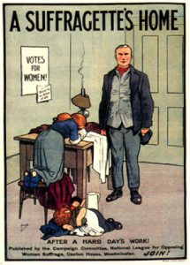
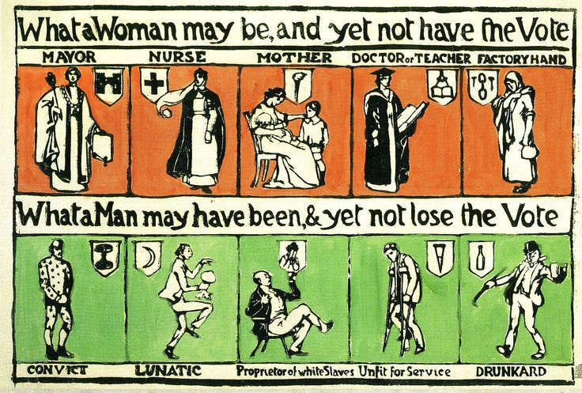

Slide 17
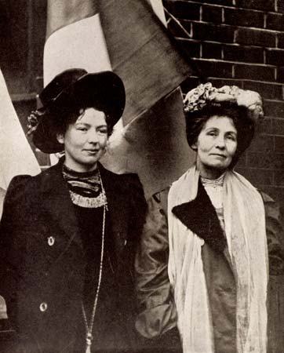
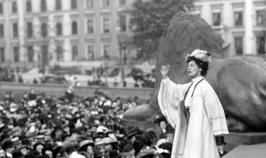
Suffragettes 1
By the 1890’s there was some dissatisfaction with the parliamentary strategy of the Suffragists.
Bills were introduced 1889,1890,1892,1893, 1894, 1895, 1906, 1907, 1908, 1909 ,1910, 1911, and 1913 without success.
In 1903 Mrs Emmeline Pankhurst (1858-1928) and her daughter Christabel Pankhurst (1880-1958) split with the NUWSS and formed the Women’s Social and Political Union (WSPU) with explicit militancy as their aim. It started in Manchester and moved to London in 1906. The name suffragette was invented by The Daily Mail in 1906 but was adopted by the WSPU.
The motto of the suffragettes was deeds not words.
After 1906 they regarded the Liberals as hostile to women’s suffrage and resolved to fight the new government.
Emmeline Pankhurst in 1912

Slide 18
Suffragettes 2
Initially the WSPU's tactics were to cause disruption and some civil disobedience.
From 1907 they campaigned in by elections against liberal and anti women’s suffrage candidates.
They claimed every by election as a success, though it is difficult to assess whether they had any real impact.
They disrupted many political meetings particularly starting in 1905 when at the Free Trade Hall in Manchester Christabel Pankhurst and Annie Kenney disrupted a large Liberal meeting, they were arrested and sent to prison.
These protests culminated in 1908 when 50 women disrupted a Liberal meeting of Lloyd George.
Subsequently women were banned from political meetings or only allowed if accompanied by a man who vouched for their good behaviour.

Slide 19
Suffragettes 3
In 1906 suffragettes went to the Commons to get a promise to consider women’s suffrage. When this was refused women protested in the lobby of the House of Commons. 10 women were arrested and chose to go to prison for 2 months rather than pay fines.
In 1908 when PM Herbert Asquith refused to see a delegation of women, Mary Leigh broke windows in Downing Street and this was subsequently adopted as an official tactic and windows, particularly in Oxford street were regularly broken by suffragettes.
In 1909 Marion Wallace Dunlop began a hunger strike this was also adopted by the WSPU.
Emily Wilding Davis began setting light to letter boxes and this also was taken as a tactic.
Thus gradually the WPSU’s tactics became more violent including attacks on property and law-breaking, which resulted in imprisonment and hunger strikes.

Slide 20
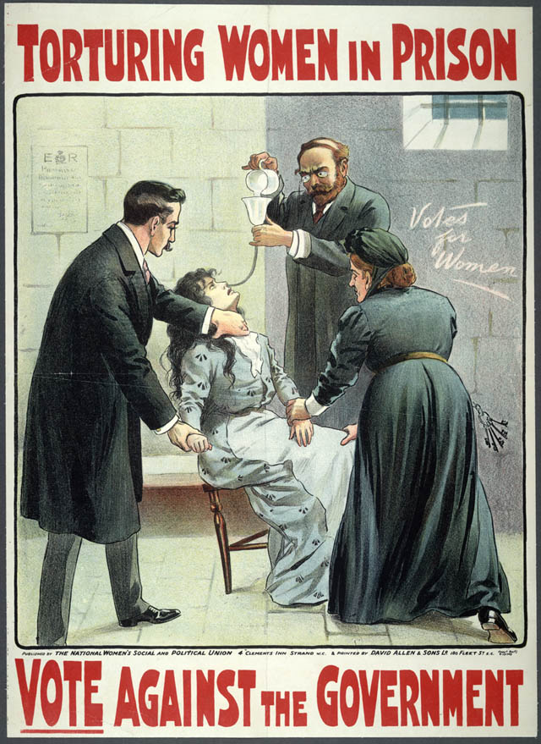
Suffragettes 4
Early on hunger strikers were released to avoid death.
But in September 1909 under government instruction prisons began the practice of force feeding the suffragettes through a tube, most commonly a nostril or stomach tube or a stomach pump.
The process of tube feeding was strenuous; without the consent of the hunger strikers, they were typically strapped down and force fed via stomach or nostril tube, often with a considerable amount of force.
It caused both short-term damage to the circulatory system, digestive system and nervous system and long term damage to the physical and mental health of the suffragettes. Suffragettes who were force fed were also known to develop pleurisy or pneumonia as a result of a misplaced tube.
This backfired on the Government as the Suffragettes gained sympathy and support, both in the press and with the public, which their tactics had previously lost them.

Slide 21
Suffragettes 5
The escalation of violence caused bitter controversy between the Pethick-Lawrences and the Pankhursts.
Emmeline and Frederick Pethick-Lawrence were prominent supporters with Emmeline Treasurer and Fred providing considerable finance and fund raising skill to the WSPU. They were expelled in 1912. Sylvia Pankhurst was also expelled in 1913 for becoming too left wing.

Slide 22
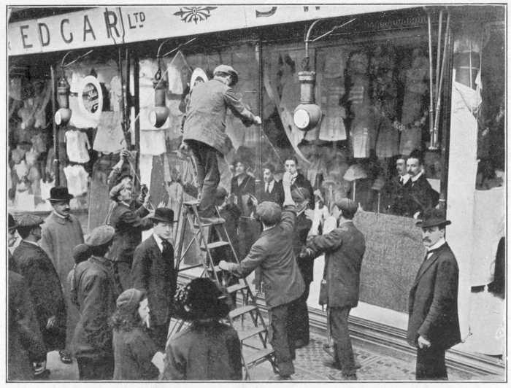
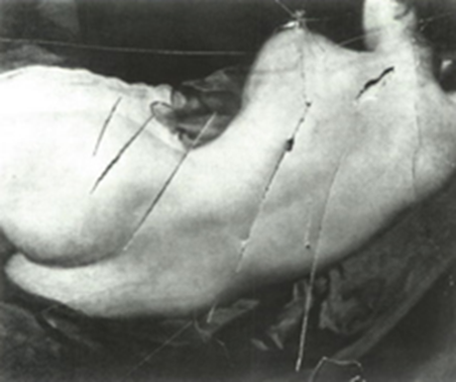
Suffragettes 6
In 1912 Suffragettes undertook window breaking, attacks on letter boxes and arson. Across the country specially selected empty houses were burned down, many of them belonging to prominent members of society, and the refreshment rooms on several of the Royal Parks were attacked by the arsonists.
In the British Museum exhibits were damaged, and in the National Gallery paintings including one of the Duke of Wellington were attacked with an axe. In the Tower of London a jewellery case was smashed, and the Tate Gallery was forced to close.
Replacing Windows smashed by suffragettes at Swan and Edgars.
Painting of Venus in the National Gallery slashed by Mary Richardson

Slide 23
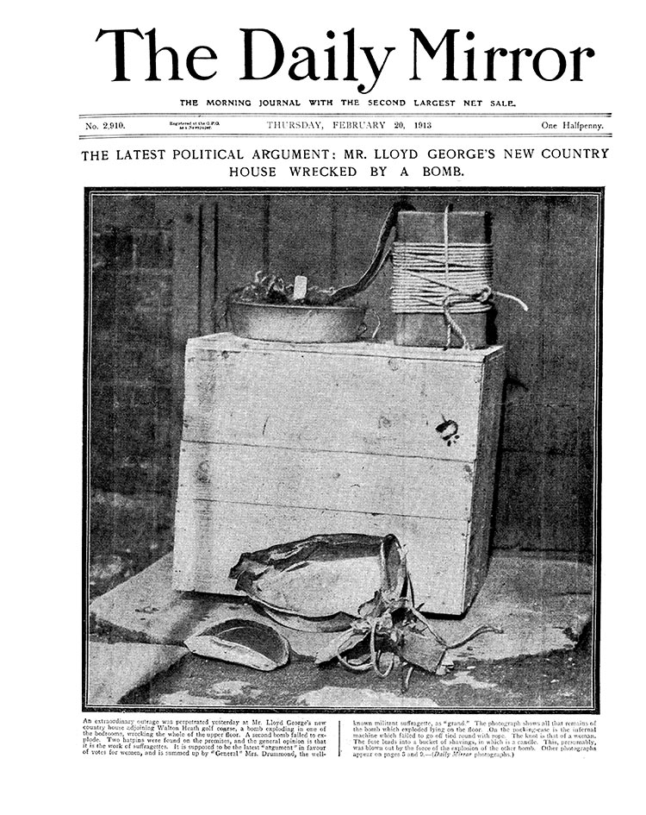
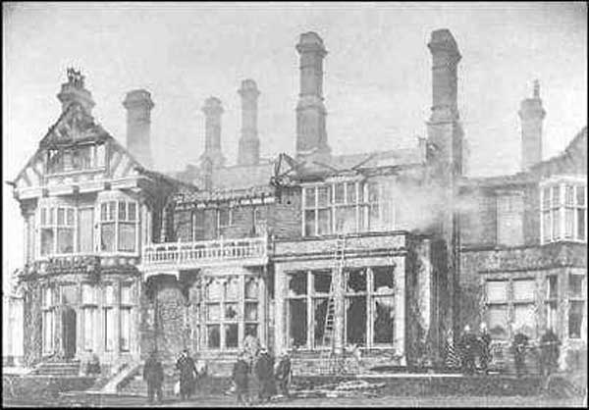
Suffragettes 7
One of two bombs discovered in Lloyd George’s cottage, February 20th 1913
Levetleigh House after the suffragette arson attack
In 1913 some Suffragettes began to resort to the tactic of small bombs. In February 1913 Lloyd George’s week-end cottage which was in the process of being built, was target of a small explosion, and in June 1914 a bomb was placed beside the Coronation Chair in Westminster Abbey. It exploded causing slight damage to the chair and the 'Stone of Destiny' below it. Several other bombs planted including one in St Paul’s Cathedral, and near the Bank of England.

Slide 24
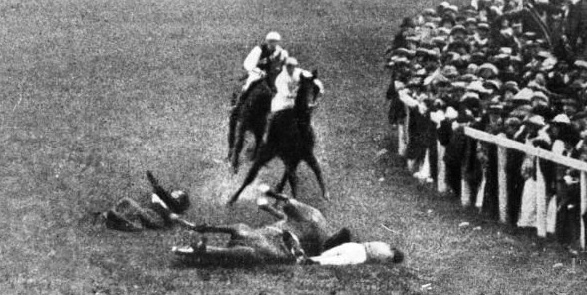
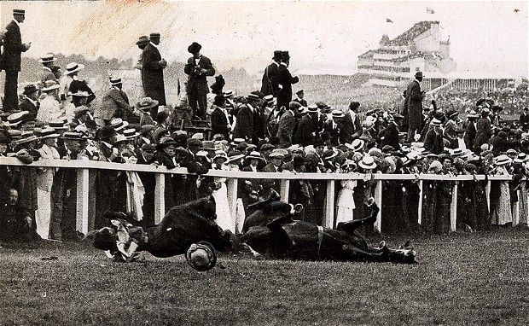
The most famous act associated with the Suffragettes was at the June 1913 Derby when Emily Wilding Davison threw herself under the King’s horse, Anmer, as it rounded Tattenham Corner. She was killed. The funeral procession drew huge attendances.

Slide 25
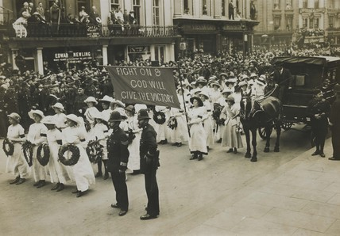
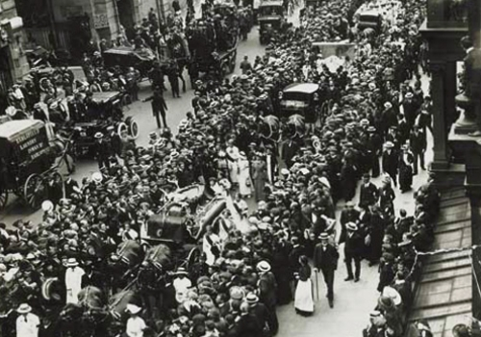

Slide 26
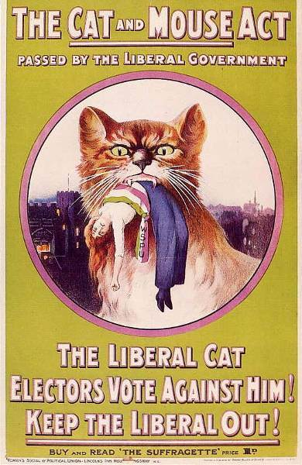
Suffragettes 7
The government moved to prosecute prominent members of the WSPU including the Pethick-Lawrences. Christabel Pankhurst fled to Paris to escape arrest, but after this the WSPU lost direction.
The government introduced the Prisoners Temporary Discharge Act in 1913. This was commonly known as the Cat and Mouse Act.
It allowed for release and rearrest of hunger strikers once they had recovered.
As a result of the debilitating effects of this act many suffragettes agreed to a promise of good behaviour in return for discharge.
There was a public reaction against the WSPU attempts at public meetings drew hostile crowds and peltings with eggs and fruit as did attempts to open new shops and offices
It has been argued that by 1914 militancy was in decline.

Slide 27
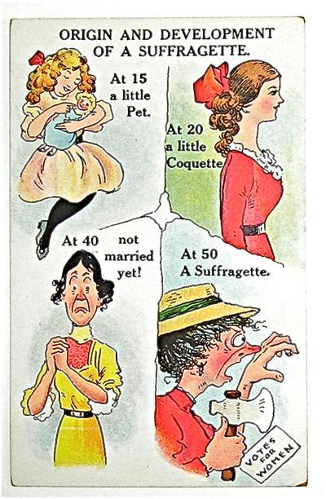
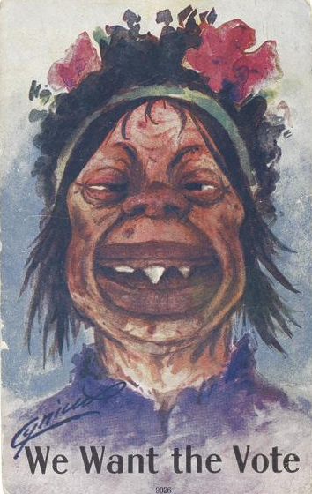

Slide 28
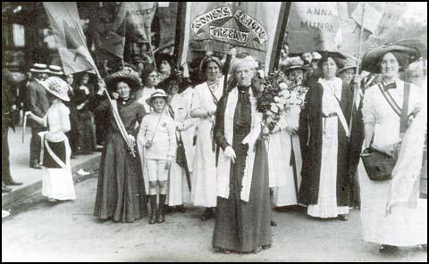
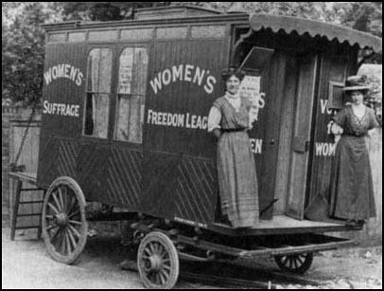
Suffragettes 8
In 1907 the WPSU split over the Pankhursts dictatorial leadership and the Women’s Freedom League under Charlotte Despard was formed. This carried out militant actions of a non violent nature. By 1914 its membership was about 4000. It organized the Women’s Tax Resistance League.
It also organized a campaign not to fill in the 1911 census which the WSPU later supported.
It became a half way house between the WPSU and the NUWSS.
The latter continued its campaigning and grew in size.
From 1911 when Labour adopted universal suffrage the NUWSS funded Labour candidates in by elections though they generally came third. However in some cases this caused the Liberal to lose to the Conservatives.
Charlotte Despard in front of the Women's Freedom League banner (17th June 1911)
The Women's Freedom League's touring publicity caravan

Slide 29
Suffragettes 9
In 1910 the government set up a Conciliation Committee to find a bill for female suffrage acceptable to all parties and subsequently a Conciliation bill was introduced in 1911 which passed its second reading with a majority of over 100.
The WSPU declared a truce when it was introduced but in July Asquith declared there was no more time for the bill and suspended Parliament to November whereupon the WSPU called off their truce.
The Conciliation Bill was again introduced in 1912. However this time the Bill was defeated by 208 to 222. The reason for the defeat was that the Irish Home Rule Party believed that a debate over votes for women would be used to prevent Irish home rule. Some MPs also seem to have changed their minds as a result of WSPU militant actions.
Asquith had declared himself in favour of manhood suffrage with a clause on women’s suffrage. The NUWSS agreed to work with it but the WSPU condemned it.
A reform bill was introduced in 1913 but the Speaker ruled out the amendment for the women’s vote.

Slide 30
International Developments
In the United States many women are actively involved in the campaign to end slavery in America, and the notion of women's rights first creeps on to the agenda in tandem with the rights of African-American slaves.
In July 1848 two anti-slavery campaigners, Elizabeth Stanton and Lucretia Mott, invite colleagues to a two-day convention on women's rights in Mrs Stanton's home in New York state (at Seneca Falls). It is the first of many such gatherings which lead, in 1869, to the formation of the National Woman Suffrage Association.
1869 Wyoming gave women the vote.
1870 Utah gave women the vote.
1881 The Isle of Man gave women the vote in parliamentary elections.
1893 New Zealand gave women the vote.
1902 Australia gave women the vote.
By 1914 11 states in the US had given women the vote.

Slide 31
World War 1 (1)
At the outbreak of the First World War, Emmeline Pankhurst suspended the activities of the Women's Social and Political Union and concentrated her efforts on helping the government recruit women into war work.
On the 10th August the government announced it was releasing all suffragettes from prison.
The NUWSS and most other women's suffrage organisations also chose to suspend their activities and many supported the war effort. Active campaigning continued behind the scenes though.
The WFL was pacifist and continued campaigning for women's suffrage. Some female pacifists resigned from other groups.
All groups entered into voluntary work to support women.

Slide 32
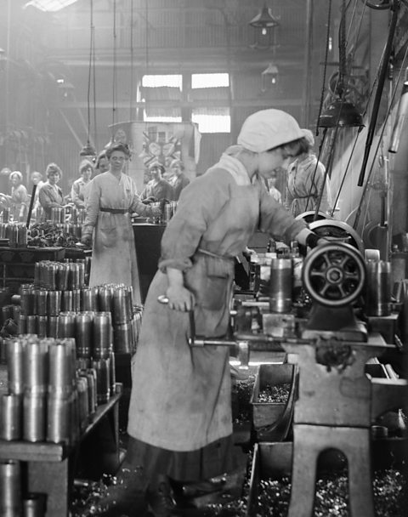
World War 1 (2)
Mobilisation of industry was a key factor in the First World War. The side which produced the greater amount munitions (guns, tanks etc.) stood a better chance of victory.
The government extended its power over the economy. There was a huge shortage of workers. Industry and agriculture demanded men, but so did the army.
The labour shortage needed to be dealt with, and women filled this gap.
Although many working class women were already in employment, they mainly held traditional female roles in domestic service or in textile factories and mills. During the War, more opportunities opened up to women and the types of jobs they undertook changed.
Women began to make war products such as guns and ammunition, taking on jobs operating heavy machinery and driving vehicles.
Women working in Woolwich Arsenal during the First World War.

Slide 33
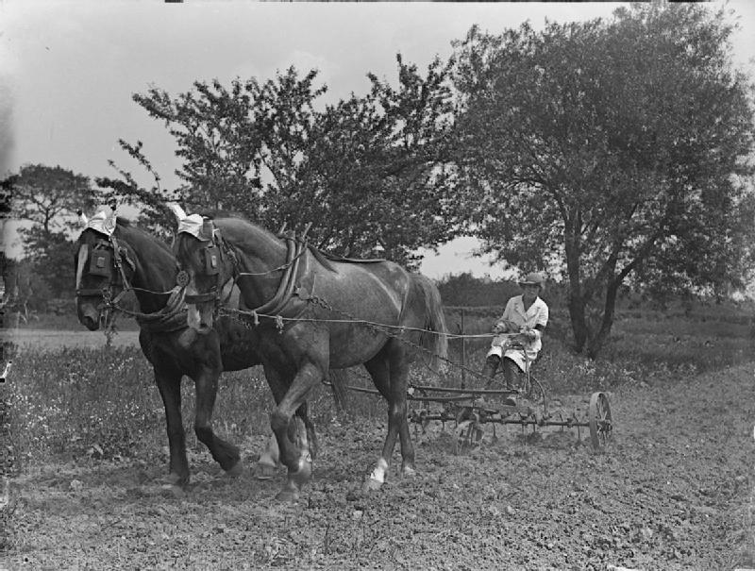
World War 1 (3)
The Women’s Land Army was formed to ensure food production continued as so many male agricultural labourers were in the army.
Around 800,000 Munitionettes who worked in highly dangerous conditions while about 250,000 worked in the Women’s Land Army.
Women also worked in transport, engineering, construction, clerical work, public services (e.g. postal workers) and emergency services. In 1915, the Women’s Police Service was formed
The Voluntary Aid Detachment (VAD) recruited volunteer nurses like Vera Brittain to serve behind the lines. Women also joined the military services – WRENS, WAAC and WRAF where they performed tasks such as telephonists, engineers, drivers, decoders etc

Slide 34
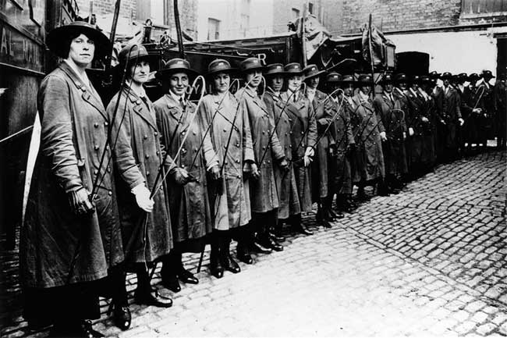
World War 1 (4)
Women also headed to the War front to work in hospitals, treating injured soldiers, while many nurses continued to help the injured at home.
By 1918 there were 1.3 million more women at work than in 1914. Women were now more visible in the world of work, and although they were employed in important roles and received improved wages, they were still paid lower rates than men.
Whilst women undertook more ‘male’ jobs, the significance of their traditional role of wife and mother was also emphasised. Women were told they had a patriotic duty to encourage their men to fight in the war.
They also helped the men at war to remain motivated, sending more than 12 million letters and parcels to the troops every week, and reminding them about the home and family they would return to after the War.
Women proved their capabilities and won great admiration for their skill, determination and bravery. Even Asquith had to admit their crucial role
In the first World War Women Post Office workers took on the role of drivers of horse drawn vehicles, a job previously reserved for men,

Slide 35
The 1918 Representation of the People Act (1)
Asquith was overthrown in 1916 and replaced with David Lloyd George as PM. He was more sympathetic to women’s suffrage though Asquith also changed his mind.
The problem was that many men fighting in the armed forces would be disenfranchised because they were not resident, whilst many more were not qualified to vote.
The government set up a Speakers Conference in 1916. Millicent Fawcett was involved in the discussions and as a result of their proposals a bill was introduced in 1917 that became the 1918 act.
The bill was passed by 385 for to 55 against on its 2nd reading.

Slide 36
The 1918 Representation of the People Act (2)
All men over 21 gained the vote in the constituency where they were resident.
Men who had turned 19 during service in connection with the First World War could also vote
Women over 30 years old received the vote if they were either a member or married to a member of the Local Government Register, a property owner, or a graduate voting in a University constituency.
Some seats redistributed to industrial towns.
Elections to be held on a the same day.

Slide 37
The 1918 Representation of the People Act (3)
Thus for men the qualification to vote was no longer dependent on property but had become a residential one.
Women were restricted to those over 30 occupying property of a certain value.
MPs were worried that if all women got the vote that women would be in the majority.
The electorate was raised to about 74% of those over 21.

Slide 38
Why Women got the Vote
Lloyd George was more sympathetic.
It was a coalition government so that party differences and advantage could be subsumed.
In World War 1 Britain portrayed itself as fighting for democracy.
It has been argued that the act was a ‘reward’ for the vital work done by women during World War One.
However women in France did equally as important work in World War One but did not receive the right to vote after the war.
The Suffragettes played a part in women gaining the vote because their violent tactics kept the campaign for women’s votes in the headlines and forced the Government to make a decision.
It may be that no one wanted to return to the pre war militancy so that the suffragettes were influential.
However it is possible that a bill might have been passed in the pre war period had militancy not reduced support for women’s suffrage.
The Suffragists were important in women gaining the vote because their methods gained the support of many MPs and trade unions and showed that they could be responsible if given the vote.

Slide 39
After the War
The end of the War meant that women were expected to return to their previous roles and allow the returning soldiers to take back their jobs.
Whilst the number of women in work returned to pre-war levels, the War did result in a number of permanent changes.
There were more women in clerical work.
A wider range of jobs were now available to women.
Changes in style and appearance made necessary by war work - wearing trousers and short hair - became fashionable.
World War I had proven that women could do a wide range of work and do them well.
The Sex Disqualification (Removal) Act 1919 made it illegal to exclude women from jobs because of their sex. Women could now become solicitors, barristers and magistrates.

Slide 40
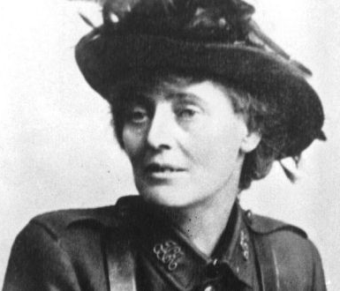
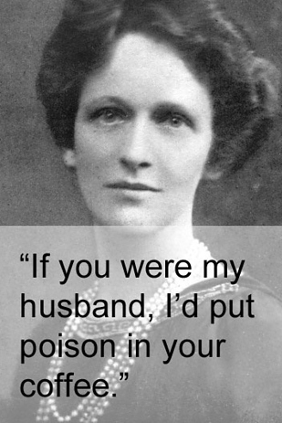
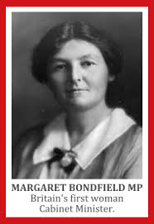
1920s
Constance Markiewicz, standing for Sinn Fein, was elected in 1918. However, as a member of Sinn Fein, she refused to take her seat in the House of Commons. She sat in the Dail Eireann and later became an Irish minister.
Nancy Astor became the first woman in England to become a MP when she won Sutton, Plymouth in a by-election in 1919.
Other women were also elected over the next few years. This included Margaret Bondfield who became the first female cabinet minister in 1929.

Slide 41
The 1928 Representation of the People Act
The Conservatives under Stanley Baldwin were elected in 1924.
They introduced a bill in March 1928 to give women the vote on the same terms as men. There was little opposition in Parliament to the bill and it became law on 2nd July 1928. As a result, all women over the age of 21 could now vote in elections.
There was universal suffrage on the basis of residence.
University seats were not abolished until 1948 so plural voting still existed.
This was always seen as not an end in itself but a step towards Women’s Rights and the struggle continued and continues.

