Slide 1
US Presidential election 2016
By Mike Allen

Slide 2
Trump Wins
Donald Trump pulled off a surprising win when most commentators were expecting Hiliary Clinton to win.
The National Polling Average had Clinton 45.9% Trump 42.8% - a 3.1% lead for Clinton.
However it was within the poll error of ± 3.5%.

Slide 3
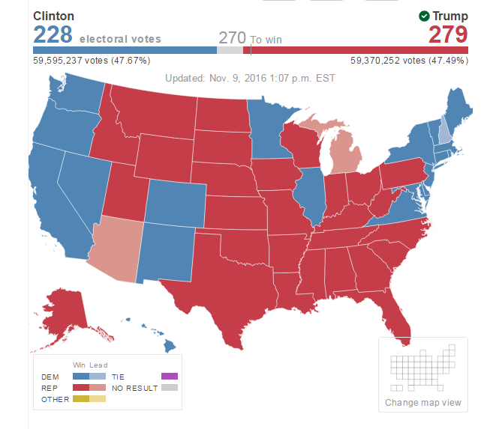

Slide 4
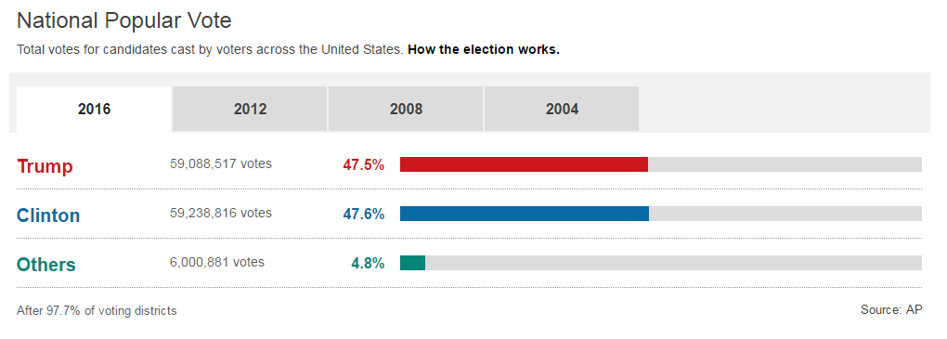
US Election 2016 Results Overview After 46 of 50 states
270 to win
Hillary Clinton: 218 electoral votes
Donald Trump: 278 electoral votes
2016 national popular vote results
Trump 59,088,517 votes 47.5%
Clinton 59,238,816 votes 47.6%
Others 6,000,881 votes 4.8%
After 97.7% of voting districts
Source: AP

Slide 5

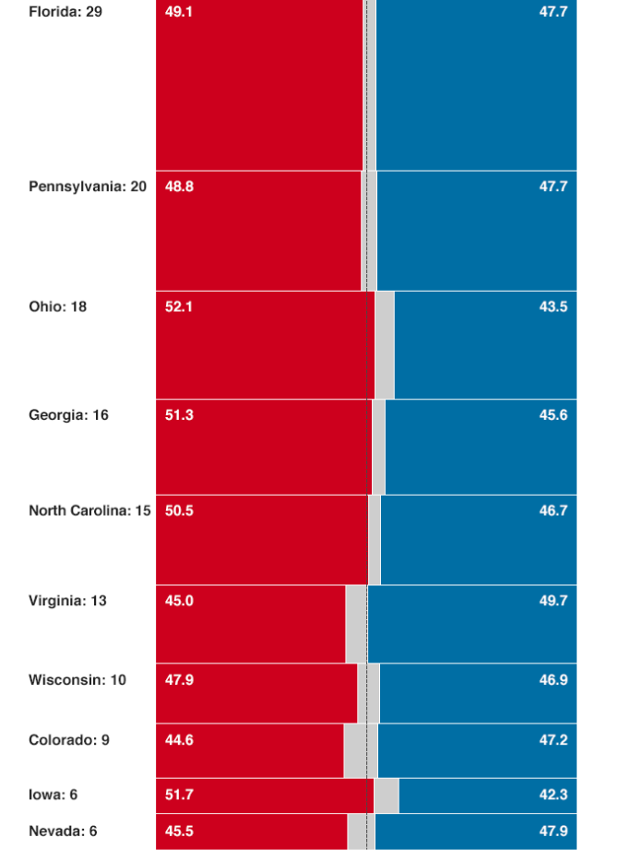

Slide 6
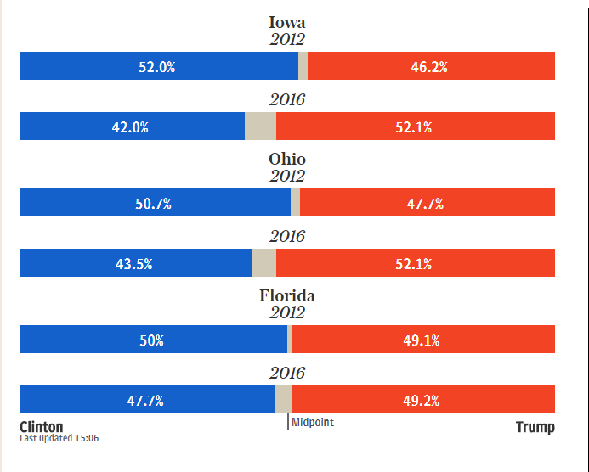
Key states

Slide 7
US Election latest updates Key battleground states
Florida
PROJECTED FOR TRUMP STATE PROJECTED AT:23:30 EST (04:30 GMT)
29 electoral votes
After 100% of voting districts
Clinton 47.7%
Trump 49.1%
Others 3.1%
Pennsylvania
PROJECTED FOR TRUMP STATE PROJECTED AT:02:48 EST (07:48 GMT)
20 electoral votes
After 99.8% of voting districts
Clinton 47.7%
Trump 48.8%
Others 3.6%

Slide 8
Ohio
PROJECTED FOR TRUMP STATE PROJECTED AT:22:23 EST (03:23 GMT)
18 electoral votes
After 100% of voting districts
Clinton 43.5%
Trump 52.1%
Others 4.4%
Michigan
NO PROJECTION YET
16 electoral votes
After 99.0% of voting districts
Clinton 47.3%
Trump 47.6%
Others 5.1%

Slide 9
North Carolina
PROJECTED FOR TRUMP STATE PROJECTED AT:23:05 EST (04:05 GMT)
15 electoral votes
After 100% of voting districts
Clinton 46.7%
Trump 50.5%
Others 2.8%
Virginia
PROJECTED FOR CLINTON
STATE PROJECTED AT:22:32 EST (03:32 GMT)
13 electoral votes
After 98.6% of voting districts
Clinton 49.7%
Trump 45.0%
Others 5.3%

Slide 10
Arizona
NO PROJECTION YET
11 electoral votes
After 97.6% of voting districts
Clinton 45.5%
Trump 49.5%
Others 5.0%
Wisconsin
PROJECTED FOR TRUMP
STATE PROJECTED AT:03:04 EST (08:04 GMT)
10 electoral votes
After 99.9% of voting districts
Clinton 46.9%
Trump 47.9%
Others 5.2%

Slide 11
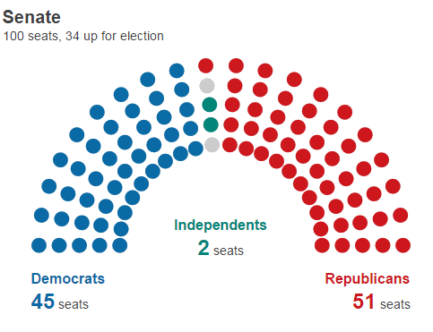
Congress Senate 2016 results
100 seats, 34 up for election
Republicans 51 seats
Democrats 45 seats
Independents 2 seats

Slide 12
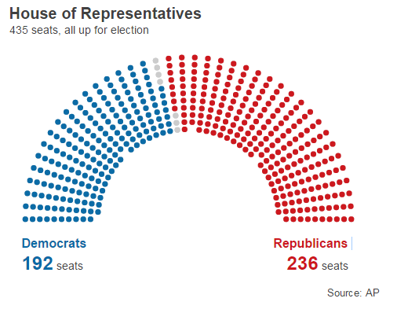
House of Representatives 2016 results
435 seats, all up for election
Republicans 236 seats
Democrats 192 seats
Source: AP

Slide 13
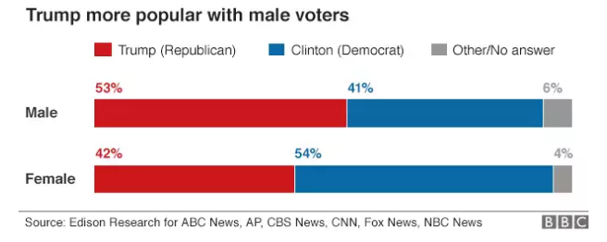
Trump won 53% of white women, Clinton 94% of black women.

Slide 14
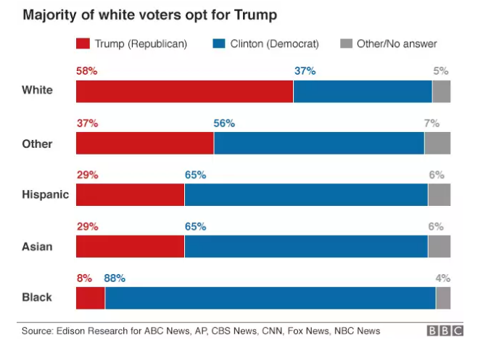
Trump's electoral victory was underpinned by his success in winning over white voters, with 58% of them voting for the Republican candidate. White voters made up 70% of the electorate in this year's election.
Trump was especially popular among non-college-educated white men, receiving seven in 10 votes from that demographic group and six in 10 votes from non-college-educated white women.
Almost nine in 10 black voters (88%) supported Clinton, compared with 8% who opted for Trump. Barack Obama secured 93% of the black vote in the 2012 election. A smaller proportion of Hispanic votes went to Clinton than those who voted for Obama in 2012.

Slide 15
Trump confounds conventional wisdom
Trump spent less than Clinton
Trump had a smaller organisation than Clinton
Trump concentrated on large rallies rather than an organisation dedicated to getting the vote out.
After the 2010 election the Republicans had an investigation that concluded that they needed to reach out to blacks and Hispanics.
Trump did none of that making statements offensive to Hispanics and other ethnic minorities and concentrating on white working class or blue collar workers.

Slide 16
Why Trump Won 1
Trump was definitely charismatic whilst Clinton was rather dull and uninspiring.
Trump seems to have inspired people that he would do something about closed factories and unemployment .
Trump made a virtue of being an outsider without political baggage.
Clinton was an insider with great experience but also with baggage-
Bill Clinton
Whitewater
Suspicions about money disappearing from charities
The use of private servers for emails- the renewed email investigation a week before polling badly damaged Hilary Clinton
Afro Americans were less enthusiastic about supporting her than Barack Obama.
The white working class (including women) deserted the Democrats for Trump.
In the last 20 to 30 years the income of most Americans has not increased.

Slide 17
Why Trump Won 2
There has also been a precipitate decline in manufacturing industry with many factories closing down as a result of Globalisation though many blame trade deals.
The 2008 recession produced 10% unemployment and though Obama has reduced that to 5% it is still a high level of unemployment.
The fact that Bernie Sanders won so many primaries in states dominated by conservative Democrats, such as West Virginia, should have set off even louder alarm bells than it did. His appeal was really more about tapping into disaffection with the status quo than his far-left ideology.
So the crucial factor may be the economy and jobs. Perhaps Hilary Clinton spent too little time on economic policy.

Slide 18
Why Trump Won
Trump won key states mostly narrowly.
Clinton won the popular vote but her votes were in the wrong place.
Trump had coattails and a number of Republicans were elected on the back of his success thus enabling the Republicans to retain control of both House of Congress.
It was always going to be an uphill struggle for Clinton. It is very rare in the US for a 2 term president to be followed by a president of the same party.

Slide 19
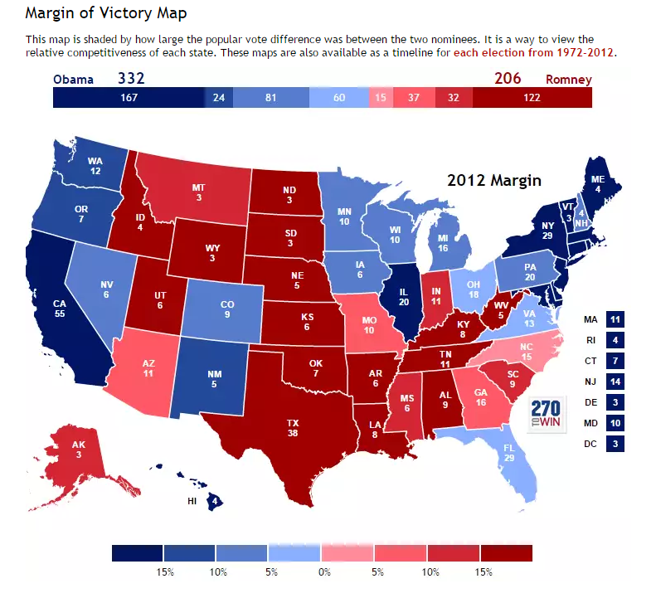
2012

Slide 20
Trump’s policies 1
He will have an opportunity to abolish Obamacare.
Trump will easily be able to reverse Obama’s actions taken on Executive action.
Trump will have an easier ride with Congress than Obama, however some senior figures did not endorse him and there are some policiy differences.
He has pledged to build a wall with Mexico. It is unlikely he will get the Mexicans to pay for it so it implies a big increase in expenditure. Experts predict the cost of such a construction could be four times higher ($40bn) than Trump estimated during the campaign. 1
Similarly he has pledged to reduce business Taxes and taxes on the rich whilst increasing expenditure on infrastructure projects. This implies a big increase in the US deficit.
The Transatlantic Trade and Investment Partnership (TTIP) is a new deal being negotiated behind closed doors between the EU and USA. Trump will probably end it.
¹ This and subsequent points on the next 2 slides are adapted from https://www.theguardian.com/us-news/2016/nov/09/donald-trump-president-policy-immigration-agenda-healthcare

Slide 21
Trump’s policies 2
Trump has pledged to roll back gun restrictions to make gun-carrying legal in more places, including on military bases and perhaps in schools. He said he supports a new federal law that would make concealed carry permits issued in one state valid across the country. This legislation, long a policy priority for gun owners, could undermine the current strict local gun restrictions in states like California and New York.
Trump’s twin policies on the Islamic State (Isis) were to “take their oil” and “bomb the shit out of them”. The first is impractical without a vast military occupation and the second is illegal if it was suggesting indiscriminate bombing. A dual offensive against Isis is under way aimed at its twin strongholds of Raqqa and Mosul led by US allies, and a President Trump would face serious resistance from the Pentagon if he wanted to put US boots on the ground or carry out joint operations with the Russians.
Early on in a Trump presidency, expect a summit with Putin in which US-Russian relations will be reworked along lines the Russian leader has been pushing for, ceding Moscow areas of influence in the Middle East and on Russian borderlands.
Such a discussion will shock major US allies in Nato, an alliance Trump has described as “obsolete”. He has questioned whether it would be worthwhile for the US to provide a security umbrella to allies who are not deemed to have contributed enough, in financial terms, to collective security. Turmoil within Nato could meanwhile tempt Putin to make encroachments on its eastern flank, Estonia, Latvia and Lithuania.

Slide 22
Trump’s policies 3
Will he stop Moslems entering the US? Trump’s administration has pledged to pursue a temporary ban on migration from regions he deems exporters of terrorism.
Trump will triple the number of Immigration and Customs Enforcement agents and seek to create a “special deportation taskforce”. Although the president-elect has claimed this taskforce will first focus on “the most dangerous criminal illegal immigrants”, Trump has made clear that any undocumented migrants could be affected. Up to 6.5 million people could be at risk of swift deportation.
He will have the opportunity to fill the vacancy on the Supreme court.
The world’s largest economy is now headed by a man who believes climate change is a hoax, perhaps perpetrated by the Chinese.
One of Trump’s first tasks is likely to be withdrawing the US from the Paris climate deal.

