Slide 1
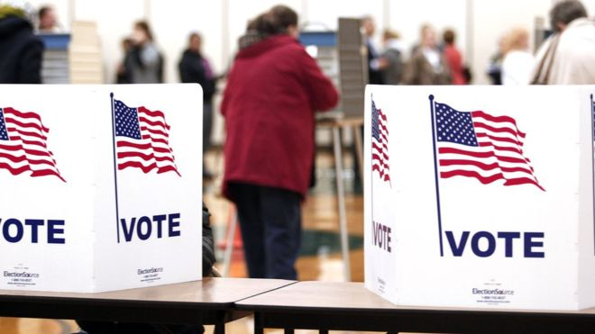
US Elections and Voting
By Mike Allen

Slide 2
The Electoral System¹
The United States uses the simple majority system or first past the post (FPTP)
The successful candidate/party does not need to have an absolute majority of votes, but rather a plurality: the largest number of votes.
In some states, a candidate in a given election must win a majority of the votes cast: Georgia requires such a run-off in the election of senators, as it does – along with Arizona – for the election of governors.
In America, the ‘winner takes all’ system has worked against the development of minor parties, which usually obtain little reward for their efforts. The simple majority system convert seats into votes in a way that damages the interests of small parties, particularly if their limited support is spread across many constituencies.
The effects of the system are evident in the fortunes of the American Socialist Party. Even during its peak years of electoral support (1912–20), when it won 3–6 per cent of the national vote in presidential elections, it was barely represented in Congress. At its high point of 1912 (6 per cent), it failed to elect a single representative to Congress.
¹ Understanding US/UK government and politics Duncan Watts

Slide 3
Turnout in US and UK elections
Year | US President | Year | UK Election
1948 | 51.1% | 1945 | 72.8%
1952 | 61.6% | 1950 | 83.9%
1956 | 59.3% | 1951 | 82.6%
1960 | 62.8% | 1955 | 76.8%
1964 | 61.4% | 1959 | 78.7%
1968 | 60.7% | 1964 | 77.1%
1972 | 55.1% | 1966 | 75.8%
1976 | 53.6% | 1970 | 72.0%
1980 | 52.8% | 1974 Feb | 78.8%
1984 | 53.3% | 1974 Oct | 72.8%
1988 | 50.3% | 1979 | 76.0%
1992 | 55.2% | 1983 | 72.7%
1996 | 49.0% | 1987 | 75.3%
2000 | 50.3% | 1992 | 77.7%
2004 | 55.7% | 1997 | 71.4%
2008 | 57.1% | 2001 | 59.2%
2012 | 54.9% | 2005 | 61.4%
 |  | 2010 | 65.1%
 |  | 2015 | 66.1%
The comparison is not as simple as it seems since the UK figures are based on those registered to vote whereas the US figures are based on those eligible to vote.

Slide 4
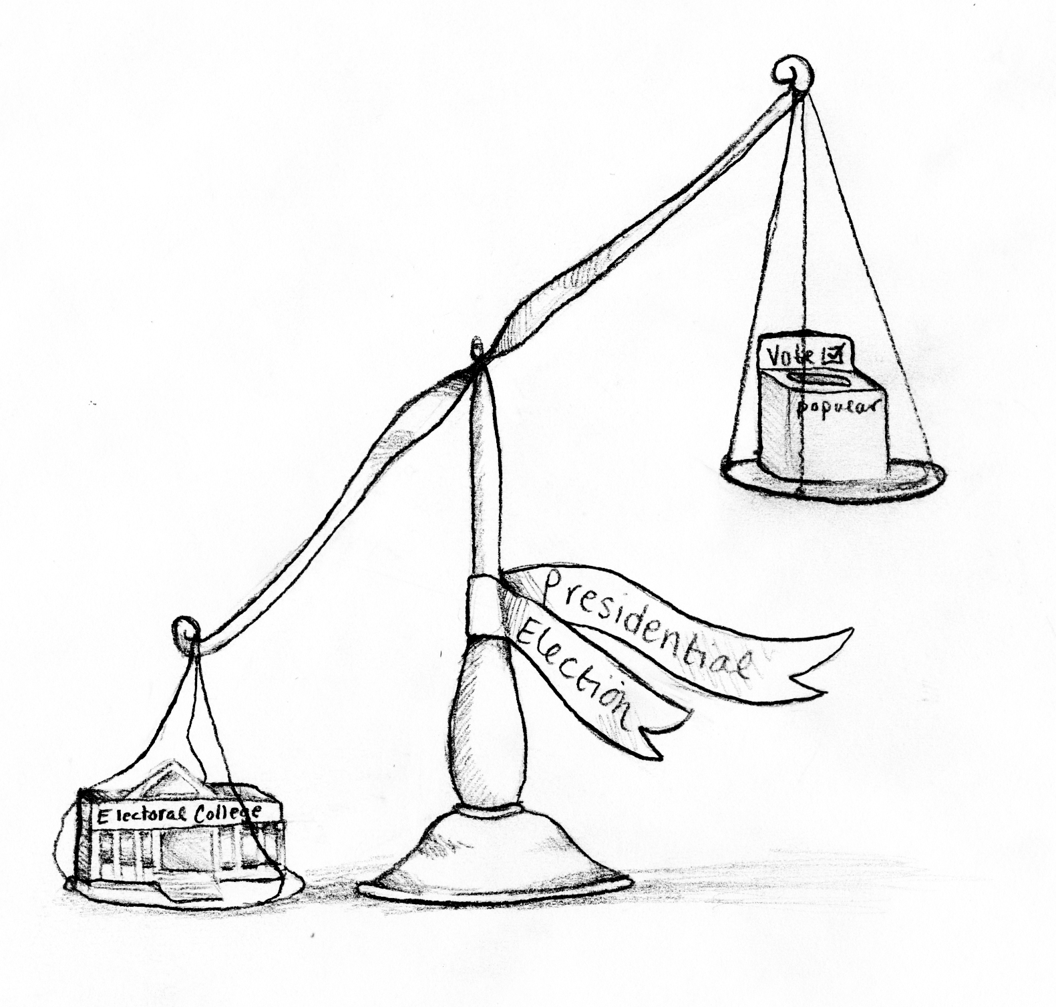
The Electoral College
The United States Presidential election system is an indirect election.
The people are electing representatives to an electoral college which will then meet to decide who the President should be.
Electoral College votes are decided upon per state with the number being decided by the number of the House of Representatives plus the number of senators per state with a minimum of 3 electoral college votes per state.
NB It is not the representatives and senators who go to the electoral college they merely provide the number. The electoral college electors are elected by the people (state by state)
Total Electoral Votes: 538; Majority Needed to Elect: 270

Slide 5
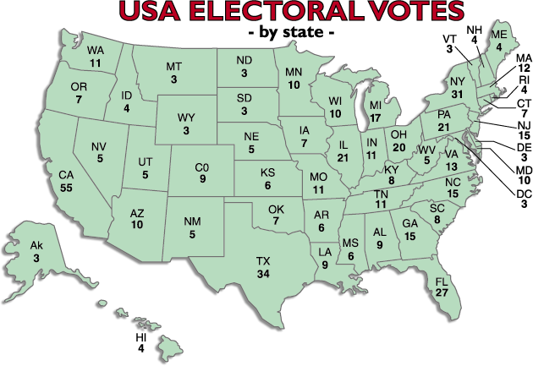

Slide 6
State | Number of Electoral Votes | State | Number of Electoral Votes | State | Number of Electoral Votes
Alabama | 9 | Kentucky | 8 | North Dakota | 3
Alaska | 3 | Louisiana | 8 | Ohio | 18
Arizona | 11 | Maine | 4 | Oklahoma | 7
Arkansas | 6 | Maryland | 10 | Oregon | 7
California | 55 | Massachusetts | 11 | Pennsylvania | 20
Colorado | 9 | Michigan | 16 | Rhode Island | 4
Connecticut | 7 | Minnesota | 10 | South Carolina | 9
Delaware | 3 | Mississippi | 6 | South Dakota | 3
District of Columbia | 3 | Missouri | 10 | Tennessee | 11
Florida | 29 | Montana | 3 | Texas | 38
Georgia | 16 | Nebraska | 5 | Utah | 6
Hawaii | 4 | Nevada | 6 | Vermont | 3
Idaho | 4 | New Hampshire | 4 | Virginia | 13
Illinois | 20 | New Jersey | 14 | Washington | 12
Indiana | 11 | New Mexico | 5 | West Virginia | 5
Iowa | 6 | New York | 29 | Wisconsin | 10
Kansas | 6 | North Carolina | 15 | Wyoming | 3

Slide 7
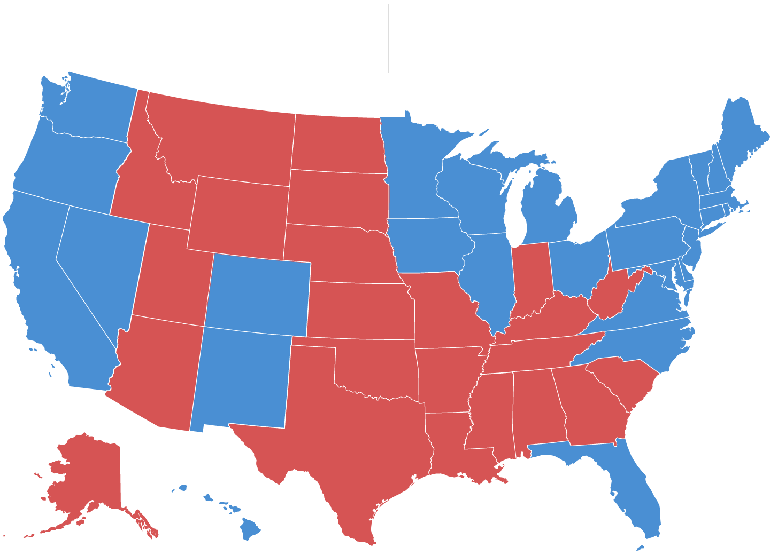
If today’s general election polling holds true, Hillary Clinton will easily defeat Donald Trump.
Clinton 347
Trump 191
ELECTORAL
VOTES

Slide 8
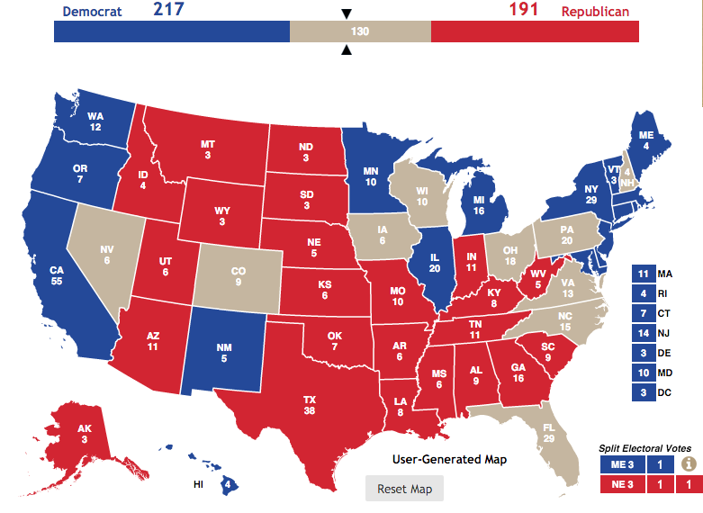
Swing States

Slide 9
Presidential Elections²
America has fixed term elections that occur every four years.
The first presidential election was held in 1788.
A presidential election has been held every four years even in war time.
If the president dies in office there is no special election the vice president becomes president.
The election is held on the on the Tuesday after the first Monday in November every fourth year.
² Unless otherwise stated all subsequent slides are based on US Government & Politics by Anthony J Bennett Chapter 2 Elections and Voting

Slide 10
Presidential elections: a four stage process
Stage | Functions | Occurs
Primaries and caucuses | Show popular support for candidates Choose delegates to attend National Party Conventions | January to early June
National Party Conventions | Choose presidential candidates Choose vice presidential candidate Decide on party platform | August to September They lasts about four days
General election campaign | The campaign between the candidates of various parties | September, October, first week of November
Election day and the electoral college | Elected president and vice president | November/December

Slide 11
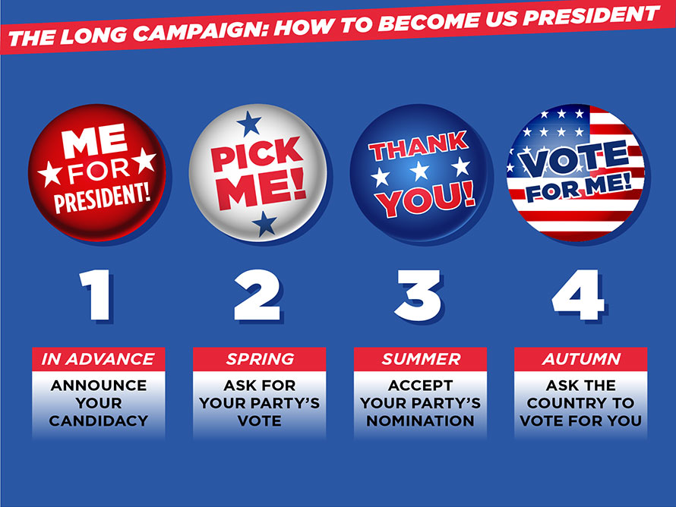

Slide 12
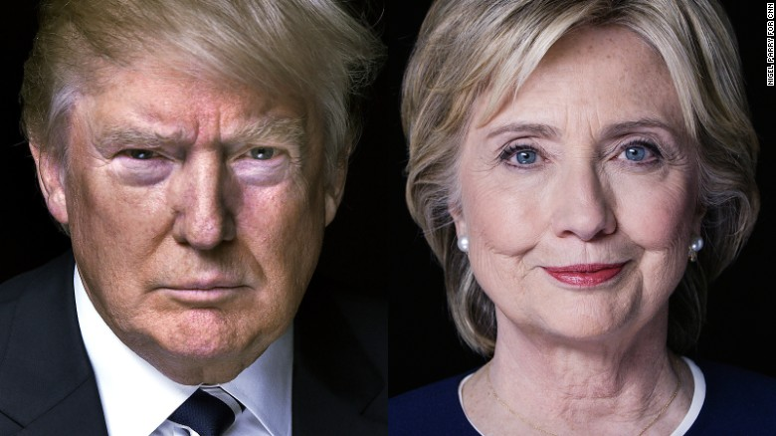
Requirements for a presidential candidate
Natural born American citizen
At least 35 years old
The residency qualification of 14 years
Not to have already served two terms as president

Slide 13
Extra-constitutional requirements 1
Political experience - normally presidential candidates are either former vice presidents, Senators or Governors.
The last time the Democrats or Republicans nominated somebody for the presidency who did not have a political background was in 1952 when Republicans nominated the former Second World War general Dwight Eisenhower. Donald Trump has never held elective office.

Slide 14
Winning and losing candidates in presidential elections 1968- 2012
Year | Winning candidate | Losing candidate
1968 | Richard Nixon (R) | Hubert Humphrey (D)
1972 | Richard Nixon (R) | George McGovern (D)
1976 | Jimmy Carter (D) | Gerald Ford (R)
1980 | Ronald Reagan (R) | Jimmy Carter (D)
1984 | Ronald Reagan (R) | Walter Mondale (D)
1988 | George HW Bush (R) | Michael Dukakis (D)
1992 | Bill Clinton (D) | George HW Bush (R)
1996 | Bill Clinton (D) | Bob Dole (R)
2000 | George W Bush (R) | Al Gore (D)
2004 | George W Bush (R) | John Kerry (D)
2008 | Barack Obama (D) | John McCain (R)
2012 | Barack Obama (D) | Mitt Romney( R)

Slide 15
Extra-constitutional requirements 2
Major party endorsement. It is vital to be chosen as a candidate of one of the two major parties. Third-party candidates do occur e.g. George Wallace 1968, John Anderson 1980, Ross Perot 1992 and 1996, and Pat Buchanan 2000 but they are not successful.
Personal characteristics
Up to 2008 all presidential candidates were white males. Barack Obama has been the first black president. Hillary Clinton will be the first female presidential candidate.
It is an advantage to be married there has been only one bachelor president, James Buchanan elected in 1856.
Scandal involving marital infidelity could roll out a possible candidate Sen Edward Kennedy’s chances were ended by the Chappaquiddick affair. In 1980 Ronald Reagan proved that divorce was not an insuperable problem - Nancy Reagan was his second wife. John McCain was also divorced and remarried.

Slide 16
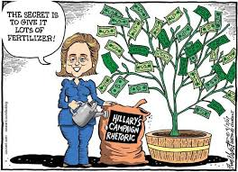
Extra-constitutional requirements
Ability to raise large sums of money campaigns are so expensive that very few candidates can afford to finance their own campaigns, only billionaire candidate such as Ross Perot 1992 and Donald Trump can afford to finance their own campaigns. Candidates need to raise large sums of money even before the primaries and caucuses begin.
Effective organisation During the candidate selection process the major parties cannot endorse specific candidates. So candidates cannot use the party’s organisational structure and must therefore create their own organisation. This is time-consuming and expensive and demanding. That is key to winning the nomination and election will stop one of the major reasons why Hillary Clinton lost to Barack Obama in the Democratic nomination in 2008 was his superior organisation. This was also a major reason for his presidential victories in 2008 and 2012.
Oratorical skills and being telegenic The abilities to speak well and good on television are crucial.
Sound and relevant policies Style is important but the candidate must have policies that both practical and relevant.

Slide 17
Invisible primary
This is the period between candidates declared an intention to run for the presidency and the first primary contests.
It is played out in the media. Candidates hope to being mentioned in newspapers and magazines and serious political television programmes.
Support for candidates is shown by opinion polls and these may affect their fundraising abilities.
Some candidates publish a book e.g. Barack Obama’s Dreams of my Father and The Audacity of Hope in 2008.

Slide 18
Primaries and caucuses 1³
A primary election is a preliminary election to appoint delegates to a party conference or to select the candidates for a principal, especially presidential, election.
In the United States, other types can be differentiated:
Closed primary. People may vote in a party's primary only if they are registered members of that party prior to election day. Independents cannot participate. Eleven states — Delaware, Florida, Kansas, Kentucky, Maine, Nebraska, New Jersey, New Mexico, New York, Pennsylvania, and Wyoming — have closed primaries.
Semi-closed. As in closed primaries, registered party members can vote only in their own party's primary. Semi-closed systems, however, allow unaffiliated voters to participate as well. Thirteen states — Alaska, Arizona, Colorado, Iowa, Kansas, Massachusetts, New Hampshire, New Jersey, North Carolina, Oregon, Rhode Island, Utah, and West Virginia — have semi-closed primaries that allow voters to register or change party preference on election day.
Open primary. A registered voter may vote in any party primary regardless of his own party affiliation. Eleven states - Alabama, Arkansas, Georgia, Hawaii, Michigan, Minnesota, Missouri, Montana, North Dakota, Vermont, and Wisconsin - have open primaries.
³ This and the subsequent slide are adapted from Wikipedia.

Slide 19
Primaries and caucuses 2
Semi-open. A registered voter need not publicly declare which political party's primary that they will vote in before entering the voting booth. When voters identify themselves to the election officials, they must request a party's specific ballot. Only one ballot is cast by each voter. The primary difference between a semi-open and open primary system is the use of a party-specific ballot. In a semi-open primary, a public declaration in front of the election judges is made and a party-specific ballot given to the voter to cast.
Blanket primary. A primary in which the ballot is not restricted to candidates from one party.
Nonpartisan blanket primary. A primary in which the ballot is not restricted to candidates from one party, where the top two candidates advance to the general election regardless of party affiliation. Louisiana has famously operated under this system, which has been nicknamed the "jungle primary." California has used a nonpartisan blanket primary since 2012 and the state of Washington has used a nonpartisan blanket primary since 2008.
A caucus is a meeting of supporters or members of a specific political party or movement. They may be used as an alternative method to choose candidates.

Slide 20
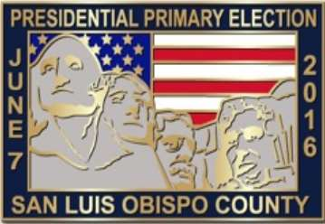
The timing of Primaries
National parties lay down the dates within which primaries must be held normally January to the beginning of June.
A number of states and arrange their primaries together on the first Tuesday in February Super Tuesday.
Most states award delegates in proportion to the number of votes a candidate gets with usually a minimum of 15% per candidate to get any delegates.
All Democrat and most Republican primaries are proportional primaries however in 2008 16 states plus the District of Columbia held winner take all primaries in the Republican's nomination race.
Victory in early primaries such as New Hampshire or the higher were caucuses is very important and often produces momentum and brings media coverage money and a boost in the opinion polls. However failing to live up to expectations can be devastating.

Slide 21
The increased importance of primaries
Nowadays the primaries per play the most important part in gaining the nomination.
However that was not always the case. Primary is started around the turn of the 20th century that even by the 50s and 60s most states did not hold primaries so that presidential candidates were chosen by party bosses in the conventions.
This system was deemed undemocratic elitist nonparticipating and corrupt and was reformed at the instigation of the Democratic party after Hubert Humphrey was chosen by the party convention to be candidate even though he had not taken part in the primaries.

Slide 22
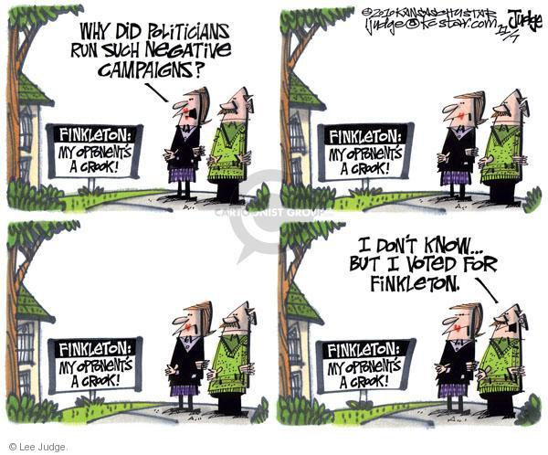
Strengths of the new nomination process
There is an increased level of participation but ordinary voters in 1968 the last year of the uninformed system and the 11.7 million Americans took part in the nomination process and 11% of the voters.
In 2008 30% of voters took part in the nomination process the 2016 figure is around 29%
There is a significant increase in choice of candidates in 1968 there were just five presidential candidates choose from three Democrats and three Republicans. 2016 and there were 11 Republicans and five Democrats.
The process is open up to outsiders such as Jimmy Carter in 1976 Bill Clinton in 1992 and Barrack Obama in 2008.
The power of party bosses is removed.
The gruelling test of the primaries is seen appropriate for the demanding job of president.

Slide 23
Criticisms of the new nominating process
The turnout for primaries is much lower than in the real election and can be particularly so where an incumbent president is standing for re-election.
Primary voters are unrepresentative of the voting age population. Primary voters tend to be more ideological than the wider electorate.
The process is far too long with candidates announcing their candidacy over a year before the first primary.
It is very expensive. In 2008 between them like Obama Hillary Clinton and John McCain had raised over $700 million.

Slide 24
Possible reforms of Primary elections
Regional primaries - four regions east south Midwest and West. The order of the regions would change every four years.
it would end frontloading
cut down travelling
produce a more measured decision
Weighting votes for elected politicians that the National party convention - members of Congress, state governors ,city mayors and like would increase the party bosses roll.
The pre-primary mini convention to determine three candidates to stand in the primaries.

Slide 25
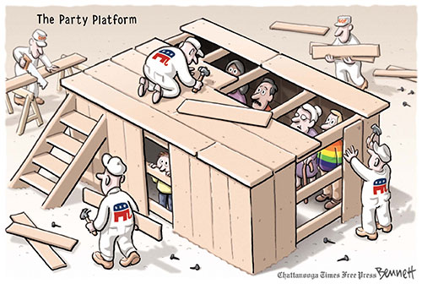
National Party Conventions
Choose presidential candidates
Nowadays one candidate has normally won enough committed delegates for the choice to be more or less automatic.
The convention confirms the choice of candidate rather than chooses.
Choose the vice presidential candidate
This function has been lost. 1956 was the last time a convention chose a running mate.
Today the winning presidential candidate chooses the vice presidential candidate and it is confirmed by the Convention.
Decide on the party platform (the equivalent of a British party manifesto)
The platform committee holds hearings around the country in election year. The National Committee then agrees on a draft platform which is presented to the Convention and is debated. However in recent years parties have sought to avoid heated debate at their Conventions because it is seen as disunity.
Informal functions
Promoting unity.
Enthusing the party faithful.

Slide 26
National Party Conventions
National Party Conventions are much less important than they used to be since they are largely scripted and choreographed to present an image rather than have real power to choose candidates. TV coverage has dropped by ABC, CBS and NBC from 46 hours in 1968 to 12 hours in 2008.

Slide 27
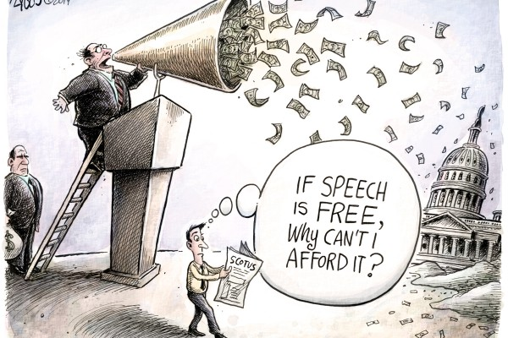
Campaign Finance 1
The Background
The core of the present campaign finance system was created after the 1972 Watergate scandal, which included revelations that President Richard Nixon took secret corporate donations in exchange for favourable government treatment.
The package of laws included a public financing system for campaigns, donor disclosure mandates and contribution limits. By the 1990s, candidates were exploiting loopholes.

Slide 28
Campaign Finance 2
In the 2000 election, George W. Bush was the first presidential primary candidate to opt out of public financing, which came with spending limits. In 2008, President Barack Obama declined public financing for both his primary and general elections.
The Bipartisan Campaign Reform Act 2002, also known as the McCain-Feingold law, banned "soft money," unlimited contributions to parties and national party committees. The law also defined political issue ads paid for by corporations or unions as "electioneering communications" and prohibited the broadcast of such ads within 30 days of a primary or within 60 days of a general election.

Slide 29
Campaign Finance 3
In 2007 in Federal Election Commission v. Wisconsin Right to Life. The Supreme Court rules that bans on ads paid for by corporations or unions in the weeks leading up to an election are an unconstitutional restriction on the right to advocate on an issue.
In 2010 the U.S. Supreme Court sanctioned some unlimited political spending in its Citizens United v. Federal Election Commission ruling, saying it is a form of protected speech under the First Amendment.
To keep the national parties competitive in the new environment, Congress in December 2014 lifted the maximum contributions to the Democratic and Republican parties’ campaign committees to $801,600 from about $100,000 each year.
In 2008 Obama raised huge amounts of money through the Internet from small donors, Bernie Sanders operated similar tactics. This development means that some candidates do not need wealthy backers support.

Slide 30
Campaign Finance 4
The two major candidates for president are former Secretary of State Hillary Clinton, the Democrat, and New York real-estate developer Donald Trump, the Republican.
There are 39 fund-raising committees and organizations associated with them.
Some of the groups are super-PACs, political action committees that, thanks to a 2010 federal court ruling, can raise unlimited amounts of money from individuals, corporations and labour unions. Unlike traditional PACs, super-PACs cannot contribute directly to or coordinate their spending with a candidate, but they can spend unlimited amounts on advertisements and other efforts to support a candidate or attack her opponent. In addition, organizations known as 501(c)(4)s, the IRS code for tax-exempt “social welfare” groups that do work broadly benefiting the community, also spend money to influence elections.
Behind both super-PACs, which disclose their donors, and 501(c)4s, which don’t, are billionaires with big stakes in elections.
All this has pushed up the costs of campaigns. The 2012 presidential race had a price tag of $2.6 billion.

Slide 31
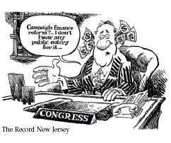
Campaign Finance 5
Congress has passed legislation to regulate campaign finance but it has partly been by-passed, and partly ruled to be contravening the right to free speech and therefore invalid by the Supreme Court.

Slide 32
The role of the media
“The United States is the only democracy that organises its national election campaign around the news media” Professor Thomas Patterson 1993.
News Media covers print journalism and TV with the latter far more important.

Slide 33
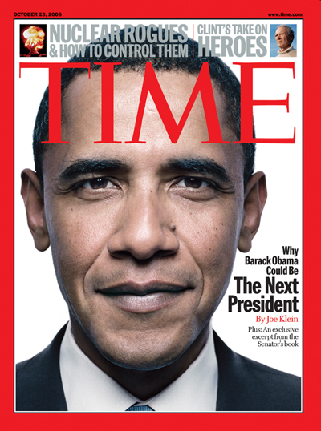
Print Journalism
The New York Times and the Washington Post are influential with their editorial comment and analysis quoted by other newspapers.
The 2 leading weeklies are Time and Newsweek. To have the candidates picture on the front cover of a weekly is worth more that 1000 TV adverts.

Slide 34
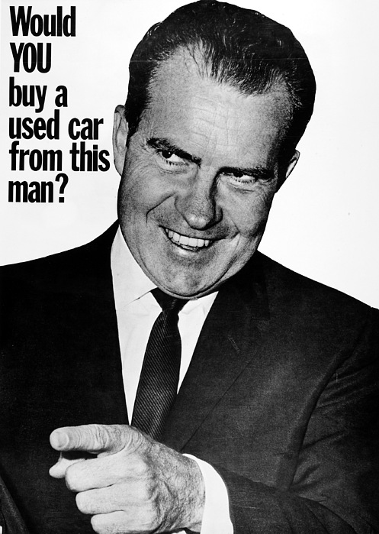
Television 1
Terrestrial Channels – ABC, CBS, NBC, PBS
Cable channels – CNN and MNSBC
The electoral content is in News, interviews and chat shows
Political commercials - politicians need to buy time
– these started in 1952 with Dwight Eisenhower.

Slide 35
Television 2
Televised debates
These were first used in 1960 but not again until 1976 but regularly since.
Various formats have been tried
One questioner
A panel of questioners
Audience questions
The debates have rarely been significant in shaping the outcome of the race.
The person seen as the winner of the debates does not always go on to win the election. Mondale (1984), Dukakis (1988) Kerry (2004).

Slide 36
Voting Behaviour 1
Party Affiliation - in 12 out of15 presidential elections the party that gained the highest support form its party identifiers won the election.
Gender – in 9 out of 10 elections between 1964 and 2000, women were more supportive of the Democrat candidate than men. This is called the gender gap. 2012 Barack Obama vs Mitt Romney 55% to 44% Women 45% to 52% Men
Ethnicity
African Americans have supported the Democrats since the 1960s with never less than 83% and 93% supported Obama’s re-election in 2012.
In the Hispanics, the support level is more divided between parties with 44% supporting Bush in 2004, but 71% supporting Obama in 2012. As with African Americans they are more likely to be at the poorer end of American society, and will support Democrat attempts to help them. However, the Hispanic group is widely seen as a new source of votes, that will become more and more significant as time goes on. In some states the total Hispanic population reaches 25% and most are relatively young.
The vote is often so divided among Hispanics because of religion and origins of the Hispanics ancestors. Those from Cuba are more likely to support the Republicans over their anti-communist and anti-Castro policies, whereas Hispanics with origins in Mexico and Puerto Rico are more likely to favour the Democrats owing to their stance on immigration.

Slide 37
Voting Behaviour 2
Traditionally, Republicans have been described as WASPs (White Anglo-Saxon Protestants), and the rest - Catholic, black, Jewish, and Southern - have tended to side with the Democrats.

Slide 38
Voting Behaviour 3
Religion
Religion is a key factor in voting behaviour in the US with different religions or denominations supporting different parties. Religion plays a more significant role in US Politics than it does in the UK. Catholics have generally been seen to vote for the Democrats, as many are immigrants from Ireland or Italy, and these are the groups that have been courted by the Democrats in the past. However, some Catholics will vote for the Republicans over the issue of abortion. In 2012 50% of US Catholics supported Obama.
The Jewish vote is also traditionally a Democrat heartland, with 69% of Jews voting for Obama in 2012, and 79% voting for Gore in 2000. It is argued that this arises from the fact that Jewish people in America see themselves as a minority, and as such believe that the Democrats will do their best to protect them and advance their interests.
The Protestant vote is however a stronghold of the Republican Party with almost 80% of the voting population supporting Republican candidates in 2004 and 2012. This basis for this support lies in the Republican’s social conservatism which appeals to those with strong religious beliefs, especially around the issue of gay marriage, capital punishment, and abortions.

Slide 39
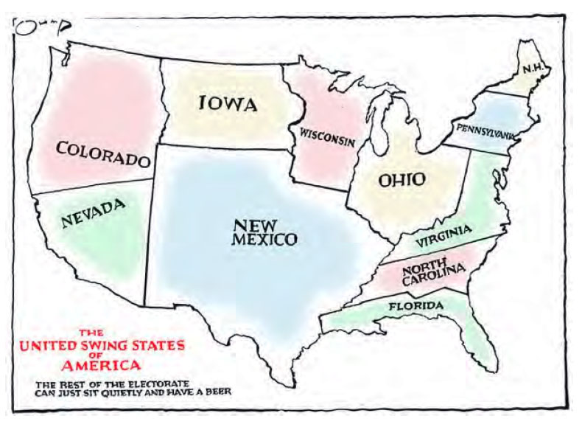
Voting Behaviour 4
Region
Typically the Pacific Coast and North East will always vote Democrat and the South and Mid West will always vote Republican. The more rural the area the more likely it is to be Republican, the more urban, the more likely it is to be Democratic.
Historically the South used to vote for the Democrats, but the Civil Rights legislation passed by Democratic presidents has led to many in the South feeling alienated and so switching to the Republican Party.

Slide 40
Voting Behaviour 5
Age
Young voters between the ages of 18 through 24 have consistently voted at lower rates than all other age groups
America’s youngest voters have moved towards less engagement over time, as 18- through 24-year-olds’ voting rates dropped from 50.9 percent in 1964 to 38.0 percent in 2012.
In contrast to young voters, in recent presidential elections Americans 65 years of age and older have typically had voting rates higher than all other age groups. In 2012, for example, the voting rate for the 65 years and older group was 69.7 percent, about 6 percentage points above the next highest age breakdown.

Slide 41
Voting Behaviour 6
Young Americans are more detached from the political system in general, but still tilt strongly toward the Democratic Party.
Middle-aged Americans from about 40 to their mid-50s are more Republican in their political leanings,
while older baby boomers tilt back toward a Democratic political orientation.
Finally, seniors for the most part constitute Republicans' strongest age group.

Slide 42
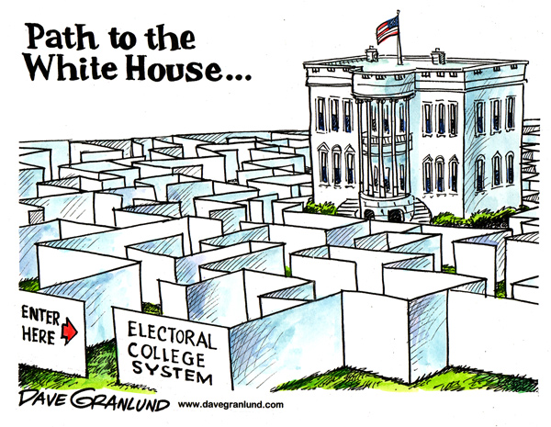
The Electoral College Criticisms
Small states are overrepresented.
Winner takes all distorts the result.
The winner of the popular vote may not win the electoral vote eg 2000.
Unfair to minor parties eg Ross Perot won 18.9% of the vote in 1992 but not a single electoral vote.
Rogue electors many states have laws binding electors to the state winner but some do not.

Slide 43
The Electoral College Defences
Preserves the voice of small population states
It tends to promote a 2 horse race.
Possible Reforms
Award 1 vote to each congressional district and 2 votes to the state winner (the Maine system) However it would have only marginal differences and would produce less proportionality.
Allocation of Electoral college votes in proportion to the popular vote.
Direct election.
Any change would need a successful constitutional amendment.

