Slide 1
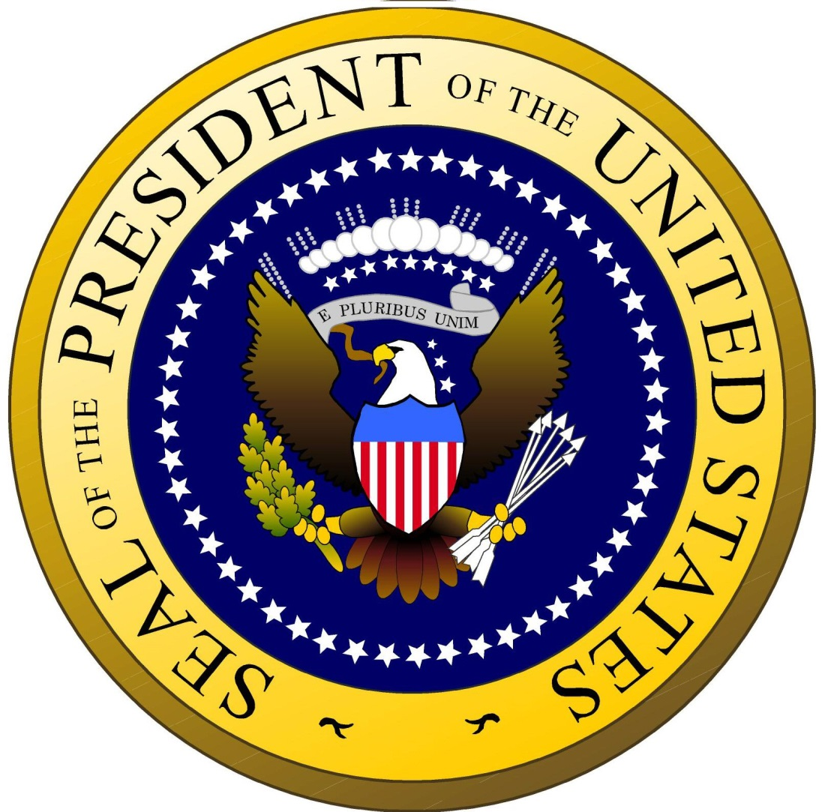
The United States President
By
Mike Allen

Slide 2
The presidency and the Constitution¹
Giving the Executive a secondary role
The need for more effective co-ordination of national affairs led to the setting up in 1787 of the Constitutional Convention which drafted the current Constitution.
While the need for a stronger government was evident, the Founders remained fearful of giving too much power to its leader.
Thus, they gave primacy to the legislature, with a range of specified powers in the, symbolically significant, Article I of the document.
The executive, reduced to secondary consideration in Article II, would be responsible for carrying out the wishes of Congress and representing the nation in foreign affairs.
However the Constitution is quite vague about the precise powers of the President, especially in domestic affairs.
¹ Adapted from US Government and Politics William Storey 2007 Edinburgh University Press P281

Slide 3
Presidential Power²
There are three categories of presidential power:
Constitutional powers: powers explicitly granted by the Constitution
Delegated powers: powers granted by Congress to help the president fulfil his duties
Inherent powers: powers inherent in the president’s power as chief of the executive branch
Constitutional and delegated powers make up the expressed powers because these powers are clearly outlined in the Constitution. Presidents have interpreted inherent powers differently, sometimes in ways that grant the president great power.
² http://www.sparknotes.com/us-government-and-politics/american-government/the-presidency/section4.rhtml

Slide 4
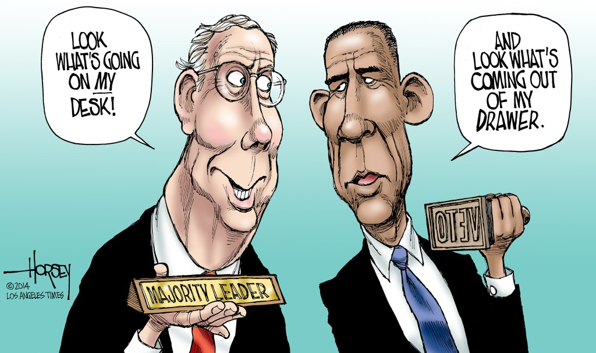
Constitutional powers³
Within Article II of the US Constitution, the President is given a series of powers, which are:
Command the military, including Army, Navy, and National Guard.
Grant clemency, pardons, and other reprieve for offenses against the United States.
Handle all foreign affairs, including negotiating treaties.
Appoint ambassadors, justices, public ministers, councils, and executive officers.
Convene, or dismiss, Congress at the President’s leisure.
Oversee the execution of the laws.
Sign bills, return them to Congress with suggested changes, or veto them.
Recommend legislature and measures to Congress.
Authorisation (but not the requirement) to form a cabinet of the heads of departments of state.
Has Executive Power as needed in order to fulfil the above duties. The inherent powers or powers implied by the constitution derive from this clause.
³ http://reverbpress.com/politics/
much-power-president-actually

Slide 5
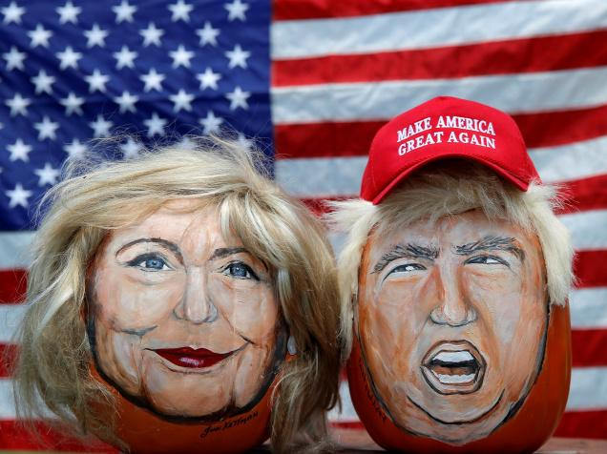
Executive Power
The constitution states that “The Executive Power shall be invested in a President of the United States of America.”
This vague wording has always been open to a wide range of interpretations.

Slide 6
Inherent Powers 1⁴
Emergency Powers
The most common inherent powers are emergency powers, exercised only in times of great need. Some emergency powers are limited in scope. The president can declare a place devastated by a storm a federal disaster area, making it eligible for federal aid. Other emergency powers are much vaster in scope. During the Civil War, for example, President Abraham Lincoln spent money without congressional approval, and he also suspended a number of civil liberties, including the writ of habeas corpus.
⁴ This and the 2 subsequent slides are from http://www.sparknotes.com/us-government-and-politics/american-government/the-presidency/section4.rhtml

Slide 7
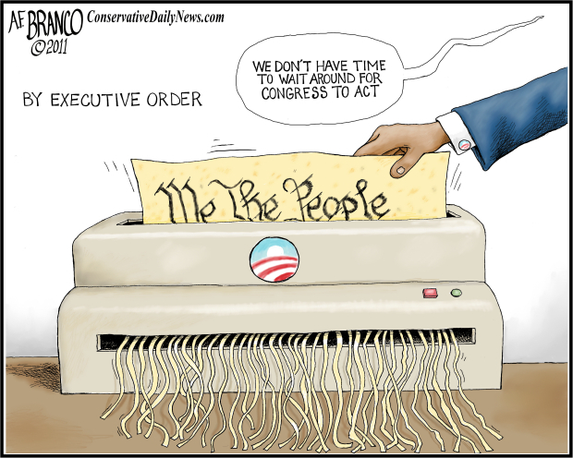
Inherent Powers 2
Executive Orders
Another type of inherent power is the executive order, which is a rule or regulation issued by the president that has the force of law. The president can issue executive orders for three reasons:
To enforce statutes
To enforce the Constitution or treaties
To establish or modify how executive agencies operate
All executive orders must be published in the Federal Register, the daily publication of federal rules and regulations.

Slide 8
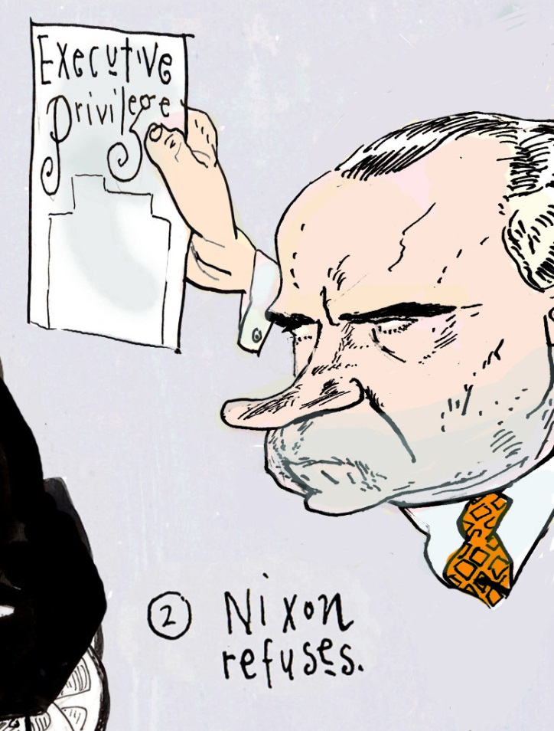
Inherent Powers 3
Executive Privilege
Executive privilege is the right of officials of the executive branch to refuse to disclose some information to other branches of government or to the public. It includes refusing to appear before congressional committees. Executive privilege is an inherent power that is not clearly defined, and the courts have had to set limitations on the use of the privilege. In 1974, for example, the Supreme Court ruled that executive privilege could not be invoked to prevent evidence from being used in criminal proceedings against the president.

Slide 9
Presidential Power- Domestic
The President’s role as chief executive of the government. These include:-
Implementation of existing Federal laws.
Initiation of new laws and programmes to address the needs and development of the nation.
Management of the economy.

Slide 10
The President as Chief Executive
In order to manage the executive branch effectively, however, each President faces a number of challenges, including:
Assembling a suitable team to lead the departments that administer government policy.
Exerting effective political control over the civil servants who implement policy.
Maintaining effective political focus on his political agenda when the next presidential election is looming.

Slide 11
Choosing the Cabinet 1⁵
The President needs to select people to run the fifteen government departments.
This means appointing people who can ensure that the President’s political priorities are implemented within their departments,
work together with other departmental heads whenever co-ordination of policy is necessary
and support the President with policy proposals that support his goals.
⁵ This and the following 2 slides are adapted from US Government and Politics William Storey 2007 Edinburgh University Press p283-4

Slide 12
Choosing the Cabinet 2
The President has less freedom of choice than the head of government in many other countries, including Britain.
The restrictions include the following:
The President cannot adjust the number of departments, or their responsibilities, to help promote his policy priorities. This can only be done by Congress.
By convention, the head of each department has a background that is compatible with the responsibilities of the department.
By convention, the heads of department (who make up the Cabinet) are expected to be broadly representative of the population of the country.
This is particularly important when a state governor becomes President, as was the case with both Bill Clinton (Arkansas) and George W. Bush (Texas). It would be inappropriate for the national government to be run almost exclusively by the
President’s close associates from his home state.
By convention, powerful pressure groups that have an interest in the affairs of a department are consulted in the appointment of its head.

Slide 13
Choosing the Cabinet 3
Once the President has found potential appointees to his Cabinet, he still faces a number of obstacles:
Persuading candidates to move to Washington DC. A President will be in office for a maximum of eight years, which may mean a candidate leaving a well-established career and uprooting a family for a limited period.
Persuading candidates to take a pay cut. In 2006, the pay of a head of department was $175,700, considerably less than the earnings of senior managers in the private sector.
The Senate has to confirm the appointees before they can take office. In most cases, this is routine but confirmation is certainly not guaranteed.

Slide 14
Role of the Cabinet
The cabinet is advisory only, it does not take decisions.
The President takes the decisions. President Harry Truman had a sign on his desk which said “The buck stops here.”
Lincoln asked his Cabinet to vote on whether he should go through with delivering the Emancipation Proclamation. The Secretary of State stood and said “Nay,” then the Secretary of Interior followed, and then all of the rest. Each had clearly voted against delivering the Proclamation. After hearing each of them, Lincoln stood and said “The Ayes have it.”

Slide 15
Cabinet Meetings 1⁶
The frequency of cabinet meetings varies from one president to another and tends to become less frequent as the presidents term goes on. Both President Carter and President Reagan held thirty-six Cabinet meetings in their first year but just six and twelve respectively four years later.
The fact that heads of department, the Cabinet secretaries, are usually policy specialists means that they may have little to contribute to discussions on unrelated policy areas.
The result can be meetings in which there is little meaningful discussion, which hardly aids the President’s decision-making.
⁶ All Cabinet meeting slides are adapted from US Government and Politics William Storey 2007 Edinburgh University Press. 285 -7

Slide 16
Cabinet Meetings 2
A consequence of these shortcomings is that policy-making is often the result of bi-lateral meetings between the President and the most influential ‘top tier’ Cabinet members: Defense, State, Treasury and Justice.
Despite these limitations all Presidents have found it beneficial to bring the Cabinet together periodically.

Slide 17
Cabinet Meetings 3
The benefits to the administration include:
Embodying the presidential platform – for Clinton, the Cabinet represented his campaign theme of inclusivity; for George W. Bush, the cabinet represented his campaign theme of compassionate conservatism.
Presenting an image of being ‘in touch’ – having representatives from all sectors of American society creates an image of a government that understands all sectors of American society.
Presenting an image of open, collective government – Cabinet meetings are always accompanied by a photo opportunity, which counters the sense that most key decisions are taken by a small group of advisors who have never been subject to Senate ratification.

Slide 18
Cabinet Meetings 4
Although Cabinets have a reputation for limited debate on government policy, there are points in the calendar when the President will usually call the secretaries together to discuss major initiatives that affect all departments, such as when the annual budget is being submitted to Congress.
At other times, even in the absence of useful policy-making discussions, Cabinet meetings provide an opportunity for information exchange, a check on the progress of legislation, an opportunity for secretaries to meet each other and an opportunity for the ‘second tier’ secretaries to meet the President.
All this can help build team spirit, important at the beginning of a Presidents term and can be significant if the administration goes through a period of political turbulence.

Slide 19
Cabinet Councils
To overcome the problem of using full cabinet for policy discussions Presidents have developed a series of policy specific cabinet councils. Under Obama these have been the Council on Environmental Quality, the National Security Council, the Domestic Policy Council and the National Economic Council.
The bring together departmental leaders to coordinate government policy.

Slide 20
Regulatory commissions, independent agencies and government corporations
Other parts of the Federal government that have, by law, a significant measure of independence from the White House.
The executive branch of government includes independent regulatory commissions. These are agencies, established by Congress and independent of the President, with responsibility for regulating important aspects of society.
They are empowered to establish rules for the policy area they regulate, which have the force of law, and to enforce their rules. All are run by boards of commissioners, consisting of five or seven members, who are appointed by the President.
Their independence from the President is established by long terms of office that end at different times. Thus, at any one time, some of them will not owe their allegiance to the current President. In addition, a maximum of four members of a seven-person board of Commissioners, or three members of a five-person board, may be of the same party, so that even if one political party controls the White House over an extended period (for example, when President Reagan was succeeded by George Bush Snr), the views of the opposition party must be considered by the Commission.
Finally, they cannot be removed by the President if they become a political irritant. In the case of Rathbun v. United States (1935), the Supreme Court ruled that commissioners could only be removed from office for failing to fulfil their obligations or for abusing their powers.

Slide 21
Regulatory commissions
The most visible commissions are the Federal Reserve, the Central Bank of the USA, which oversees the financial sector and sets interest rates, and the Federal Elections Commission, which administers and enforces campaign finance legislation.
The Federal Reserve illustrates how difficult it can be for Presidents to effectively control their administrations. Whenever there is an economic slowdown the President is invariably held responsible, yet the main tool for manipulating economic growth is controlled by the independent Federal Reserve, which does not consider presidential political fortunes when setting interest rates.

Slide 22
Independent agencies
These are responsible for specific areas of policy and are, in most respects, organised like the fifteen main government departments, headed by people responsible to the President.
The President has more control over these bodies than he does over the independent regulatory commissions, but they tend to complicate the organisation of government and lines of responsibility.
For example, the Environmental Protection Agency has responsibilities that overlap with, and sometimes clash with, the Department of the Interior, which is responsible for managing inland waterways, forests and national parks, and the Department of Agriculture.
The Environmental Protection Agency (EPA) illustrates how such bodies come into being. In response to the growing public demand for cleaner water, air and land, it was agreed by Congress and the White House that the Federal government was not structured to make a coordinated attack on the pollutants that harm human health and degrade the environment. The EPA was thus established to repair the damage already done to the natural environment and to provide guidance on making a cleaner environment a reality.

Slide 23
Government corporations
Are public services administered as business enterprises, such as the United States Postal Service and the national passenger rail service, Amtrak.
Inevitably, the President plays a minimal role in the daily functions of these organisations but public perception of the effectiveness of his administration may be significantly affected by the late delivery of the mail or the late arrival of a train.

Slide 24
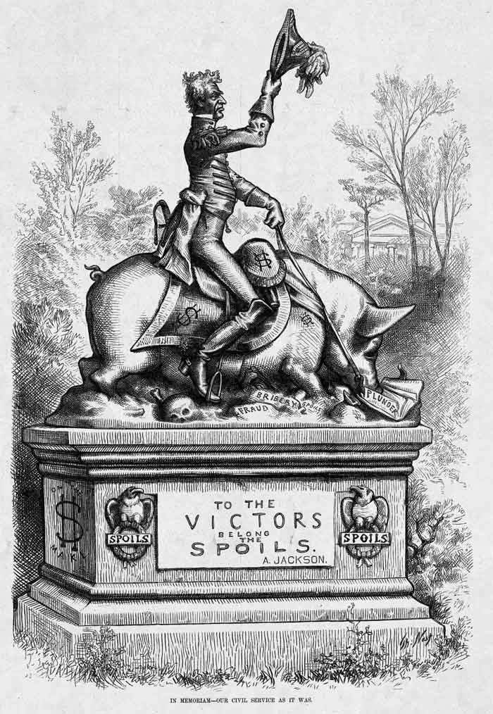
Exerting control over the Federal bureaucracy: the spoils system
Presidents have appointed political sympathisers to jobs in the government.
Many government jobs were given to supporters.
In 1881, President Garfield was assassinated by a man who had
been passed over when the ‘spoils’ were handed out.
This led to a reorganisation of government, with most positions held by permanent civil servants, appointed on merit.
However about 3 per cent of positions continue to be filled on the basis of political affiliation, rather than merit.

Slide 25
The Executive Office of the Presidency 1
Even with political appointees in place to monitor the implementation of presidential priorities, there is a need for providing co-ordination and direction to an executive branch that has become larger and more complex each decade.
This was apparent by the mid-1930s, with President F. D. Roosevelt and his advisors struggling to managed all of the new agencies created to overcome the effects of the economic depression.
In response Congress passed the Reorganization Act of 1939, creating the Executive Office of the President (EOP).

Slide 26
The Executive Office of the Presidency 2
The White House staff: These advisors have the tasks of:
Providing information and analysis of the key issues facing the administration.
Providing guidance in specialist policy areas.
Evaluating the political and legal significance of presidential decisions.
Writing speeches and presenting the President’s views to the outside world.
Liaising with Congress to gain support for the President’s programmes.
Filtering who, and what, gets access to the President.
Above all, monitoring the work of executive departments and agencies to ensure that they are carrying out the President’s political agenda.

Slide 27
The Executive Office of the Presidency 3
The Office of Management and Budget (OMB) This is the largest agency within the EOP and, after the White House staff, the most important. It prepares the budget the President proposes to Congress each year, with the amount allocated to each policy area reflecting the President’s priorities.
In the same way, it reviews all policy proposals produced by the executive departments and agencies to ensure that they are consistent with the President’s goals.
The OMB is of such importance that the post of director is subject to Senate confirmation.
The Council of Economic Advisors: While the OMB tends to focus on short-term economic policy, the Council of Economic Advisors concentrates on long-term economic planning and aids the executive departments and agencies with their long-term plans.
The National Security Council (NSC): The NSC is responsible for coordinating foreign and military policy.
Each President has added or abolished other agencies within the EOP in accordance with his priorities.

Slide 28
Conclusion
Overall, therefore, the President faces a range of challenges that limit how effectively he can impose his will on the branch of government that he leads, including:
An inability to reorganise the executive branch to meet the needs of his agenda.
A lack of control over key instruments for implementing policy, such as the Federal Reserve.
Term-limits that cause all political forces to concentrate their attention on the next President once the mid-terms are over.
All remaining slides are adapted from US Government and Politics William Storey 2007 Edinburgh University Press

