Slide 1

The US Congress and Parliament
A Comparison¹
By
Mike Allen
¹ Adapted from US Government and Politics William Storey pp 273-276

Slide 2
Key differences
The two legislatures carry out similar functions, but the way in which they operate is affected by significant differences between them:
Separation of powers v. fusion
  Congress is separately elected from the presidency, and separately accountable.
  in the UK the Prime Minister is drawn from the largest party in Parliament. The government is drawn from and responsible to Parliament.
Elected v. unelected upper chamber
  Congress is composed of two elected chambers
  in Parliament, the House of Lords is unelected.

Slide 3
Resources
Members of Congress have a number of staff in their district or state and a larger team in the Washington office, including legislative and committee specialists, a press officer, an appointments secretary and case workers to deal with issues relevant to the district, under the direction of a chief of staff. In addition, when working in committee, members may rely on the research and advice of hundreds of specialist staff. They also have the resources of the Library of Congress, with more than 130 million items, and the resources of the Congressional Research Service, which has researchers who are experts in a wide variety of policy areas and provide comprehensive reports within hours of a request.
Members of Parliament, by contrast, are allocated staff allowances of around £70,000 per year, which can fund no more than two full-time staff and one part-time worker to deal with case work, appointments and research. Committees are staffed by a clerk, with limited expert assistance, and the House of Commons library provides an efficient, prompt service to MPs but lacks equivalent resources to the Congressional Research Service.

Slide 4
Scrutiny 1
Separation of powers means that most people who enter Congress expect to build their career there. Presidents do sometimes invite members of Congress to fill important positions in the executive branch but the short period of office of Presidents (at most eight years), combined with the power that can be wielded as a committee chairman, means that this may not be an attractive option.
When scrutinising the executive branch, therefore, most members of Congress do not have to consider the effect on their careers of potentially embarrassing their own party.
Of course, factors such as party loyalty and shared ideological goals may affect their scrutiny if the same party controls both Congress and the White House, but since the Second World War these two institutions have been controlled by rival parties most of the time.
Furthermore, the resources available to Congress means that it is able to mount detailed examinations of the executive branch whenever it is inclined to do so, as illustrated by the work of the 9/11 Commission.

Slide 5
Scrutiny 2
Ambitious Members of Parliament, by comparison, expect to build careers as ministers or shadow ministers in positions that are in the gift of their party leaders.
The governing party always has a majority in the legislature (albeit not always an overall one), which, in principle, has responsibility to hold it to account.
Aside from the factors of party loyalty and shared ideological goals, this dependence on the very people they are supposed to be scrutinising inevitably inhibits the process.
Moreover, the mechanisms available to MPs to scrutinise the executive lack teeth and are poorly resourced.
Questions to ministers, and the Prime Minister, are short, and half of the questions come from supporters of the government who may be more interested in ingratiating themselves with senior members of their party than in holding them to account.
Select committees often attempt to adopt a bi-partisan approach (except when an election is imminent), but their membership is heavily influenced by party whips and they have limited resources to carry out in-depth research into issues they are investigating.

Slide 6
Legislating
The factors that influence the relationship between the legislature’s scrutiny of the work of the executive also apply to their approach to legislative proposals from the two heads of government.
Presidential bills are almost certain to be substantially modified by Congress.
Government bills in the UK have to be sensitive to the views of the parliamentary party, and those that are not – such as the Education Bill of 2006 – may be in jeopardy. Aside from this caveat, however, government bills will usually pass through Parliament unscathed.

Slide 7
Representation 1
Legislatures may be judged on how effectively they fulfil their representative role in two ways.
They may be judged by the extent to which they reflect the population they are supposed to represent.
Both the USA and UK are diverse societies led by politicians who have historically tended to be white, male and Protestant.
This is no longer as true as it once was in Congress. In the 109th Congress, starting in 2005, of the 435 Congressmen and 100 Senators, there were 43 African-Americans (all Democrats) but only one of these, Barak Obama, was a Senator. There were 24 Hispanics, 1 Native American and 4 Asians. There were 68 women, of which 14 were Senators.
In Parliament, there were 15 minority ethnic MPs in a chamber of 645 after the 2005 general election.
The House of Lords, with 728 members, does not keep figures on ethnicity but in 2004 the campaign group Operation Black Vote identified 24 non-white peers. At the same time, there were 126 women in the Commons and 134 in the Lords.

Slide 8
Representation 2
Alternatively, legislatures may be judged by their responsiveness to the needs and wishes of the voters.
In this respect, one difference between the two systems is immediately apparent. Senators face reelection every six years while their counterparts in the UK are unelected.
Supporters of the House of Lords point out that their appointed membership is more diverse than either the Commons or their US equivalents in the Senate.
Furthermore, appointing a range of people who have a distinguished record of service in their field creates a centre of expertise that makes a significant contribution to the roles of scrutiny and legislation.
Critics respond that a lack of accountability is a relic of a past age and that all of the contributions made by the Lords can also be made by an elected body, such as the Senate, which boasts a range of vastly experienced people. Besides, in the final analysis, Peers cannot block government legislation, regardless of its faults.
When comparing the House of Commons and the House of Representatives, the dependence of MPs on their party leaders for career development again becomes a factor.
If there is a tension between the demands of constituents and decisions made by the party leadership, there is no guarantee that local issues will prevail.

Slide 9
Other differences
In both the House of Representatives and the Senate, the majority party chairs all committees which have considerable power.
In the two chambers of the British legislature, committee chairs are allocated between the different parties, roughly in proportion to the size of the party in the House, and the committees are much less powerful than in the US Congress.
In the House of Representatives, the Speaker - chosen by the members of the largest party - has considerable power and acts in a highly partisan fashion.
In the House of Commons, the Speaker - chosen by the whole House - only has procedural responsibilities and acts in a non-partisan manner (usually he is not opposed in a General Election).
The House of Commons is the dominant part of the UK Parliament.
In the US Congress the chambers are more equal in powers.
There is no equivalent of the Leader of the Opposition or shadow Cabinet in the US.

Slide 10
Overall effectiveness
Independence from the executive, together with the recourses to mount potent investigations, has earned Congress the title of the most powerful legislative body in the world.
Certainly, when compared to Parliament, it is highly effective at scrutinising the work of the Executive and legislative proposals.
It also appears to fulfil its representative role more effectively.
In sum, therefore, it appears to deserve the accolade.
However as a system of Government the UK may be more effective.

Slide 11
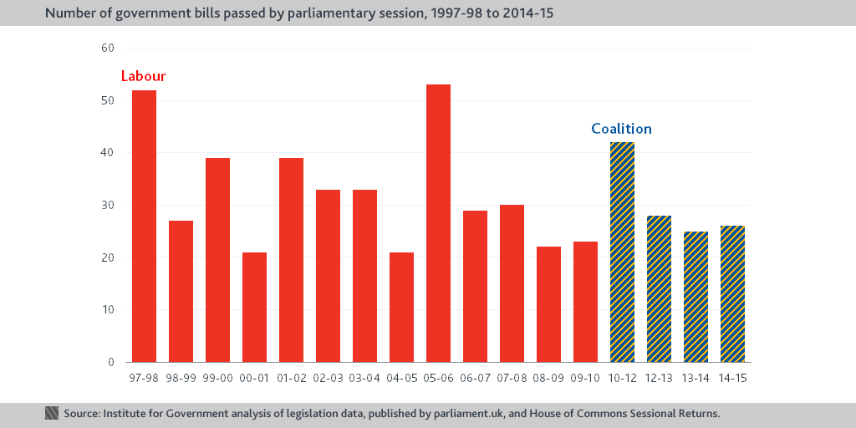
Appendix 1
However it has been argued that 98% of legislation is by delegated powers and does not appear on this table.

Slide 12
Appendix 2
Congress | Enacted Laws
114thJan 6, 2015 -Jan 3, 2017 | 329 3%
113thJan 3, 2013 -Jan 2, 2015 | 296 3%
112thJan 5, 2011 -Jan 3, 2013 | 284 2%
111thJan 6, 2009 -Dec 22, 2010 | 385 3%

