Slide 1
The Third Reform Act 1884-5
By
Mike Allen

Slide 2
Two Portraits Benjamin Disraeli
One of the greatest Victorian prime ministers.
Conservatives have seen him as a reforming Tory who improved the lot of the poor. He legalised picketing, widened suffrage and made the state more active in areas of public health and housing.
Always something of a dandy, he arrived at a dinner party wearing 'green velvet trousers, a canary coloured waistcoat, low shoes, sliver buckles, lace at his wrists and his hair in ringlets...' [Henry Bulmer]
He had affairs with married women until he married.
He liked younger men, but not sexually.
He loved the company of women, who he found more sympathetic and interesting than men; ‘I live for Power and the Affections’, he declared.
A powerful orator he was also a great wit.
Reply to a taunt by the Irish nationalist Daniel O'Connell.
“Yes, I am a Jew, and when the ancestors of the right honourable gentleman were brutal savages in an unknown island, mine were priests in the temple of Solomon.”
“There are three types of lies -- lies, damn lies, and statistics.”
“He was distinguished for ignorance; for he had only one idea, and that was wrong.” Sybil 1845

Slide 3
Two Portraits William Gladstone
Four-times Liberal prime minister of Great Britain, Gladstone was one of the dominant political figures of the Victorian era and a passionate campaigner on a huge variety of issues, including home rule for Ireland.
A great orator, and a towering intellect, a double first at Oxford, he was not good at social interrelationships with cabinet colleagues and backbenchers.
He moved from being a high Tory opposing any change to the Anglican church in Ireland and to electoral reform, to championing electoral change and Home Rule for Ireland.
He was deeply religious and a lay preacher.

Slide 4
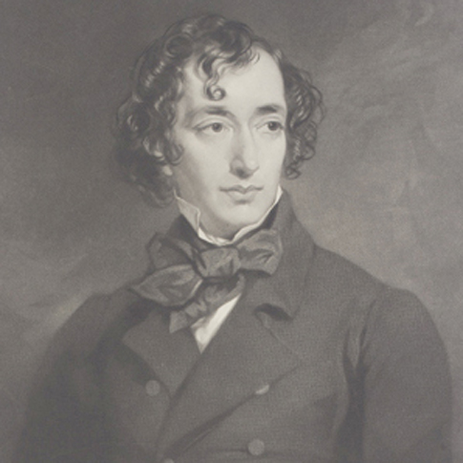
Benjamin Disraeli 1804-81 ¹
Born to Italian-Jewish parents, in 1817 Disraeli's father baptised his children as Christians. With Jews excluded from parliament until 1858, this enabled Disraeli to pursue a career that would otherwise have been denied him.
Early business ventures failed, leaving him heavily in debt. He had a breakdown but later decided to pursue a political career. After four attempts, in 1837 he was elected as Tory candidate for Maidstone.
Disraeli's maiden speech in the House of Commons was poorly received and after a great deal of barracking ended with the words: "though I sit down now, the time will come when you will hear me."
Disraeli was now a progressive Tory and advocated triennial parliaments and the secret ballot. He was sympathetic to the demands of the Chartists and in one speech argued that the "rights of labour were as sacred as the rights of property".
In 1839 Benjamin Disraeli married the extremely wealthy widow, Mary Wyndham Lewis. The marriage was a great success. On one occasion Disraeli remarked that he had married for money, and his wife replied, "Ah! but if you had to do it again, you would do it for love."
¹ Adapted from http://spartacus-educational.com/PRdisraeli.htm

Slide 5
Benjamin Disraeli 2
The Conservative leader, Sir Robert Peel, encouraged Disraeli, but, when in 1841, Peel became prime minister, Disraeli was not given office in the cabinet. He was mortified at the rebuff, and his attitude toward Peel and his brand of Conservatism became increasingly critical.
In 1842 Disraeli helped to form the Young England group. Disraeli and members of his group argued that the middle class now had too much political power and advocated an alliance between the aristocracy and the working class.
Disraeli suggested that the aristocracy should use their power to help protect the poor. This political philosophy was expressed in Disraeli's novels Coningsby (1844), Sybil(1845) and Tancred (1847). In these books the leading characters show concern about poverty and the injustice of the parliamentary system.
Disraeli favoured a policy of protectionism and strongly opposed Peel's decision to repeal the Corn Laws. This issue split the Conservative Party and Disraeli's attacks on Peel helped to bring about his political downfall.

Slide 6
Benjamin Disraeli 3
In 1852 Lord John Russell, the leader of the Whig government, resigned. Lord Derby, the new Prime Minister, appointed Disraeli as his Chancellor of the Exchequer. This period of power only lasted a few months.
Lord Derby became Prime Minister again in 1858 and once again Disraeli was appointed as Chancellor of the Exchequer.
He also became leader of the House of Commons and was responsible for the introduction of measures to reform parliament.
In February, 1858, Disraeli proposed the equalization of the town and county franchise. This would have resulted in some men in towns losing the vote and was opposed by the Liberals.
An amendment proposed by Lord John Russell "condemning this disfranchisement" was passed by 330 to 291.

Slide 7
Benjamin Disraeli 4
In 1859 Lord Palmerston, became Prime Minister.
It was not until 1866 that Disraeli returned to the cabinet. Once again, Lord Derby appointed Disraeli as his Chancellor of the Exchequer and leader of the House of Commons.
Some members of the Liberal Party, including William Gladstone, had been in favour of legislation that would have extended the franchise. His attempts to obtain parliamentary reform failed.
Disraeli was convinced that if the Liberals returned to power, Gladstone was certain to try again. Benjamin Disraeli argued that the Conservatives were in danger of being seen as an anti-reform party. In 1867 Disraeli proposed a new Reform Act. Lord Cranborne (later the Marquis of Salisbury) resigned in protest against this extension of democracy.
In the House of Commons, Disraeli's proposals were supported by Gladstone and his followers and the measure was passed.
The 1867 Reform Act gave the vote to every male adult householder living in a borough constituency. Male lodgers paying £10 for unfurnished rooms were also granted the vote. This gave the vote to about 1,500,000 men.

Slide 8
Benjamin Disraeli 5
In 1868 Lord Derby resigned and Benjamin Disraeli became the new Prime Minister.
He commented “Yea, I have climbed to the top of the greasy pole”.
However, in the1868 General Election that followed, the Liberals were returned to power with a majority of 170.
Disraeli and the Conservative Party won the 1874 General Election. It was the first time since 1841 that the Tories in the House of Commons had a clear majority.
Social reforms passed by the Disraeli government included: the Artisans Dwellings Act (1875), the Public Health Act (1875), the Pure Food and Drugs Act (1875).
Disraeli also introduced measures to protect workers such as the 1874 Factory Act and the Climbing Boys Act (1875).
Disraeli also kept his promise to improve the legal position of trade unions. The Conspiracy and Protection of Property Act (1875) allowed peaceful picketing and the Employers and Workmen Act (1878) enabled workers to sue employers in the civil courts if they broke legally agreed contracts.

Slide 9
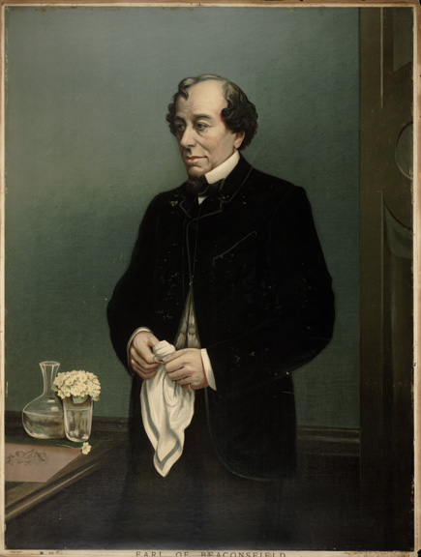
Benjamin Disraeli 6
Unlike William Gladstone, Disraeli got on very well with Queen Victoria. She approved of Disraeli's imperialist views and his desire to make Britain the most powerful nation in the world. In 1876 Victoria agreed to his suggestion that she should accept the title of Empress of India.
In August 1876 Queen Victoria granted Disraeli the title Lord Beaconsfield. Disraeli now left the House of Commons but continued as Prime Minister and now used the House of Lords to explain his government's policies. At the Congress of Berlin in 1878 Disraeli gained great acclaim for his success in limiting Russia's power in the Balkans.
The Liberals defeated the Conservatives in the 1880 General Election and Disraeli decided to retire from politics.
Disraeli hoped to spend his retirement writing novels but soon after the publication of Endymion (1880) he became very ill.
Benjamin Disraeli died on 19th April, 1881.
1880-1

Slide 10
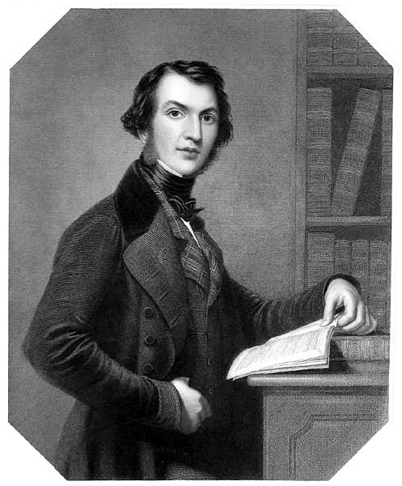
William Gladstone 1809 – 1898¹
He was educated at Eton and Christ College, Oxford where he gained a double first.
At the Oxford Union Gladstone developed a reputation as a fine orator. Gladstone was a Tory and denounced Whig proposals for parliamentary reform.
He became an MP in 1832.
He held junior offices in Robert Peel's government of 1834 - 1835.
After 1841 he held more junior posts but in 1843 Gladstone entered Peel's Conservative cabinet. When the Conservatives split in 1846, Gladstone followed Peel in becoming a Liberal-Conservative.
He remained in Opposition until 1852 when Lord Aberdeen formed a coalition government with Lord Palmerston as Home Secretary, Lord John Russell as Foreign Secretary and Gladstone as Chancellor of the Exchequer. Aberdeen's government survived until March 1857.
Gladstone in the 1830’s
¹ Adapted from http://spartacus-educational.com/PRgladstone.htm

Slide 11
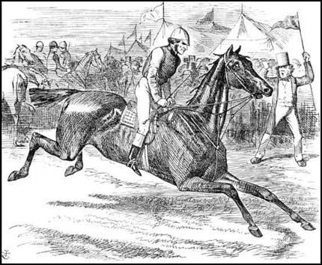
William Gladstone 2
Under Lord Palmerston, as Prime Minister in 1859, he became Chancellor of the Exchequer.
He carried out a series of reforms reducing or abolishing tariffs thus lowering the price of food and became popularly known as “the People’s William”.
He changed his mind and became a supporter of parliamentary reform.
On the death of Palmerston the new Prime Minister, Lord John Russell, asked Gladstone to become leader of the House of Commons as well as Chancellor of the Exchequer.
On 12th March 1866, Gladstone introduced the government's new reform bill. In the debate Gladstone admitted that he was a recent convert to parliamentary reform.
With Conservative opposition to the measure, Russell's government found it impossible to get the bill passed by the House of Commons. On 19th June 1866, Russell's administration resigned.
Lord Palmerston (starter): "Hi! Gladstone! Democracy! Too soon, Too soon! You mustn't go yet!" John Tenniel, Punch Magazine, 28th May, 1864

Slide 12
William Gladstone 3
Lord Derby became PM with Disraeli Chancellor of the Exchequer.
In 1867 Disraeli proposed a new Reform Act. Lord Cranborne (later Marquis of Salisbury) resigned in protest against this extension of democracy.
In the House of Commons, Disraeli's proposals were supported by Gladstone and his followers and the measure was passed.
In the general election of December 1868, the Conservatives were defeated and Gladstone, leader of the Liberal Party, became Prime Minister.
In 1870 Gladstone and his education minister, William Forster, managed to persuade Parliament to pass the government's Education Act that established school boards in Britain and elementary education (up to 13).
After 1867 voters still had to mount a platform and announce their choice of candidate to the officer who then recorded it in the poll book.
Employers and local landlords therefore knew how people voted and could punish them if they did not support their preferred candidate. I
In 1872 Gladstone's removed this intimidation when his government brought in the Ballot Act which introduced a secret system of voting.
Gladstone worked directly with fallen women (prostitutes) to try to rescue them from their circumstances. At considerable risk to his political career, Gladstone spent a great amount of his own money and time on this effort, assisted by his wife, Catherine Gladstone.

Slide 13
William Gladstone 4
In the 1874 General Election the Conservative Party won with a majority of forty-six. Benjamin Disraeli became Prime Minister.
Gladstone retired from the Liberal leadership to write about Homer though he remained an MP.
However, he was stirred into action when he read about the massacres and tortures inflicted upon the inhabitants of Bulgaria by their Turkish rulers.
This resulted in him writing a pamphlet Bulgarian Horrors and the Question of the East (1876).
The Midlothian campaign of 1878-80 was a series of foreign policy speeches given by William Ewart Gladstone, leader of Britain's Liberal Party.
It is often cited as the first modern political campaign. It also set the stage for Gladstone's comeback as a politician. It takes its name from the Midlothian constituency in Scotland where Gladstone (of Scottish ancestry) successfully stood in the 1880 election.
Parliament was dissolved in 1880, and the general election resulted in a overwhelming Liberal victory.

Slide 14
William Gladstone 5
In 1880 he became Prime Minister for a second time, much against Queen Victoria’s will. Her dislike of him was strong, complaining that he “addresses me as though I were a public meeting”.
The second ministry was taken up mainly with Irish affairs.
A Coercion Act for Ireland was passed in an attempt to deal with increasing violence and Gladstone was able to pass the second Irish Land Act that introduced the 'three Fs"-fixity of tenure, fair rents, and free sale of land.
Gladstone did introduced three new measures concerning parliamentary reform. The Corrupt Practices Act 1883 specified how much money candidates could spend during election time and banned such activities as the buying of food or drink for voters.
In 1884 Gladstone introduced his proposals that would give working class males the same voting rights as those living in the boroughs. Although the bill was passed in the House of Commons it was rejected by the Conservative dominated House of Lords. Gladstone refused to accept defeat and reintroduced the measure. This time the Conservative members of the Lords agreed to pass Gladstone's proposals in return for the promise that it would be followed by a Redistribution Bill. This was the result of a secret deal between Gladstone and Salisbury.
Gladstone accepted the terms and the 1884 Reform Act was allowed to become law. This measure gave the counties the same franchise as the boroughs - adult male householders and £10 lodgers - and added about six million to the total number who could vote in parliamentary elections.

Slide 15
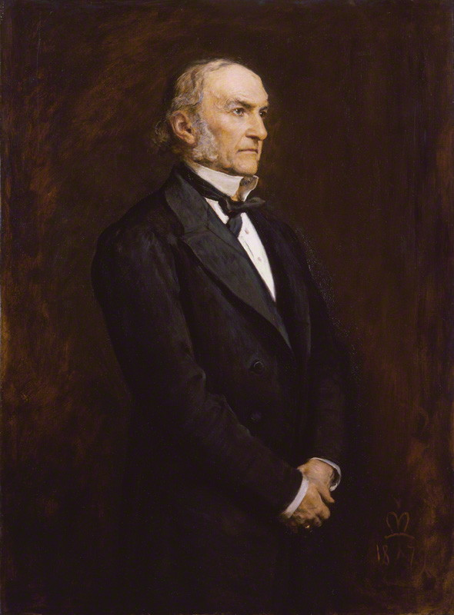
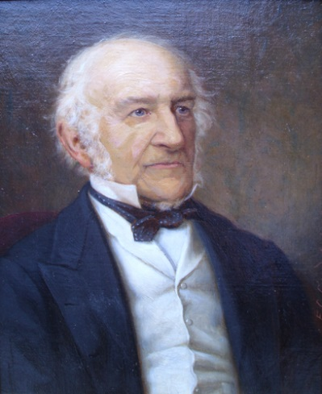
William Gladstone 6
Gladstone and his party won the 1886 General Election.
Gladstone now attempted to convince Parliament to accept Irish Home Rule.
The proposal split the party and Parliament rejected the measure.
Gladstone was defeated in the polls in the 1886 General Election but was once again elected to office in 1892. The following year the Irish Home Rule Bill was passed in the House of Commons but was defeated in the House of Lords. He wished to fight a general election on the issue but the cabinet overruled him and he resigned from office in March 1894.
He died after suffering a heart-attack at Hawarden Castle on 19th May, 1898.
“Liberalism is trust of the people tempered by prudence. Conservatism is distrust of the people tempered by fear.”
“We look forward to the time when the Power of Love will replace the Love of Power. Then will our world know the blessings of peace.”
“Selfishness is the greatest curse of the human race”
Gladstone in 1879 and 1898

Slide 16
Politics 1868-1884
1868-74 Gladstone’s first ministry.¹
Elementary Education Act (Fosters Act) 1870 By the late 1860s, it was clear that schools provided by religious volunteering societies was inadequate and unable to cope with the rapidly increasing population. The act established a system of elected school boards which had the power to levy rates locally and use the funds to build schools and employ teachers.
Civil Service Reform 1871 introduced the idea that entry into the civil service should be by examination. This led to a civil service of high quality men.
Trade Union Act 1871
Act legalised Trade Unions for the first time and gave them legal status. No trade unions could now be regarded as criminal. Trade union funds were protected.
¹Adapted from https://getrevising.co.uk/revision-notes/gladstones_first_ministry_1868_74_1

Slide 17
Politics 1868-1884 2
Criminal Law Amendment Act 1871
It stated that although unions could strike, picketing of all types, even peaceful, was forbidden. This act meant that in practice it would be impossible to make a strike effective.
The Ballot Act 1872
Even after the two Reform Acts, voting was still carried out in public by a show of hands, a system which led to corruption, involving both threats and intimidation. Employers or land owners were able to use their control over their employees to influence the vote, by present or sending representatives to check on votes. This act established a secret ballot making elections more orderly affairs.
The Licensing Act 1872 restricted the opening hours of public houses, it also regulated the content of beer. Local authorities were given the power to determine licensing hours and all premises where alcohol as sold had to be licensed: licenses could be refused.

Slide 18
Politics 1868-1884 3
Cardwell's Army Reforms 1868-1874
Refers to a series of reforms of the British Army undertaken by Secretary of State for War Edward Carnell between 1868 and 1874.
1868, he abolished flogging and other harsh disciplinary measures.
1870, bounty money for recruiting officers were abolished, and guidelines were set out for the swift discharge of known bad characters from both army and navy.
1871, Sale of Commissions was abolished. Previously, officer ranks in the army had been available to buy to any one who could afford it, whatever their military knowledge or ability. Cardwell thought that selection and promotion of officers should be on merit.
Irish Church Act 1869 This disestablished the Anglican Church in Ireland, meaning that it was no longer the official state religion
First Irish Land Act 1870 (Failed) This attempted to give some sort of protection to tenant farmers.
Courts were to make sure that landlords did not charge 'exorbitant' rents. However, it did not specify how high an 'exorbitant' rent was. The courts which decided on the rents almost always protected the landlords.

Slide 19
Politics 1868-1884 4
Benjamin Disraeli and the Conservative Party won the 1874 General Election.
Social reforms passed by the Disraeli government included: the Artisans Dwellings Act (1875) which involved allowing local councils to buy up areas of slum dwellings in order to clear and then rebuild them, the Public Health Act (1875), the Pure Food and Drugs Act (1875).
Benjamin Disraeli also introduced measures to protect workers such as the 1874 Factory Act and the Climbing Boys Act (1875).
Disraeli also kept his promise to improve the legal position of trade unions. The Conspiracy and Protection of Property Act (1875) allowed peaceful picketing and the Employers and Workmen Act (1878) enabled workers to sue employers in the civil courts if they broke legally agreed contracts.

Slide 20
Politics 1868-1884 (5)
Gladstone and the Liberals won the 1880 election.
The ministry was mainly devoted to Irish affairs.
In the 1880 elections Parnell supported Gladstone, but when Gladstone sponsored the Land Act, which fell far short of nationalists' demands, he joined the opposition.
1881 & 1882 Irish Land Acts attempted to end Irish unrest by giving Irish tenant farmers greater rights to the land they farmed.
The Corrupt and Illegal Practices Act, 1883
Candidates’ election expenses were determined by the size of the constituency.
It was made clear what campaign money could be spent on.
Election agents had to account for their spending.
A detailed definition of illegal and corrupt practices was set down.
A breach of the law disqualified a candidate for seven years.
Active involvement in corruption was punishable by a fine or imprisonment.

Slide 21
Reasons for Reform
There was a difference between the qualification to vote in the counties and the boroughs.
Many working class men, particularly in the counties (countryside), were still not entitled to vote e.g. farm labourers, craftsmen in small, country towns, soldiers in barracks, male domestic servants living in, adult sons living at home.
Increased pressure for further parliamentary reform came from Joseph Chamberlain and the Radicals within the Liberal party. They argued that although householders in the boroughs could vote, in the countryside agricultural labourers and other workers still could not vote preserving the dominance of the landowners and wealthy farmers.
By the time of the third Reform Act in 1884, Britain was less democratic than many other countries in Europe. 16% of the adult population had the vote.
There was not the same pressure from extra-parliamentary agitation as in 1831-2 and 1866-7.

Slide 22
The 1884-5 Reform Act 1
In 1884 the Commons accepted Gladstone’s bill to give working men in rural England the same rights as those in the boroughs.
However, the Conservative dominated House of Lords rejected the bill.
Gladstone persevered and the Lords passed the bill after an agreement was made with Salisbury and Gladstone that the 1884 Reform Act would be followed by a Redistribution Bill.
The 1884 Reform Act gave the counties the same voting rights as the boroughs had – all adult householders and men who rented unfurnished lodgings to the value of £10 a year. The electorate after this act stood at 5,500,000 – though an estimated 42% of all men still did not have the right to vote as a result of their status within society. 29% of the adult population had the vote.

Slide 23
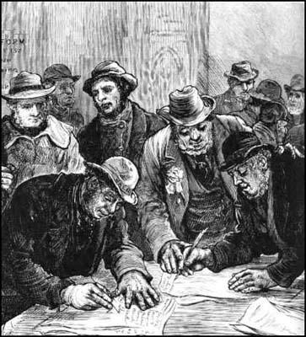
The 1884-5 Reform Act 2
Redistribution of Seats Act 1885
Boundaries were redrawn and constituencies became roughly equal in size of population – about 50,000.
Most constituencies now only had one MP
Increased representation for the industrial cities (eg Glasgow now had 7 MP’s) • Scotland and Wales were given more MP’s (Scotland had 72 in total)
Farm labourers voting for the first time Illustrated London News (1884)

Slide 24
Criticisms of the Act
Many working class men (40% of adult males in Britain) were still not entitled to vote e.g. soldiers in barracks, male domestic servants living in, adult sons living at home, paupers on poor relief and those who failed to pay their rates.
Women still could not vote in general elections.
The right to vote was still based on the ownership of property.
Also, plural voting still existed. This meant that a man could have many votes if he owned property in different constituencies.
Universities still elected Members of Parliament.

