Slide 1
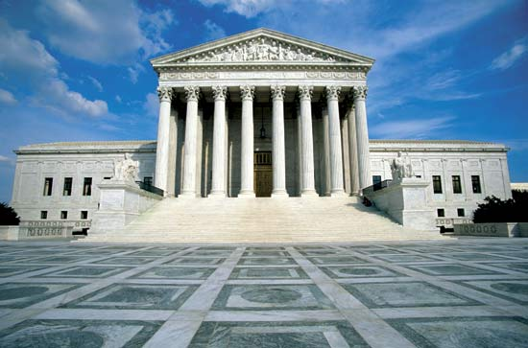
The Supreme Court¹
By
Mike Allen
¹ Adapted from US Government and Politics by Anthony J Bennett
and US Government and Politics by William Storey

Slide 2
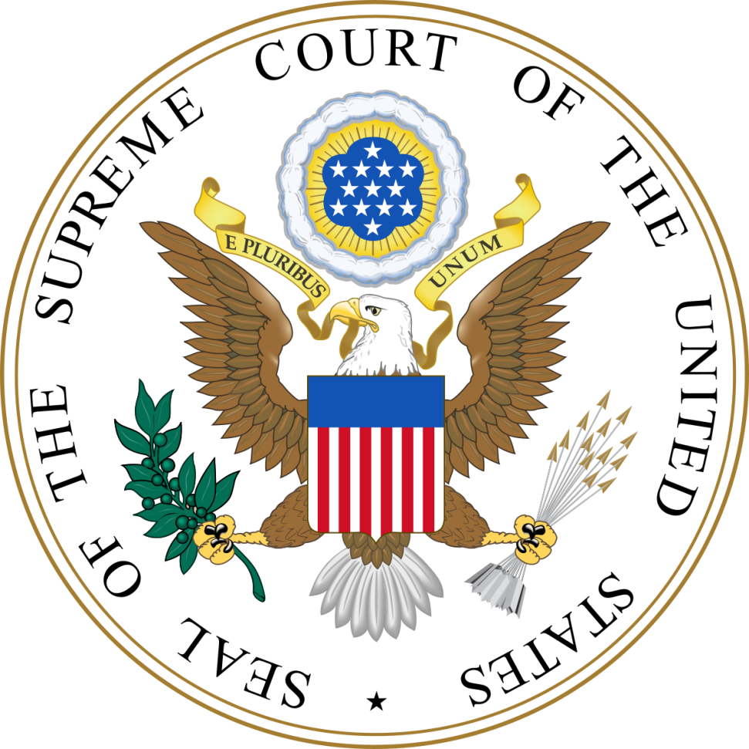
Constitutional position
U.S. Constitution, Article III, Section 1.
“The judicial power of the United States, shall be vested in one Supreme Court, and in such inferior courts as the Congress may from time to time ordain and establish.”
The Constitutional Convention set up the Supreme Court but left it to Congress to set up lower courts.
The Judiciary Act 1789 created lower courts, which have been added to since.
There are now 13 Courts of Appeal known as circuit courts.
Below these are 94 trial courts known as district courts.

Slide 3
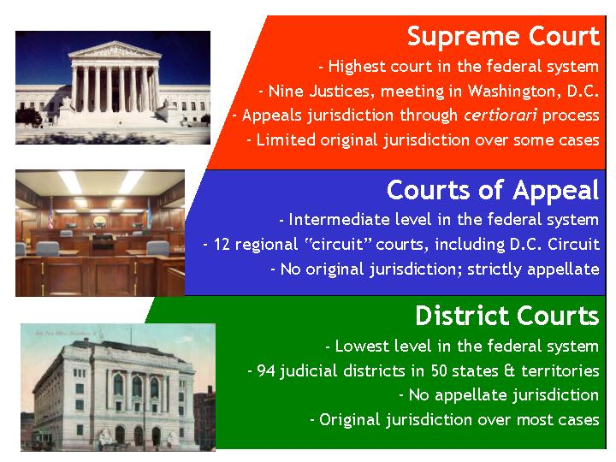

Slide 4
Membership
Congress decides on how many members it shall have. Since 1869 this has been fixed at 9.
The Supreme Court and lower Federal courts are appointed for life “during good behaviour”.
They can be impeached. It is the same procedure as for the president.
Decision on whether they be committed for impeachment by the House of Representatives by a majority
Trial by the Senate with a two thirds vote necessary for impeachment.
No Supreme Court justice has ever been impeached, though Justice Abe Fortas resigned in 1969 to avoid impeachment. He had taken money from a financier under investigation and talked to President Johnson about a pardon.
A justice may retire voluntarily.

Slide 5
States
Each of the 50 states has its own court system which hear cases relating to State law. More than 95 percent of court cases in the United States take place in state courts.
Cases which reach the State Supreme Court can be referred to the Federal Supreme Court. The Supreme Court will only hear these cases if there is a federal or constitutional issue at stake.
There is some concurrent jurisdiction
2 citizens in different states with dispute of over $50,000 can be held by either a State court or a Federal court.
Kidnapping is a crime under both state and federal law.
There is no federal crime of murder.

Slide 6
Appointment
Vacancies are appointed by the President subject to confirmation by the Senate.
Presidents regard the appointments as the most important of their term as President.
Appointments may be made from
US Courts of Appeals
State Courts
The Executive branch, especially the Justice Department
State Governors
Academia
A short list is made by the President, the FBI carries out background checks, the president interviews candidates and chooses a nominee.

Slide 7
Confirmation
This is passed to the Senate Judiciary Committee.
Hearings will take place with witnesses- both supporters and critics.
There is a rating made by the American Bar Association since 1952 – well qualified, qualified, not qualified.
The Committee vote is a pointer to the floor vote
The final vote is by the Senate.
Most nominees are confirmed.
151 people have been nominated to the U.S. Supreme Court. Twenty-nine nominees (including one nominated for promotion) have been unsuccessful.

Slide 8
Unsuccessful Nominees
Abe Fortas | 1968 | L.B. Johnson | Withdrawn†† | Conservatives members of the Senate opposed his appointment
Homer Thornberry | 1968 | L.B. Johnson | Nullified†‡ | No longer a vacancy due to Fortas withdrawal
Clement Haynsworth | 1969 | Nixon | Rejected, 45–55 | Opposed as being to conservative with a poor civil rights record.
G. Harrold Carswell | 1970 | Nixon | Rejected, 45–51 | Seen as mediocre with a poor civil rights record.
Robert H. Bork | 1987 | Reagan | Rejected, 42–58 | Seen as too conservative
Douglas H. Ginsburg | 1987 | Reagan | Withdrawn | Smoked cannabis as a student and as a Professor at Harvard
Harriet Miers | 2005 | G.W. Bush | Withdrawn | Insufficient legal qualification
Merrick Garland | 2016 | Obama | No action | Republican Senate refused to consider nomination until after the Presidential Election

Slide 9
The reasons why appointment is important
Infrequent – average every 2 years
For life
Only 9 members
Power of judicial review (see later) – with constitutional amendment so difficult the major way in which the constitution is changed is by reinterpretation by the Supreme Court
Profoundly affect American lives

Slide 10
Judges, once appointed do not always act as expected.
President Eisenhower appointed Earl Warren to Chief Justice. He subsequently said “the biggest damn fool mistake I ever made”.
Justices Steven and Souter though appointed by Republican Presidents proved more liberal than expected.

Slide 11
Present Supreme Court
Name | Political leaning | Date appointed | President
John Roberts (Chief Justice) (born 1955) | conservative | 2005 | George W. Bush
Anthony Kennedy (born 1936) | moderate conservative | 1988 | Ronald Reagan
Clarence Thomas (born 1948) | extremely conservative | 1991 | George H. W. Bush
Ruth Bader Ginsburg (born 1933) | liberal | 1993 | Bill Clinton
Stephen Breyer (born 1938) | liberal | 1994 | Bill Clinton
Samuel Alito (born 1950) | conservative | 2006 | George W. Bush
Sonia Sotomayor (born 1954) | liberal | 2009 | Barack Obama
Elena Kagan (born 1960) | liberal | 2010 | Barack Obama
Vacancy Neil Gorsuch nominated | conservative | 2017 | Donald Trump

Slide 12
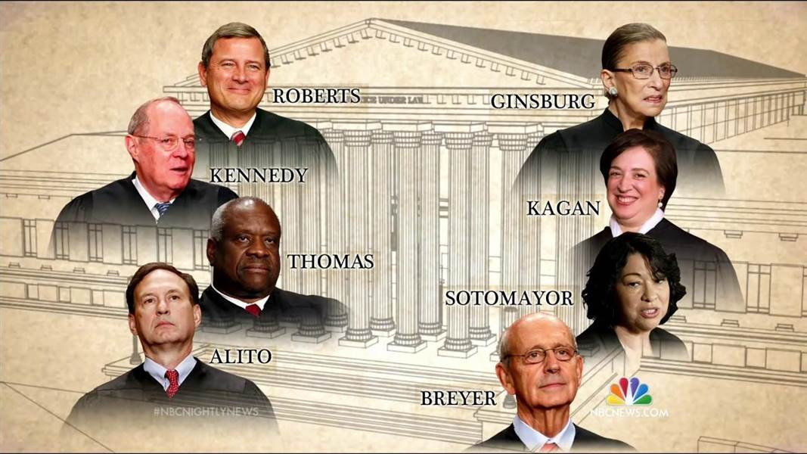

Slide 13
How the Supreme Court reaches a decision
The Supreme Court decides what cases to hear – about 100 cases per year.
Lawyers on both sides present a case.
Amicus curaie “friends of the court” documents submitted to the court by other groups e.g. pressure groups or government departments.
Justices read papers and hear arguments
Decision by a vote of all justices. All votes are equal.
If there is a split the majority decision will be written with the minority explaining their points of disagreement “dissenting opinion”. Both sides can add “concurring opinions”.

Slide 14
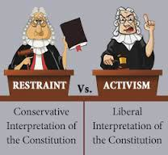
The philosophy of Justices
Conservative or liberals
Strict constructionalists – literal interpretation of the Constitution
Loose constructionalists – loose interpretation of the Constitution
Judicial activism – the court leading the way in reform
Judges are responsible for resolving current problems
The constitution is a guide but needs interpretation for the modern world and contemporary reality
Judicial restraint - and base their decisions on
precedent -the court standing by previous rulings
Strict constructionism

Slide 15
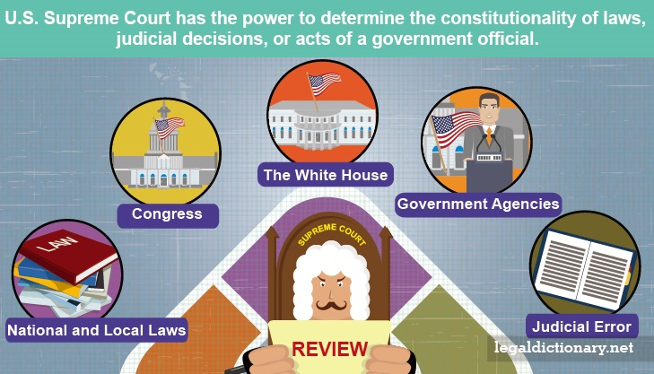
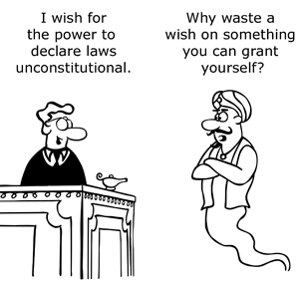
The Power of Judicial review
Judicial review was discussed at the Constitutional Convention but no decision was taken. The constitution does not give this power to the Supreme Court.
However the Supreme Court took it for itself.
Marbury v. Madison, 1803
“A law repugnant to the Constitution is void.” Chief Justice Marshall
Hereafter, the Court was recognized as having the power to review all acts of Congress where constitutionality was at issue, and judge whether they abide by the Constitution.
The actual decision was about whether a judge (Marbury) appointed by a previous President (Adams) should be confirmed by the new President (Madison) The Court ruled that the section of the Judiciary Act 1789 that enabled Marbury to bring the case was unconstitutional and therefore dismissed the case.
This means that the Supreme Court is the arbiter of the constitution.

Slide 16
The limitations of Judicial review 1
The legal process
Judges can only rule on matters brought before them
Judges are banned by the constitution from giving advisory opinions of what they might do on future cases.
Court Traditions
Judges only consider cases where the decision will make a difference.
Judges only consider cases where the decision will affect a large number of people and large harm may be caused.
They are reluctant to become involved in foreign policy.
They are reluctant to become involved in politics – they try to leave such issues to elected politicians

Slide 17
The limitations of Judicial review 2
Lack of enforcement power
Presidents and Governors have a duty to uphold the law but sometimes Supreme Court decisions are ignored or resisted. E.g. Southern States and segregation in the 50’s and 60’s.
Public Opinion
Needs to be considered
Amicus curiae
Checks and balances
Appointment should be people of suitable people with moderate views
Supreme Court judgements can be overturned by constitutional amendments.
Congress can modify laws
The Executive can modify its actions e.g. executive orders
Impeachment
Congress has the power to change the number of justices on the Supreme Court. In 1937 Rooseveldt was frustrated by the rejection of the New Deal and proposed to appoint 6 new judges. Congress rejected the proposal but subsequently the Supreme Court did not reject New Deal legislation.

Slide 18
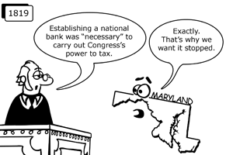
Some important cases 1²
Marbury v. Madison, 1803 as noted before it instituted judicial review whereby the court could declare an act of Congress void. An example of Judicial activism.
McCulloch v. Maryland, 1819 This established the right of Congress to pass laws that are “necessary and proper” to conduct the business of the U.S. government. Here, the court upheld Congress’ power to create a national bank. Judicial activism
² Selected from Twenty-Five Landmark Cases in Supreme Court History https://www.constitutionfacts.com

Slide 19
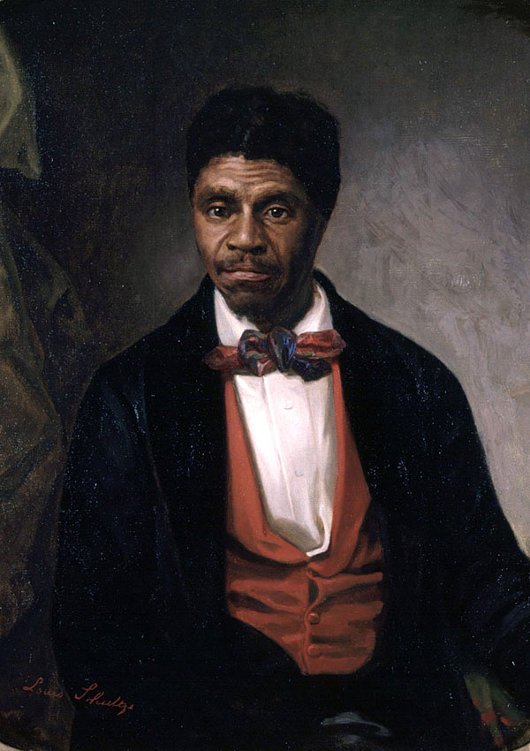
Some important cases 2
Dred Scott v. Sandford, 1857 “The Constitution does not consider slaves to be U.S. citizens. Rather, they are constitutionally protected property of their masters.” Chief Justice Roger Taney authored this opinion— one of the most important and scorned in the nation’s history. Dred Scott, a slave, had moved with his master to Illinois, a free state. He moved again to a slave state, Missouri, and filed suit to gain freedom, under that state’s law of “Once free, always free.” Taney held that Scott had never been free at all, and cited Constitutional grounds for placing the slavery decision in the hands of the states. In trying to put an end to the slavery controversy, Taney instead sped the nation toward civil war. The decision was later overturned by the Thirteenth Amendment. Strict constructionalism.

Slide 20
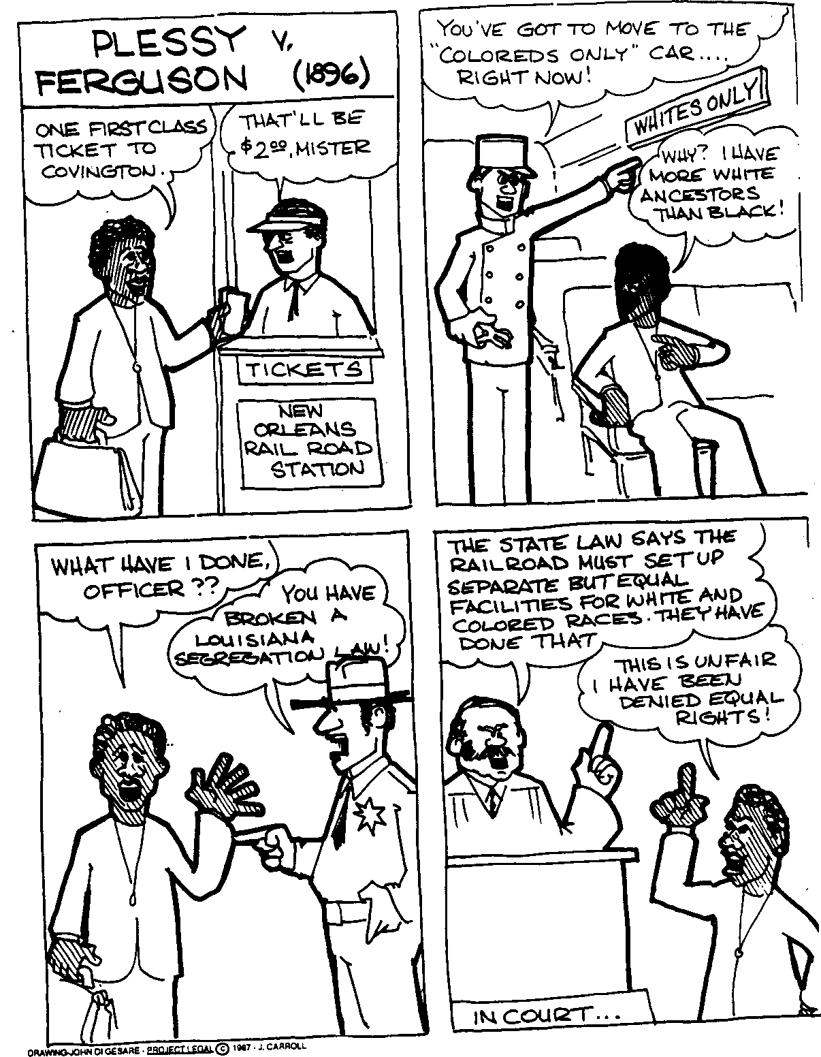
Some important cases 3
Plessy v. Ferguson, 1896
Jim Crow laws are constitutional under the doctrine of ‘Separate but Equal.’
Police arrested Homer Plessy for refusing to leave a railroad car that prohibited “colored” people. Under Louisiana law, Plessy was “colored” because he was one-eighth black. The Court ruled that the race-based “Jim Crow” laws did not violate the Constitution as long as the states proffered separate but equal treatment. Strict constructionalism.
“The Constitution is color blind, and neither knows nor tolerates classes among citizens.” —Justice John Marshall Harlan, from the lone dissenting opinion in Plessy v. Ferguson

Slide 21
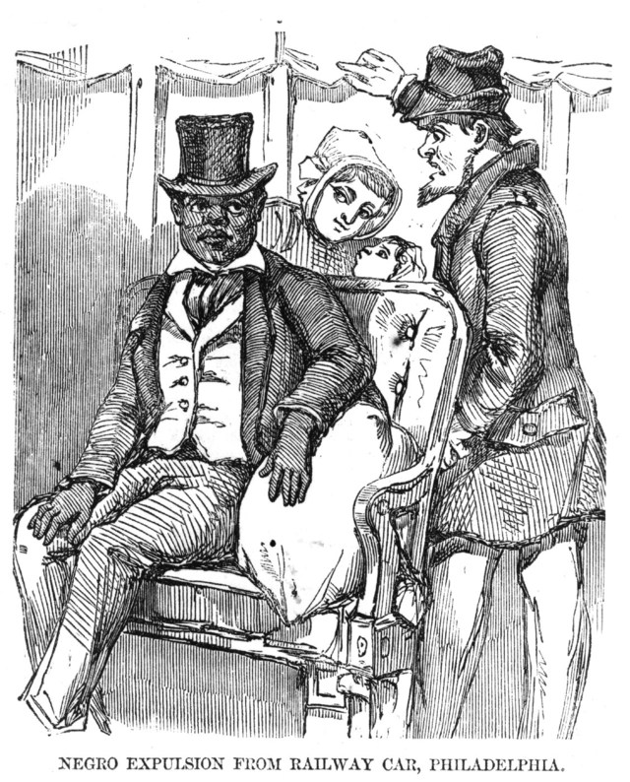
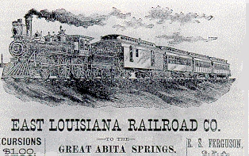
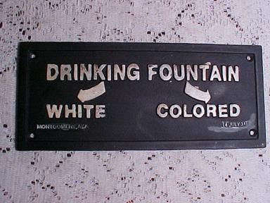

Slide 22
Some important cases 4
Near v. Minnesota, 1931
“The liberty of the press … is safeguarded from invasion by state action.”
Although the First Amendment ensures a free press, until this case, it only protected the press from federal laws, not state laws. Minnesota shut down J. M. Near’s Saturday Press for publishing vicious antisemitic and racist remarks. In what is regarded as the landmark free press decision, the Court ruled that a state cannot engage in “prior restraint”; that is, with rare exceptions, it cannot stop a person from publishing or expressing a thought.
West Coast Hotel v. Parrish, 1937
“The switch in time that saved nine.”
F. D. R. rallied against the Court’s holdings in the Lochner era. The Court struck down New Deal laws, designed to pull the country out of the Depression, on grounds that they interfered with a worker’s “right to contract.” F. D. R. pledged to expand the Court and pack it with pro “New Deal” members. In this case, the Court rejected the Lochner era decisions and said the government could regulate commerce.

Slide 23
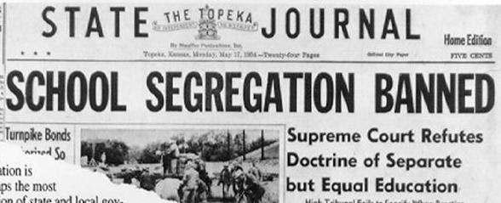
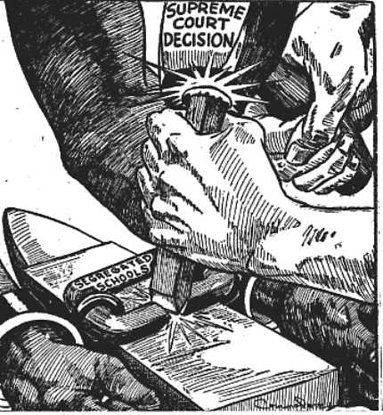
Some important cases 5
Brown v. Board of Education, 1954
“In the field of public education, the doctrine of ‘separate but equal’ has no place.”
This unanimous decision marked the beginning of the end for the “Separate But Equal” era that started with Plessy, and the start of a new period of American race relations. With Brown, desegregation of public schools began—as did resistance to it. Ten contentious years later, the Civil Rights Act of 1964 made racial equality a matter of federal law.

Slide 24
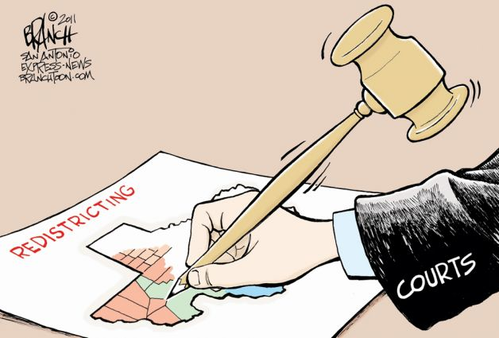
Some important cases 6
Baker v. Carr, 1962
“One person, one vote.”
The above phrase was not authored until a year after Baker, but it has its philosophical roots here. In this case, a group of Tennessee voters sued the state, claiming its voting districts diluted their political power. Until this point, the Court refused to decide this kind of case, leaving such “political questions” to the states. 89% 0f the population lived in urban areas but received 50% of the representation.
Baker, however, held that the states must meet a Constitutional standard for appointment: districts cannot be drawn in such a way that they violate the Equal Protection clause of the 14th Amendment.

Slide 25
Some important cases 7
Gideon v. Wainwright, 1963
Defendants in criminal cases have an absolute right to counsel.
Too poor to afford a lawyer, Clarence Earl Gideon was convicted for breaking into a poolroom—a felony crime in Florida.
He appealed to the Supreme Court, which ruled that the government must provide free counsel to accused criminals who cannot pay for it themselves.
At first, the ruling applied to felonies only. It was later extended to cover any cases where the penalty was six months imprisonment or longer.
Griswold v. Connecticut, 1965
The Constitution implies a right to privacy in matters of contraception between married people.
Estelle Griswold, the director of a Planned Parenthood clinic, broke an 1879 Connecticut law banning contraception. The Court struck down the law, making it a landmark case in which the Court read the Constitution to protect individual privacy.
This was to be the foundation of further privacy rulings, including the right to privacy in matters of abortion.

Slide 26
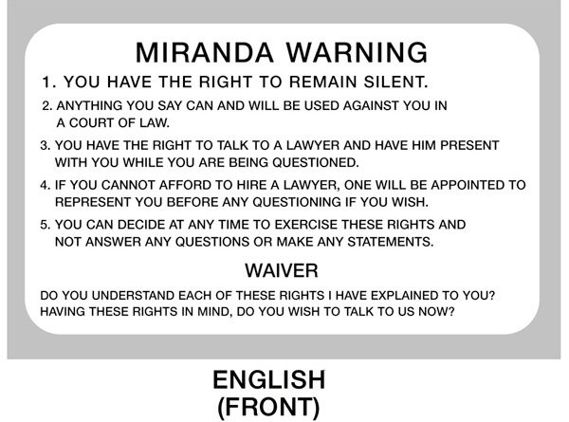
Some important cases 8
Miranda v. Arizona, 1966
“You have the right to remain silent …”
After police questioning, Ernesto Miranda confessed to kidnapping and raping a woman. The Court struck down his conviction, on grounds that he was not informed of his 5th Amendment right against self-incrimination.
Hereafter, the Miranda warnings have been a standard feature of arrest procedures.

Slide 27
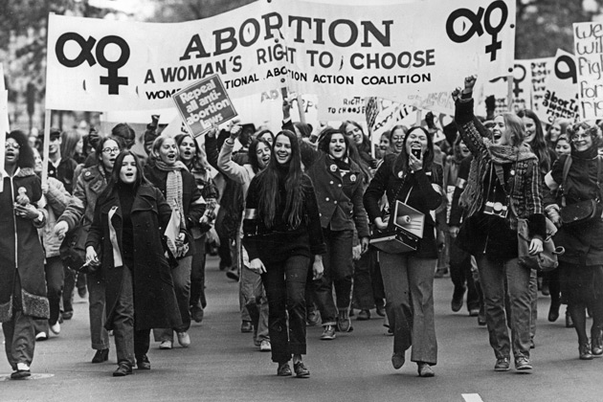
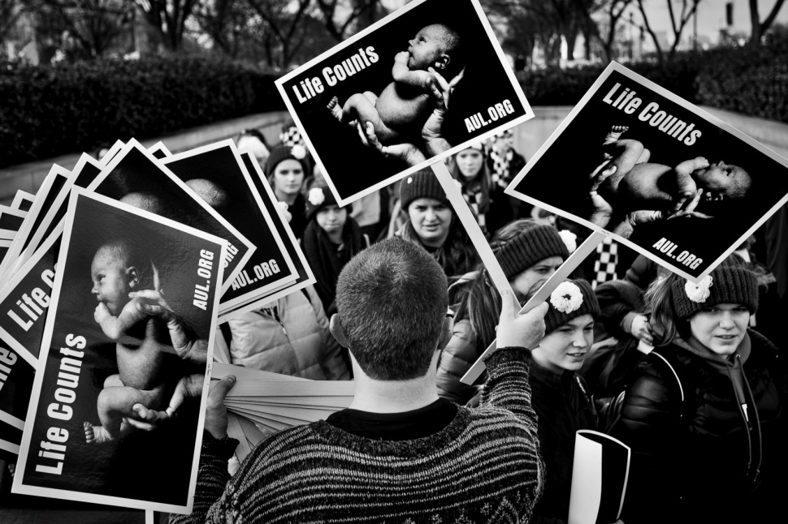
Some important cases 9
Roe v. Wade, 1973
The Constitutionally implied right to privacy protects a woman’s choice in matters of abortion.
Norma McCorvey sought an abortion in Texas, but was denied under state law.
The Court struck down that law, on grounds that it unconstitutionally restricted the woman’s right to choose.
The opinion set forth guidelines for state abortion regulations; states could restrict a woman’s right to choose only in the later stages of the pregnancy.
Later modified but not overruled, the decision stands as one of the Court’s most controversial.

Slide 28
Some important cases 10
United States v. Nixon, 1974
“Neither separation of powers, nor the need for confidentiality can sustain unqualified Presidential immunity from the judicial process.”
President Nixon sought precisely this type of immunity, rather than relinquishing the famous White House tapes during the Watergate scandal.
The Court unanimously rejected his plea as an unconstitutional power play. The House began impeachment proceedings shortly thereafter, and two weeks after the ruling, Nixon resigned.
Texas v. Johnson, 1989
The Constitution protects desecration of the flag as a form of symbolic speech.
Johnson burned a flag in front of a Dallas building in 1984. He was convicted of violating a Texas law that made it a crime to intentionally desecrate a state or national flag. Justice Brennan wrote for a 5-to-4 majority that “Government may not prohibit the expression of an idea because society finds the idea itself offensive or disagreeable.”

Slide 29
Some important cases 11³
Lawrence v. Texas, 2003 (6-3 decision)
Struck down state laws that prohibited sodomy between consenting adults.
Obergefell v. Hodges, 2015 (5-4 decision)
Same-sex marriage is legalized across all 50 states.
³http://www.usatoday.com/story/news/politics/2015/06/26/supreme-court-cases-history/29185891/

Slide 30
Comparisons between the IK and US legal systems 1
The United states inherited the British common law system and in the absence of other State or Federal law this is still used. Some post independence common law cases in the UK are referred to.
There is no written constitution in the UK.
In the US the Supreme Court has the power to declare Federal or State laws to be unconstitutional and therefore void.
In the UK the doctrine of Parliamentary Sovereignty means that no law can be held to be void.
However the UK Supreme Court can hold a law to be incompatible with the European Convention of Human Rights (under the Human Rights Act 1998) which requires the UK government to rectify the situation.
UK lawyers are divided into solicitors and barristers.
Solicitors deal with general legal work and have direct contact with the public. They may argue cases in the lower courts.
Barristers specialise in arguing cases in court and may appear in any court but only see clients via solicitors.

Slide 31
Comparisons between the IK and US legal systems 2
All lawyers are referred to as attorneys though some specialise in litigation
Grand juries for committal proceedings were abolished in the UK in the 19th century but are still in use in the US.
Over 95% of cases are decided by non legal magistrates in Britain whilst in the US all cases are dealt with by professional judges.
Juries are chosen randomly in the UK whilst in the US they are chosen by lawyers.
The US is divided into Federal and state law.
In the UK British parliamentary law is supreme and can override other law in the UK.
However there are different systems of law in Scotland and Northern Ireland.

