Slide 1
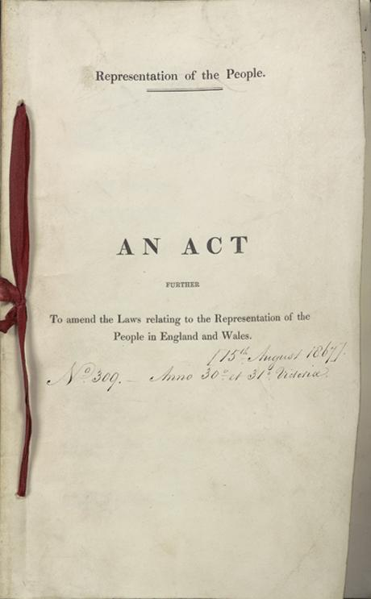
The Second Reform Act By Mike Allen

Slide 2
2 major figures of the period
Lord John Russell
“In person diminutive and rickety, he wriggled round, played with his hat, and seemed unable to dispose of his hands or his feet; his voice was small and thin, but notwithstanding this, a house of five hundred members was hushed to catch his smallest accents. You listened, and you felt that you had heard a man of mind, of thought, and of moral elevation.” Charles Sumners 1838.
Lord Palmerston
Started as a Tory became a Whig and finally presided over the creation of the Liberal party.
In early life he was mainly interested in fashion and was known as a Regency dandy.
He was a womaniser and when he was 78 there was an attempt to extort money from him for alleged adultery.
He was not a great orator but the powerful and effective debater.
He had great energy and worked very long hours.
He had limited interest in reform and after 1830 was mainly interested in foreign affairs. He pursued British interests aggressively and jingoistic and with the use of gunboat diplomacy.

Slide 3
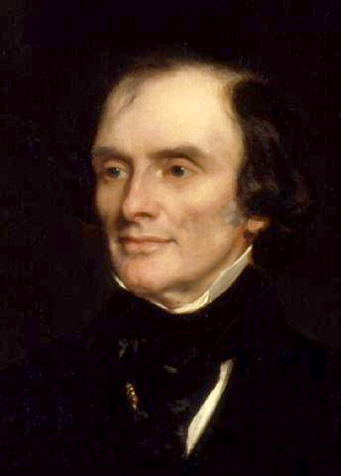
Lord John Russell 1792- 1878¹
In 1812 he became an MP. He was also granted the courtesy title, Lord Russell.
In the House of Commons Russell supported the Whigs and in 1817 he made a passionate speech against the decision by Lord Liverpool and his government to suspend Habeas Corpus. Russell also took an active part in the campaign for parliamentary reform.
For the next twelve years Russell was the leader of the Whig campaign in the House of Commons for parliamentary reform.
When he proposed the motion for an investigation into parliamentary representation in 1822, the motion was defeated by 105 votes.
An attempt by Lord Russell to introduce a bill to reduce bribery at elections also ended in failure
1853
¹ adapted from http://spartacus-educational.com/PRrussell.htm

Slide 4
Lord John Russell 2
In February 1828 he proposed a bill that would repeal the Test and Corporation Acts. Russell was totally opposed to this law under which no Catholic or Protestant Non-conformist could hold public office. Supported by Robert Peel, Lord Palmerston and William Huskisson the bill was passed with a majority of forty-five.
The following year Lord Russell led the successful campaign for the Catholic Relief Bill. As a result of these measures Catholic Emancipation was finally achieved.
After the Duke of Wellington resigned in November 1830, Lord Grey formed a Whig administration and Russell was offered the post of postmaster-general. the government's proposals for changing the electoral system.
Lord Russell introduced the Electoral reform bill in the House of Commons in March 1831. After it was rejected by the House of Lords he reintroduced it on December 1831. As a result of Lord Russell's perseverance the Reform Act was finally passed on 7th June, 1832.
After the general election for the new reformed House of Commons, the Whig government had a majority of 315. Earl Grey and his colleagues were now in a position to try and introduce a series of reforms. Russell was one of the most important figures in this campaign for change. In 1834 he introduced the Dissenters' Marriage Bill and the Irish Tithe Bill.
In November, 1834 Lord Althorp, the leader of the House of Commons, succeeded to the peerage on the death of his father. William IV objected when the post was offered to Lord Russell and took the opportunity to dismiss the Whig government.
Sir Robert Peel was invited by the king to form a Tory government.
After Peel lost a vote on 3rd March, 1835 concerning the Irish Church, he resigned and was replaced by Lord Melbourne as prime minister..

Slide 5
Lord John Russell 3
Lord Russell became the Home Secretary in Melbourne's new Whig government. Russell's first reforming measure concerned the reform of local government. For many years most English towns had been under the control of a self-elected body of aldermen and councillors. Under the terms of the Municipal Corporations Act, these men now had to be elected by the whole body of ratepayers.
In 1836 Lord Russell was responsible for several new reforms including the establishment of the civil registration of births, marriages, and deaths, and the legalisation of the marriage of dissenters in their own chapels.
Lord Russell was able to steer bills establishing reformatories for juvenile offenders and new Irish Poor Law through parliament.
Lord Russell had for a long time been a advocate of reforming the Corn Laws. This eventually became the policy of Lord Melbourne's government. However, when the proposed changes were defeated by thirty-six votes on 18th May, 1841, the government resigned. The following general election resulted in Sir Robert Peel becoming prime minister.

Slide 6
Lord John Russell 4
Although Lord Russell was opposed to most of Peel's policies, he fully supported his plans to reform the Corn Laws. In a speech he made on 22nd November 1845, Russell called for a total repeal of the corn laws. Peel was also coming to the same conclusion and with Whig support, the corn laws were finally abolished on 26th June 1846.
When Sir Robert Peel resigned the following month, Lord Russell was asked to form a new government. Russell immediate problem was to deal with the potato famine in Ireland. Russell attempted to help by allocating £10 million to be spent on public works in Ireland. Russell also vigorously supported John Fielden in his campaign for factory reform. This resulted in the passing of the 1847 Factory Act. The following year he managed to persuade parliament to accept his government's Public Health Act that gave municipalities powers to set up local boards of health.
In December 1851 Lord Russell sacked his foreign minister, Lord Palmerston, after he had recognised the government formed by Napoleon III in France without consulting with his fellow cabinet ministers. Palmerston gained revenge by proposing an amendment to the Militia Bill that was carried by eleven votes. As a result of this defeat Russell resigned and was replaced by the Earl of Derby.
Russell returned to the government when Lord Aberdeen became prime minister in 1852. In December Russell brought before the cabinet a new parliamentary reform bill. Many members of the cabinet, including Lord Palmerston, disagreed with the measure and threatened to resign. Disappointed by the lack of support from his colleagues, Russell decided to leave office. For the next four years Russell concentrated on writing books about his political hero, Charles Fox.

Slide 7
Lord John Russell 5
In 1859 Russell became foreign secretary in Lord Palmerston's government. The following year Russell introduced a new parliamentary reform act into the House of Commons. The bill which included reducing the qualification for the franchise to £10 in the counties to £6 in towns was not supported by Lord Palmerston and did not become law.
In July 1861 he was raised to the peerage as Earl Russell. He continued to hold the office of foreign secretary and when Lord Palmerston died in October, 1865, Russell once again became prime minister. One of his first decisions was to try again to persuade parliament to accept the parliamentary reform proposals that had been rejected in 1860. The majority of the MPs in the House of Commons were still opposed to further reform and after the government was defeated on a vote on 18th June 1866, Earl Russell resigned.
After leaving office Russell continued to attend the House of Lords where he supported and voted for the 1867 Parliamentary Reform Act. He was also one of the main campaigners for the 1870 Education Act. Earl Russell died on 28th May 1878

Slide 8
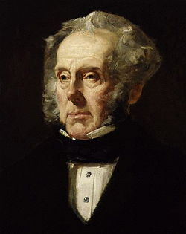
Henry John Temple Lord Palmerston 1784 –1865²
He succeeded to the Irish peerage on his father's death in 1802.
He became an MP in 1807.
He became Secretary of War in 1809 and held the post until 1828 when he resigned.
A dispute between Wellington and Huskisson over the issue of parliamentary representation for Manchester and Birmingham led to the resignation of Huskisson and his allies, including Palmerston.
1855
² http://spartacus-educational.com/PRpalmerston.htm

Slide 9
Lord Palmerston 2
Although he had always been a member of Tory administrations, Lord Palmerston accepted the offer to join Lord Grey and his Whig government in 1830. Palmerston became Secretary of State for Foreign Affairs, and for the next two years was preoccupied with persuading France and Holland to accept that independence of Belgium.
One of the condition of being a member of Lord Grey's government was to support the Whig policy of parliamentary reform. Although Palmerston had previously been opposed to parliamentary reform, he agreed to support Grey's proposed measures. The decision upset his electors at Cambridge University and he was forced to move to Bletchley and when this seat disappeared as a result of the 1832 Reform Act he became the MP for South Hampshire.
Between 1832 and 1852 Lord Palmerston served both Whig (Lord Melbourne, Lord John Russell) and Tory (Sir Robert Peel) governments.
Although Palmerston had the support of most of Parliament, he was strongly disliked by Queen Victoria. Palmerston believed the main objective of the government's foreign policy should be to increase Britain's power in the world. This sometimes involved adopting policies that embarrassed and weakened foreign governments.
Victoria and her husband, Prince Albert, on the other hand, believed that the British government should do what it could to help preserve European royal families against revolutionary groups advocating republicanism.

Slide 10
Lord Palmerston 3
Queen Victoria also objected to Palmerston's sexual behaviour. On one occasion he had attempted to seduce one of Victoria's ladies in waiting. Palmerston entered Lady Dacre's bedroom while staying as Victoria's guest at Windsor Castle. Only Lord Melbourne's intervention saved Palmerston from being removed from office.
In the summer of 1850, Queen Victoria asked Lord John Russell to dismiss Palmerston. Russell told the queen he was unable to do this because Palmerston was very popular in the House of Commons. However, in December 1851, Palmerston congratulated Louis Napoleon Bonaparte on his coup in France. This action upset Russell and other radical members of the Whig party and this time he accepted Victoria's advice and sacked Palmerston. Six weeks later Palmerston took revenge by helping to bring down Lord John Russell's government.
In 1855 Lord Palmerston, aged seventy, became Prime Minister. Queen Victoria found it difficult to work with him but their relationship gradually improved. She later wrote in her journal: "We had, God knows! terrible trouble with him about Foreign Affairs. Still, as Prime Minister he managed affairs at home well, and behaved to me well. But I never liked him."

Slide 11
Lord Palmerston 4
Palmerston first period as Prime Minister lasted for three years. His second period started in 1859 when he was seventy-five years old. The main foreign events that he had to deal with during this period included the American Civil War and Napoleon III's war with Austria. The main domestic issue involved the continuing debate over parliamentary reform.
Palmerston was totally opposed to any extension of the franchise and during 1864 came into conflict with William Gladstone, his Chancellor of the Exchequer, who was a strong supporter of reform. Palmerston won the argument and Gladstone had to wait until he became Prime Minister before he could introduce these measures.
Parliament was dissolved on 6th July 1865. Although nearly eighty-one years old, Palmerston refused to retire and once again was elected to Parliament. However, before he could take up office he became very ill and died on 18th October, 1865.

Slide 12
British Politics 1846-1867 (1)
1846 was a turning point in British politics.
Sir Robert Peel became convinced that repeal of the Corn Laws was a necessity. He secured the passage of the bill with Whig support but the majority of the Conservatives rejected the measure.
After the passage of the repeal of the Corn Laws he was defeated in parliament and resigned.
The Conservatives did not gain an overall majority until 1874.

Slide 13
British Politics 1846-1867 (2)
Lord John Russell became the new Prime Minister of a Whig minority government dependent on Peelite, Radical, and Irish MPs support.
Peel died in 1850 but there was no reconciliation between the Peelites and the Conservatives. Disraeli made several attempts to woo the Peelites but without success.
The 1847 general election saw the Whigs with 325 seats the Conservatives 230 the Peelites about 100 with 36 Irish and three others.
Russell continued in office with Peelites support.
In 1848 the government was defeated on a Private Members Bill to introduce a common franchise. Russell resigned but Lord Derby was unable to form an administration and Russell returned.

Slide 14
British Politics 1846-1867 (3)
In 1851 Lord Palmerston congratulated Louis Napoleon Bonaparte upon his coup d’état without Cabinet approval and was sacked as Foreign Secretary.
In 1852 the government fell over a local versus a national militia. The governments backed the former whilst Palmerston supported the latter.
Disraeli offered Palmerston leadership in the Commons under a Conservative ministry but Palmerston refused over protectionism.
Lord Derby formed a Conservative minority government.
The 1852 budget contained compensation for the impact of the reform of the corn laws. Gladstone attacked it and the government fell.

Slide 15
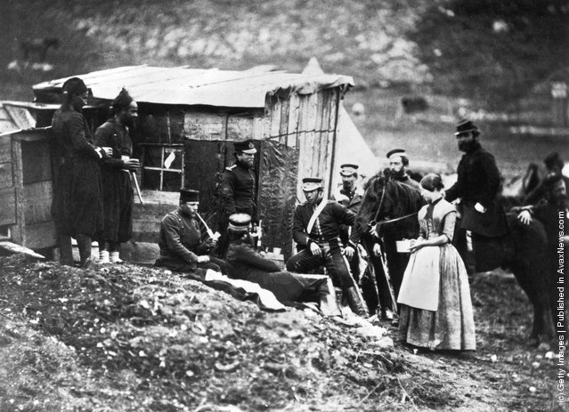
British Politics 1846-1867 (4)
In December 1852 a coalition government under Lord Aberdeen was formed of Whigs Peelites and Radicals. The cabinet consisted of 6 Whigs 6 Peelites and 1 Radical.
The Crimean War in 1854 - 6 was badly mismanaged and promoted public anger.
In 1855 the government fell on a motion to a committee of enquiry into the war.
Derby and Russell failed to form ministries and Palmerston became Prime Minister.
He was defeated in Parliament in 1857 and gained a large majority in the subsequent general election.
Members of the 4th Light Dragoons at camp in the Crimea, circa 1855. (Photo by Roger Fenton)

Slide 16
British Politics 1846-1867 (5)
In 1858 an Italian assassin called Orsini, based in London tried to assassinate Napoleon III.
Palmerston tried to amend the conspiracy law to prevent refugees from plotting assassination but this was defeated and he resigned.
Lord Derby formed a minority Conservative administration which lasted from 1858-9
Disraeli persuaded his colleagues to support a measure of parliamentary reform this was to be based upon a county franchise of £10 and special franchises to give the vote to the upper working class classes with a redistribution of 15 seats. This was defeated in parliament
The Peelites, Whigs and Radicals had a meeting in Willis’s Tea Rooms, St James Street on 6th of June 1859 an agreement was reached to table a motion of no confidence in Derby’s government. The Liberal party dates its foundation from this meeting.
They won the 1859 election and Palmerston became Prime Minister. His supporters became increasingly referred to as Liberals.

Slide 17
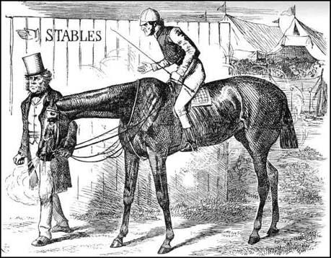
British Politics 1846-1867 (6)
Palmerston was the dominant politician in the late 1850s and up to his death in 1865.
He was a barrier to reform. He had referred to the franchise as “a trust reposed in the voter for the public good” and not a right of every citizen.
In 1852 he wrote “to go sneaking to the ballot box, and, poking in a piece of paper, looking round to see that no one could read it, is a course which is unconstitutional and unworthy of the character of straightforward and honest Englishmen.”
Lord John Russell took the 1832 reform act as final but in 1851 he changed his mind and introduced a bill in 1852. The Whigs and Tories denounced it as going too far and he withdrew it.
He tried again in 1854 but it was withdrawn partly because of Palmerston disapproval, partly because of radical opposition to its mild measure and also because of the outbreak of the Crimean War.
After the failure of the Conservative bill in 1859 Russell introduced a further moderate reform in 1860 but it was criticised from all sides and was unsuccessful.
William Gladstone: "Permit me to explain democracy." Lord Palmerston: "Oh, bother your explanation! You've blown your horse, and you are out of the race." John Tenniel, Punch Magazine, 11th June, 1864

Slide 18
The growing movement for Parliamentary Reform in the 1860’s
Italian unification 1859-60 was interpreted as a popular struggles for freedom and increased agitation
The American Civil War 1862-5 was seen as a test for democracy and northern workers supported the Union despite deprivation in the cotton industry. The union victory saw more calls for democracy.
William Gladstone, May 1864: “every man who is not presumably incapacitated by some consideration of personal unfitness or of political danger, is morally entitled to come within the pale of the constitution. Of course, in giving utterance to such a proposition, I do not recede from the protest I have previously made against sudden, or violent, or excessive or intoxicating change … Hearts should be bound together by a reasonable extension, at fitting times and among selected portions of the people, of every benefit and every privilege than can be justly conferred upon them.”

Slide 19
The growing movement for Parliamentary Reform in the 1860’s 2
The National Reform Union 1864 started in Manchester and branches were established nationwide. It attracted nonconformist clergyman, Progressive Liberal politicians and businessmen.
It wanted
triennial parliaments
the secret ballot
equal distribution of seats
A ratepayer franchise.
The Reform League 1864
This was more radical and was committed to
manhood suffrage
the ballot.
It attracted large numbers of working men including trade unionist and former chartists.
The continuing changes caused by industrialisation was also a factor.

Slide 20
The Electoral position in 1867
Figures differ but around 8% had the right to vote (no females)
Rotten or pocket boroughs still existed.
88 constituencies had less than 4000 electors
Voting was open
Bribery and corruption was endemic.
The South and South West was overrepresented.
Large industrial towns like Manchester were underrepresented.
Very few working class people had the vote.

Slide 21
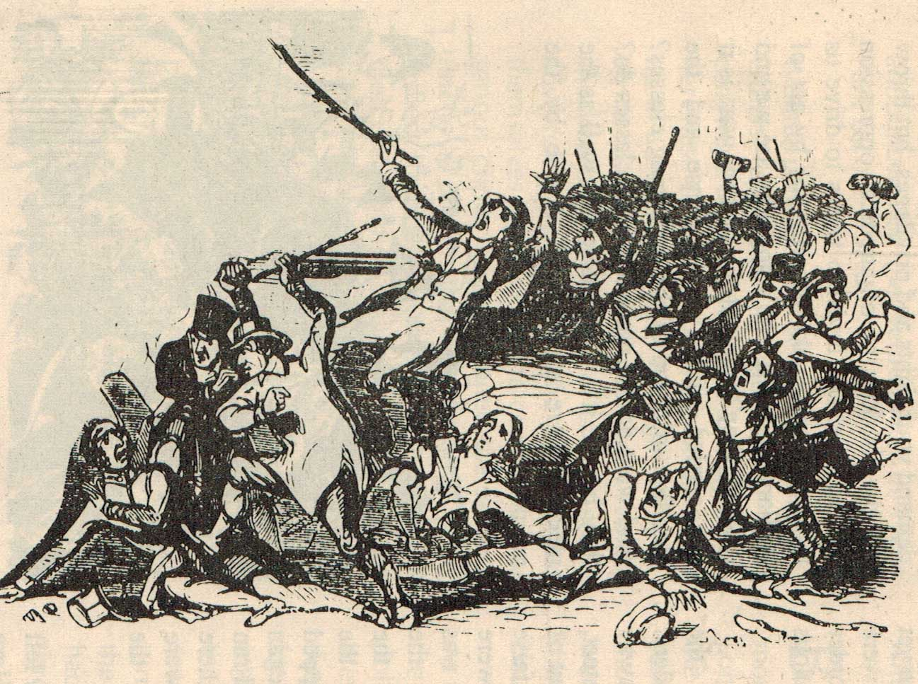
The 1866 Reform Bill
On Palmerston’s death in 1865 Lord Russell became Prime Minister at the age of 74 and introduced a bill to reform the franchise.
Gladstone’s bill sought to enfranchise occupiers of property in the boroughs worth £7 in rent a year, as against the existing £10 qualification, and also those lodgers who rented property worth £10 a year.
The county franchises was to be dropped from £50 to £14.
one in four men would have been able to vote, instead of the existing one in five.
Radicals oppose the bill as being too weak.
Some liberals oppose the bill as going too far. They were known as Adullamites.
Disraeli proposed the details of the bill on technical grounds.
And able to secure a majority for reform Russell resigned.
There were disturbances in Hyde Park in July 1866 and is convinced many that reform was necessary.
Hyde Park riots 1866

Slide 22
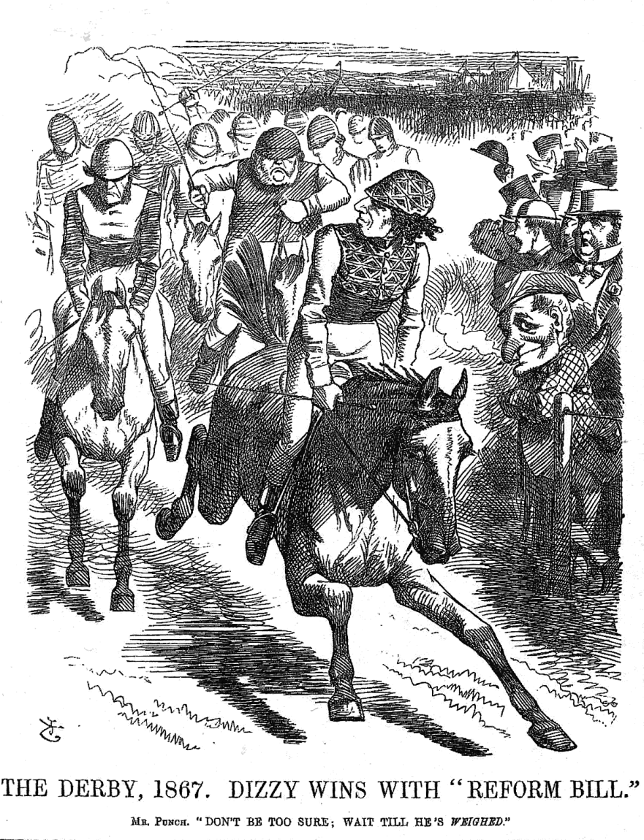
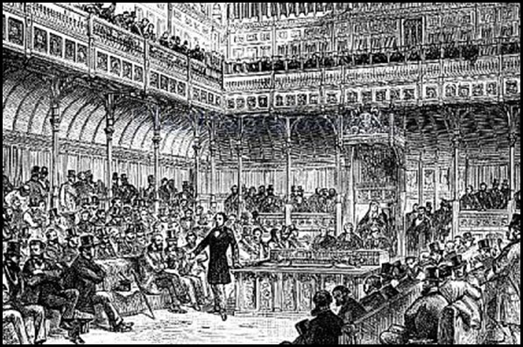
1867 Reform Act 1
Disraeli introducing the 1867 Reform Bill to Parliament
Lord Derby formed a minority Conservative administration in 1866.
He and Disraeli were convinced that electoral reform was necessary in order to show that the Conservatives were not opposed to reform.
Disraeli introduced a bill in 1867 and was very adept and guiding it through Parliament.
He accepted many Liberal amendments and was careful to keep his backbenchers fully informed in contrast to Gladstone in 1866 and the bill was passed and became an act.

Slide 23
1867 Reform Act 2
Suffrage was extended
All borough householders with 12 months' residency and to £10 lodgers.
In the counties it was extended to £5 property owners and £12 occupiers.
Seats were re-allocated again, many to the new towns.
Boroughs with less than 10,000 inhabitants lost one of their MPs. Two hundred and three boroughs existed before the act. Of these, fifty-six boroughs, each with a population of less than two thousand, were completely abolished. Thirty two-member boroughs, each with a population of less than four thousand, lost half their representation.
One extra seat was given to Liverpool, Manchester, Birmingham and Leeds;
Twenty-five seats to counties whose population had increased since 1832. The Act also increased the number of county members.
The Act's enfranchising clauses created 65 county seats and 65 borough seats.
In all, the Act added 1,120,000 voters to the previous 1,400,000. This meant that one in three men could vote, 47% in the boroughs.
It gave the vote to the wealthier working classes in the boroughs but not in the counties.
Overall the number of people over 21 who could vote had increased to about 16% (no women}.

Slide 24
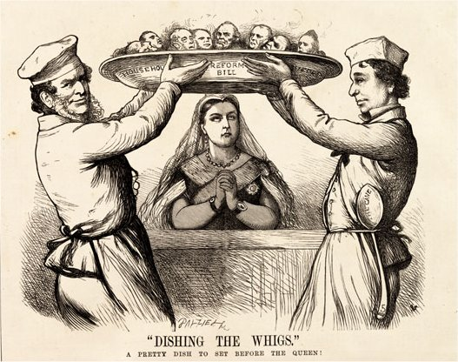

Slide 25
Historians reaction.
The Whig school believes that political changes came about in response to a changing economic and social structure and to pressure from below. Many socialist historians also support this whilst concentrating on the last point.
The smaller Tory school stress the competition between parties in 1866-7 and focus attention on the Disraeli’s political calculations.
Dr Robert Harrison a socialist historian has emphasised the part played by mass agitation, the Hyde Park riot and contemporary fears of revolution in 1867.
However Robert Blake in his biography of Disraeli denied that the agitation in general or the Hyde Park rights in particular influenced Disraeli but rather he saw reform as a means of isolating Gladstone, keeping the Liberal party divided, and consolidating his own leadership in the Commons.

Slide 26
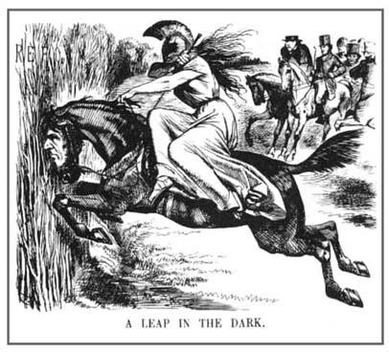
The Leap in the Dark
Benjamin Disraeli, the Times once famously wrote, saw the Conservative voter in the working man just as the sculptor sees “the angel in the marble”.
Many had begun to see a deference to his betters in the working man and thus the Conservatives may have seen the possibility of working class support.
The second reform act did not immediately benefit the Conservatives with the Liberals winning the 1868 election.
They did however return to power with an overall majority in 1874.

Slide 27
The results of the 1867 Reform
It was a further stage in the UK’s journey to democracy, though it is still a property based franchise.
Centres for party loyalty and organisation had been created by the formation of the Carlton Club 1832 and the Reform Club 1836.
Electoral reform associations had been formed in the 1840s and 1850s.
These became constituency party associations in the 1850s and 1860s.
In 1867 the National Union of Conservative and Constitutional Associations was established.
The 1867 act heard is created some 3 seat borough constituencies, but an amendment in the Lords had provided voters with two votes. The Birmingham Liberal caucus organised voters to return three Liberals in 1868.
This was followed by the formation of the National Liberal Federation in 1877.
So the act led to further party organisation outside parliament and greater spending by the parties.
Inside parliament it led to greater party discipline and unity.
Fewer independents were able to get elected.
Bribery and corruption still existed.

