Slide 1
The President and Congress
By
Mike Allen

Slide 2
The president’s role and powers in relation to Congress
He can propose legislation (Article II)
He submits an annual budget. The Office of Management and Budget draws this up.
He signs legislation.
He can veto legislation. This can be overcome by a two thirds majority in both houses but is rarely achieved (about 10% of vetoes are overcome).
He nominates officials which have to be confirmed by the Senate.
He nominates all Federal Judges
Supreme Court
Federal Trial (district)
Appeal (circuit courts)
All judges are appointed for life. These have to be confirmed by the Senate.
Senate approval of Treaties.
Senate approval of Declarations of War.

Slide 3
Source: A2 US Government & Politics Anthony J Bennett Philip Allan; 3rd edition 2009

Slide 4
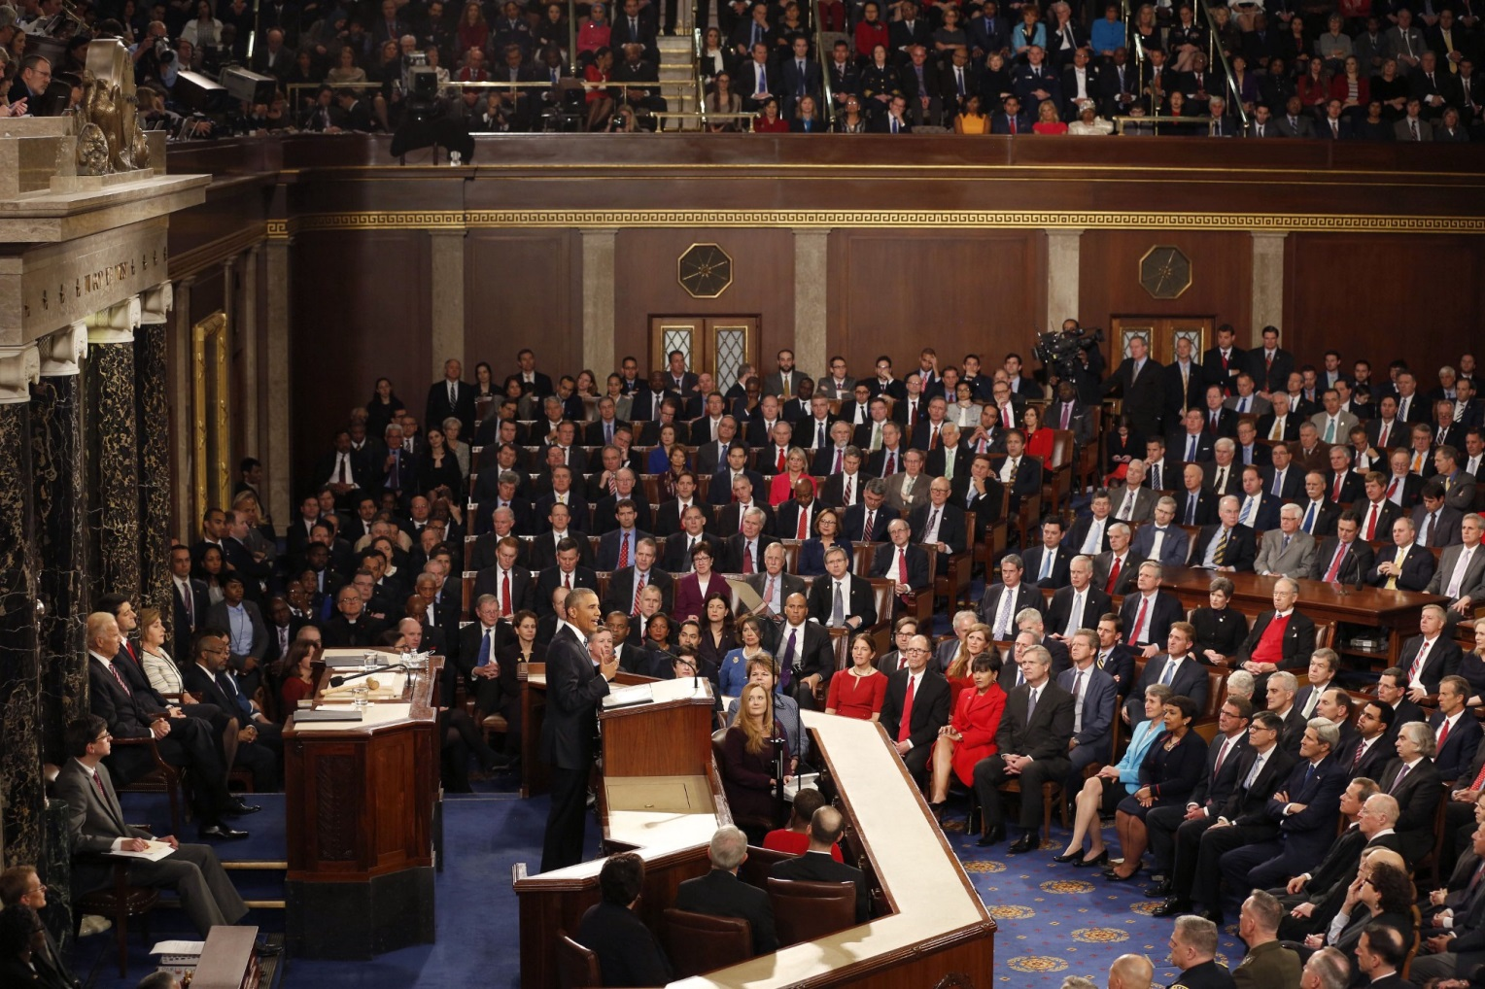
The President’s role as chief legislator¹
The State of the Union Address
It is expected that the legislative agenda for the Federal government will be set by the President. As the only person elected by the whole nation, the President is expected to present a programme for government that meets the nation’s needs

Slide 5
The President’s role as chief legislator continued
The State of the Union Message, an address to both houses of Congress, which takes place around 20 January.
The President identifies the key issues the administration believes need to be addressed and outlines the bills the White House will send to Congress to resolve these issues.
On the first Monday in February, the President’s budget is delivered to the House of Representatives. In contrast to the UK it contains both taxation and spending.
¹Adapted from US Government and Politics William Storey 2007 Edinburgh University Press p295

Slide 6
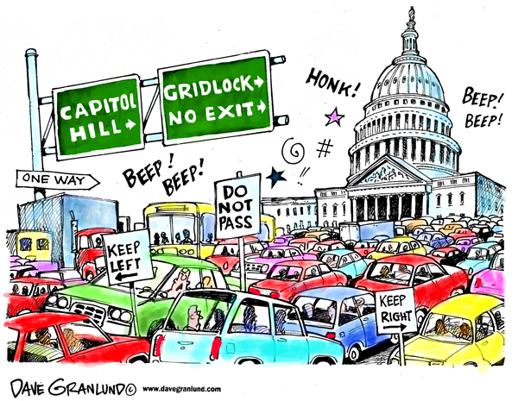
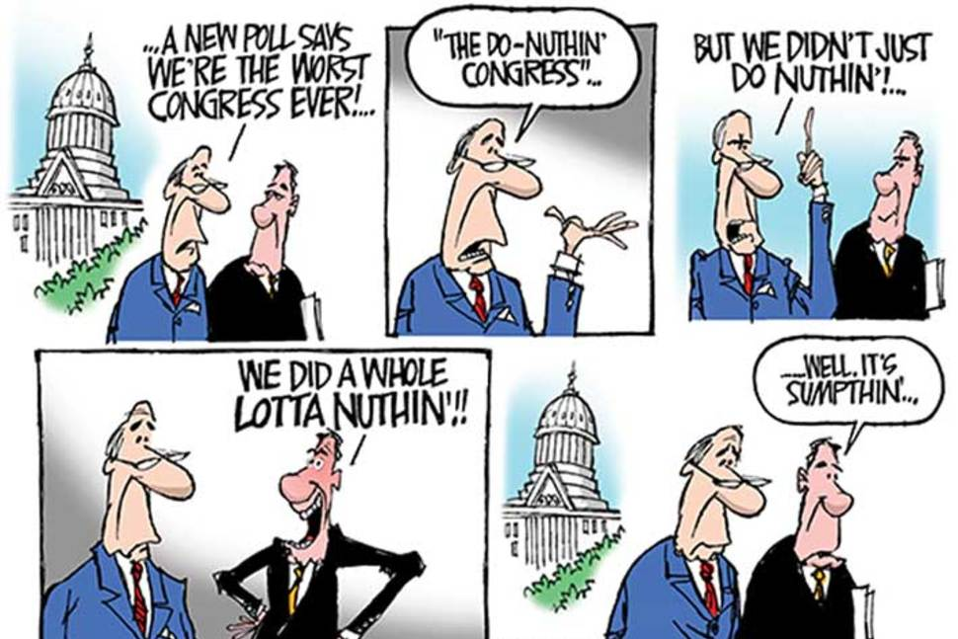
Composition of Congress
Either one or both House may be controlled by a different party to the President. Even if they are from the same party it does not guarantee success for the President e.g. President Clintons healthcare reforms 1993-4.
Congressmen are responding to a different electorate.
Representatives are elected every 2 years and are concerned with parochial issues.
Two thirds of Senators are not elected at the same time as the president and most serve for longer time spans so they may not have the same concerns as the President.
This can lead to inaction and gridlock e.g. President Obama 2010-16.
Even if it does not lead to gridlock Congress can and does amend legislation, sometimes so much that the President no longer supports the bill.

Slide 7
Amendments by Congress²
Unacceptable modifications come in two forms.
Congress may delete key provisions that weaken the bill to such an extent that it will not be able to fulfil its purpose even if it passes.
Members of Congress may also add provisions to the bill, known as ‘riders’ or ‘earmarks’, which benefit their districts.
This can lead to presidential initiatives becoming ‘Christmas tree’ bills, covered with presents for the constituents of the most influential members of Congress at huge expense to the taxpayer.
² Adapted from US Government and Politics William Storey 2007 Edinburgh University Press p296

Slide 8
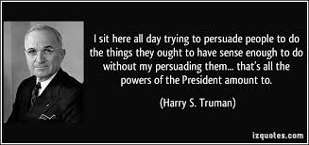
Presidential persuasion 1³
Little happens by presidential command, most action is the result of persuasion.
“Presidential Power is the power to persuade.” Richard Neustadt 1960.
The President cannot do all of it himself, he uses other people:-
The Vice President
The Office of Legislative Affairs – full time lobbyists who meet with members of Congress and their senior staff.
Cabinet Officers in their policy areas. E.g. G W Bush used Education Secretary Rod Page in 2001 on educational reform and in 2002 Secretary of State Colin Powell to persuade Congress to use troops in Iraq.
Party leadership in Congress – the House Speaker, majority and minority leaders in both Houses, the party whips, and committee chairs and ranking (most senior) minority members.
³Adapted from A2 US Government & Politics Anthony J Bennett Philip Allan; 3rd edition 2009

Slide 9
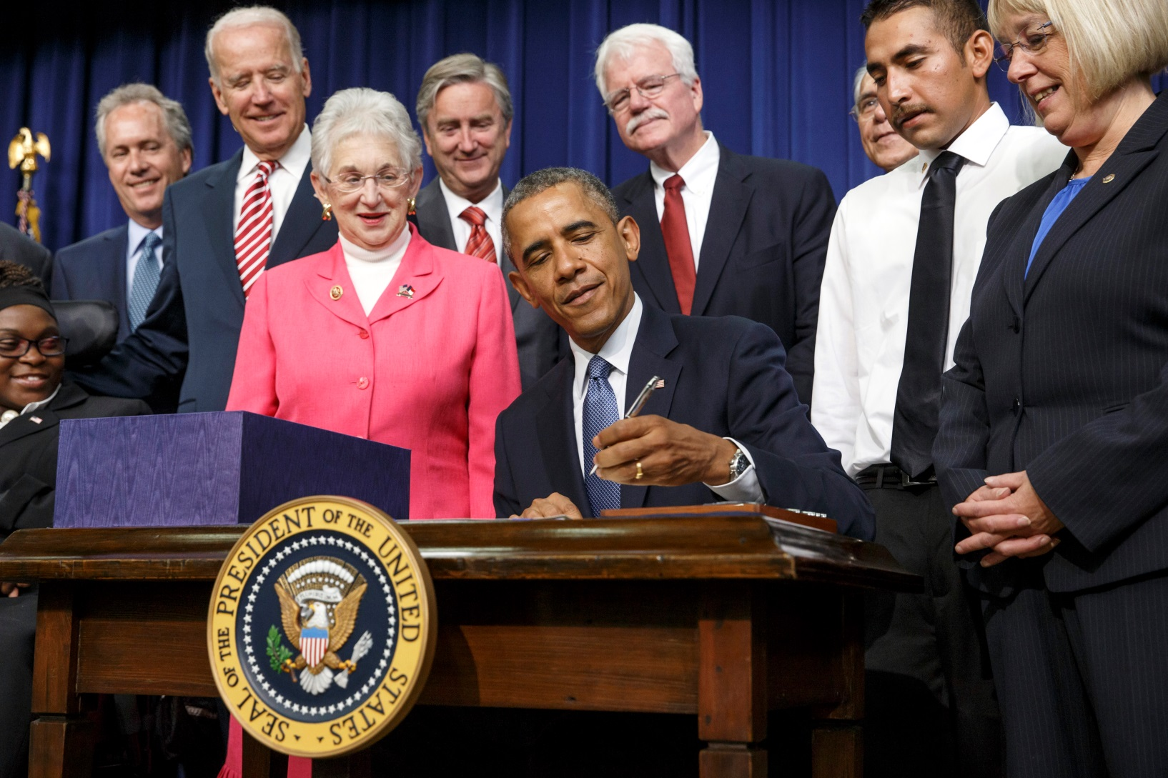
Bill signing
President Barack Obama, joined by Vice President Joe Biden, members of Congress, and invited guests, signs the Workforce Innovation and Opportunity Act, which aims to help job seekers gain valuable employment skills, at the Eisenhower Executive Office Building in the White House complex in Washington, Tuesday, July 22, 2014. He is flanked by Sen. Patty Murray, D-Wash., at far right, Rep. Virginia Foxx, R-N.C., left, with Rep. George Miller, D-Calif., looking over the president’s shoulder at center right. (AP Photo/J. Scott Applewhite)

Slide 10
Presidential persuasion 2
Bargaining skills are essential for the President. – “Bargainer in chief” David Merrin 1993 e.g the presidential phone call.
The presidential job of persuasion is now more difficult than in the 50’s or 60’s.
Increased levels of party discipline
Less likely that the President and Congress are from the same party
Members of Congress are more aware of constituents wishes with the development of the Internet.
More outsiders are becoming President who thus know less about Congress and have few personal contacts. E.g. Carter, Reagan, Clinton and Trump.

Slide 11
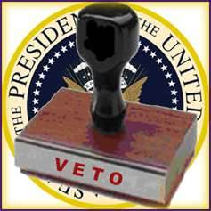
The power of veto 1 ⁴
Part of the negotiation process is the threat that the President will use his constitutional power to veto an entire bill if it no longer meets his key requirements.
This is quite a powerful weapon, as Congress will be reluctant to force a veto.
As it takes a two-thirds majority of both houses of Congress to override a presidential veto, only rarely is Congress able to gather sufficient votes to force through legislation that does not have the President’s support.
⁴ Adapted from US Government and Politics William Storey 2007 Edinburgh University Press

Slide 12
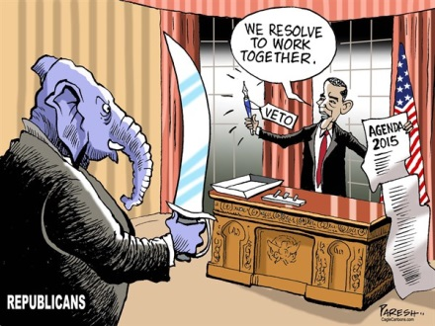
The power of veto 2
On the other hand, the veto is a blunt weapon, eliminating the benefits of a bill as well as its disadvantages.
In the past, Presidents have had the means of ignoring those parts of bills of which they disapproved.
It used to be possible for Presidents to impound (not spend) money for any programme Congress had funded but which the President did not support. This power was removed by the Congressional Budget and Impoundment Control Act (1974).
It also became possible for the President to veto only those parts of a bill with which he disagreed, a line-item veto, as a result of an act passed in 1994. In 1996 however, the power to veto only parts of a bill was declared unconstitutional by the Supreme Court on the grounds that it effectively gave the President the power to draft legislation, which breaches the constitutional principle of separation of powers.

Slide 13
The power of veto 3
Executive Orders
In one respect, however, Presidents have considerable freedom of legislative manoeuvre. Once a law is passed, Presidents have the power to issue rules and regulations that clarify the law or aid its implementation.
The precise limits of this power are difficult to establish. The desegregation of the US armed forces in 1948, for example, was made by Executive Order 9981.
However, when the same President, Harry S. Truman, placed all of the nation’s steel producers under Federal control during the Korean War, in Executive Order 10340, he was overruled by the Supreme Court in Youngstown Sheet & Tube Co. v. Sawyer (1952), on the grounds that this amounted to creating new legislation.

Slide 14
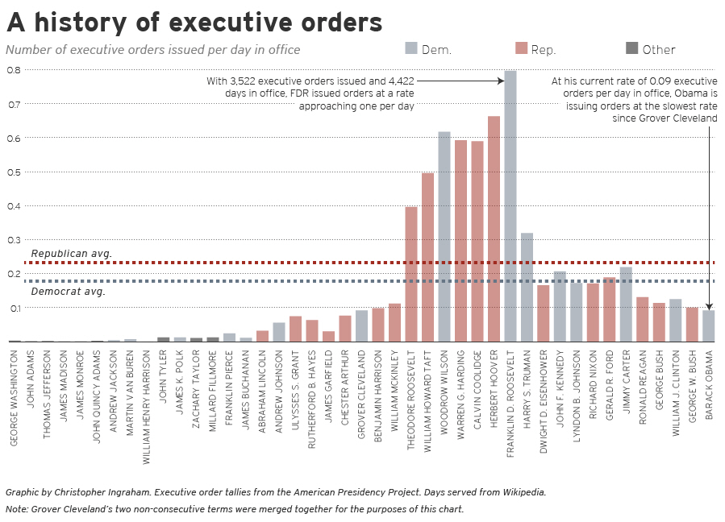

Slide 15
Conclusion
The relationship between President and Congress varies according to the disposition and abilities of the President.
It also varies according to the party composition of Congress and to the degree of policy difference between the president and the other party.
No President has the power of a British Prime Minister to get legislation through Parliament. It is very rare for a government bill to be defeated or withdrawn due to opposition.
This happens frequently for bills proposed by the President in the US. It has been calculated that a successful president can get two thirds of his legislation through whilst an unsuccessful president gets about one third of his legislation approved. President Obama may have been even less successful since 2010.
Congress remains a substantial check on the President as the framers of the constitution intended.

