Slide 1
The Humours of an Election
is a series of four oil paintings and later engravings by William Hogarth that illustrate the election of a member of parliament in Oxfordshire in 1754.
The oil paintings were created in 1755.
The first three paintings, An Election Entertainment, Canvassing for Votes and The Polling, demonstrate the corruption endemic in parliamentary elections in the 18th century, before the Great Reform Act.
The last painting, Chairing the Member, shows the celebrations of the victorious Tory candidates and their supporters.

Slide 2
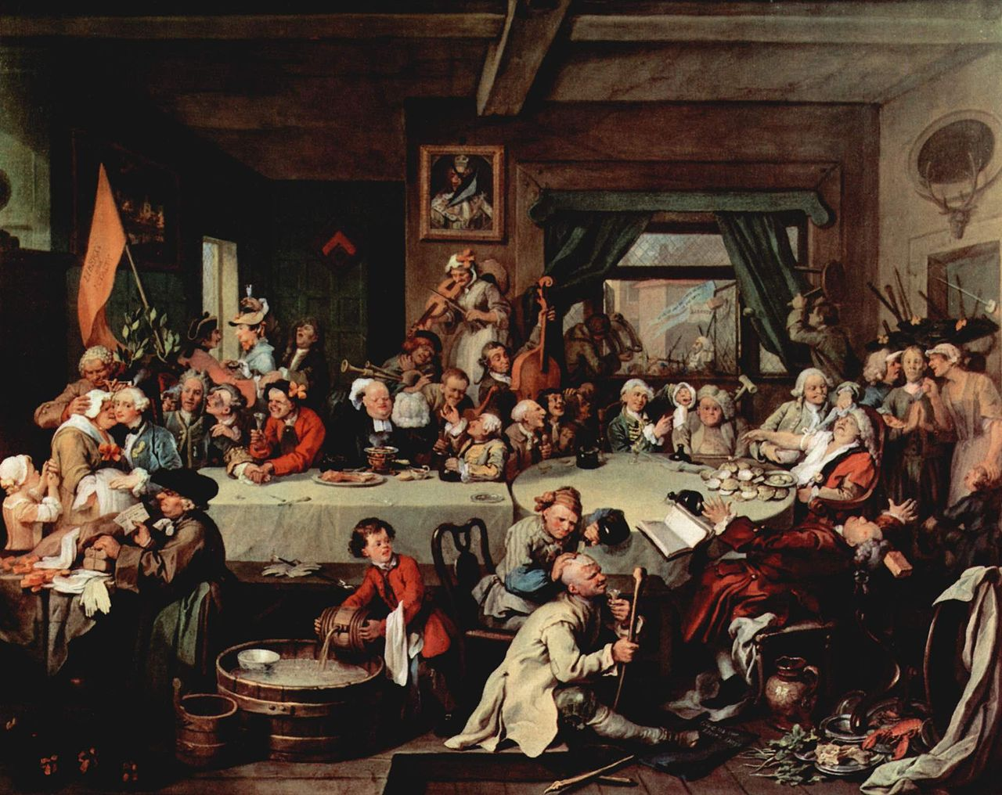
An Election Entertainment
The painting depicts a tavern dinner organised by the Whig candidates, while the Tories protest outside.
A banner containing the words "Give us our Eleven days", a protest against the adoption of the Gregorian calendar, which was carried by the Tories, is on the tavern floor.
In the tavern the two Whig candidates are ingratiating themselves with supporters. One candidate is kissing an ugly pregnant woman; the other is listening to a drunken bore. At the other end of the table the Mayor is collapsing from over indulgence in oysters, while the Election Agent is knocked out by a brick thrown through the window by the Tory mob. Other supporters throw furniture at the Tories.
The composition of the scene parodies traditional images of the Last Supper and other Biblical feasts.

Slide 3
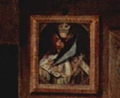
Picture of King William probably damaged in a Tory “treat”
A pot boy mixing punch in a large tub
One of the 2 candidates with a somewhat pained expression suffering the embraces of a fat old women.
The man behind is smoking a pipe and has set light to the candidates wig.
While the candidate is occupied a young girl examines his ring probably in order to steal it

Slide 4
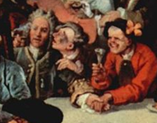
The other candidate is enduring the attentions of 2 drunks
The candidates are distinguished with laurels attached to their chairs and the orange banner with LIBERTY AND LOYALTY behind them

Slide 5
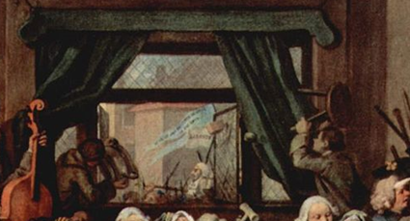
In the street outside the Tory party is holding a procession and some of their supporters are hurling bricks at the opposing party.
One man fends these off with a stool while another empties the contents of a chamber pot over the Tories.
The Tories also carry an effigy labelled “No Jews”.

Slide 6
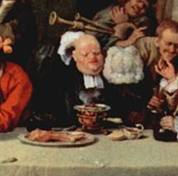
A gross parson seems to be the only man still eating. The heat from the chafing dish in front of him makes him sweat and he has taken his wig off to mop his bald head .

Slide 7
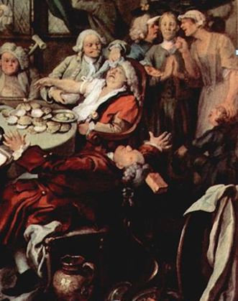
The mayor is about to be bled by a barber-surgeon; he has collapsed following a surfeit of oysters.
Behind him stands a man who is refusing a bribe, with his hands folded as if in prayer, although his wife urges him to take it while his son is pointing out he needs new shoes.
The election Agent has been hit by a brick.

Slide 8
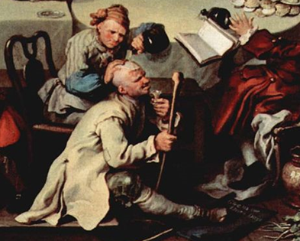
A man has been injured in a fight with the Tories. He has captured one of their banners inscribed “Give us our/Eleven Days”
This refers to the adoption of the Gregorian calendar in 1752.

Slide 9
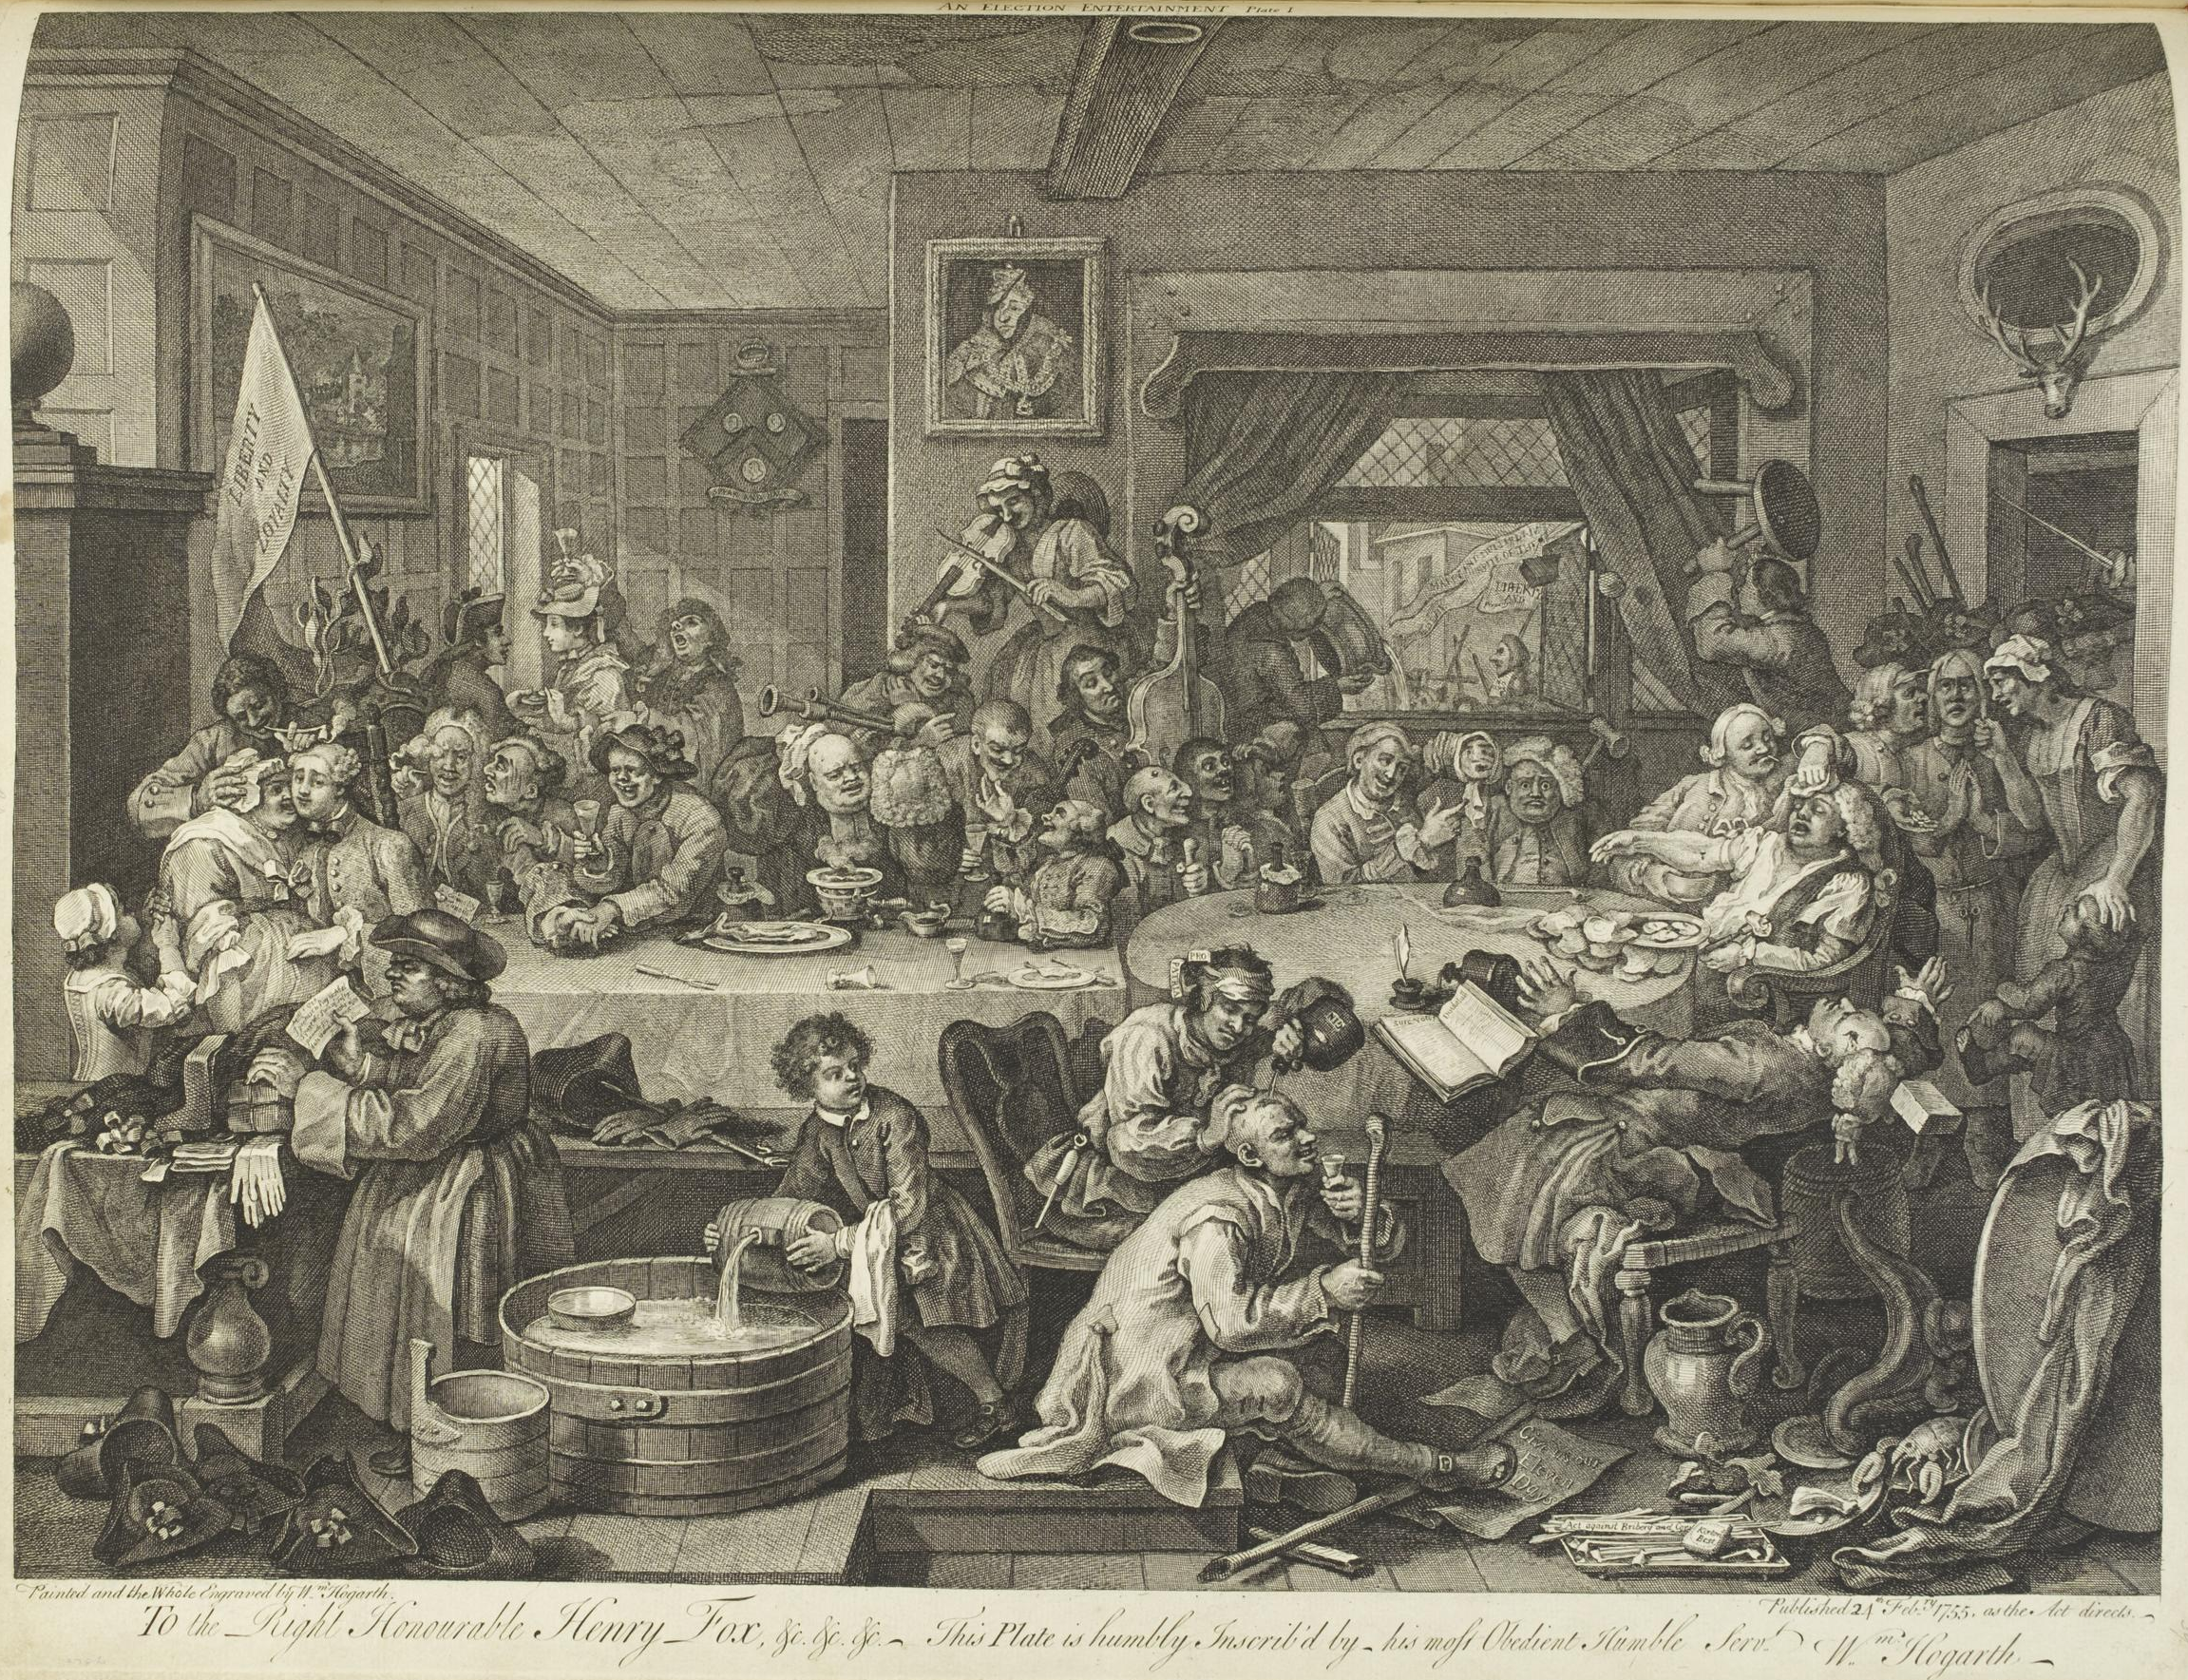

Slide 10
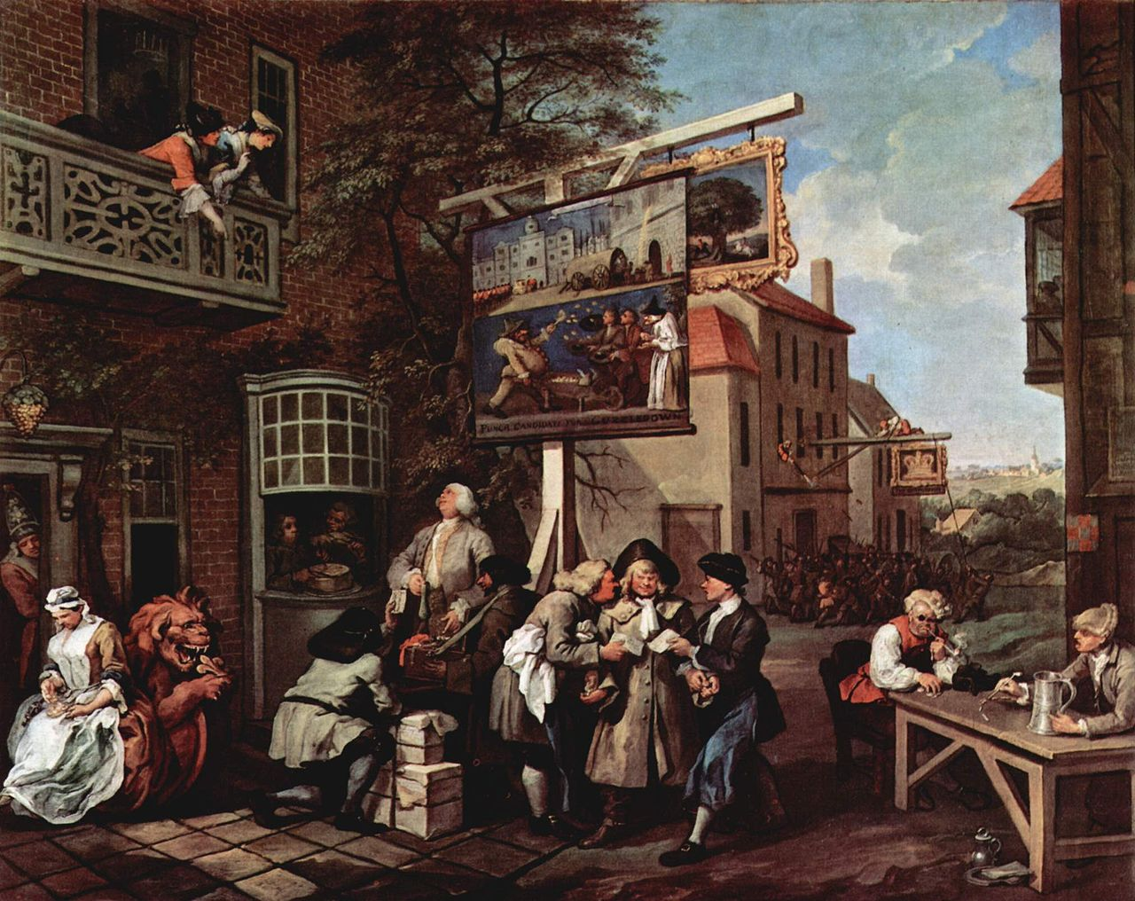
Canvassing for Votes

Slide 11
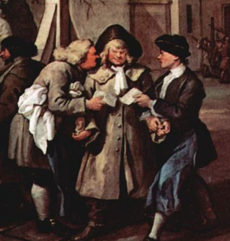
The stout young countryman is being bribed by the landlords of both these establishments acting as agents for the rival parties. Each is placing coins in one hand and proffering in an invitation. He slyly looks to see which offer is larger and seems to favour the bribe of the Royal Oak.

Slide 12
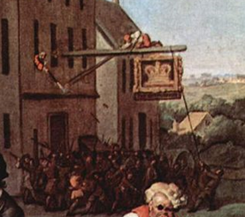
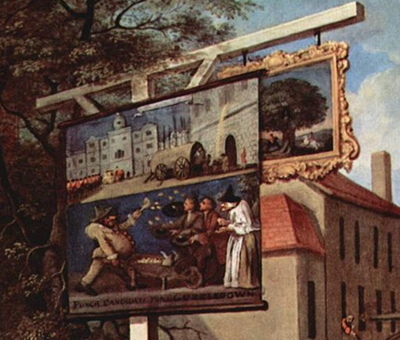
The Crown is being used for a Whig “treat”. The crowd outside the tavern is protesting about government taxation.
The yard of the Royal Oak is being used to stage an anti government play or puppet show and its sign partially obscures the pub sign.

Slide 13
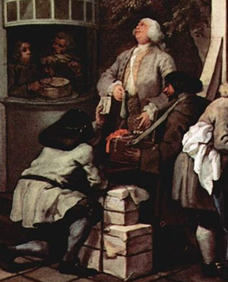
A kneeling man is trying to deliver handbills for the play. However the agent is buying gifts for the ladies on the balcony from the Jewish pedlar.

Slide 14
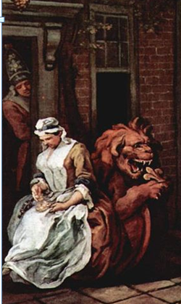
The landlady is seated by the door Royal Oak counting the money they have made from treats held at the Inn.
A soldier eyes the money enviously from the doorway.
Her seat is the figurehead of a ship showing the British lion eating a French fleur de lys. Britain and France were at war at the time.

Slide 15
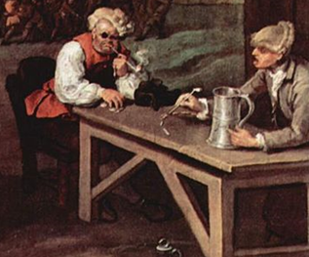
At the Portobello Inn a barber with a basin and a cobbler are enjoying a drink and smoke. They are recalling how Admiral Vernon captured Portobello in 1739 with only six ships. The Barbara uses pieces of clay pipe to explain the plan of the battle.

Slide 16
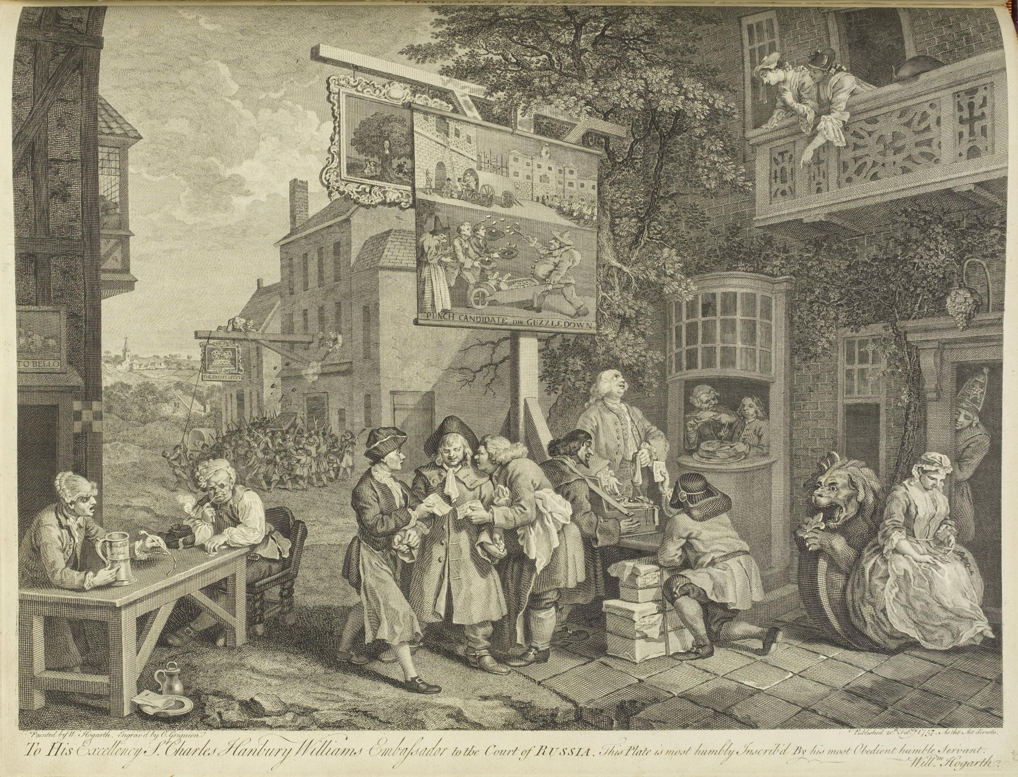

Slide 17
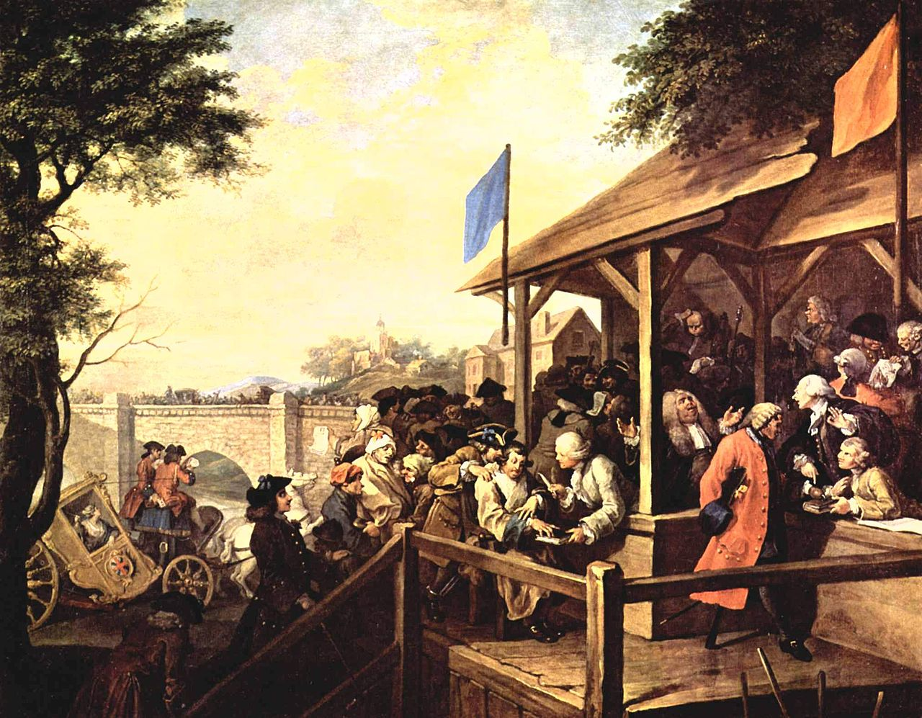
The Polling
Voters are shown declaring their support for the Whigs (orange) or Tories (blue). Agents from both sides are using unscrupulous tactics to increase their votes or challenge opposing voters. A Whig voter with a hook instead of his amputated hand is being challenged because he is placing his hook, rather than his hand, as legally prescribed, on the book.
Meanwhile, the Tories are bringing a mentally disabled man to vote. A dying man is being carried in behind him. In the background a woman in a carriage with a broken axle stands for Britannia. Her coachmen are gambling, ignoring the fact that the carriage is broken.

Slide 18
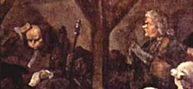
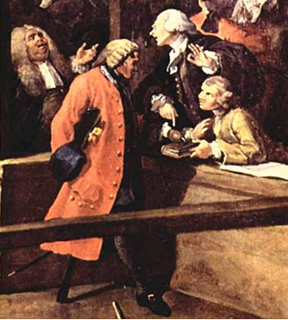
The two candidates can be seen seated on highchairs at the back of the booth. One seems calm and satisfied leaning on his cane, the other is worried by the way the election is going and mops his brow.
Between then the constable has fallen asleep clutching his staff of office.
The voter is a soldier who has lost both hands and one leg in the service of his country. He has no hand to lay on the Bible in order to take the oath. One lawyer is suggesting he is therefore disenfranchised, which is being disputed by the other lawyer who feels his hook is a suitable substitute

Slide 19
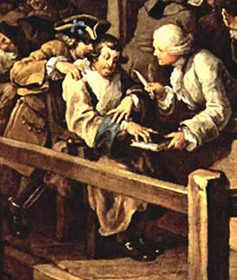
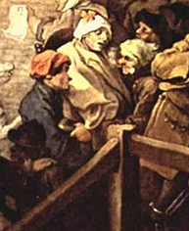

The next voter is a mentally disabled person who seemed unlikely to comprehend the issues involved. He is prompted loudly by the man who has carried his chair to the polling booth. This man wears fetters on his legs and has presumably escaped from prison
Behind is a grey faced man wrapped in a blanket who seemed close to death but has nonetheless been bought out to record his vote
On the stone bridge in the background is a scene of chaos as those arriving to vote meet those were leaving, and it seems that fighting has broken out. This may refer to a recent incident.

Slide 20
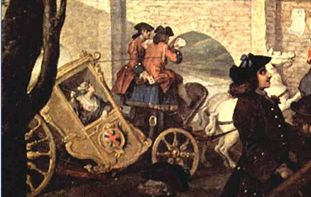
The sense of a nation being failed by its political leaders is made even more explicit in the polling than it was in the previous scene. On the left Britannia’s coach with the union flag of England and Scotland painted on the door, has just broken down and the horses are plunging about wildly; a reference perhaps the wild stallions of rule in house of Hanover.
The coachman, allegorical representations of the country’s leaders, seem not to care and do not respond to the attempts of the female passenger to gain their attention. They are engrossed in a game of cards at which one seems to be cheating.
Hogarth suggests that those entrusted with the welfare of Britannia are deaf to her needs and pursue only their own corrupt pleasures and interests.

Slide 21
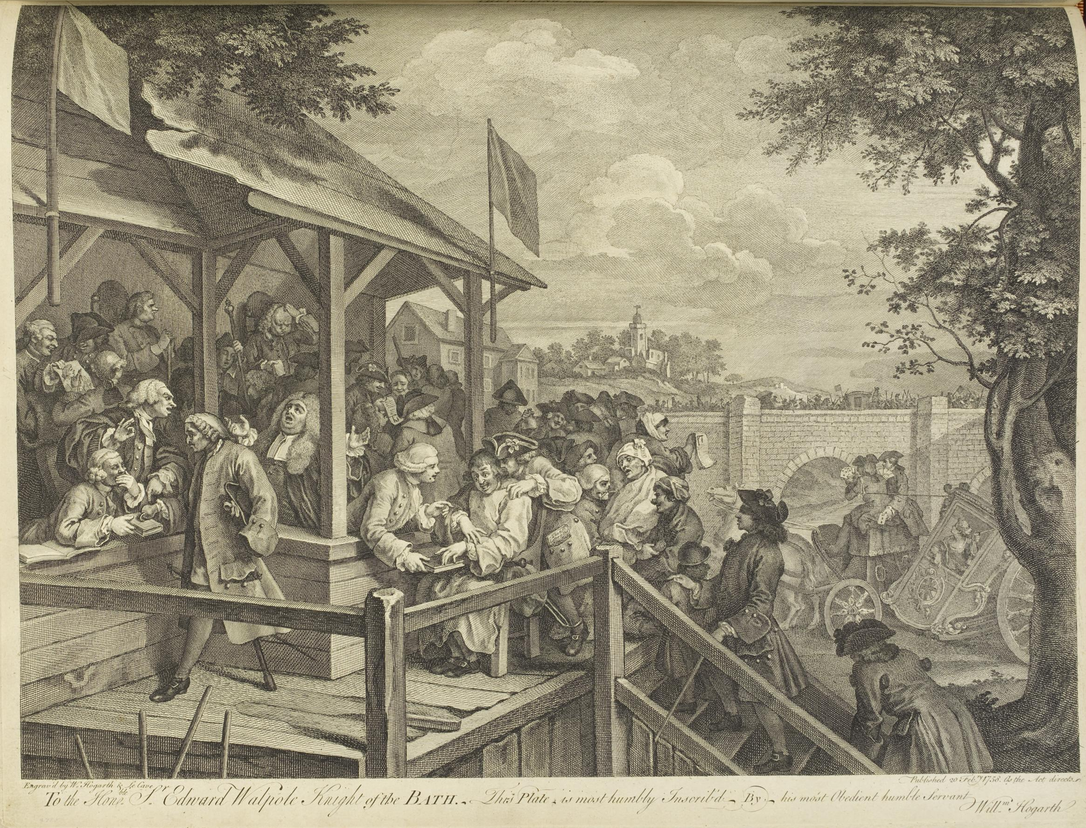

Slide 22
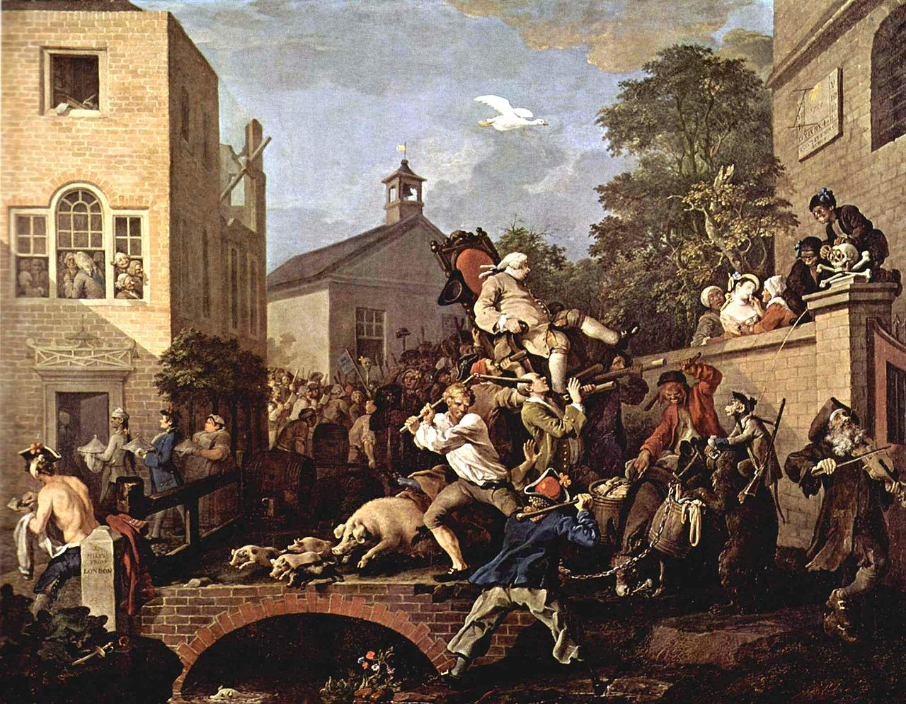
Chairing the Member
One of the victorious Tory candidates is being carried through the streets on a chair in a traditional ceremony. He is about to tumble down because one of his carriers has just been accidentally hit on the head by a flail carried by a Tory-supporting rural labourer who is attempting to fight off a Whig supporter (an old sailor with a bear).
A group of frightened pigs run across the scene in a reference to the story of the gadarene swine. The Whig leaders watch from a nearby house. At the right two young chimney sweeps urinate on the bear.

Slide 23
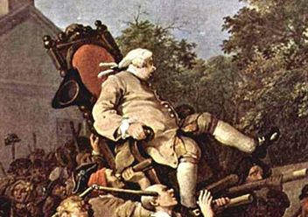
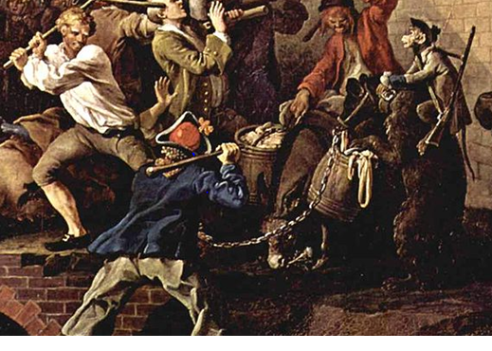
This shows one of the successful Tory candidate being carried or chaired through the streets in triumph. He leans back in alarm as he suddenly comes face-to-face with a skull and cross bones decorating one of the gate posts the churchyard.
In the foreground a one legged sailor and a rustic are fighting fiercely and the latter has swung his flail back so wildly that he has hit one of the bearers carrying the chair; he is about to collapse and precipitate the new member of Parliament on the ground.
The sailors performing bear takes advantage of his masters inattention and investigates the barrels of offal on the back of a donkey.

Slide 24
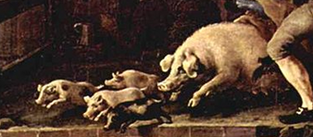
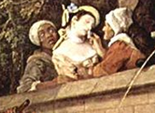
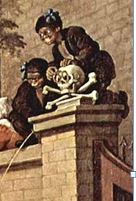
A charging sow and her litter cause even more confusion as they rushed towards the stream, an allusion to the madness of the Gadarene swine, which drowned themselves, possessed by Demons cast out by Christ.
Behind the churchyard wall well-dressed young girl is overcome by the confusion and is being tended by an old woman helped by a black lady.
Two chimney sweeps are urinating on the bear. This is a reference to the battle on Magdalen Bridge in the previous painting where the fighting was only stopped when a Captain Turton shot dead a Tory chimney sweep

Slide 25
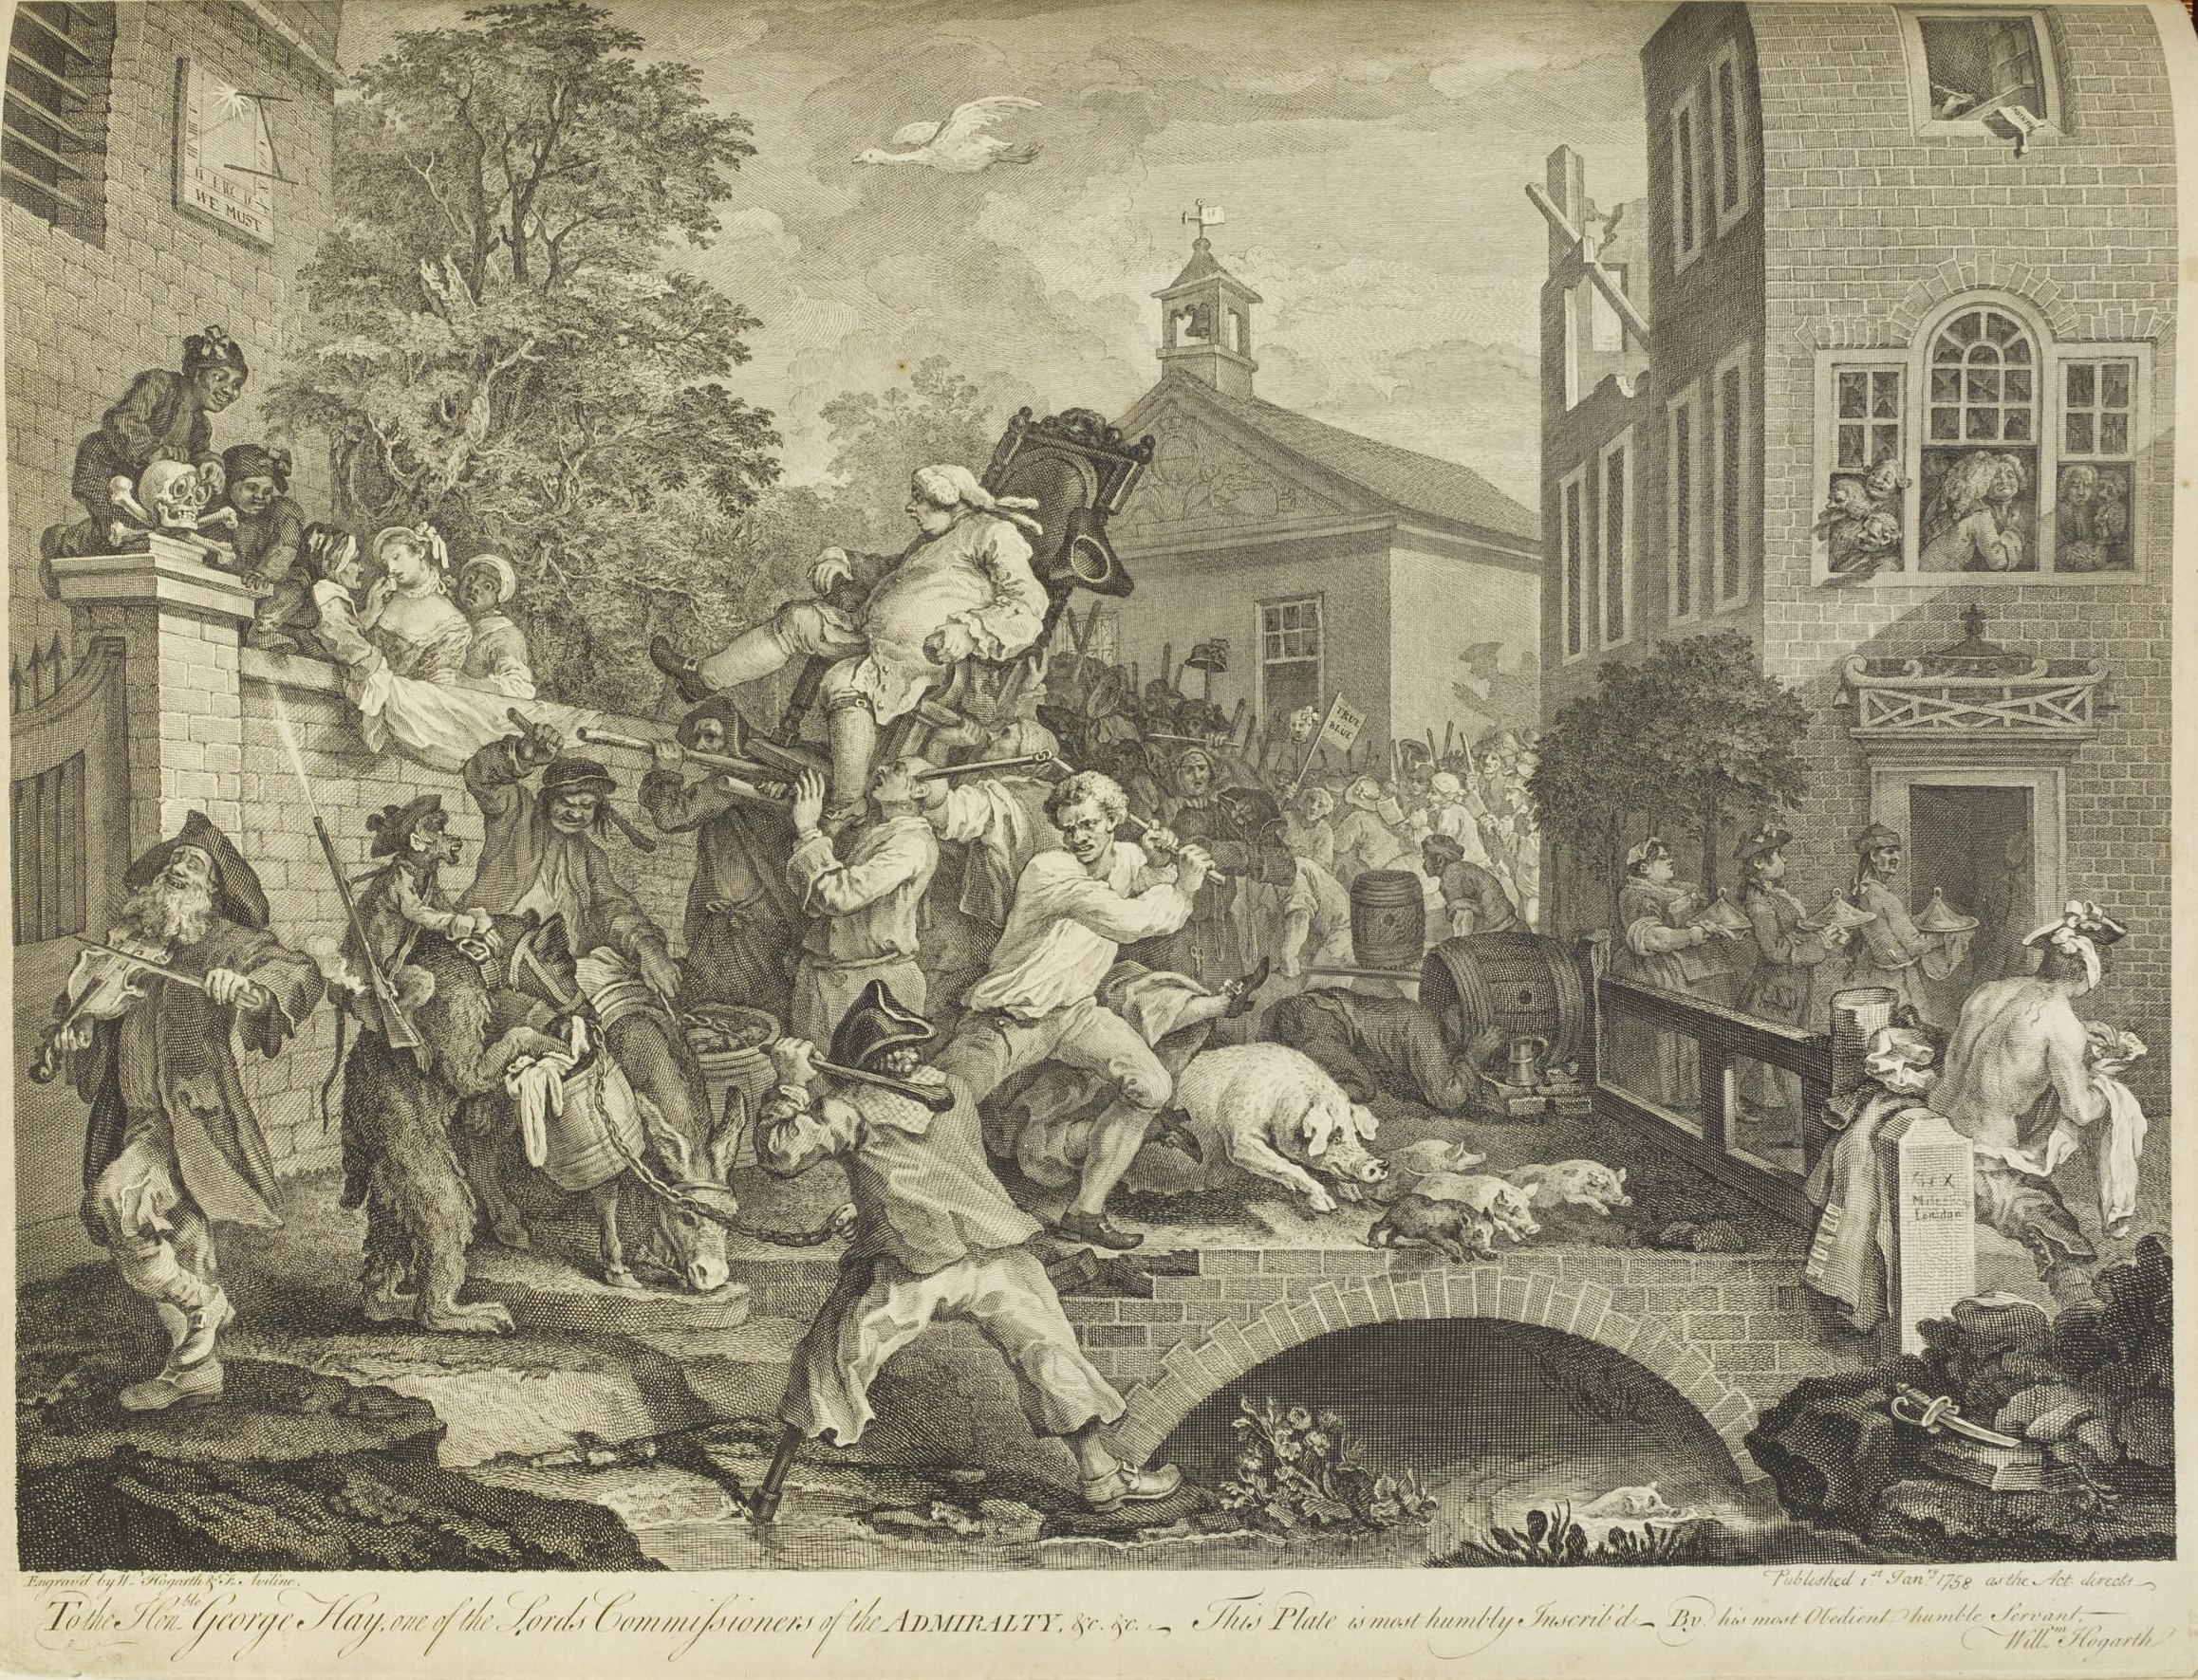

Slide 26
Conclusion
In fact there was no triumphal procession in Oxford in 1754 as the Tory victory was immediately challenged by the Whigs who made allegations of dubious voter qualifications. Eventually the Sheriff of Oxford took the unusual and technically illegal step of recent returning all four candidates as MPs, leaving Parliament to decide. It was no surprise given the wind dominance of the house, but the Whigs candidates were duly elected.
Descriptions adapted from The Soane Hogarths Christina Scull Libanus Press 1991.

