Slide 1
The History of Democracy Early origins to Medieval England
By
Mike Allen

Slide 2
Direct Democracy 1
The term democracy comes originally from Ancient Greece and it means rule of the people.
It is from the ancient Greek “demos” - common people and “kratos” - rule.
Athens a Greek city state practised a form of direct democracy from the 5th century BC.
It is known as the cradle of democracy.
However democracy may have existed before.
Notes:
“It comes from the Greek!” My Fat Greek Wedding.

Slide 3
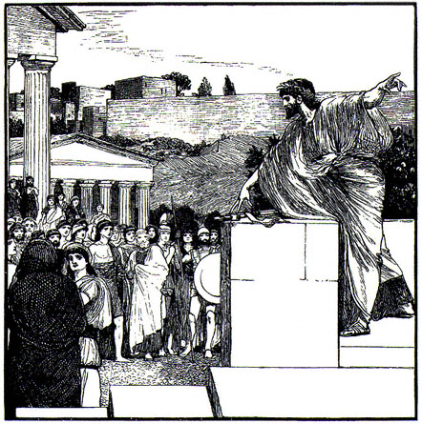
Direct Democracy 2
All the citizens of the state took all the major decisions of the state in large meetings.
Thus democracy was associated with the direct participation of the whole population by discussion and voting on all major decisions.

Slide 4
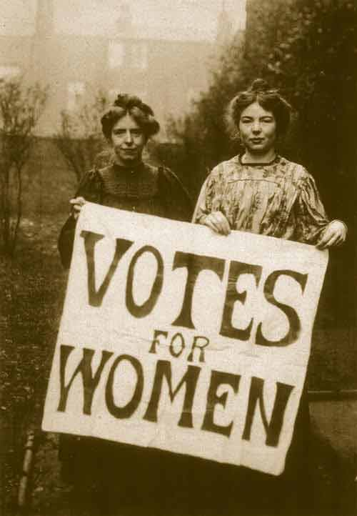
Direct Democracy 3
In practice in Athens only adult males were regarded as citizens, slaves, women, and foreigners were excluded.
Some officials were also chosen to carry out functions on behalf of the state.

Slide 5
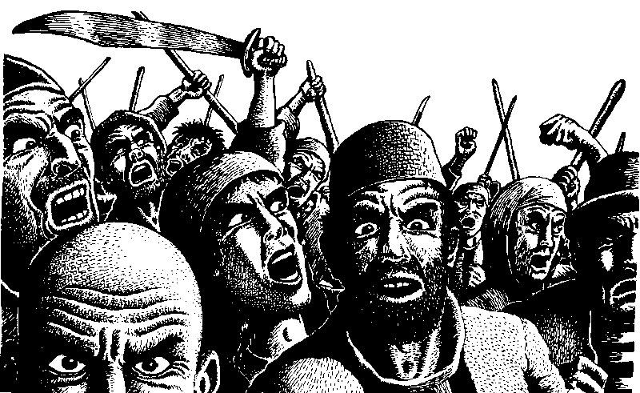
Direct Democracy 4
Direct democracy fell into disuse and was regarded with disfavour as it was associated with mob rule. It survives in modern times in the form of referendums (see later).

Slide 6
Indirect democracy or Representative democracy 1
Democracy was practiced in a different form in later societies. Indirect democracy or Representative democracy is the idea that the people elect deputies to act on their behalf and to take decisions for them.
An elected deputy can be regarded in 2 ways:-

Slide 7
Indirect democracy or Representative democracy 2
A delegate
This is an elected person who may only act according to the instruction of his or her electors. If anything new comes up s/he must refer back to his/her electors for fresh instructions. The idea of the delegate is still in use, particularly in the Trade Unions.

Slide 8
Indirect democracy or Representative democracy 3
A representative
This is an elected person who has freedom of action to take decisions on behalf of his/her electors. Normally there is some sort of re-election process so that the representative is responsible or accountable to the people for his/her actions.
Notes:
Your representative owes you, not his industry only, but his judgment; and he betrays instead of serving you if he sacrifices it to your opinion.
Edmund Burke

Slide 9
Indirect democracy or Representative democracy 4
In practice the distinction is somewhat blurred because it may not be practical for a delegate to refer back to his/her electors and in those circumstances will use his/her initiative thus acting as a representative.

Slide 10
Indirect democracy or Representative democracy 5
Similarly MPs tend to think of themselves as representatives, but as elected party candidates are expected to support the party in Parliament, especially on Party Manifesto policies .
Thus they are acting as national party delegates though they do not always follow the party line.

Slide 11
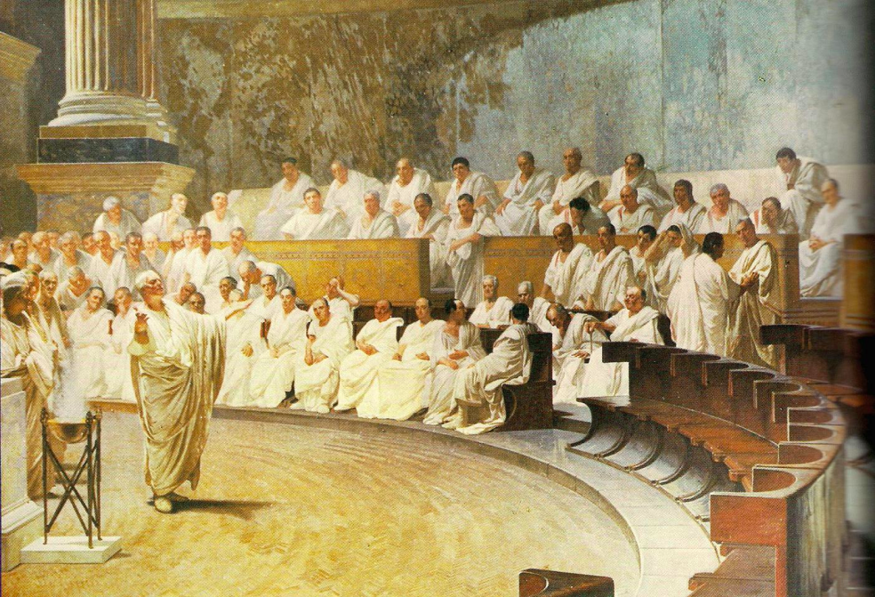
The Roman Republic 1
Slides 11-23 - Adapted from http://www.historyworld.net/wrldhis/PlainTextHistories.asp?historyid=ac42
The Roman republic is a good example. Early in the 5th century the citizens of Rome, by a programme of passive disobedience, won the right to elect their own officials - the tribunes. Two centuries later, in 287 BC, the decisions of the people's assembly are technically given the status of law. But in this oligarchic society, the votes of the people are mainly important as an expression of the power of their elected tribunes - who themselves become key figures within the oligarchy.

Slide 12
The Roman Republic 2
The votes of the Roman people, or plebs, are registered not individually but as the decision of a tribe. Every Roman citizen was a member of a tribe (he was allotted to one, if not a citizen by birth). By the 3rd century BC the number of tribes grows to thirty-five, as more are added to enrol an urban population of new citizens.
Until 139 BC citizens vote orally, giving their answer to a teller. Thereafter they mark a tablet and place it in an urn, constituting a secret ballot. When each tribe's returns have been counted, the result is taken to the magistrate as a single vote.

Slide 13
The Roman Republic 3
It is the beginning of the kind of voting system needed in any democracy larger than an ancient Greek city (similar methods are now used for elections in many representative democracies).
But the change from republic to empire, in the 1st century BC, brings a temporary end to such developments.
Julius Caesar was assassinated in 44BC and his grandnephew and adopted son, Octavius (later called Caesar Augustus) wins the civil war and was the first Roman Emperor.
Roman citizens are subsequently appeased with bread and circuses rather than votes.

Slide 14
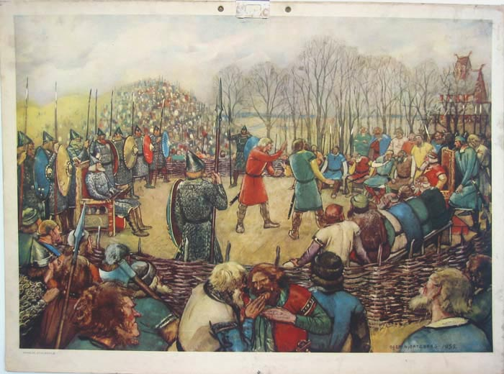
The Scandinavian thing: from the 8th century
In the extreme north, in Scandinavia, there is an interesting example of a kind of a democracy more common among very small and primitive communities. It takes place in a thing.
A thing is a meeting of all the free men of a community (several communities coming together for a joint meeting on larger issues constitute an all-thing).
The ancient tradition of the thing is echoed today in the names of the parliaments of Iceland (Althing), Norway (Storting) and Denmark (Folketing).

Slide 15
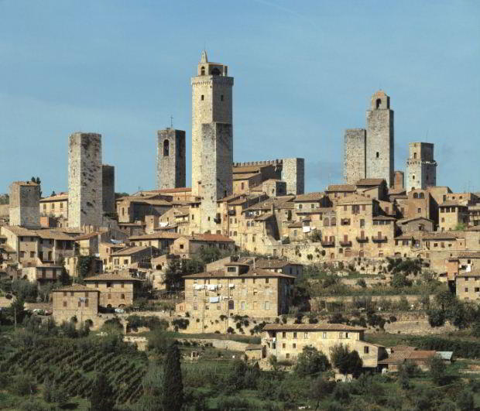
Communes in Italy: 11th - 13th century 1
The period from the 11th to the 13th century sees a steady rise in prosperity in the cities of Europe. One of the first regions to prosper is northern Italy.
Between about 1080 and 1140 many of the towns of northern Italy (among them Pisa, Siena, Florence, Bologna, Milan and Genoa) acquire municipal councils in which the elected councillors call themselves consuls - in a deliberate echo of Italy's republican past.
The defensive towers of San Gimignano

Slide 16
Communes in Italy: 11th - 13th century 2
As these republican communes grow in wealth, and assert control over large tracts of the surrounding countryside, they become in effect independent.
In the early years of these Italian communes every male citizen can participate in an assembly known as the arengo. But this glimmer of democracy is soon extinguished in favour of oligarchy. Electoral power in the communes becomes increasingly restricted to members of a few families.
This process in its turn leads towards authority in each city being placed in the hands of one man.

Slide 17
Communes in Italy: 11th - 13th century 3
During the last three decades of the 12th century nearly all the north Italian communes appoint a mayor or podestà to run the city's affairs.
The podestà is usually a nobleman from another district, who arrives with his own household and administrative staff. His appointment is for a fixed term, rarely more than a year.
During the second half of the 13th century the podestágives way to the signore.

Slide 18
Communes in Italy: 11th - 13th century 4
In commune after commune, from the late 13th century, the local oligarchs accept a powerful leader as their signore and subsequently allow the post to remain with a family. The Visconti of Milan are an early example. Matteo Visconti is signore from 1287 to 1322 and the post is declared hereditary in 1349. Florence remains technically a republican commune for very much longer; the Medici only become hereditary dukes in 1532.
In this way the near-democracy of the early Italian communes reverts gradually to princely rule. The one exception is the earliest commune of them all. The self-perpetuating oligarchy of Venice preserves power in the hands of the local grandees until the 18th century.

Slide 19
Parliament: 12th - 14th century 1
The idea of parliament, a place for speaking (from the French parler) begins to evolve from the 12th century in the monarchies of western Europe. It develops from the curia regis, or 'council of the king', the feudal court in which the monarch makes legal judgements and discusses important issues of state with the most powerful bishops and nobles of his kingdom.
A parliament is summoned whenever the king requires it. At a period when a monarch is almost permanently on the move to maintain his authority, a parliament will be held wherever the royal court may happen to be.
The crucial step in the evolution of the curia regis into parliament is the inclusion of citizens representing the wealthy towns of the period. They are the third estate, added to the two already familiar in royal councils - the nobles and the bishops.

Slide 20
Parliament: 12th - 14th century 2
The burghers of the towns become involved because rulers increasingly need their support (almost invariably of a financial kind). Spain provides one of the earliest examples of representatives of the towns being summoned to a king's council. They take part in a parliament in Léon in 1188.
England is often referred to as the 'mother of parliaments' (a phrase coined by John Bright in 1865). It is a valid claim in some senses, such as the length of the unbroken parliamentary tradition in England. And Westminster is the first parliament to assert its independence of the monarch, in the person of Charles I. But the British cannot claim any priority in historical precedence.
Parliaments are held fairly frequently in England from 1246. By that time the Spanish Cortes ('courts') are well established as parliaments in Léon, Castile and Catalonia. In Portugal a Cortesis summoned in 1211, and commoners are included as the third estate from 1254.

Slide 21
Parliament: 12th - 14th century 3
France is the first kingdom to establish parliament on a permanent basis. In the mid-13th century Louis IX grants the parlement a chamber in his palace on the Ile de la Cité in Paris, where the councillors gather for sessions four times a year.
But the name of the room, the chambre aux plaids ('pleading chamber'), reflects the fact that this French parliament is restricted to the legal work of the broader curia regis. All the councillors are jurists, trained in law. The Palais de Justice stands today on the same site.
The French parlement acquires an element of political power in the early 14th century, when it is given the task of registering the king's edicts. The ability to withhold or delay registration eventually brings the parlement into direct opposition with Louis XIV in the 17th century.
In England parliament develops into a vehicle for the political expression of the community's views. In France this function is fulfilled by a different form of occasional assembly - that of the estates general.

Slide 22
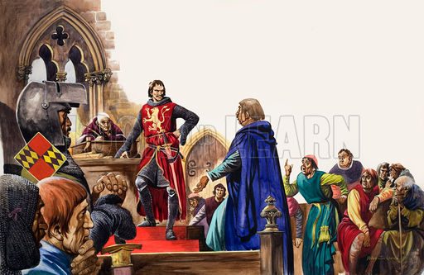
Two famous English parliaments:1265-1295 1
When Simon de Montfort summons his parliament in Westminster Hall in 1265, he knows that he has relatively little support among the nobility (in the event only five earls and eighteen barons attend). Hoping to involve other sections of the community in his cause, he invites to Westminster two knights from each county, and two burgesses from each borough.
This is not a representative assembly, since any known opponents of Montfort are excluded. But something closer to representation evolves in some of the many parliaments summoned between 1275 and 1307 by Edward I.
Notes:
Conflict with Henry III

Slide 23
Two famous English parliaments:1265-1295 2
Edward summons parliaments when he feels he needs them, and for whatever reasons the particular moment demands. To some of these assemblies (approximately one in seven, and usually when he has pressing needs for funds) he invites people of lesser rank than the magnates of nobility and church. Knights are summoned from the shires and citizens from the towns.
These men are genuinely representatives of their community. The king insists that they come with full delegated authority so that any agreement made in parliament (in particular a commitment to provide money) will be honoured by their county or borough. They are the origin of the Commons (or commoners) who eventually become the more powerful of the two houses of parliament.

Slide 24
Two famous English parliaments:1265-1295 3
The parliament summoned by Edward in 1295 later comes to seem the most significant of his reign, because it prefigures a future pattern - as its subsequent name, the Model Parliament, implies.
This assembly in Westminster Hall represents the nation in a very real sense. The magnates are present in force (the two archbishops, all the bishops, 67 abbots, 8 earls, 41 barons) but they sit with elected representatives of the parish clergy (2 from each diocese) and of each shire (2 knights), city (2 citizens) and borough (2 burgesses). The underlying purpose is to raise money for the king, but that will be true of many subsequent parliaments. Meanwhile a valid pattern of representation has almost accidentally fallen into place.

Slide 25
Parliament in the 14th century
Parliament has been divided into two houses since 1341, with knights and burgesses sitting in what became known as the House of Commons while clergy and nobility sat in the House of Lords.
In 1376 the first Speaker of the House of Commons is appointed to represent the Commons permanently.

Slide 26
Parliament 14th – 16th centuries
Initially the Commons is quite subservient to the king but gradually Parliament and particularly the Commons begins to gain more power, especially by establishing the principle that they need to approve new taxation.
They extract concessions from the King in return for new taxation.
This is not however a simple progression and they are ups and downs in the power relationship.
The monarch is in a more dominant position under the Tudors.

Slide 27
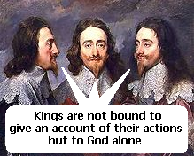
Parliament in the 17th century
Charles I believed in the Divine Right of Kings and tried to rule without Parliament.
Problems with Scotland and war in Ireland caused Charles to recall parliament but conflict ensued and in 1642 Charles declared war against Parliament. He was defeated and beheaded.
Oliver Cromwell established the Protectorate but after his death in 1658 Charles II was made king in 1660.

Slide 28
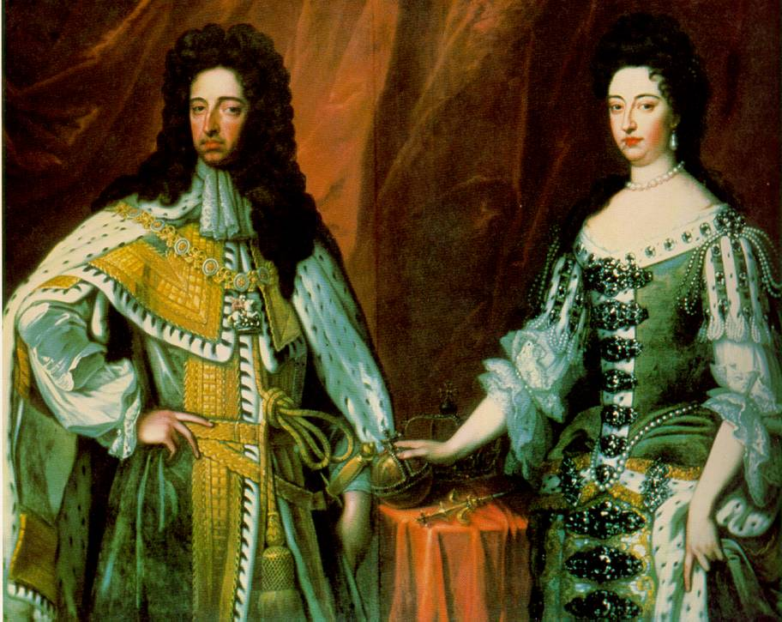
Parliament 17th – 19th centuries
His successor James II was Catholic and was overthrown by William and Mary in 1688 who became joint king and queen.
They accepted the Bill of Rights of 1689 which guaranteed the rights of Parliament.
Anne succeeded William but died childless and was succeeded by a cousin the Elector of Hanover who became George I in 1715.
George I appointed Robert Walpole who is now seen as the first prime Minister.
By the end of the 18th century/early 19th century under William Pitt the cabinet had become a collective body responsible to parliament.

Slide 29
The Franchise
How representatives were selected in medieval times is shrouded with obscurity and there is a good deal of speculation in even authoritive texts. In some cases the Lord Lieutenants in the counties nominated themselves.
Originally the knights of the shire meant the lesser nobility but this seems to have evolved into landowners who were not Lords (peers).
Quite a lot of people voted in early county elections and there is even evidence of some women voting.
There was a feeling that too many “lesser” people were voting and in 1430 legislation was passed limiting the vote to the 40 shilling freeholder.
This remained in place until the reform Act of 1832. Inflation meant more people were able to vote and freeholder was interpreted quite liberally.
The boroughs were left to their own devices and a variety of franchises emerged.

