Slide 1
The Congress of Vienna
By Mike Allen

Slide 2
Objectives ¹
At the end of the Napoleonic Wars the fate of Europe was settled by the coalition powers Russia, Prussia, Austria and Great Britain. France under Louis XVIIIth was allowed to attend.
Objectives
To preserve the balance of power and avoid war. Powerful buffer states were erected around France
To reward the allies and punish France and its allies.
The restoration of rulers and states on the principle of legitimacy.
The allies recognised that the conditions before the French Revolution could not be recreated and a compromise was reached between restoration and practicality.
¹ Adapted from Mastering Modern European History by Stuart T. Miller.

Slide 3
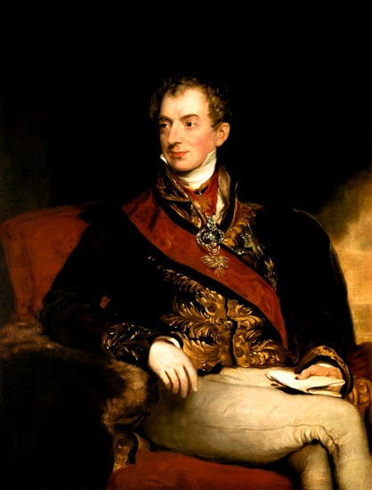
Outstanding personalities in the Congress: Prince Metternich of Austria
The congress included all the European states except Turkey. Even France, the defeated nation, was represented. But the negotiations were dominated by 5 men.
He was the Austrian Chancellor and Foreign Minister who presided over the congress and became its guiding spirit.
He became the most outstanding figure in Europe from 1815-1848 which was a period often referred to as the era of Metternich.
He was the embodiment of the older Europe of the monarchies fighting against the newer Europe of revolutionary ideals. He devoted his life vanquishing revolutionary principles spread by Napoleon’s army.
He regarded himself as the apostle of conservatism.
His thoughts were too deeply rooted in the old order to find the ideas of liberty and equality attractive.
Prince Metternich (1815) by Sir Thomas Lawrence.

Slide 4
Metternich of Austria
His policies in the congress:
He sought to prevent the outbreak of revolutions in Europe through the joint efforts of the five great European powers. He opposed nationalist and revolutionary movements as they would threaten the existence of the Austrian Empire which was multi-racial state.
He sought to preserve the Austrian Empire on the basis of a balanced society of European states and of an international alliance of like-minded rulers. He knew how to use the great powers’ fear of the revolution to create the concert of Europe. Thus, he was able to establish a balance of power among the five great powers which would counteract the increased power of Russia, the naval power of England and the diminished power of France.
As Metternich saw the need of some machinery for concerted action to maintain European peace, he supported the device of periodic congresses. In fact, Metternich’s idea was not only that rulers should meet frequently in congresses to decide what measures to take, but also that they should be able to intervene in a neighboring state to restore order when it was threatened. The contention of Metternich was that internal and international affairs are inseparable.
In giving the European alliance its anti-revolutionary, anti-liberal character, Metternich had a very clear sense of serving first of all the interests of Austria, the power most vulnerable to popular attack.

Slide 5
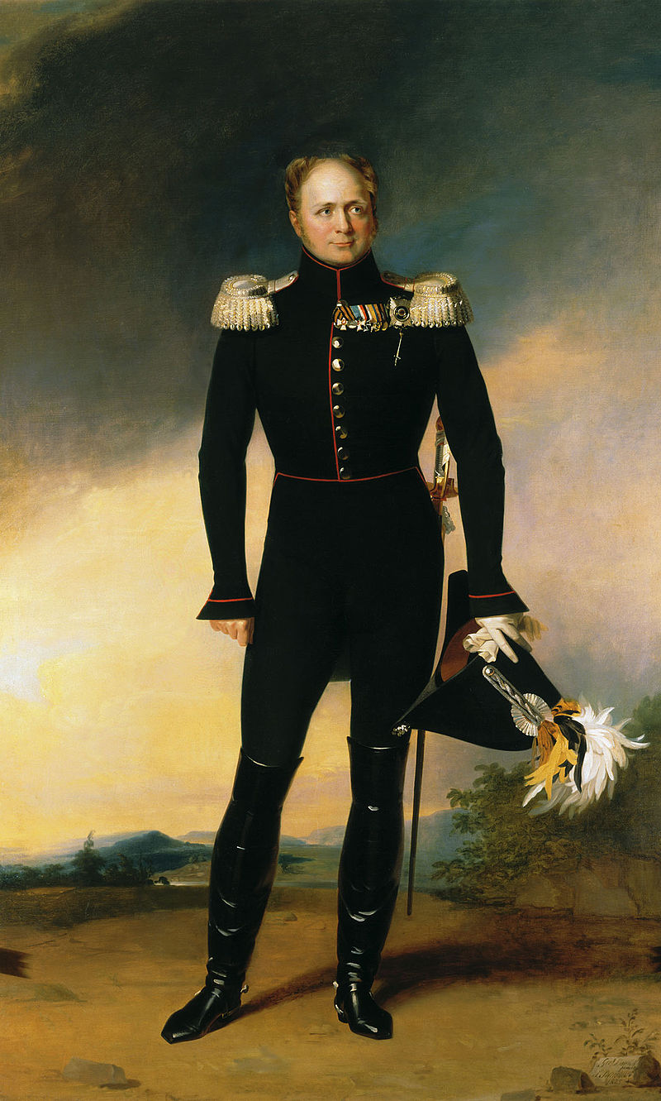
Alexander I of Russia
He had a major role in the downfall of Napoleon and through him, Russia could have assumed the leadership of Europe at the time. But he had neither the diplomatic skill nor the persistence of Metternich. He was inconsistent and too much of an idealist. At one moment, he was a champion of liberalism but at the next, an ambitious imperialist
Alexander I looked forward to territorial gains and he had an ambition over Poland. What he desired most was to have the whole of Poland. Such Russian aim was supported by Ferderick William of Prussia.

Slide 6
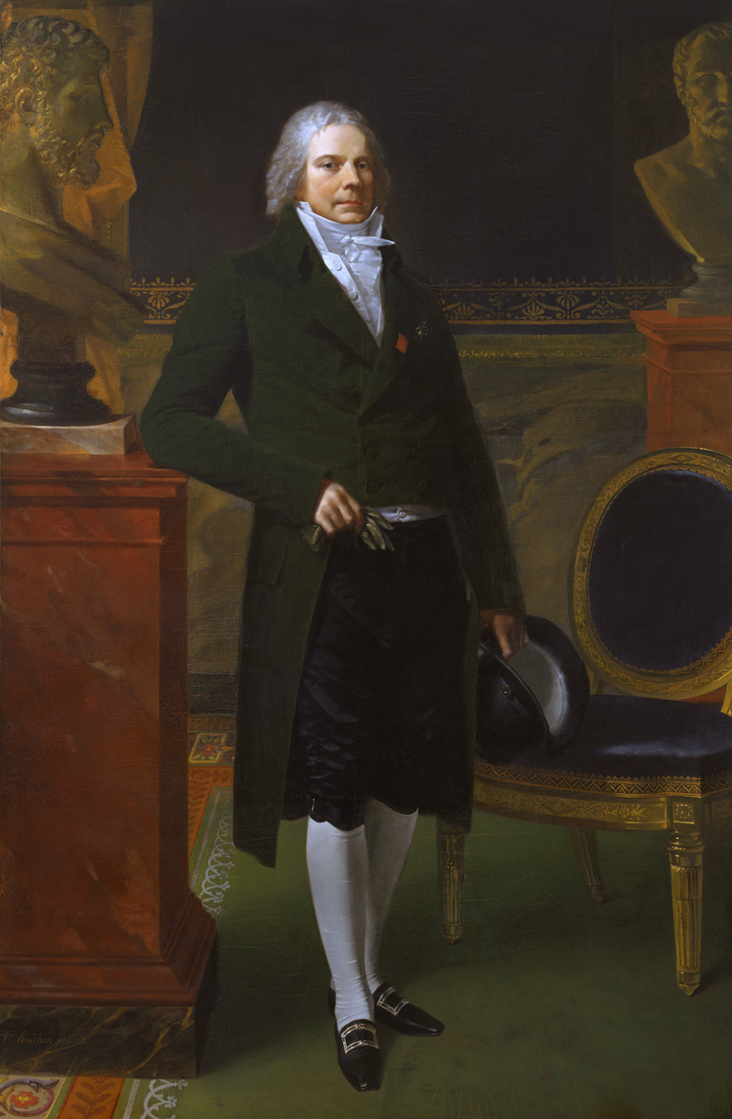
Charles Maurice de Talleyrand-Périgord Talleyrand of France
Although he represent France, the defeated nation, he succeeded in establishing himself as an influential member of the congress by means of skillful diplomacy.
All he wanted was to secure a lenient treaty for France, to promote and safeguard the interests of France and to end her isolation.
He secured admission to the congress on the plea that it was not France but Napoleon whom the allies had been fighting.
He was shrewd enough to set the victors against one another by making use of their different selfish interests in order to get he wanted for France.
The allies’s quarrel over the question of Poland and Saxony offered an ideal opportunity to Talleyrand. He openly supported the Austrians in their resistance to Prussian acquisition of Saxony.
When Hardenberg of Prussia announced that any further interference would lead to war, Tallryand proposed to Castlereagh of England and Metternich a secret treaty of alliance against Prussia and Russia. The treaty was signed in 1815.
Talleyrand could say in triumph that France was no longer isolated.

Slide 7
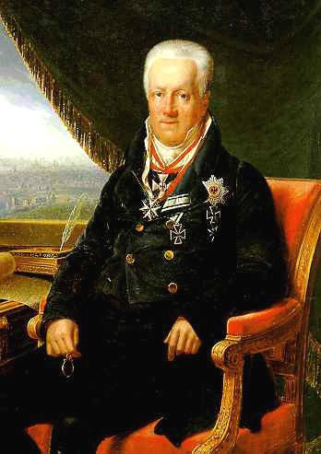
Prince Hardenberg of Prussia
Karl August von Hardenberg.
Hardenberg cared relatively little for the general European settlement but a great deal for the fortunes of Prussia. His attention was concentrated on gaining as much territories as possible for the loss of Prussian Poland to Russia and to reassure Prussia’s position in Germany.
He wished to increase support for the government by making moderate reforms.
These policies were applied in Britain 1820s to 1840’s.

Slide 8
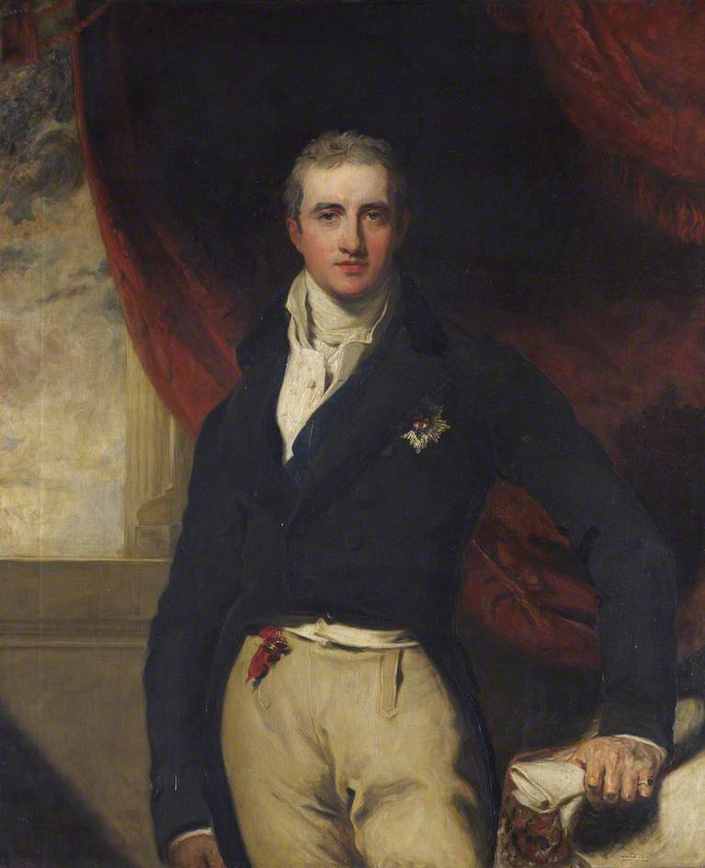
Viscount Castlereagh of England
Robert Stewart, Viscount Castlereagh.
He was the British Foreign Minister. He had a typically practical British mind as opposed to Alexander I’s idealism.
What worried him most was how to keep the European continent open to British trade. Napoleon had tried to close Europe to British goods. He had also attempted to invade England. In fact, the Napoleonic war had greatly upset the British trade pattern.
For these reason, he wanted to achieve peace in Europe. Only by this could it be possible for English trade and commence to proper and develop.
As such, it was necessary to create a balance of power in Europe. The wealth, population and territory of the states needed to be carefully redistributed. This would ensure that no one power would be too strong to endanger to others.

Slide 9
Castlereagh 2
His idea of a balance was, first to contain France. He was adamant on keeping the French out of the lowland countries.
The next problem was to strengthen central Europe as a buffer between France and Russia.
He also believed that the joint meetings of persons in authority were a better method of removing international misunderstanding.

Slide 10
Previous agreements
The Treaty of Chaumont in 1814 had reaffirmed decisions that had been made already and that would be ratified by the more important Congress of Vienna of 1814-15.
They included the establishment of a confederated Germany, the division of Italy into independent states, the restoration of the Bourbon kings of Spain, and the enlargement of the Netherlands to include what in 1830 became modern Belgium.

Slide 11
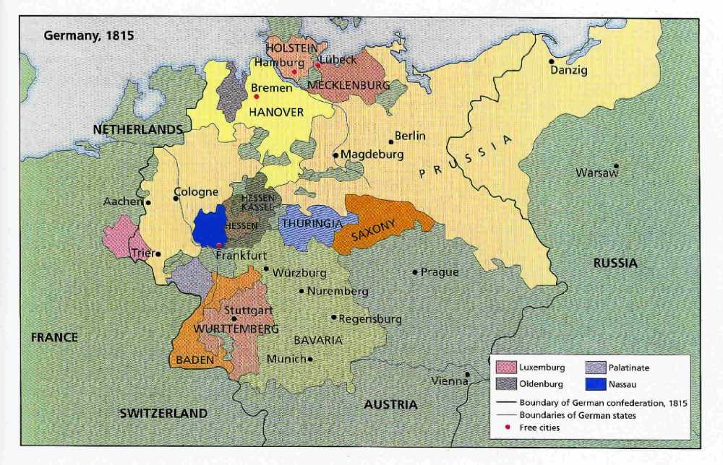
The Vienna Settlement 1815
The Final Act, embodying all the separate treaties, was signed on 9 June 1815 (a few days before the Battle of Waterloo). Its provisions included:
Russia was given most of the Duchy of Warsaw (Poland) and was allowed to keep Finland (which it had annexed from Sweden in 1809 and held until 1917).
Prussia was given three fifths of Saxony, parts of the Duchy of Warsaw (the Grand Duchy of Posen), Danzig, and the Rhineland/Westphalia.
A German Confederation of 39 states was created from the previous 300 of the Holy Roman Empire, under the presidency of the Austrian Emperor. Only portions of the territory of Austria and Prussia were included in the Confederation.

Slide 12
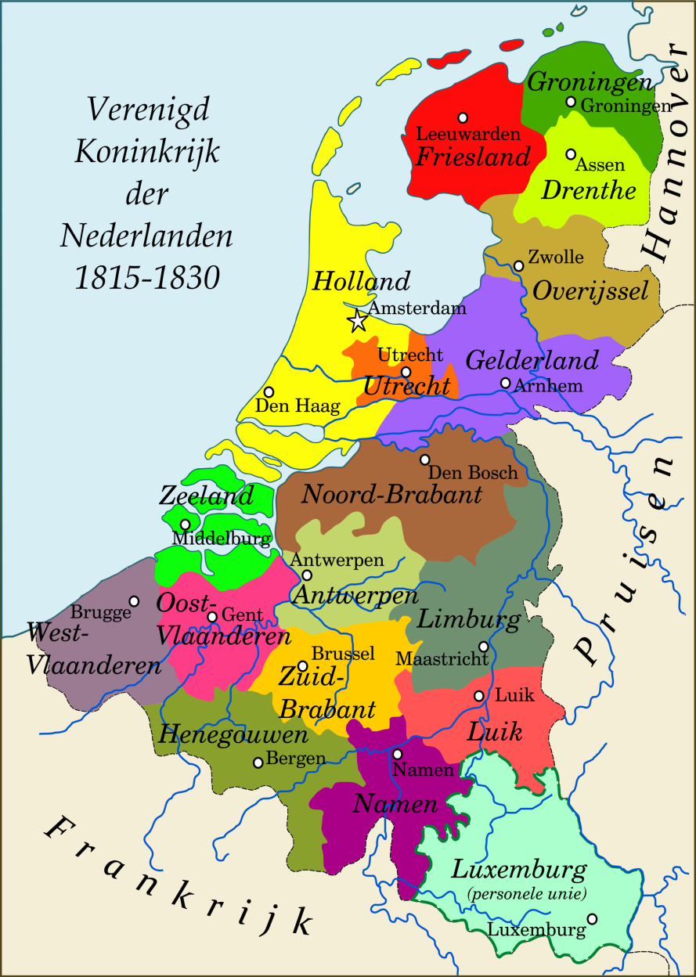
The Vienna Settlement 1815
The Netherlands and the Southern Netherlands (approx. modern-day Belgium) were united in a monarchy, the United Kingdom of the Netherlands, with the House of Orange-Nassau providing the king (the Eight Articles of London).
The United Kingdom of the Netherlands and the Grand Duchy of Luxembourg were to form a personal union under the House of Orange-Nassau, with Luxembourg (but not the Netherlands) inside the German Confederation.

Slide 13
The Vienna Settlement 1815
Swedish Pomerania, given to Denmark a year earlier in return for Norway, was ceded by Denmark to Prussia. France received back Guadeloupe from Sweden in return for yearly instalments to the Swedish king.
The neutrality of Switzerland was guaranteed.
Hanover gave up the Duchy of Lauenburg to Denmark, but was enlarged by the addition of former territories of the Bishop of Münster and by the formerly Prussian East Frisia, and made a kingdom.
Most of the territorial gains of Bavaria, Württemberg, Baden, Hesse-Darmstadt, and Nassau under the mediatizations of 1801–1806 were recognized. Bavaria also gained control of the Rhenish Palatinate and parts of the Napoleonic Duchy of Würzburg and Grand Duchy of Frankfurt. Hesse-Darmstadt, in exchange for giving up the Duchy of Westphalia to Prussia, received Rhenish Hesse with its capital at Mainz.
Austria regained control of the Tyrol and Salzburg; of the former Illyrian Provinces; of Tarnopol district (from Russia); received Lombardy-Venetia in Italy and Ragusa in Dalmatia. Former Austrian territory in Southwest Germany remained under the control of Württemberg and Baden, and the Austrian Netherlands were also not recovered.

Slide 14
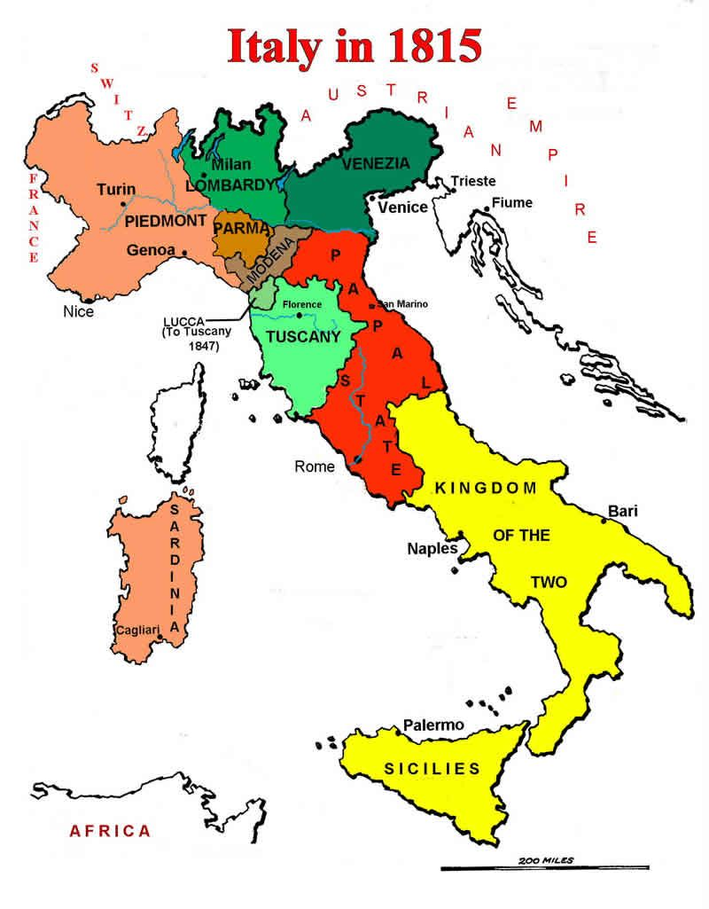
The Vienna Settlement 1815
Habsburg princes were returned to control of the Grand Duchy of Tuscany and the Duchy of Modena.
The Papal States were under the rule of the pope and restored to their former extent, with the exception of Avignon and the Comtat Venaissin, which remained part of France.
The King of Sardinia was restored in Piedmont, Nice, and Savoy, and was given control of Genoa (putting an end to the brief proclamation of a restored Republic).
The Duchies of Parma, Piacenza and Guastalla were given to Marie Louise, Napoleon's wife.
The Duchy of Lucca was created for the House of Bourbon-Parma, which would have reversionary rights to Parma after the death of Marie Louise.
The Bourbon Ferdinand IV, King of Sicily was restored to control of the Kingdom of Naples after Joachim Murat, the king installed by Bonaparte, supported Napoleon in the Hundred Days and started the Neapolitan War by attacking Austria.

Slide 15
Britain was confirmed in control of the Cape Colony in Southern Africa; Tobago; Ceylon; and various other colonies in Africa and Asia.
Other colonies, most notably the Dutch East Indies and Martinique, were restored to their previous owners.
The slave trade was condemned.
Freedom of navigation was guaranteed for many rivers, notably the Rhine and the Danube.
The Final Act was signed by representatives of Austria, France, Portugal, Prussia, Russia, Sweden-Norway, and Britain. Spain did not sign the treaty but ratified it in 1817.

Slide 16
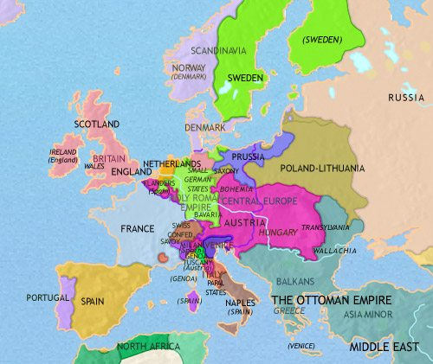
Europe before 1789

Slide 17
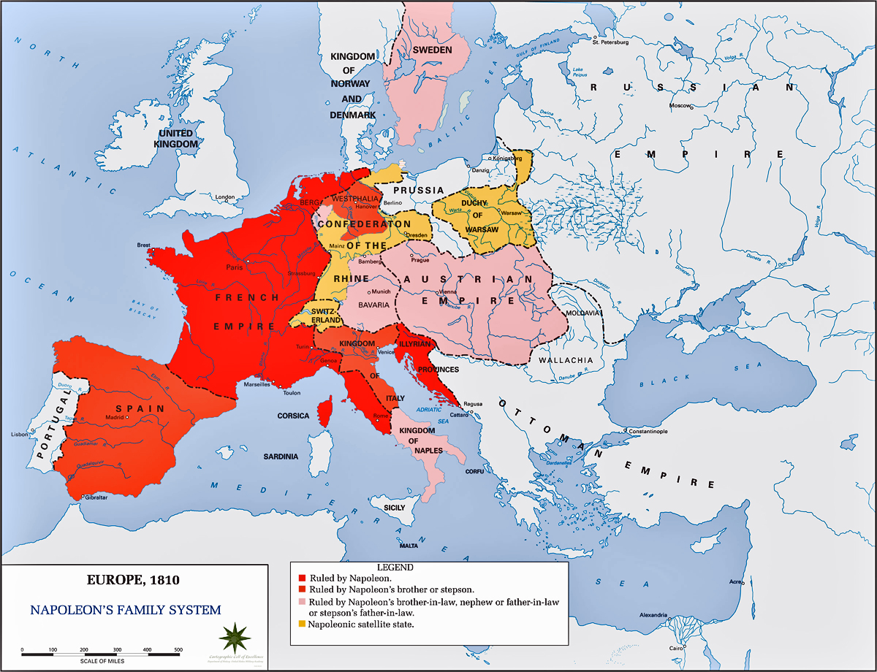
Europe 1810

Slide 18
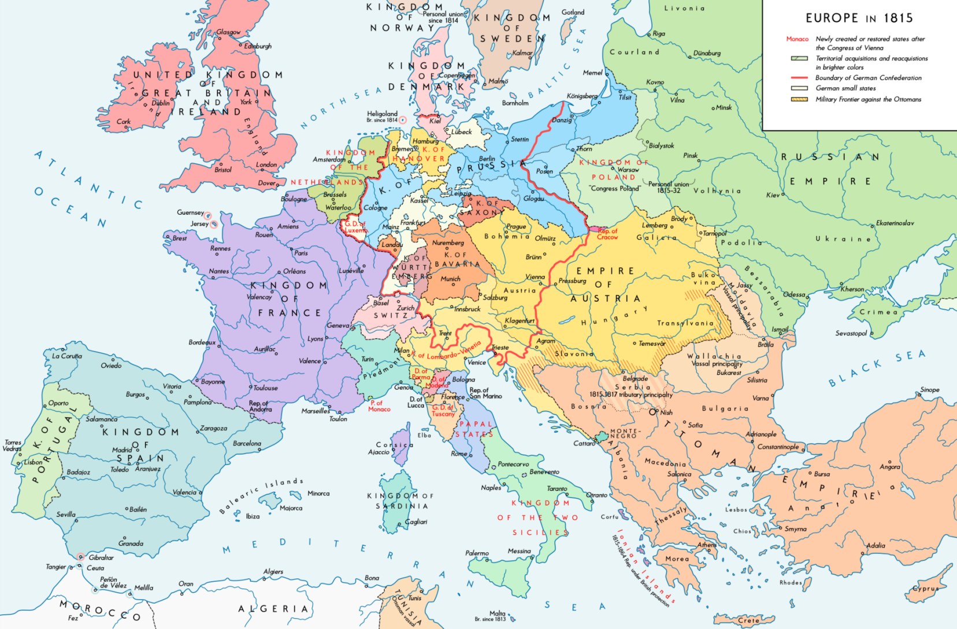
Europe in 1815

Slide 19
France was surrounded by buffer states
The United Netherlands.
Prussia on the Rhine.
An enlarged Piedmont/Sardinia which regained Savoy and Nice and was given Genoa.
A reconstituted and enlarged Swiss Confederation.

Slide 20
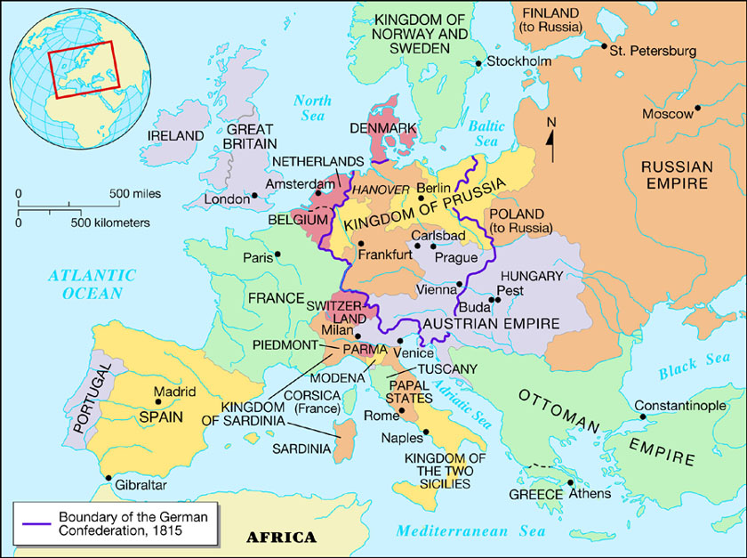

Slide 21
THE CONGRESS SYSTEM
The war had been won by cooperation. It was natural that the powers should consider keeping the peace by continuing that cooperation.
The problem was that the idea of cooperation was expressed in two separate documents, and these were the source of disagreement:
(a) the Treaty of Paris (November 1815) Article VI and the Quadruple Alliance
Napoleon's near success in the 'Hundred Days' proved the need to make some permanent arrangements to safeguard the Settlement. Largely as a result of the efforts of Lord Castlereagh, the British foreign secretary, it was agreed:
That the Quadruple Alliance of Austria, Russia, Britain and Prussia should continue for another twenty years to exclude the Bonaparte dynasty from France.
Article VI provided that Congresses would be held so that the Allies could discuss 'great common interest' and measures necessary 'for the repose and prosperity of the peoples and for the maintenance of the peace of Europe'.

Slide 22
The Holy Alliance May 1815
The Tsar (under the influence of the German religious mystic Baroness von Krudener) had produced another document. This was to be the basis of a personal pact between the European rulers.
Its main signatories were Prussia, Austria and Russia. Indeed it was signed by all of the rulers except the Pope, the Sultan and the King of Britain.
Its intention was very vague. The Tsar probably intended it as a renewal of the old Christian unity of Europe. The governments and peoples were to behave as 'members of one and the same Christian nation'.
Rulers were urged to behave as `fathers of families' towards their subjects.
Castlereagh said it was nonsense. Even Metternich called it a 'loud sounding nothing'. However, he had a use for this vague link between the three great absolutist powers.

Slide 23
THE CONCERT OF EUROPE
Between 1815 and 1822 there were a series of conferences to discuss matters of common interest.
The most important matters were the revolutions which broke out in some of the states of Europe in 1820 and continuing revolutions in South America.
Very soon a rift grew between the European powers over the purpose of the congresses

Slide 24
Congresses
The Congress of Aix La Chapelle (1818)
The first congress settled the issues of payment of the indemnity and withdrawal of the army of occupation from France
The Congress of Troppau, Silesia (1820)
In 1820 revolts broke out in Spain, Portugal and the Kingdom of the Two Sicilies. It was over these events that the line was first clearly drawn between the attitudes of Castlereagh and Metternich towards intervention:
The State Paper of 5 May 1820.
Even before the meeting Castlereagh made his position clear. He saw the congresses as designed to prevent the restoration of the Bonaparte dynasty in France and to protect the Vienna Settlement.
It was not that he sympathised with revolution. He once remarked 'we are always pleased to see evil germs destroyed'.
His fear was that intervention could upset the balance of power in Europe. Revolutions were internal matters, to be dealt with by the governments of the states concerned.
The Troppau Protocol.
Metternich's view was summed up by the agreement of Russia, Prussia and Austria that they would intervene in the affairs of any state in Europe where events seemed to threaten the interests of any other state.
Clearly this was an alliance against revolution. Castlereagh sent only an observer to Troppau and after the agreement was made he protested at the misuse of the Congress for this purpose.

Slide 25
Congresses 2
The Congress of Verona (1822)
By the time the next meeting took place, things had changed considerably:
(i) The Greek War of Independence had developed from a small scale revolt against the Turks in 1819. The Tsar sympathized with this rebellion because Turkey was Russia's old enemy.
(ii) The new British foreign secretary was George Canning (Castlereagh had committed suicide in 1821). On the whole Canning followed Castlereagh's line in opposing general European agreements to intervene in the affairs of other states. However, Canning was very different in other ways:
– He had a reputation for being more liberal in outlook. Castlereagh had been associated with repression in Britain, and Canning had long opposed him.
– He had a greater understanding of the needs of British trade.
He was the MP for Liverpool, which brought him into close contact with merchants and businessmen.
– He was a brilliant speaker, whereas Castlereagh was very poor. Canning could stir public opinion much more easily, fully understood the power of the press and was cuttingly witty.
All he could do at this stage, though, was to send the Duke of Wellington to the Congress of Verona to object to the French intervention with 100,000 troops in Spain. Even so, that intervention took place in 1823 with the approval of Congress.

Slide 26
Canning
Canning now took the initiative in three regions:
In the Spanish American colonies, he guaranteed the independence of the newly created states.
In Portugal, he actively supported the more liberal group against their opponents.
In Greece, he brought about a diplomatic agreement to achieve self government. In so doing he also split the Holy Alliance powers.
As a result of these events he could rejoice that he was restoring things to normality, 'back to a wholesome state'.
In fact, what the three regions had in common was that the Royal Navy could brought into action and that British trade interests were strong.

Slide 27
The Spanish American colonies
In 1823 it was rumoured that the European powers led by France and Russia were prepared to support the re-establishment of Spanish rule
In December 1824 Canning officially recognised the independence of the new states.
Portugal
In 1824, King John of Portugal asked for British help to restore him to his throne.
Here the situation was unusual. Instead of liberal revolutionaries forcing a constitution upon the ruler the King had already granted one and wished to maintain it. He was supported by the liberals and the threat came from his own wife and his brother Miguel.
Britain had a long-established relationship and trade links with Portugal. It looked as if France would step in if no action was taken, and would support Miguel.
So Canning contributed naval assistance and the king was restored to his throne.
The persistent Miguel tried again at a later date, and in 1833 the Royal Navy was used again to restore the throne of the grand-daughter of King John, Maria.

Slide 28
Greece 1
In 1821 there was a widespread Greek revolt.
By 1823, the rebels were so successful that the Sultan turned for help to his vassal, Mehemet Ali, Pasha of Egypt. Under his rule Egypt had been ruthlessly modernised and he followed an expansionist policy.
In 1824 he was given command in the Morea and his son Ibrahim Pasha began systematically to exterminate the population.
Russia sympathised very strongly with the Greeks. The Tsar had no hesitation in wanting to support rebels in this case.
Austria was opposed to intervention. Metternich had already been embarrassed by the Tsar's keenness to throw Russia's weight about all over Europe. Now he feared Russia would `gobble Greece at one mouthful and Turkey at the next'.
Britain faced a dilemma. A Russian victory over Turkey could increase her power in the Near East and threaten India. On the other hand Canning was aware of tremendous enthusiasm in Britain for the Greek cause and at the prospect of considerable trade opportunities. A loan of £800,000 had been floated in London in 1824 to help the Greek cause.

Slide 29
Greece 2
By 1826 it looked as if the Greeks were about to be defeated by the Egyptian army acting on behalf of the Turkish government. The new Tsar Nicholas I and Canning were both under pressure to do something.
In a very clever move to prevent Russia acting alone an getting out of control, Canning brought Britain, Russia and France together with the Treaty of London in 1827.
They agreed to persuade Turkey to grant self government to Greece. Canning was jubilant. a had broken the link between Russia, Prussia and Austria.
He rejoiced `The Holy Alliance no longer marches en corps, I have dissolved them into individuality'.
Greece became independent in 1830 but with 800,000 out of 2.5M Greeks in the Ottoman empire.

Slide 30
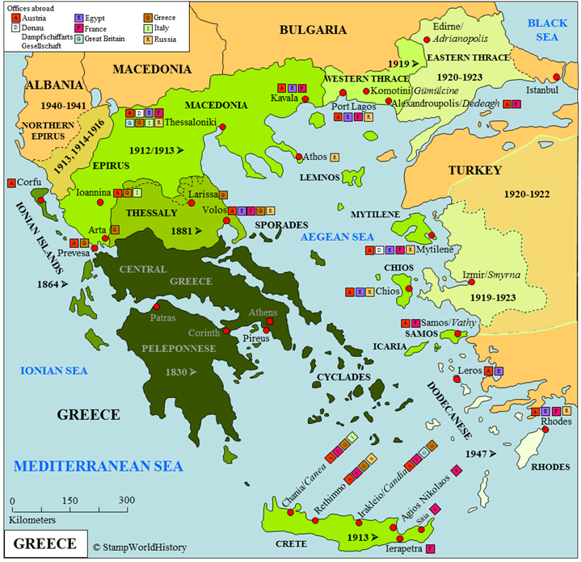

Slide 31
An Assessment of the Vienna Settlement 1
In later years the Settlement came in for considerable criticism. However, this may not have been altogether deserved. There are two broad views of it which can be contrasted:
The 'Forty Years Peace'
Not until 1854 did a general European war break out. It has been claimed that this period of peace was because the Vienna Settlement left no great grievance outstanding.
On the other hand, there were other factors as well:
Much was due after 1815 to the work of Internationalists' such as Metternich.
The powers were distracted from aggressive diplomacy by post-war economic exhaustion and internal revolutionary threats.

Slide 32
An Assessment of the Vienna Settlement 2
'Bartering the happiness of millions'
The usual criticism is that the diplomats at Vienna were out of touch with the new ideas which were developing in Europe.
In particular, it was claimed that they ignored the growing opposition to absolutist monarchy and the nationalist pressure towards the redrawing of the map of Europe on the basis of language and culture.
On the other hand:
Few people in 1815 actually understood these new forces. The liberals and nationalist did not have any clearly expressed programmes. Anyhow they could be easily seen as terrorists and crazed fanatics.
For much of what the diplomats did there was no alternative. It was unlikely that an independent Belgium would have survived. In northern Italy, it seemed that the only alternative to Austrian rule was French rule.

Slide 33
An Assessment of the Vienna Settlement 3
Some concessions were made to the new forces. The new Germany was a good deal less divided than the old one. All of the German rulers were supposed to establish constitutions as well.
The Settlement has been unfairly blamed for the revival of revolutions in the 1820s and 1830-1. These seem to have been due more to the short-sighted repressive policies of European rulers like Charles X of France and the Spanish and Neapolitan monarchs.
Until an even greater settlement took place at Versailles after World War I, it was customary for historians to condemn the statesmen of Vienna. It was later realized how difficult their task was, as was the fact that they secured for Europe a period of peace, which was its cardinal need.

Slide 34
An Assessment of the Vienna Settlement 4
For all the trouble France had caused, the Congress was remarkably mild towards France, which basically got to keep its traditional, pre-Revolution boundaries.
In the 20th century, many historians came to admire the statesmen at the Congress, whose work prevented another widespread European war for nearly 100 years (1815–1914).
Among these is Henry Kissinger, who in 1954 wrote his doctoral dissertation, A World Restored, on it.
Historian Mark Jarrett argues that the Congress of Vienna and the Congress System marked "the true beginning of our modern era". He says the Congress System was deliberate conflict management, and was the first genuine attempt to create an international order based upon consensus rather than conflict. "Europe was ready," Jarrett states, "to accept an unprecedented degree of international cooperation in response to the French Revolution.“

Slide 35
An Assessment of the Vienna Settlement 5
Historian Paul Schroeder argues that the old formulae for "balance of power" were in fact highly destabilizing and predatory. He says the Congress of Vienna avoided them and instead set up rules that produced a stable and benign equilibrium.
The Congress of Vienna was the first of a series of international meetings that came to be known as the Concert of Europe, which was an attempt to forge a peaceful balance of power in Europe. It served as a model for later organizations such as the League of Nations in 1919 and the United Nations in 1945.

Slide 36
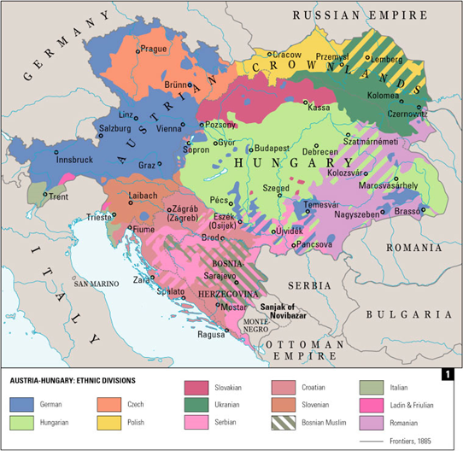
Addendum

