Slide 1
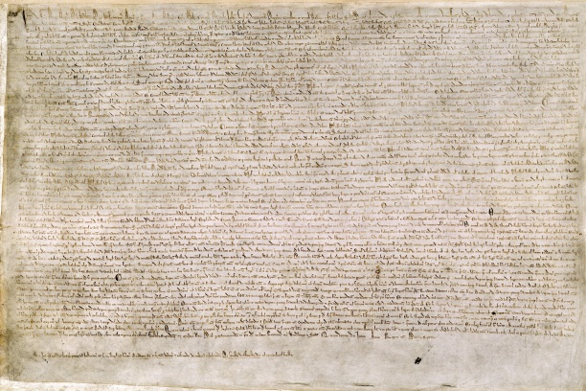
The Articles of the Barons How a failed treaty became Magna Carta an icon of our freedoms
By
Mike
Allen

Slide 2
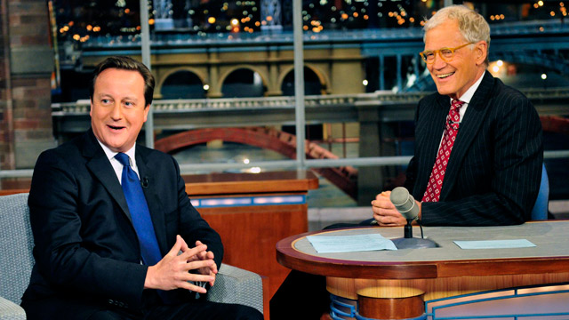
David Cameron on the David Letterman show failing to remember what Magna Carta meant (2012)

Slide 3
Outline
This lecture will attempt to outline
The underlying concept of feudalism
The nature of King John’s rule
The events which lead to the agreement of the Articles of the Barons, subsequently known as Magna Carta
Its importance in the middle Ages
Its revival in the 17th century with Coke, the Petition of Right and the Bill of Rights 1689
Its supersession by legislation in Britain
Its importance for United States

Slide 4
Feudalism 1
When William I conquered England in 1066
He took personal ownership of all land in England.
Almost all the Anglo Saxon nobility lost their land.
William gave out parcels of land – fiefs – to his supporters.
The classic version of feudalism ^{[1]} describes a set of reciprocal legal and military obligations among the warrior nobility, revolving around the three key concepts of lords, vassals and fiefs.
A lord was in broad terms a noble who held land, a vassal was a person who was granted possession of the land by the lord, and the land was known as a fief.
In exchange for the use of the fief and the protection of the lord, the vassal would provide some sort of service to the lord. The obligations and corresponding rights between lord and vassal concerning the fief form the basis of the feudal relationship.
[1] http://en.wikipedia.org/wiki/Feudalism

Slide 5
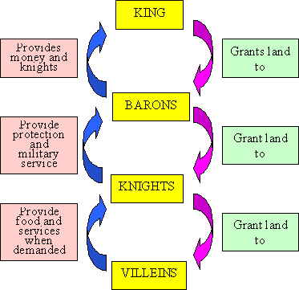
Feudalism 2
A simple plan showing how the Feudal System works[1]
[1] http://www.historyonthenet.com/medieval_life/feudalism.htm

Slide 6
Feudalism 3
Feudalism was a concept invented in the 17th century to explain what was happening in the period roughly between 900 and 1500.
There are many different versions
In practice those in control tended to exploit those below them.
However the key point is that there was supposed to be some kind of contract between the parties involved.

Slide 7
King John 1
John became King in 1199 on the death of Richard I his brother.
King John was a particularly bad king.
Before he became king John had rebelled against Richards appointed ministers ^{[1]}
Interfered with the ecclesiastical appointments
Connived at the destruction of the Justiciar William Longchamp
Encouraged an invasion from Scotland
Asked Philip II to help him secure the English throne for himself
Done homage to Philip for his brothers continental the lands
Granted to Philip almost the whole of the Duchy of Normandy
Tried to bribe the German Emperor to keep his brother in prison
Misruled England whilst his brother was away
^{[1]} Adapted from The Plantagenets Dan Jones Harper Press London 2012 p150-1

Slide 8
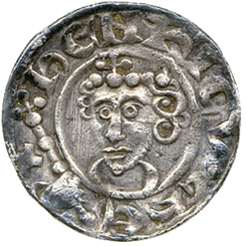
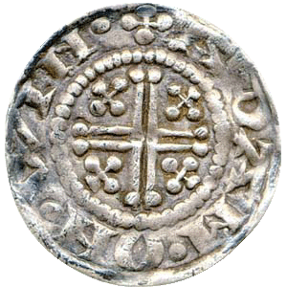
King John 2 Character
John was known for his tough financial demands and fierce temper
Like Henry II he was known to be cruel
He tended to make vicious threats against those who thwarted him
Unlike Henry and Richard he was also weak, indecisive and unchivalrous
John and his supporters sniggered when they heard of others’ distress
He was deemed untrustworthy suspicious and advised by evil men
Adapted from The Plantagenets Dan Jones Harper Press London 2012 p151
Silver penny minted at Winchester 1205

Slide 9
King John 3
John was faced by a rival to the throne Arthur of Brittany
He captured Arthur in 1202 and imprisoned him in ghastly conditions
Arthur was murdered in 1203 almost certainly by John himself
He treated his allies badly and they deserted him
By 1204 he had lost the majority of French Empire with nominal control in Poitou and Aquitaine because of loyalty to his mother
When his mother died later in 1204 he lost most of Aquitaine

Slide 10
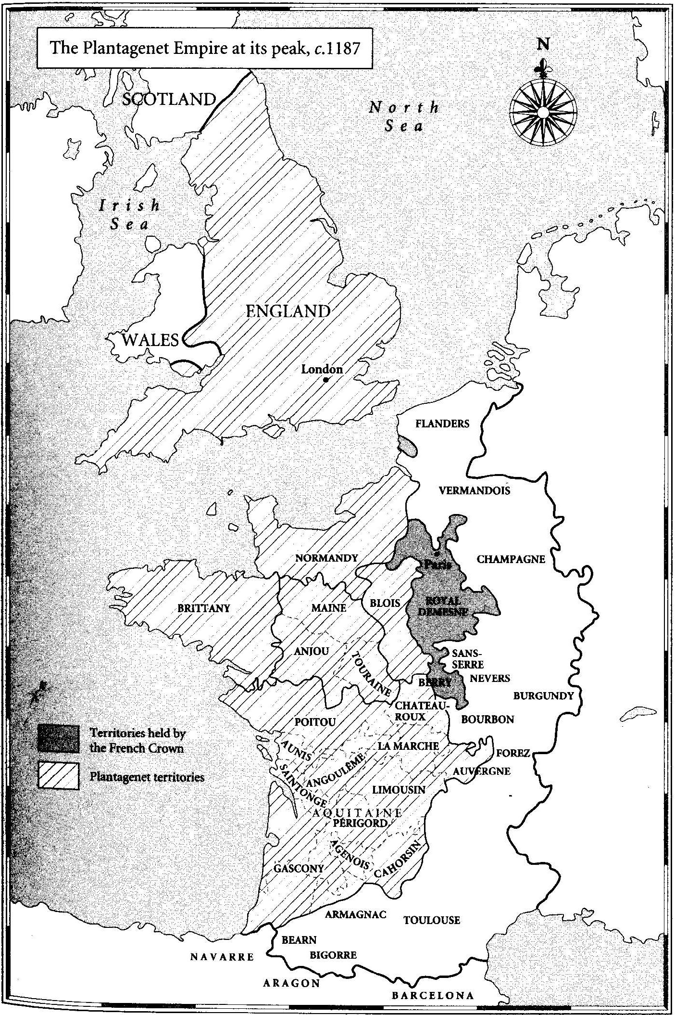
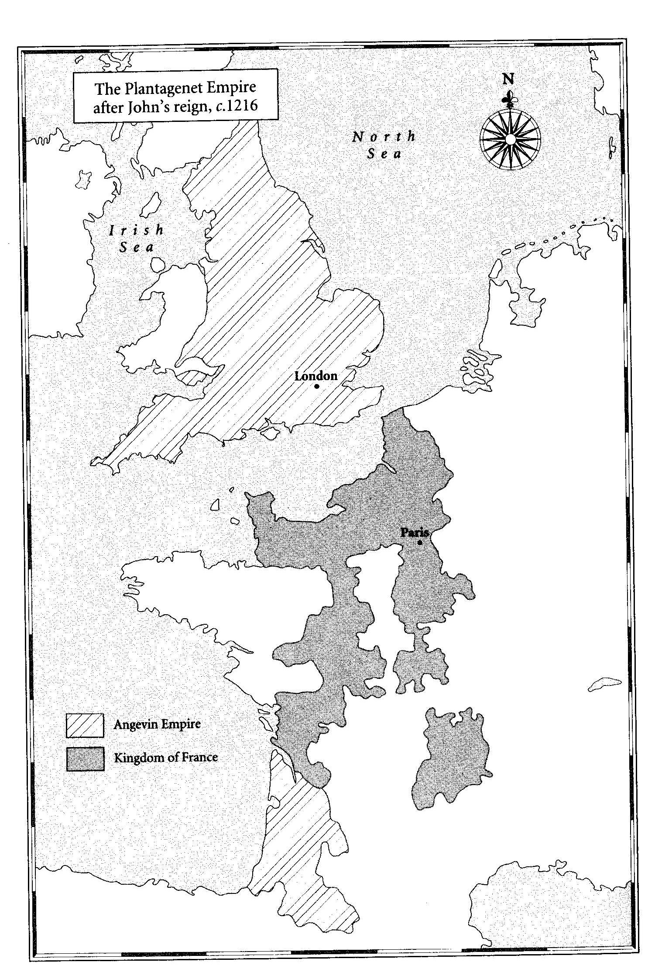

Slide 11
King John 4
Back in England after 1205
John increased taxes
He made money from Royal Justice including selling writs
He pursued his forest rights where land had been encroached or beasts illegally hunted with large fines
He seized baronial lands
In 1207 he opposed the appointment of Langton as Archbishop of Canterbury by the Pope Innocent III
The Pope excommunicated John in 1209
John extorted large amounts of money from the clergy
He also extracted large sums from the Jews who he persecuted including imprisonment and torture. This was nothing new but by the standards of or the time the measures were harsh
He fell out with one of his friends William de Briouze captured his wife and eldest son and starved them to death. Briouze went into exile.
In 1213 John submitted to the Pope in feudal vassalage.

Slide 12
King John 5
In 1214 he invaded France in an effort to regain its territories but lost the battle of Bouvines.
Baronial disquiet which had been bubbling up since 1212 now burst into the open.
Negotiations 1214 -5 were unsuccessful and in 1215 a group of rebels renounced their homage and fealty.
In May they seized London.

Slide 13
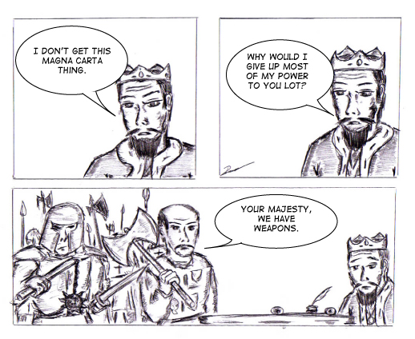
King John 6
After negotiation King John agreed to a document called the “Articles of the Barons,” which his seal was attached at Runnymede on June 15, 1215.
After John agreed to this document the barons then renewed their oaths to the king.
This was later called Magna Carta

Slide 14
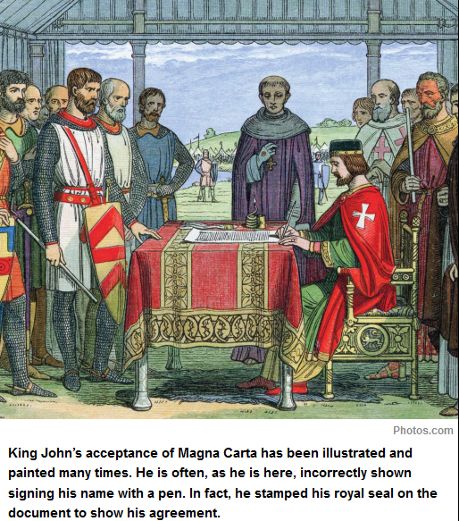
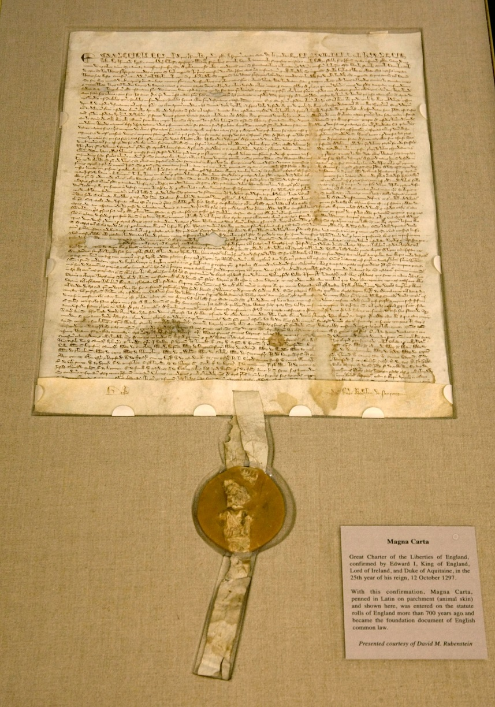

Slide 15
Quotations from Magna Carta
“the English church shall be free and shall keep all its rights and its freedoms”
“No freeman shall be seized or imprisoned, or have his property taken away or outlawed or exiled….except by the lawful judgement of his equals” (his guilt or innocence would be decided by men who had the same rank as him)
This idea eventually developed into a key part of English common law known as habeas corpus.
[habeas corpus: the legal concept that an accused person cannot be jailed indefinitely without being charged with a crime] the court must consent.
To no-one will we sell , to no-one deny or delay right and justice (the king will not accept bribes to favour certain people in a dispute, nor will he try to delay or stop a court case)

Slide 16
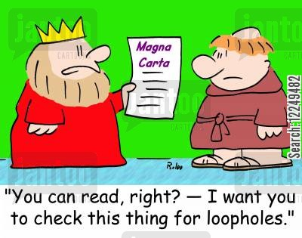
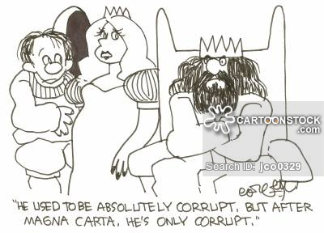
King John 6
As a peace treaty it was a failure, John applied to the Pope who annulled it.
War resumed and Prince Louis of France (heir to the French throne) was invited by the barons to England.
John died of dysentery in 1216.

Slide 17
Magna Carta 1
His 9 year old son was crowned king as Henry III under William Marshall as his guardian.
Marshall defeated the French and rebels at Lincoln and after the French fleet was defeated Louis left England.
The charter was reissued in 1216 and 1217 and became Magna Carta.
It was again reissued by Henry in 1225 in return for money to fight the French in Gascony

Slide 18
Magna Carta 2
In 1258 a group of Barons under Simon de Montfort seized power and he summoned a Parliament including wealthy commoners.
They were defeated in 1267 and Henry issued the statute of Marlborough with one of its clauses including a fresh commitment of Magna Carta.
Henry continued to call Parliaments sometimes including commoners.
This became the norm after 1297 under Edward I.
In 1297 Magna Carta was made part of Statute law.

Slide 19
Magna Carta 3
Magna Carta continued to be reaffirmed by each new king on accession to the throne.
In 1354 The clause “No Freeman shall be taken or imprisoned, or be disseised of his Freehold, or Liberties, or free Customs, or be outlawed, or exiled, or any other wise destroyed; nor will We not pass upon him, nor condemn him, but by lawful judgment of his Peers, or by the Law of the land. We will sell to no man, we will not deny or defer to any man either Justice or Right.”
Was revised to "No man of what estate or condition that he be, shall be put out of land or tenement, nor taken, nor imprisoned, nor disinherited, nor put to death, without being brought in answer by due process of the law.” 1354 Liberty of Subject Act

Slide 20
Magna Carta 4
By the mid 15th century Magna Carta ceased to occupy a central role in English political life, as monarchs attempted to reassert their sovereignty after its decline in the previous 150 years.
Interest in Magna Carta revived in the early 17th century as opponents of James I and Charles I and the doctrine of the divine right of kings sought to discover ancient rights and customs.
Sir Edward Coke a leading judge used Magna Carta to argue for a restriction of the king’s powers.
There was an attempt to reaffirm Magna Carta in 1621 which failed.
The Petition of Right was passed on 7 June 1628.
The Petition contains restrictions on non-Parliamentary taxation, forced billeting of soldiers, imprisonment without cause, and the use of martial law.
Initially rejected by Charles I, he ratified it on the 7th June in order to gain approval of taxation.

Slide 21
Magna Carta 5
The Bill of Rights 1689
James II was overthrown by William and Mary
They became joint king and queen but had to accept the Bill of Rights, these included:-
Jury trials
No excessive bail
Free elections to Parliament
Free speech in Parliament
Right to arms
Free to petition the king
No taxation without Parliament's approval
No cruel or unusual punishment

Slide 22
Magna Carta 6
In 1965, Parliament created the Law Commission for statute revision ^{[1]}
Legislation that followed in 1970 left only four chapters of Magna Carta intact: chapters 1, 13 and 39 of King John’s Charter, and 37 of the 1225 version.
The first Chapter promised freedom for the English Church.
Chapter 13 (9 in the 1225 version), guaranteed the City of London its ancient liberties and free customs.
Chapter 39 (29 in the 1225 Charter) was the key provision in Magna Carta, curbing the crown’s power to pursue individuals beyond the law.
Chapter 37, found only in the 1225 Charter, contained a clause important for the perpetuity of Magna Carta’s liberties, ‘and if anything contrary to this [charter] is procured from anyone, it shall avail nothing and be held for nought’. –
[1] http://www.historytoday.com/ralph-v-turner/meaning-magna-carta-1215#sthash.P4KldfVF.dpuf

Slide 23
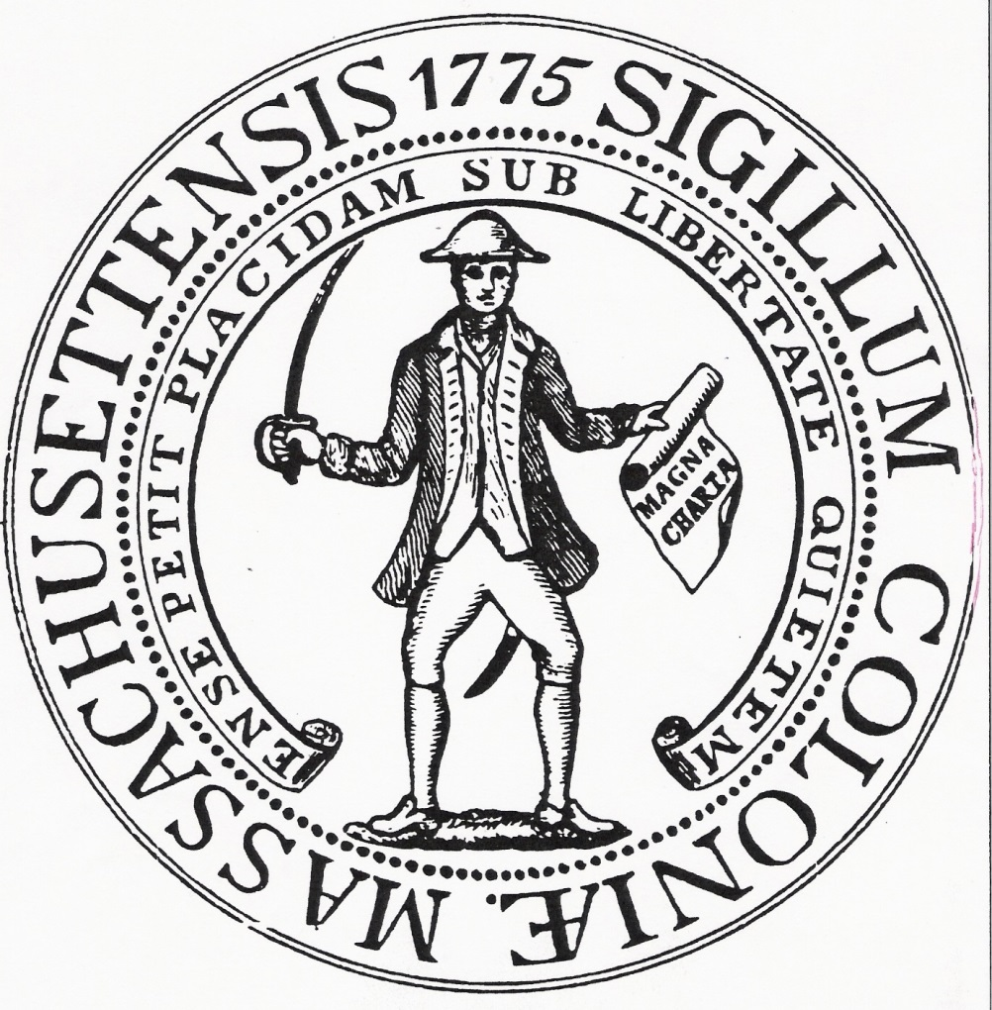
Influence on the US
The first seal of Massachusetts was a militiaman with a sword in one hand and a copy of the Magna Carta in the other hand.
This seal was adopted at the start of the American Revolution.
The seal was an example of how serious the Americans took the Magna Carta.

Slide 24
Influence on the US
America included part of Magna Carta in its constitution (1787):
“No person shall be held to answer for a crime without trial by jury, nor shall their life, liberty and property be taken without following the law”
September 1787 - Constitution of the United States is signed. In order to get it ratified the Bill of Rights is added to the U.S. Constitution as the first ten amendments, 15 December 1791.
Supreme Court citations of the Charter now number over a hundred.
It is also seen as important by many Commonwealth countries

Slide 25
Later developments
10 December 1948 - Universal Declaration of Human Rights
The United Nations adopts the Universal Declaration of Human Rights. 2 October 2000 - British Human Rights Act
The British Human Rights Act 1998 comes into force. This makes the European Convention on Human Rights enforceable in UK courts.

Slide 26
Summary
In many ways, Magna Carta only protected the rights and privileges of nobles.
But it also limited the power of the king and ended the idea of rule by divine right.
However, as time passed, the English came to regard it as the beginning of people’s rights and liberties that would lead to democracy.
One other outcome of the loss of French lands was to make the English king more English.

