Slide 1
The 1832 Reform Act
By
Mike Allen

Slide 2
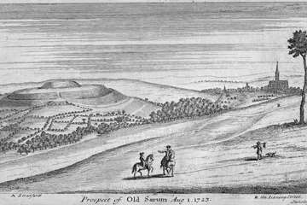
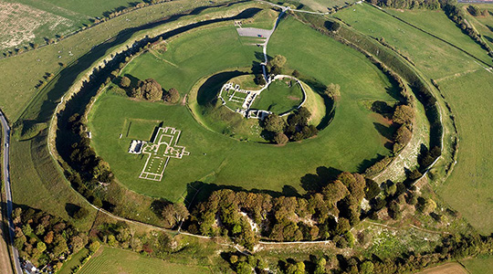
Constituencies
There were 558 members of Parliament including 45 from Scotland.
There had been no major change in the representation of England and Wales since the 17th century.
The representation of Scotland and Ireland had been settled by the Acts of Union.
There had been big changes in the population but there had been no redistribution of seats.
Manchester, Birmingham, Leeds and Sheffield were unrepresented.
Rotten or pocket boroughs existed where very few or even no electors lived. The most notorious was Old Sarum where the electorate consisted of 11 landowners who lived elsewhere.

Slide 3
The Franchise
The franchise was based on property.
In counties the right to vote was possessing freehold property worth 40 shillings a year. Introduced in 1430.
Boroughs had a variety of franchises
  Pot-walloper - the vote was held by all men who could boil a pot on a hearth. E.g. Aylesbury.
  Burgage – the vote was held by owners or occupiers of certain house, plots of land or property rights. E.g. Old Sarum.
  Scot and lot - all male householders who were not in receipt of poor relief had the vote. E.g. Northampton.
  Freemen – all the freemen of the borough had the vote. E.g. East Retford
  Corporation – the members of the Corporation (usually self perpetuating) had the vote. E.g. Bodmin

Slide 4
Voting
Voting was open, the secret ballot was not introduced until 1872.
Bribery and corruption was common.
Voters expected to be courted and bribed, at least with drink in the constituencies with larger electorates.

Slide 5
The Political System 1
The King was still an important figure and George III and George IV prevented catholic emancipation being passed during their reigns.
The position of Prime Minister and Cabinet had been established by 1831. The King did not have a complete free hand in choosing the PM. He had to choose from the prominent political groupings within the Commons.
However he could use his control of boroughs and patronage to support his nominee as PM.
Notes:
First PM Robert Walpole 1721-42

Slide 6
The Political System 2
The revolutionary settlement of 1688 and particularly the Bill of Rights of 1689 had established the primacy of Parliament in law making and taxation.
Prime Ministers were as likely to come from the Lords as the Commons, and this continued throughout the 19th century.
Party does not exist in the modern sense.
There is no professional or amateur organisation outside of parliament.
We talk of the Whigs and the Tories but these are best understood as loose attitudes towards certain policies.
There were loose groupings in Parliament centred around prominent figures which coalesced together in support of or opposition to the government.
Elections did not normally decide the governments fate.

Slide 7
The reasons why reform occurred 1
The Age of Reason (1685-1815), or simply the Enlightenment. Enlightenment thinkers in Britain, France and throughout Europe questioned traditional authority and embraced the notion that humanity could be improved through rational change. ¹
Radical enlightenment, largely inspired by the philosophy of Spinoza, which adhered to: "democracy; racial and sexual equality; individual liberty of lifestyle; full freedom of thought, expression, and the press; eradication of religious authority from the legislative process and education; and full separation of church and state". ²
the moderate enlightenment, expressed some support for critical review and renewal of the old modes of thought, but in other parts sought reform and accommodation with the old systems of power and faith. Examples are the writings of Descartes, John Locke, Isaac Newton or Christian Wolff. ²
The American and French Revolutions were directly inspired by Enlightenment ideals. ¹
Adapted from https://en.wikipedia.org/wiki/Age_of_Enlightenment
Adapted from http://www.history.com/topics/enlightenment

Slide 8
The reasons why reform occurred 2
The American Declaration of Independence 1776
“We hold these truths to be self-evident, that all men are created equal, that they are endowed by their Creator with certain unalienable Rights, that among these are Life, Liberty and the pursuit of Happiness.
That to secure these rights, Governments are instituted among Men, deriving their just powers from the consent of the governed.”
Adapted from https://en.wikipedia.org/wiki/United_States_Declaration_of_Independence

Slide 9
The reasons why reform occurred 3
The Declaration of the Rights of Man 1789
The French declaration listed the "inalienable rights" of the individual which were "liberty, property, security, and resistance to oppression" and the rights to freedom of speech and of the press were guaranteed.
The document asserted the equality of men and the sovereignty of the people, on whom the law should rest, to whom officials should be responsible, and by whom finances should be controlled.
The declaration had immense effect on liberal thought at the end of the 18th century and in the 19th century.
One of the mottoes of the revolution was Liberté, égalité, fraternité French for "liberty, equality, fraternity”.
Adapted from https://en.wikipedia.org/wiki/Declaration_of_the_Rights_of_Man_and_of_the_Citizen

Slide 10
The reasons why reform occurred 4
There was great population growth in 1721 the population was 7.1 M, this rose to 14.2 M by the end of the century.
The Agricultural and Industrial Revolutions produced a reduction in people working on the land and an increase in those working in industry with an increase in people living in cities.
Some of these were new towns such as Birmingham which had no representation,

Slide 11
Parliamentary reform 1780-1790
There were a number of attempts to promote Parliamentary reform in the 1780s and 90s, by William Pitt and Lord Grey without success.
The French revolution produced a reaction against its excesses and Parliamentary reform was off the agenda. Pitt (1783-1801 &1804-6) and later Lord Liverpool (1812-27) were able to create a long lasting Tory majority against change, with groups such as the Portland Whigs joining the government.

Slide 12
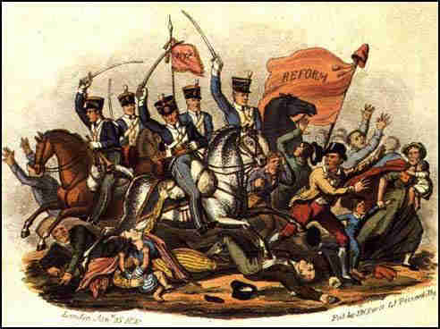
Parliamentary Reform after 1815
The radical movement revived after 1815 and there was agitation for reform.
In 1817-19 there were many mass meetings and political demonstrations.
In 1819 at St. Peters Square in Manchester the radical Henry Hunt addressed a mass meeting of up to 40,000 people. The authorities sent in cavalry and at least 11 people were killed and 44 wounded. The massacre of Peterloo caused great resentment and an outcry.

Slide 13
Liberal Toryism?
Whilst the Government of Lord Liverpool reacted with repression to the agitation, after 1822 Lord Liverpool promoted a number of more reformist Tories. In 1922 Robert Peel became Home Secretary and amongst other reforms established the Metropolitan Police.
William Huskisson became President of the Board of Trade and promoted a number of liberalising measures reducing tariffs and barriers to trade.
Canning became Foreign Secretary and adopted a less isolationist Foreign policy.

Slide 14
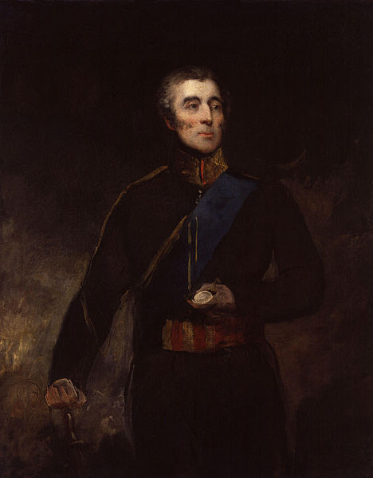
The break up of the old Tory Party
Lord Liverpool suffered a stroke in 1827 and died shortly afterwards.
George Canning became PM but a number of Tories who objected to his support for Catholic Emancipation refused to join his administration and he invited some Whigs to become ministers. He died after a few months. His successor Viscount Goderich was unable to assert authority over the party and resigned in 1828.
Wellington became PM at his resignation. The liberal Tory Canningites did not support his administration and when he and his Home Secretary Robert Peel introduced Catholic Emancipation in 1829 he lost the support of the Ultra or right wing protestant Tories.
Daniel O’Connell formed the Catholic Association in 1823 to press for Catholic emancipation and the repeal of the Act of Union of 1800. The threat of civil war in Ireland forced the Wellington government to enact Catholic emancipation.
However this meant that the Tory party was split in 3 ways.
The Duke of Wellington in 1831

Slide 15
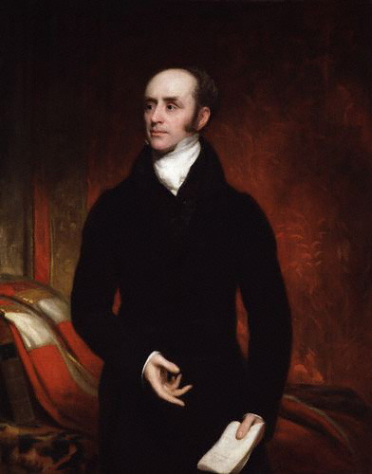
The Reform Crisis 1830-2
In 1830 George IV died and was replaced by William IV. The general election traditional on the death of a monarch caused no great changes.
However Wellington’s speech in favour of the unreformed Commons caused reaction and his government fell in November 1830 to be replaced by a Whig government under Lord Grey, though most of the Canningites joined them.

Slide 16
The Reform Crisis 1830-2
The government introduced a measure for Parliamentary Reform.
To disenfranchise boroughs with less than 2000 inhabitants and to reduce to one member boroughs with less than 4000 inhabitants .
The borough Franchise was to become uniform at the £10 per year householder.
This became bogged down in committee and Lord Grey asked for a dissolution which William IV granted.

Slide 17
The Reform Crisis 1830-2
The General election of 1831 was therefore fought on the question of parliamentary and electoral reform.
The Whigs won an overwhelming majority. All the constituencies with genuine electorates returned Whigs.
The Reform Bill was passed by the Commons but rejected by the Lords.
Riots broke out in Derby, Nottingham, Bristol, Dorset, Leicestershire, and Somerset.

Slide 18
The Reform Crisis 1830-2
In December 1831, the Third Reform Bill was brought forward, it passed in the House of Commons by even larger majorities in March 1832; it was once again sent up to the House of Lords. Amendments were passed to change its fundamental character.
Lord Grey asked the King to be willing to create sufficient Whig peers to overcome the Lords.
The king refused and Grey resigned.
The King invited the Duke of Wellington to form a new government.

Slide 19
The Reform Crisis 1830-2
There was a great deal of political agitation.
Wellington was unable to form an administration so that Grey returned as PM.
The King consented create peers but he circulated a letter among Tory peers, encouraging them to desist from further opposition, and warning them of the consequences of continuing.
Enough peers abstained from for the legislation to pass in the House of Lords, and the Crown was not forced to create new peers. The bill finally received the Royal Assent on 7 June 1832, thereby becoming law.
MPs were influenced by the spate of liberal revolutions in Europe in 1830 and particularly the replacement of Charles X by Louis Philippe in France, feeling that they needed to reform Parliament to stave off revolution.

Slide 20
1832 Reform Act
Abolition of seats
The 56 smallest boroughs were completely abolished.
The next 30 smallest boroughs each lost one of their two MPs. In total the Act abolished 143 borough seats in England
Creation of new seats
In their place the Act created 130 new seats in England and Wales:
26 English counties given two extra members.
8 English counties and 3 Welsh counties each received an additional representative.
Yorkshire, was given an extra two MPs so that it had 6MPs.
22 large towns were given two MPs.
Another 21 towns (of which two in Wales) were given one MP.
Thus 65 new county seats and 65 new borough seats were created in England and Wales.

Slide 21
1832 Reform Act
Extension of the franchise
In county constituencies, in addition to forty-shilling freeholders, franchise rights were extended to owners of land in copyhold worth £10 and holders of long-term leases (more than sixty years) on land worth £10 and holders of medium-term leases (between twenty and sixty years) on land worth £50 and to tenants-at-will paying an annual rent of £50.
In borough constituencies all male householders living in properties worth at least £10 a year were given the right to vote.
Existing borough electors retained a lifetime right to vote.
The Act also introduced a system of voter registration, to be administered by the overseers of the poor in every parish and township.)
The Scottish Reform Act and the Irish Reform Act.
Scotland received eight additional seats, and Ireland received five (no overall change).
Voter qualifications were standardised and the size of the electorate was expanded in both.

Slide 22
Results of the Reform
The electorate was expanded from about 400000 to 650000. From 4% of the population over 21 to 7%.
It did not satisfy the desire for reform and led to the Chartist movement of the 1840s.
It eventually led to further electoral reform.
The requirement to register led to the formation of registration societies that in turn lead to local constituency associations in support of the parties so that more disciplined parties were formed with extra parliamentary organisations.

Slide 23
Results of the Reform
Political leaders realised that they needed to appeal to the new electorate rather than use bribery and corruption in rotten boroughs. Robert Peel’s Tamworth Manifesto is an indication of this.
He argued that the Tories were not simply a party of reaction but were in favour of peaceful peacemeal reform and used the term conservative which was subsequently taken up as the party label.

Slide 24
Results of the Reform
It removed the influence of the monarch over elections.
1841 was the first election which changed the government, subsequently it was general elections which decide the government’s fate.
About 70 rotten boroughs remained after 1832. Mainly Tory seats had been abolished. These were not abolished until 1867. Voting was open until 1872 and corrupt practices were not made illegal until 1883 so that bribery, corruption and intimidation was still prevalent.

Slide 25
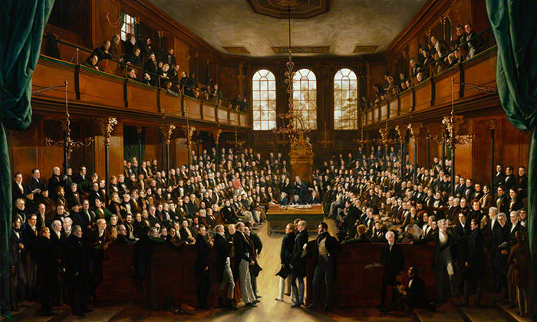
The House of Commons, 1833 by Sir George Hayter

Slide 26
Bibliography
The Age of Improvement Asa Briggs 1959
The Age of Improvement Sir Llewellyn Woodward 1938
The Age of Reform Sir Llewellyn Woodward 1962
The Birth of Modern Britain Eric J. Evans 1997
Democracy and Reform 1815-1185 D.G.Wright 1970
Britain Before the Reform act: Politics and Society 1815-1832 Eric J. Evans 1989
http://en.wikipedia.org/wiki/Reform_Act_1832
https://en.wikipedia.org/wiki/Age_of_Enlightenment
http://www.history.com/topics/enlightenment
https://en.wikipedia.org/wiki/Declaration_of_the_Rights_of_Man_and_of_the_Citizen

