Slide 1
The Reform of Parliament
By
Mike Allen

Slide 2
The Golden Age of the Individual MP 1832-1867
Parliament removed governments from office.
Ministers could be individually censured and forced to resign.
MPs controlled the organisation of the house.
Information could be demanded from the government.
Government bills were rewritten on the floor of the
house.
Backbench MPs could introduce legislation.
Adapted from The Government & Politics of Great
Britain by John Kingdom Polity Press 1991

Slide 3
Criticisms of Parliament 1
The Commons is dominated by the government
i)The growth of disciplined party majorities after 1868 meant:‑
By 1900 the government controlled the timetable of the House of Commons and the time available for private members was severely restricted.
It also meant that by use of the whipping system the government could get its legislation through the Commons. Most legislation is passed unamended. J.A.G.Griffith in 1975 found that only 10% of government backbench and only 5% of opposition amendments were passed.
c)The Commons no longer removes the government from office

Slide 4
Criticisms of Parliament 2
ii) The growth of the bureaucracy.
The growth in government activity has meant a corresponding growth in the number of civil servants. This has tilted the scales in favour of the government and made it difficult for the Opposition and individual MPs to challenge the government. The weight of information and expertise is heavily in favour of ministers. There has not been a corresponding increase in support for backbenchers and the Opposition.

Slide 5
Criticisms of Parliament 3
iii) The increase in the influence of pressure groups.
Government has come to rely on pressure groups for advice, cooperation and information. MPs find it difficult to get the government to accept change to something which has been pre-negotiated with pressure groups.

Slide 6
Criticisms of Parliament 4
TV has become a rival as a centre of political attention and debate.
Foreign commitments have reduced the power of parliament.
Various treaties such as the European Convention on Human Rights 1950.
The European Community/Union.

Slide 7
Criticisms of Parliament 5
Parliament has lost control of finance.
There is a large amount of delegated legislation by the government - about 10,000 orders per year that Parliament does not effectively check so that the government has a great amount of independent law making power.
The Lords is an inadequate check upon the government. It is afraid to use its powers.
The previous section is adapted from British Politics Today by Jones and Kavanagh eds.

Slide 8
Criticisms of Parliament 6
. Representation
It is argued that Parliament does not represent the people adequately.
Some argue that FPTP does not reflect the way people voted accurately and that PR should be adopted.
Parliament is not a microcosm of the nation, it is overwhelmingly white male and middle class.
Sleaze. Recent revelations suggest that some MPs are using their position to make money for themselves -their own financial interest rather than representing their constituents and the nations' interests.

Slide 9
Criticisms of Parliament 7
3. Scrutiny
It is argued that there is insufficient scrutiny.
Question Time and debate are inadequate.
Select Committees are under resourced and have not discovered major scandals.
There are inadequate resources for the opposition parties and individual MPs
The government is too secretive.

Slide 10
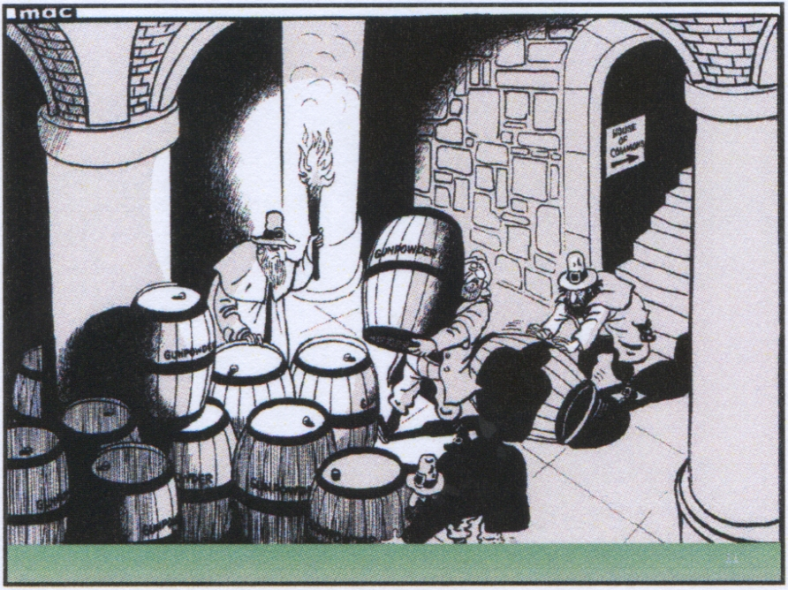

Slide 11
