Slide 1
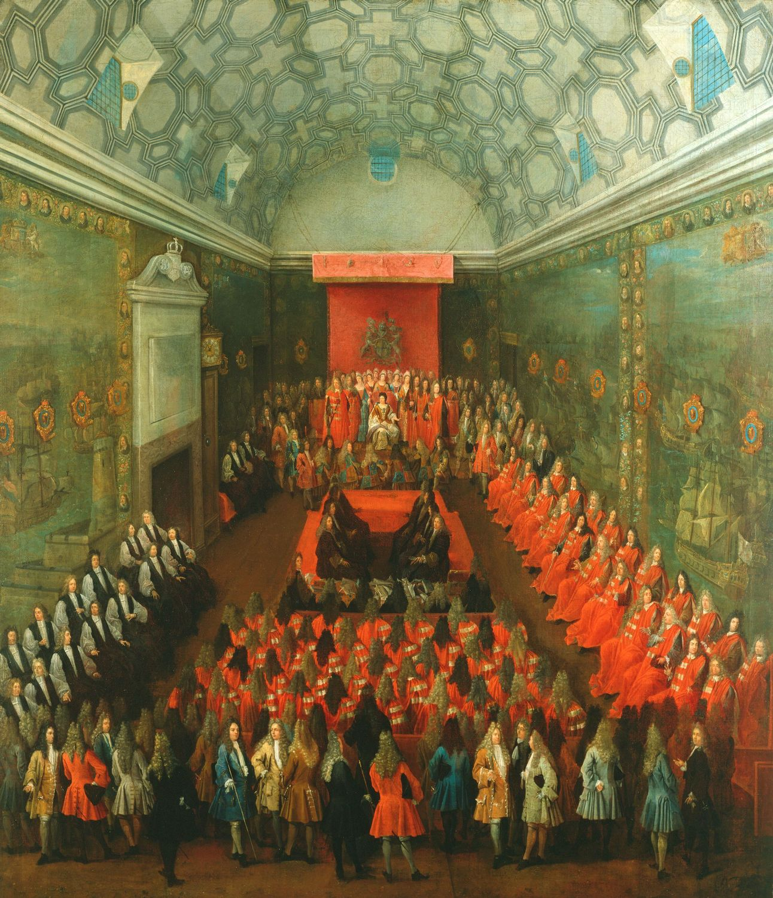
The House of Lords and Democracy
By
Mike Allen
Queen Anne presides over the House of Lords as Scottish peers first sit in the chamber in 1707

Slide 2
The Lords 1
The House of Lords was and is an undemocratic element in our political system.
11th century
Parliament originates in the Anglo Saxon King’s council or Witan – a political body attended by religious leaders, magnates and the King’s ministers.
13th century
The Parliament of 1265 called by Simon de Montfort includes representatives from counties, cities and boroughs for the first time.
14th century
Two distinct Houses of Parliament emerge. Representatives from the towns and counties begin to meet separately as the House of Commons. Archbishops, bishops and certain abbots and priors (Lords Spiritual) and noblemen (Lords Temporal) form the House of Lords.

Slide 3
15th century
Lords Temporal attend the House of Lords on an almost entirely hereditary basis. ‘Peers’, as they became known, are accountable to each other and divide into five ranks: duke, marquess, earl, viscount and baron.
16th century
After the 1539 suppression of the monasteries, only bishops attend the House and the Lords Temporal form a majority for the first time.

Slide 4
17th century In 1642, during the Civil War, bishops are excluded from the House of Lords but are returned by the Clergy Act 1661.
In 1649, after the Civil War, the monarchy and the House of Lords are abolished.
After the restoration of Charles II in 1660 the House is reinstated. The Commons pre-eminence in financial matters is further asserted by the passing of resolutions in 1671 and 1678.
The Declaration of Rights establishes Parliament’s authority over the King and is later embodied in the 1689 Bill of Rights.

Slide 5
By the end of 19th century: The House of Lords was represented by hereditary peers, representative peers for Scotland and Ireland, bishops and lords of appeal.
The lords of appeal were life peers created by the Appellate Jurisdiction Act 1876.
The Bishopric of Manchester Act 1847 (and later Acts), limited the number of bishops entitled to sit to 26. Most of the Irish and all the Welsh bishops ceased to sit when their respective churches were disestablished in 1869 and 1920. Retired bishops cannot sit or vote in the House.
The Prime Minister mostly came from the Lords in the first half of the 19th century. The last Prime Minister to sit in the Lords was Lord Salisbury (1886-92, 1895-1902).
Lord Home renounced his title on appointment as PM in 1962, fought a by election and met the House of Commons as an MP as Sir Alec Douglas-Home.

Slide 6
The Lords 2
There were approximately 650 peers in the Lords in the 19th century. Most of them were created in the 18th and 19th centuries.
In the 1860s there was a Conservative majority of 60-70.
However from the 1870s onwards there was a steady defection of Whig-Liberals to the Conservative party.
This was increased in 1886 by the defection of Liberal Unionist peers.
The 1893 vote in the Lords on the 2nd Home Rule bill was 419 to 41.
So by the end of the 19th century there was an overwhelming Conservative and Unionist majority in the Lords.

Slide 7
The Lords 3
The Lords was theoretically co-equal in powers with the Commons.
However the democratisation of the Commons had given it pre-eminence.
From the 1860s onwards Chancellors of the Exchequer had undertaken the practice of gathering together tax legislation in one finance bill (act) to avoid interference by the Lords and a convention had grown up that the Lords did not interfere in financial legislation.

Slide 8
The Lords 4
The Conservative majority in the Lords used their powers to negate Liberal legislation.
In 1884 the Lords refused to accept the electoral reform bill and it was only passed as a result of a deal between Gladstone and Salisbury.
The 1893-4 Home Rule Bill was rejected by the Lords as were a number of Liberal measures.
The Liberal Party took office at the end of 1905 under Sir Henry Campbell-Bannerman and consolidated its hold with a sweeping victory in the general election of January 1906, when it won 400 seats to the Conservatives 157.

Slide 9
The Lords 5
Arthur Balfour led the Conservatives and encouraged the House of Lords to amend Liberal Bills so they were barely recognizable or reject them.
An Education Bill (1906), a Plural Voting Bill (1906), a Land Reform Bill (1907) and a Licensing Bill (1908) were among those rejected by the Lords.
The Liberal Party was furious and frustrated, and David Lloyd George was not exaggerating when he famously said in the House of Commons in 1907: ‘The House of Lords is not the watchdog of the Constitution; it is Mr Balfour’s poodle.’
Lloyd George, the most prominent radical in the Liberal cabinet, had succeeded Herbert Asquith as Chancellor in 1908 when Asquith became prime minister.

Slide 10
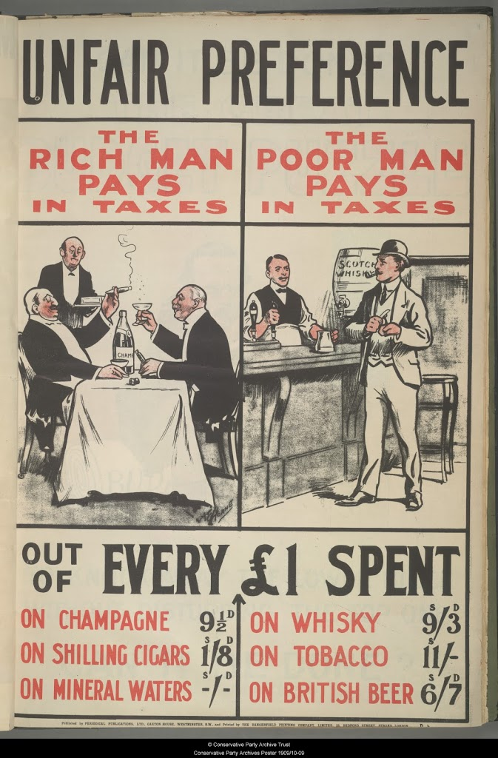
The Lords 6
In the following year, Lloyd George’s budget led to a serious clash with the House of Lords. Needing to raise extra revenue to pay for, among other things, old age pensions (introduced 1908) and new battleships,
Lloyd George proposed an increase in taxes to cover the additional expenditure. He also saw a need to accumulate revenue for future welfare measures that he and colleagues had in mind. Some of these including health and unemployment insurance under the 1911 National Insurance Act would come to fruition between 1909 and 1911.
This was the justification for what came to be known as the ‘people’s budget’ of 1909, which symbolised the New Liberal commitment to helping the needy by taxing the wealthy.

Slide 11
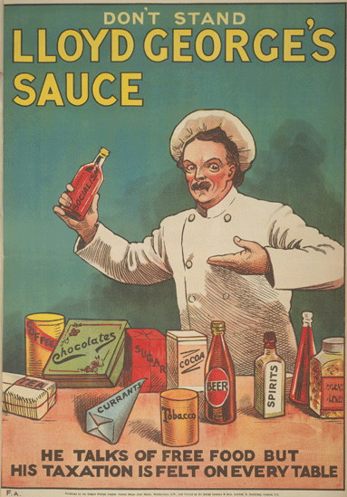
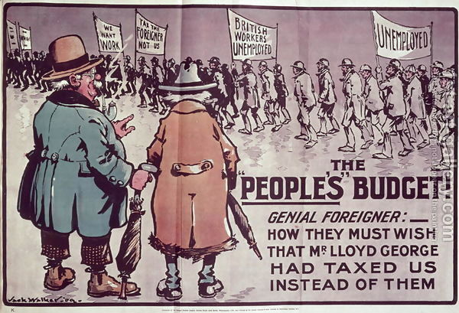

Slide 12
The Lords 7
Lloyd George’s preference was for direct taxation rather than for the Conservative solution of indirect taxation such as customs duties.
He sought to implement this taxation by increasing death duties and imposing a new super-tax on annual incomes over £5,000. In addition, he proposed to tax landowners on any unearned increase in land values.
This was the most controversial aspect of what proved a highly contentious budget.
It provoked intense attacks both from the Conservative opposition in the House of Commons and from the House of Lords.

Slide 13
The Lords 8
The main objections of the Lords were directed against the proposals to tax the profits derived by landowners from the increased value of their land, from site values and leaseholds, and from undeveloped land and mineral rights.
Lloyd George in particular was ready to widen the conflict into an issue of the people versus the peers. During the summer and autumn of 1909, he provoked and even dared them to reject the budget, something that had not been done for over 250 years and thus force a general election.
He then hoped the Liberals would receive a clear mandate from the electorate to reform the House of Lords.
The House of Lords rejected the budget on 30 November by 350 votes to 75.

Slide 14
The Lords 9
Asquith had no option but to dissolve Parliament and call a fresh general election to take place in January 1910, which was effectively about the powers of the House of Lords.
The election figures were as follows.
Liberals 275
Conservatives 273
Irish Nationalists 83
Labour 40
The Liberal Party was able to continue in power as a minority government.
However, it now had to rely on the support of Irish MPs who wanted Home Rule for Ireland.
The Conservatives, accepting the verdict of the electorate, grudgingly allowed the passage of the budget in due course.

Slide 15
The Lords 10
The constitutional crisis now entered a second phase. The Liberals introduced a bill to restrict the Lords’ power of veto.
Asquith asked King Edward VII for a guarantee that if the Lords rejected the bill he would permit the creation of a large number of Liberal peers in order to swamp the Conservative majority in the Lords. However, Edward died.
The new king, George V, asked for a cross-party constitutional conference to try to arrive at consensus. The conference failed to produce an agreed solution.
He stated that he would only sanction the creation of new peers after a general election had been held in which this issue was discussed.
Consequently, in December 1910 another election took place. The result was virtually the same as in January and, re-confirmed in power, the Liberal Party introduced its bill.

Slide 16
The Lords 11
Faced with the threat of creating peers that supported the Liberal Party if it rejected it, the Lords grudgingly gave in; the Parliament Bill was subsequently passed in August 1911. The final vote was 131 to 114.
Parliament Act 1911
delaying power of 2 years introduced. It could be overcome by the bill being passed 3 times by the commons in successive sessions. The third time it would become law without Lords approval.
power over finance effectively removed.
absolute veto over extension to Parliamentary lifetime
House of Commons lifetime reduced from 7 to 5 years
This was a major and significant reduction in the unelected Lords powers.

Slide 17
The Lords 12
The Lords used their delaying power in the 1911-14 period in particular over Home Rule.
If the Conservatives had not rejected Home Rule from 1886 onwards Ireland might still be part of the UK. We will never know!!
From its creation Labour was opposed to the House of Lords.
When they gained power with a majority in 1945 they carried out their manifesto pledge.
Parliament Act 1949
delaying power reduced to 1 year
Rejection by the Lords would be overcome by the bill being passed 2 times by the commons in successive sessions. The second time it would become law without Lords approval.
1958 Life Peerages Act - introduced life peers - both men and, for the first time, women.
1963 Peerage (Renunciation) Act - hereditary peers were allowed to renounce (resign) their peerages and female hereditary peeresses where allowed to attend the Lords for the first time.

Slide 18
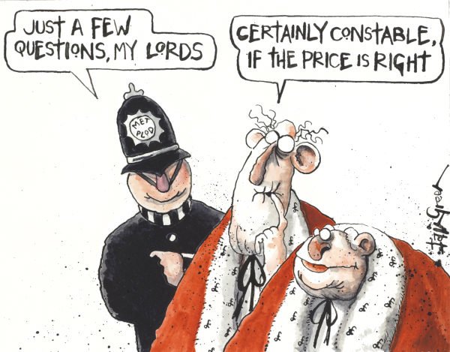
The Lords 13
1999 Parliament Act reduced the number of hereditary peers eligible to sit in the Lords to 92. These are elected by all the hereditary peers.
The Constitutional Reform Act 2005
created a 12 member Supreme Court separate from the House of Lords and
the Lord Chancellor ceased to be head of the judiciary, which became the role of the Lord Chief Justice.
The Lord Chancellor ceased to be the chair of the Lords and the Lords has since elected a Lord Speaker.

Slide 19
The Lords 14
The Coalition agreement of 2010 included reform of the House of Lords. 2011 Nick Clegg, the deputy prime minister outlined plans for reform with a future bill.
120 elected members
30 appointed members
up to 21 bishops
up to eight ministerial members
a number of transitional members equal to two-thirds the membership of the House on 27 June 2012.
On the vote to give the bill a second reading, 91 Conservative MPs voted against the three line whip while 19 more abstained. Labour opposed the second reading on the grounds that the second chamber should be fully elected. As a result the bill was dropped. Nick Clegg said the Conservatives had “broken the coalition contract”.
Subsequently the Liberal Democrats withdrew their support for equal sized constituencies.

Slide 20
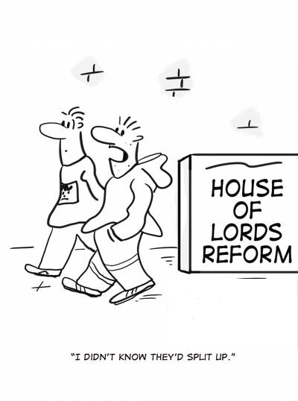
The Lords 15
The Lords remains an undemocratic part of our political system.
The 1999 act is flawed since it gave a simple majority to the government but no overall majority.
David Cameron created nearly 250 peers when he was PM, partly to make the Conservatives the largest party in the Lords.

Slide 21
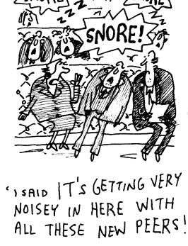
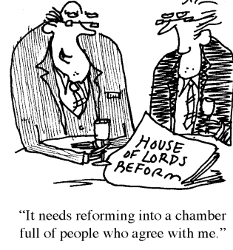

Slide 22
Reform of the Lords 1
Second chambers throughout the world are a problem. This derives from their composition and powers.
If they are elected in the same way as the first chamber then it is duplication and it does not seem worthwhile to have such a chamber.
If the second chamber is elected in a different way then it is likely to produce a different party composition from the first chamber and there could be clashes between the two.

Slide 23
Reform of the Lords 2
Also if the first chamber is elected by the best method possible then what is the justification for using a different method for the second chamber?
The problem about the powers of a second chamber is that if it has powers then it may thwart a duly elected government whilst if it has no powers then again it does not seem worthwhile having a second chamber.

Slide 24
Reform of the Lords 3
On the other hand second chambers are used for a number of purposes:-
To restrict the power of the first chamber.
To restrict the power of the government - particularly important in a parliamentary system where the government would normally command a majority in the first chamber, either with one party as in the UK or with a coalition of parties as in many European parliamentary democracies.
To represent minorities and interests not well represented in the first chamber.
To provide room for second thoughts

Slide 25
Reform of the Lords 4
The problems and criticisms of the Lords
It is non elected.
The hereditary system does not necessarily guarantee suitability for taking part in political affairs.
It is unrepresentative of the nation - it is dominated by males and includes the upper class (the aristocracy) and sections of the middle classes, but there are few peers from a working class background or who are female or black (Afro-Caribbean or Asian).

Slide 26
Reform of the Lords 5
The Conservative bias amongst peers has been eliminated by the reform of 1999.
Representation of the Church of England seems outdated. Approximately 3 million people attend church regularly, with 1.5 million out of the population of 60 million attending the Church of England.
The Lords has little power and rarely uses them. They are afraid to use their powers through fear of abolition. It would seem undesirable to have powers that are not used for this reason.

Slide 27
Defence of the Lords
It is a constitutional check on the government and the Commons.
It has a valuable revising function.
It is part of our history and heritage.
It is a reservoir of experience and expertise.
It is very difficult to agree on an alternative.

Slide 28
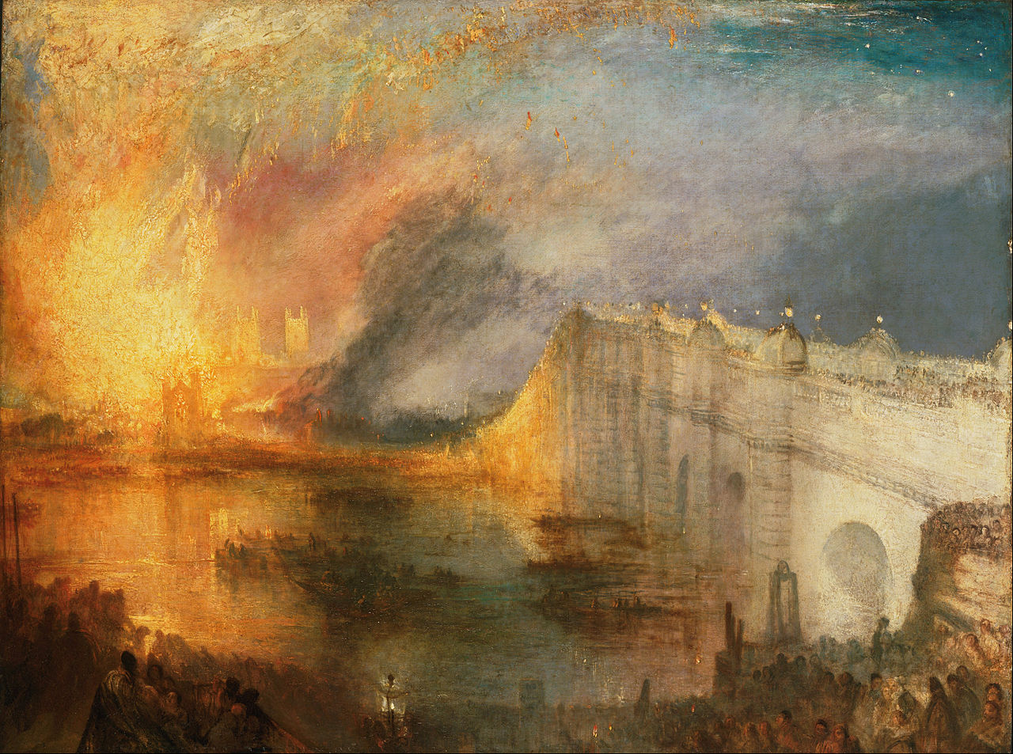
The Burning of the Houses of Lords and Commons by J.M.W. Turner

