Slide 1
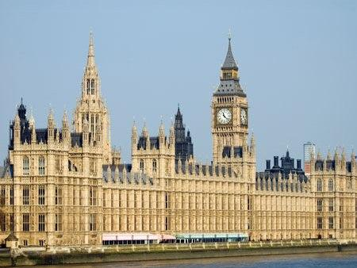
The House of Commons 4
By
Mike Allen

Slide 2
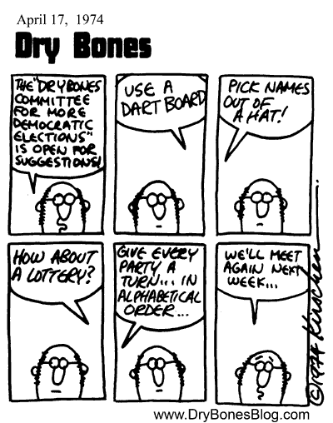

Slide 3
Select Committees Historical background 1
The first permanent Select Committee was the Public Accounts Committee set up in 1861.
This looks at Government accounts and checks that money is spent as Parliament voted.
It looks for examples of waste and extravagance and makes recommendations to try to avoid these problems in the future.
It has traditionally worked in a bi-partisan manner and was the model for those who wanted to reform the Commons.

Slide 4
Select Committees Historical background 2
In the 50s, 60s and 70s gradually more select committees were established.
In 1978 the Select Committee on Procedure recommended a comprehensive system and the Conservatives adopted a pledge to strengthen Parliament in their 1979 manifesto.
The leader of the House Norman St. John Stevas set up a comprehensive system of Departmental Select Committees in 1979.

Slide 5
Select Committees Historical background 3
Committees have a set of 10 core tasks, set out in 2002 to guide their work. These were introduced by Robin Cook.
These include
examining government policy proposals (white papers, green papers etc.), departmental decisions and outputs,
pre-legislative scrutiny of draft bills,
scrutiny of the implementation of policy and legislation (post-legislative scrutiny),
departmental expenditure,
the workings of Executive Agencies, Non-Departmental Public Bodies (NDPBs) and regulators,
and major appointments made by the department.

Slide 6
Select Committees Today 1
The Select Committee on the Reform of the House of Commons Committee (known informally as the Wright Committee) reported on 12 November 2009 and made recommendations.
Reduction in the number of committees and in the size of a standard departmental committee to eleven members.
Chairs of departmental and similar select committees should be directly elected by secret ballot of the House using the alternative vote.
Members of departmental and similar committees should be elected from within party groups by secret ballot.

Slide 7
Select Committees Today 2
Backbench business should be scheduled by the House rather than by Ministers.
The House should decide its sitting pattern for itself.
An effective e-petitions system should be introduced, including the possibility that members of the public might be able to compel an issue to be debated in the House.
One backbench motion per month should be routinely scheduled for debate.
In May 2010, the coalition Conservative and Liberal Democrat government agreed to bring forward the Wright Committee's recommendations in full.
It was decided that the chairman of select committees would be 12 Conservatives, 10 Labour and 2 Liberal Democrats.

Slide 8
Select Committees Today 3
There are 2 basic types of Select Committees.
Domestic committees that have something to do with the organisation of the Commons.
Scrutiny Committees which look at a particular area of government activity or policy.
There used to be a third type called ad hoc committees which were set up to look at a particular problem, report and dissolve, but these have fallen into disuse having been superseded by Committees of Enquiry and the permanent scrutiny committees.

Slide 9
The Present Select Committees
Domestic Committees
Administration Committee (Commons) Committee considers the services that the House of Commons provides for Members of Parliament, staff and the general public
Backbench Business Committee Chooses the business to be debated during backbench time.
Finance and Services Committee considers expenditure on, and the administration of, services for the House of Commons: it has responsibility for detailed scrutiny of the House's budget.
Liaison Committee Comprises all the chairs of select committees in the House of Commons, they look at the work of their committees and decide which committee reports the House of Commons should be debating

Slide 10
Domestic Committee Continued
Members' Expenses Committee
Considers matters relating to Members’ expenses referred to it by the House.
Procedure Committee
Makes recommendations on, the practices and procedures of the House of Commons.
Standards and Privileges Committee
Oversees the work of the Parliamentary Commissioner for Standards and to consider any matter relating to the conduct of Members.
The Committee of Selection used to be classed as a select committee but is now classed under other committees.

Slide 11
Scrutiny Committees - Departmental
They examine the administration, expenditure and policy of the department.
Business, Innovation and Skills Committee
Communities and Local Government Committee
Culture, Media and Sport Committee
Defence Committee
Education Committee
Energy and Climate Change Committee
Environment, Food and Rural Affairs Committee
Foreign Affairs Committee
Health Committee
Home Affairs Committee
International Development Committee
Justice Committee
Northern Ireland Affairs Committee
Political and Constitutional Reform Committee The Committee was newly appointed in June 2010 to consider political and constitutional reform, scrutinising the work of the Deputy Prime Minister.
Scottish Affairs Committee
Transport Committee
Treasury Committee
HM Treasury, HM Revenue & Customs, and associated public bodies, including the Bank of England and the Financial Services Authority.
Welsh Affairs Committee
Work and Pensions Committee

Slide 12
Scrutiny Committees – Non Departmental 1
Armed Forces Bill Committee
Every 5 years an Armed Forces Bill is passed to provide the Armed Forces to be recruited and maintained as disciplined bodies. It makes a report and recommendations to the Commons.
European Scrutiny Committee
scrutinises draft EU legislation and recommends some draft legislation for debate
Public Accounts Committee
Committee examines reports produced by the Comptroller and Auditor General (C&AG) on his value for money studies of the economy, efficiency and effectiveness with which government departments and other bodies have used their resources
Public Administration Select Committee (PASC)
considers matters relating to the quality and standards of administration within the Civil Service

Slide 13
Scrutiny Committees – Non Departmental 2
Regulatory Reform Committee
Committee scrutinises government proposals for draft legislative reform orders
Science and Technology Committee (Commons)
Ensures that government policy and decision-making is based on good scientific and engineering advice and evidence
Environmental Audit Committee
The Environmental Audit Committee considers how well government policies and programmes contribute to environmental protection and sustainable development, and it audits performance against targets in those areas
Statutory Instruments Committee (Commons)
Committee responsible for scrutinising all statutory instruments laid before the House of Commons (its work is closely related to that of the Joint Committee on Statutory Instruments)

Slide 14
How Select Committees Work
They decide upon the line of inquiry.
Then gather written and oral evidence.
They have powers to “send for persons, papers and records”.
This does not include ministers though they have undertaken to attend.
They then make a report to the Commons.
They have no power as such – they can only make recommendations and hope to influence the Government and Parliament.

Slide 15
Arguments Against 1
Most select committee success are in areas of bi-partisan agreement, they avoid important areas of political debate.
They detract from the real action on the floor of the House.
Enoch Powell argued that the MPs job is not to rival ministers and civil servants expertise but to ask the right questions.

Slide 16
Arguments Against 2
Other MPs cannot keep up with all the information.
Specialisation leads to narrowness of outlook.
They have not revealed important scandals.
There has been an over influence of whips.

Slide 17
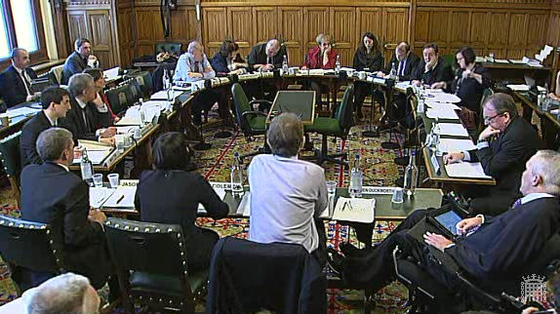
Arguments in Favour 1
They allow cross questioning of ministers.
They allow cross questioning of civil servants
Outside experts can be called in.
Outside witnesses can be called in.
The Public Accounts Committee

Slide 18
Arguments in Favour 2
They cut across party lines because they try to act in a bi-partisan way.
They can influence government policy.
They can extract information from the government.
They may make government more efficient.

Slide 19
Arguments in Favour 3
Sir Douglas Wass, joint head of the civil service in 1981 in the Reith lecture said that select committees mean that
Ministers and the civil service prepare policy more rigorously.
They made Whitehall publish more information.
They made the exposure of weak policy more likely.

Slide 20
The influence of Select Committees
The Report “Selective Influence: The Policy Impact of House of Commons Select Committees” by Meg Russell and Meghan Benton of the University College London Constitution Unit in 2011 found that:-
Around 40% of recommendations are accepted by government, and a similar proportion go on to be implemented.
Calls for small policy change are more likely to be accepted and implemented, but around a third of recommendations calling for significant policy changes succeed.

Slide 21
Further Reform
More specialists to gather evidence and prepare the committee.
They should consider how legislation is implemented.
They should have the power to call ministers to appear before them, and the power to demand to see government papers.

