Slide 1
The House of Commons 2
By
Mike Allen

Slide 2
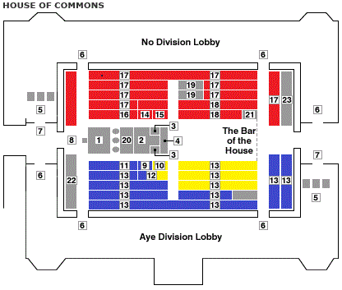
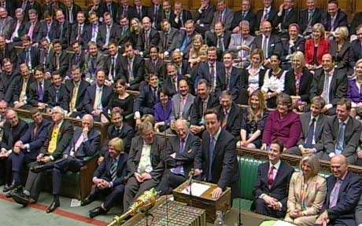
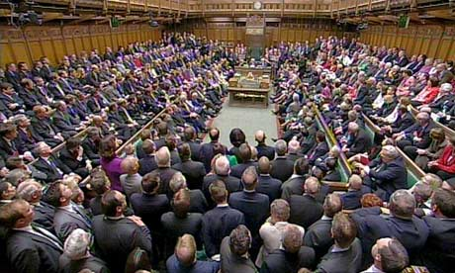
1 Speaker's Chair
2 Table of the House
3 Despatch boxes
4 Mace
5 Division Clerks' Desks
6 Entrances to Lobbies
7 Exits from Lobbies
8 Petition bag
9 Prime Minister
10 Government whips
11 Ministers
12 Parliamentary Private Secretaries
13 Govt back benches
14 Leader of the Opposition
15 Opposition Whips
16 Shadow ministers
17 Opposition back benches
18 Oppositions back benches
19 Other small parties
20 Clerks
21 Serjeant at Arms
22 Civil Servants
23 Strangers (public visitors

Slide 3
Types of Bills 1
There are two basic types of bills:-
Private Bills - which only affect a section of the community, even one person.
They are promoted by outside bodies and are presented to Parliament in the form of a petition. They may start in either the Commons or the Lords, though the more contentious would start in the Commons.
They follow a similar procedure to Public bills, but the promoter of the bill presents arguments to the Committee for the Bill. If a bill is opposed then the opponents present arguments against the bill. Legal counsel is usually employed by the promoters and often by opponents to present their arguments. The Committee of MPs or peers act as a sort of judge and jury on the bill and usually the full House follow their recommendations.
They may carry over from one session to another.
A recent example is the Canterbury City Council Bill, which makes provisions relating to street trading and consumer protection in the city. Began in 2008 and has still not reached its 3rd reading in 2012.

Slide 4
Types of Bills 2
Public Bills - affect the whole community. They may be introduced by either the government and these are known as Government Bills, or by backbenchers and these are known as Private Members Bills. They follow similar procedures.
Hybrid Bills - these are bills which only affect a section of the Community but are of national importance eg The Channel Tunnel Act 1987 and the Crossrail Act 2008.

Slide 5
The Passage of Legislation through Parliament 1
A Bill is a proposed law. When it is passed by Parliament it becomes an Act of Parliament, or a statute, or a piece of legislation (they all mean the same).
Public Bills follow similar procedures. Government Bills are introduced by the government. Private Members Bills are introduced by backbench MPs.

Slide 6
The Passage of Legislation through Parliament 2
A Government Bill goes through the following procedures:-
First Reading
The title of the bill is read out and a date is set for the second reading.
The bill is then published.

Slide 7
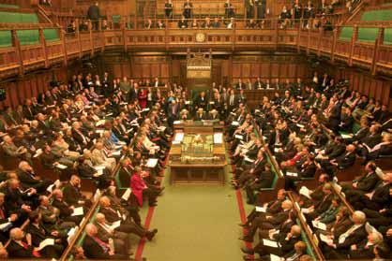
The Passage of Legislation through Parliament 3
Second Reading
This is a general debate on the principles of the bill. No detailed amendments are allowed.

Slide 8
The Passage of Legislation through Parliament 4
The Committee stage
This can be taken either in a Committee of the Whole House - the House sitting as a committee (minus the speaker) This is used for uncontroversial legislation or for very controversial legislation.
or in a Public Bill Committee formerly called Standing Committees (the name was changed 2006)
This is the normal procedure.
These are smaller committees of the Commons of between 20 and 50 MPs plus a chairman which reflect the party strengths in the Commons.
This is where the bill is debated in detail and amendments to the wording of the bill can be made.

Slide 9
The Passage of Legislation through Parliament 5
Since 2006 Public Bill Committees have the power to receive written evidence from outside organisations and members of the public, and to take oral evidence from interested parties, in the same way as Select Committees do, as part of their consideration of the Bill.
Public Bill Committees normally take oral evidence at the start of proceedings, starting with evidence from the relevant Minister or Ministers and Departmental officials.
They are now named for the bill eg Welfare Reform Bill Committee

Slide 10
The Passage of Legislation through Parliament 6
The committee stage is the time when determined opposition, either from the Opposition or from a group of MPs can delay a bill to the point where it would be lost ie not get through all its stages in a session.
The chief method to avoid this is to set a timetable for debate. This is called a guillotine motion.
Another method is the kangaroo where the speaker selects an amendment for debate from a group of similar amendments.

Slide 11
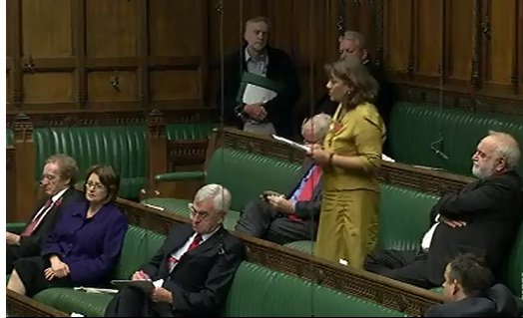
The Passage of Legislation through Parliament 7
The Report Stage
This is a debate on the amendments made at the committee stage on the floor of the Commons and the House votes whether to accept these amendments. Further amendments may be made.
Valerie Vaz, MP for Walsall criticised the inclusion of the Human Fertilisation and Embryology Authority (HFEA), the Human Tissue Authority (HTA), and the Equality and Human Rights Commission (EHRC) in the Public Bodies Bill.

Slide 12
The Passage of Legislation through Parliament 8
Third Reading
This is a general debate on the principles of the bill as amended where no detailed amendments are allowed. It is similar to the second reading.

Slide 13
The Passage of Legislation through Parliament 8
The Lords
The Bill then goes to the Lords where it goes through the same stages.
The Lords may make amendments at the committee stage.
The Commons debate the Lords amendments. The Commons discusses the Lords amendments and votes whether to accept or reject them.

Slide 14
The Passage of Legislation through Parliament 9
The bill then returns to the Lords. If Lords amendments have been rejected, normally the Lords gives way. However it is possible that the bill goes to and from the Commons and the Lords without a solution to differences. The bill would not then be passed. The government could seek to pass the bill without the Lords approval by reintroducing the bill in the next session of Parliament. If passed through the commons it would then proceed to the next stage without the Lords agreement.
The Royal Assent
This is the final stage in legislation which signifies that a bill has become an act of Parliament and is either law immediately or at a date specified in the act.
It is automatically given. Royal Assent was last given in person by the Sovereign in 1854. It is governed by the Royal Assent Act 1867. Essentially the monarch signs Letters Patent and her consent is read out to the houses of Parliament by the Speaker and Lord Speaker.

Slide 15
Royal Commissions & Committees of Inquiry
Pressure Groups
Public Opinion
Court decisions
Parties
Departments
European Union
Cabinet Committee
Green Paper
Department
Minister
White paper
Commons
Pressure Groups
First Reading
Second reading
Committee Stage
Report Stage
Third reading
Lords (same process)
Commons – Lords Amendments
Royal Assent = Act of Parliament

Slide 16
Private Members Bills 1
These are pieces of legislation (Public Bills) introduced by a backbench member of parliament.
There are limited opportunities to introduce Private Members Bills. There are basically 3 :-
Ten Minute Rule Bills
Proposers queue at the Public Bill office to get the chance to introduce their bills. Proposers ask the Commons for permission to introduce a bill at the end of Question time on Tuesdays and Thursdays. They get a 10 minute speech with a 10 minute reply from a minister. Very few reach the statute books because there is no time allocated for their discussion. 12 have become law 1983-2010.

Slide 17
Private Members Bills 2
Ordinary presentation procedure
An MP can present a bill which has little chance of being debated. No time is allocated for discussion. 41 have become law 1983-2010.
Balloted Private Members Bills (SO13)
20 MPs are chosen by lot to introduce bills. Limited time is available and between 6 and 12 will be successful per session. 186 have become law 1983-2010.

Slide 18
Private Members Bills 3
Private Members Bills face a formidable list of obstacles:-
drafting - the government has professional lawyers (Parliamentary draughtsmen) at their disposal - the individual MP may find difficulty to put the proposed legislation into legal language.
Subject - MPs do not normally choose the subject before the ballot (the odds are about 25 to 1). The government is likely to oppose a bill on a big subject, and too long a bill is unlikely to get through all of its stages. The MP will be besieged by pressure groups and colleagues suggesting subjects.
Some Private Members bills are really Government Bills in disguise. If a backbencher from the governing party gets a place on the ballot then they may be approached by a Government minister to take on a short Government Bill. The MP will get the kudos, the government will get a bill it could not find space for in its legislative programme.
Sometimes an MP will decide to introduce a bill with no chance of being adopted in order to get some publicity eg Tony Benn introduced a Constitution of Britain Bill

Slide 19
Private Members Bills 4
if it involves spending any public money, then it needs government support.
Government hostility would normally be enough to kill a bill. A bill normally needs at least government neutrality.
Determined opposition from a group of backbenchers would probably defeat a bill. Even if they could not win the vote against a bill they could prolong debate by procedural means so that the time allocated was taken up before the bill had got through all of its stages.
The House of Lords may reject a Private Members bill. They do not feel the same obligation as to government legislation (which is normally not rejected by the Lords).
The actual procedure is largely the same as for a government public bill.

Slide 20
Private Members Bills 5
There is therefore a high casualty rate for bills. In the 2008/9 session, 4 out of 63 were successful.
However some significant changes in legislation has come about through Private Members legislation:-
Abortion Act 1967 - legalised abortion up to 28 weeks of pregnancy. David Steel
amended 1990 - reduced to 24 weeks of pregnancy Theresa Gorman
Homosexual law reform 1968 - legalised homosexual relations between men over 21 Leo Abse
amended 1995 - age limit reduced to 18 Edwina Currie
Murder Act amendment 1965 (Abolition of Capital Punishment) Sidney Silverman
Obscene Publications Act 1958 - liberalised law on pornography Roy Jenkins

Slide 21
Private Members Bills 6
Public Displays Act 1984- prohibited displays of sexually explicit material where minors could see it
National Audit Office Act 1984 - established this office under Commons control which looks at the accounts of government departments and agencies Norman St. John Stevas
More recently, the Sunbeds (Regulation) Act 2010 came from a Private Members' Bill from Labour MP Julie Morgan and now bans the use of commercial tanning equipment by under-18s.
Conservative Cheryl Gillan's Private Members' Bill became the Autism Act 2009, which puts a legal duty on councils and NHS services to look after people with autism.

