Slide 1
The Structure And Organisation Of Political Parties
By Mike Allen

Slide 2
The Conservative party The Leader 1
Before 1965 there was no system of election of the Conservative leader.
The leader was said to emerged by a process of consultation within the party.
A system of election was adopted in 1965.
Only MPs taking the Conservative whip could vote.
First ballot - to win a candidate needed an overall majority +15% of the votes cast.
Second ballot – to win a candidate needed an overall majority of the votes cast.
Third ballot – the Alternative Vote would be used with a leading three candidates from the second ballot.

Slide 3
The Conservative party The Leader 3
1998 election system
Only MPs can be nominated.
They use a form of election in a series of votes where the bottom candidate drops out at each ballot until only two candidates remain.
These two candidates are then put to a ballot of all the members.

Slide 4
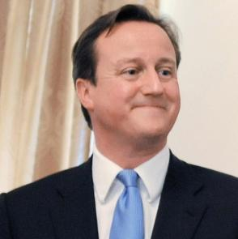
The Conservative party The Leader 4
2005 (Resignation of Howard)
1st Ballot 18th October 2005
David Davis 62
David Cameron 56
Liam Fox 42
Kenneth Clarke 38
2nd Ballot 20th October 2005
David Cameron 90
David Davis 57
Liam Fox 51
Membership Ballot 6th December 2005
David Cameron 134,446
David Davis 64,398

Slide 5
The Conservative party The Leader 5
The powers and duties of the Conservative leader.
The leader has complete discretion in his/her choice of colleagues for: -
the Shadow Cabinet or Cabinet.
Senior party officials such as the chairman. The chairman runs Conservative Central Office and the election campaign.
The leader has the last say in policy making.
Conservative MPs, members of the Cabinet or Shadow Cabinet and the National policy Forum may put their views but the leader has the final decision.

Slide 6
The Conservative party The Leader 6
The leader has the power to withdraw the whip but this is extremely rare e.g. Michael Howard expelled Ann Winterton MP for failing to apologise the joke about the deaths of 20 Chinese cocklers in 2004. It had previously not been done since 1942.
The leader appoints the party chairman.
As Prime Minister the leader will occasionally attend meetings of the 1922 committee. In opposition the leader will attend more frequently.
An incumbent Leader may be challenged if 15% of the Parliamentary Party send in a letter expressing no confidence; if this happens, a vote of confidence is held in the current Leader. A Leader who wins the vote of confidence is immune from challenge for the next year.
The only time this has happened was in 2003. Iain Duncan Smith was defeated by 75 to 90 on a motion of confidence.

Slide 7
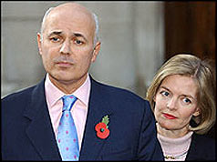
The Conservative party The Leader 7
The Conservative leader has a very wide powers and is subject to very little control by the party.
However whilst the Conservative party is willing to grant its leader considerable discretion it has not been prepared to allow leader to remain in office if it is felt that he or she has not made the best use of the powers of leadership, particularly if they have lost elections.
Iain Duncan Smith, his wife by his side, resigned soon after the vote

Slide 8
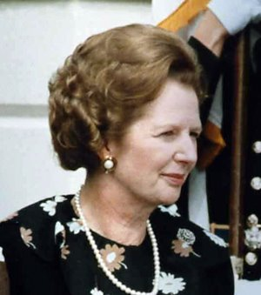
Conservatives leaders since 1945
1940-1955 Winston Churchill
1955-1957 Sir Anthony Eden
1957-1963 Harold Macmillan
1963-1965 Sir Alexander Douglas-Home
1965-1975 Edward Heath
1975-1990 Margaret Thatcher
1990-1997 John Major
1997-2001 William Hague
2001-2003 Iain Duncan Smith
2003-2005 Michael Howard
2005 David Cameron

Slide 9
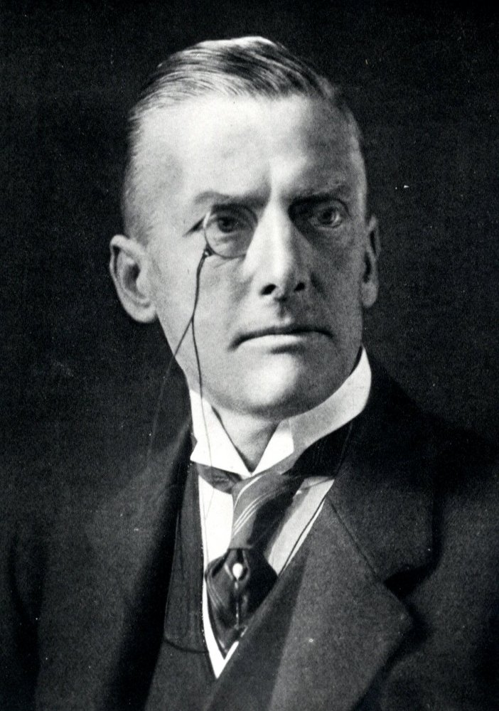
Conservative Parliamentary organisation 1
This is called the 1922 committee. Its official name is the Parliamentary committees it is never used.
Before 1922 there was no backbench organisation. In 1922 the leader’s policy of fighting the general election in coalition with the Lloyd George liberals was rejected at a meeting of conservative MPs at the Carlton club and the leader of Austin Chamberlain resigned.
The 1922 committee was formed to avoid such a gulf between the leadership and the backbench MPs occurring again.
It is composed of all Conservative backbenchers.
It excluded ministers when the parties in power, but this was changed in May 2010 although they may not vote in 1922 committee elections.
In opposition the Shadow ministers act as chairman of its policy groups.

Slide 10
Conservative Parliamentary organisation 2
The 1922 committee elect a chairman and executive. Graham Brady is the current chair.
Traditionally the chairman has been the channel of communication between backbenchers and the leader.
Votes are not taken at meetings, the views of the meeting are interpreted by the chairman. It has considerable influence.

Slide 11
The Conservative Party before 1998
The Conservative Party had no official constitution.
The party instead consisted of 3 separate components operating mainly on the basis of
The volunteers in the Constituency Associations (who were represented in the National Union of Conservative Associations)
The party professionals at regional HQ and at Central Office
Parliamentary Party MPs and MEPs.
One reason why the Conservative Party did not exist as a compact, legally recognized organization was that historically, the party had only existed in Parliament as a parliamentary group.

Slide 12
The Conservative Party since 1998
William Hague introduced reforms in 1998. In a ballot 96% supported the proposals (only 36% of membership voted).
The Conservative party now has a written constitution, a national membership scheme and for the first time the party's 3 separate components have been united within a single party structure.

Slide 13
Conservative party structure
1 The Board of 14 members
The Board has supreme responsibility for all aspects of party management outside Westminster including the party conference.
It normally meets once a month and is chaired by the party chairman.
It also responsible for running Conservative Central Office.
2. The National Convention
The NC is made up of national, regional and area officials, officers from constituency associations and members of affiliated organizations.
Its function is to channel grass roots views to the leader and to advise the Board on extra parliamentary organization.
Meets twice a year.

Slide 14
Conservative party structure
3. The National Convention Executive
Made up of 6 senior members with day-day responsibility for voluntary activity and is accountable to the board.
4. The Policy Forum
The aim of the policy forum is to allow ordinary members to play a part in devising policy by making proposals to conference.
It is chaired by the minister responsible for policy development. Like the NC, the forum has advisory powers.

Slide 15
Conservative Constituency Associations
There is a branch in each ward or polling district.
Direct officers raise money, conduct elections and appoint agents and candidates.
Each association has a chairman and other officers and executive committee.
Constituency associations used to be largely autonomous and free to run their own affairs. The 1998 reforms reduced their freedom in three ways.
A new ethics and integrity committee overseen by the board has been set up with the power to suspend or expel unsuitable members. This gives the National party some control over candidate selection.
The board can set efficiency criteria of each individual association if these are not met the board can order it to be reorganised and force its officers to be replaced.
Associations now have to submit accounts to Central office.
Conservative membership was estimated to be 177,000 in 2010.

Slide 16
National Annual Conference
Composed of representatives from the constituencies, all MPs prospective party candidates and important party officials.
It has no binding effect on party policy.
It is seen as a rally of faithful supporters and is an occasion for electioneering.
It is rare for party divisions to be shown at conference.

Slide 17
Summary
The Conservative party outside Parliament has always been seen as subservient to the party inside Parliament and has sometimes been described as the handmaid of the party.
The actual power is concentrated in the leadership of the party leader in particular.
The 1998 reform has given the party membership more say in the selection of the leader.

Slide 18
The Labour Party organisation
The Leader
Selection
Until 1981 selection was done by Labour MPs only.
1981 -1993 selection was done by a special electoral college made up of 40% trade union votes 30% Parliamentary Labour Party votes and 30% constituency Labour Party votes.
Since 1993 selection is done on the basis of 33% trade union votes 33% Parliamentary Labour Party votes and 33% constituency Labour Party votes.
Trade unions and constituency Labour parties were required to ballot their members individually with the results being allocated proportionally.
Only MPs can stand. They need the support of 12.5% of the PLP.
The alternative vote system is used.
The Deputy Leader is elected by the same system.
In 2011 Labour agreed that if national and local parties can recruit more than 50,000 registered supporters, this will trigger these supporters being given 3% of the electoral college. This could rise to 10%.

Slide 19
Labour Party leader
Powers and duties
Until recently these depended upon whether the Labour party was in power or opposition.
In September 2011 the Labour conference ended elections to the shadow cabinet.
Thus the leader has the power to appoint members of the Cabinet and government when in power and the shadow cabinet when in opposition. This includes the whips.
The Labour leader has no direct control over the withdrawal of the whip, this is a decision of the entire PLP. Withdrawal the whip is extremely rare.

Slide 20
Labour Party leader 2
The Labour leader in the past has had no direct control over their head office this is the function of the NEC which also appointed general secretary of the party.
Since 1983 a strategy committee has in practice given the leader control over head office.
In the past policy was made in theory by the conference this was downgraded in 1997.
The manifesto is approved by joint meetings of the Cabinet or Shadow Cabinet together with the NEC. Policy when the party is in power is also made by the Cabinet.
In theory the leader is only one amongst these groups although he is especially influential. However the prime ministerial government theory would place the leader in a more pivotal position.

Slide 21
Labour Party leader 3
The Labour leader was more circumscribed in his powers than the Conservative leader but recent developments have concentrated more powers in the Labour Party leadership.
Labour Party leaders have had great security of tenure in office.

Slide 22
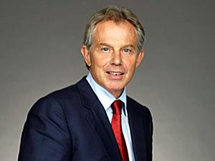
Labour Party leaders since 1945
1935 - 1955 Clement Attlee
1955 - 1963 Hugh Gaitskell
1963 - 1976 Harold Wilson
1976 - 1980 James Callaghan
1980 - 1983 Michael Foot
1983 - 1992 Neil Kinnock
1992 – 1994 John Smith
1994 – 2007 Tony Blair
2007 – 2010 Gordon Brown
2010 - Ed Miliband

Slide 23
The Parliamentary labour Party
Consists of all Labour MPs.
The PLP meets about once a week.
Motions are put and formal votes are taken.
The PLP has an important role in parliamentary tactics.
Since 1970 the PLP has elected a separate chairman.
It has subject and area committees.
Only the PLP as a whole can withdraw the whip.
It is never a solely backbench organisation.

Slide 24
The mass organisation of the Labour Party 1
The Labour Party reflects its origins. It was formed by trade unions and socialist societies.
There is representation for trade unions and socialist societies at both local and national level.
There are 4.7 million trade union members of the Labour Party and about 200,000 individual members.

Slide 25
The mass organisation of the Labour Party 2
The National Executive Committee is an important part of the administration and discipline.
It can suspend or discontinue a local party.
It decides on the expulsion of members.
The NEC together the Cabinet or shadow cabinet decides upon the manifesto – the joint policy committee.
There have been clashes between the leader and the NEC in the past but the leader has always played down the role of the NEC on such occasions.
There are regional parties.
The National Policy Forum develops policy in the party submits documents to the Labour Party conference which normally cannot be amended.
It has 184 members.

Slide 26
The mass organisation of the Labour Party 3
Constituency Labour Parties CLP
A CLP's main decision-making body is normally its General Committee or All Member Meeting. Day-to-day management is generally carried out by the Executive Committee (EC).
The General Committee is made up of delegates from Branch Labour Party’s, locally affiliated trade unions, socialist societies and the local branch of the co-operative party.
It elects the executive committee.
In many CLP’s the GC has been replaced by an All Member Meeting.

Slide 27
The mass organisation of the Labour Party 4
These CLP’s prime functions are a natural and very similar to the Conservative constituency associations.
Their most important function is the choice of parliamentary candidates.

Slide 28
Labour Party Annual Conference
Delegates to the conference are elected by Constituency Labour Parties, affiliated trade unions and socialist societies.
Currently, affiliated trade unions hold 50% of the votes at the conference – reduced down from 80% in 1993.
Ed Miliband plans to reduce it further to 40%.
The National Executive Committee leads the conference
Many critics argue that the Labour Party Conference has become less democratic in recent years and more like a party rally.

Slide 29
Conclusion
In both major parties there has been a move strengthen the party leader.
Both parties have experienced declining party membership.
PARTY MEMBERSHIP
1951 Conservative 2.9m - Labour 876,000
1971 Conservative 1.3m - Labour 700,000
1981 Conservative 1.2m - Labour 277,000
1991 Conservative 1m to 0.5m - Labour 261,000 - Lib Dem 91,000
2001 Conservative 311,000 - Labour 272,000 - Lib Dem 73,000
2011 Conservative 177,000 - Labour 190,000 - Lib Dem - 66,000 (Source: Estimates based on party reports and House of Commons Library)

