Slide 1
State and local elections
By Mike Allen

Slide 2
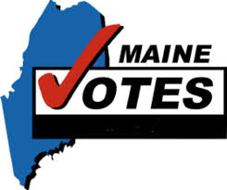
State and local elections ¹
There are also state representatives to be elected.
As at the national level, states are run by a head of government, the governor, and a parliament which, in all but one state, has a direct equivalent to the House of Representatives and the Senate.
The exception is Nebraska, which has a single-chamber assembly.
Unlike the national level, however, many of the people who work under the head of government are not appointed but directly elected, such as the lieutenant governor (equivalent, at state level, to the Vice President).
In addition, in many states the senior judges are also elected.
¹ All of these slides are from US Government and Politics by William Storey

Slide 3
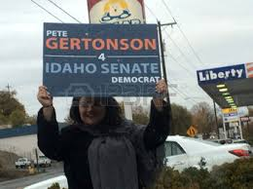

Slide 4
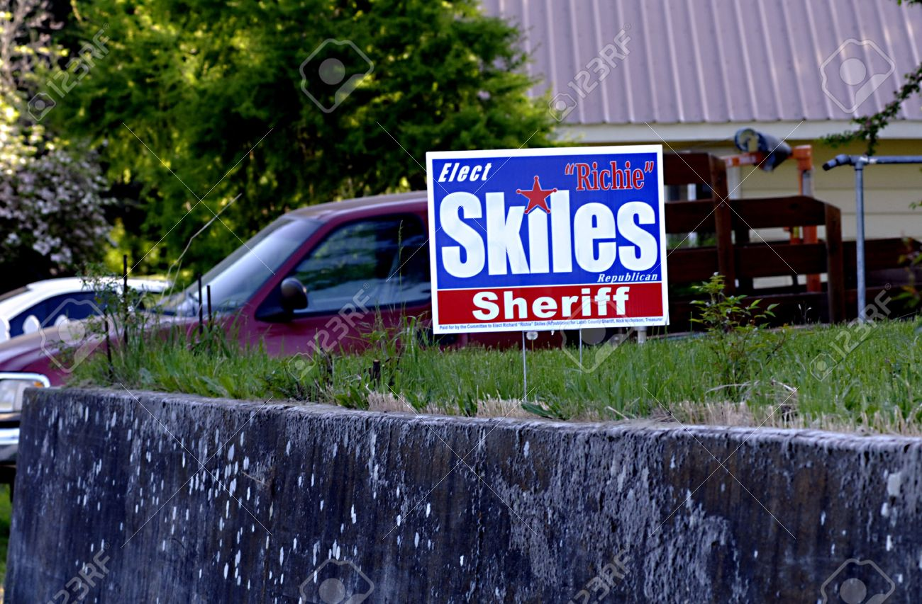
Local Elections 1
US citizens are entitled to vote for a wide range of local officials who make decisions that can affect the quality of life in a community.
The pattern varies in different parts of the country, but this may encompass
the people in charge of the justice system, including the most senior police officer (the Sheriff),
the senior prosecuting officer (the District Attorney)
and the district judge responsible for sentencing anyone convicted.

Slide 5
Local Elections 2
All across the USA, school boards responsible for delivering a high quality of education are elected
and in many areas the commissioners of sanitation services, such as garbage collection and water supplies, are elected.
In each case, the principle of accountability applies: if the quality of education at the local school is poor, or the garbage is not collected, with the associated hygiene risks, someone should be held responsible for the situation and for improving it.
All this is in addition to the elected local representatives found in most countries, such as the mayor and town council.
It has been calculated that over 1 million officials are elected in the US.
As elections for state and local representatives are often scheduled to take place at the same time as Federal elections, ballot papers can become extremely long and, at times, confusing.

Slide 6
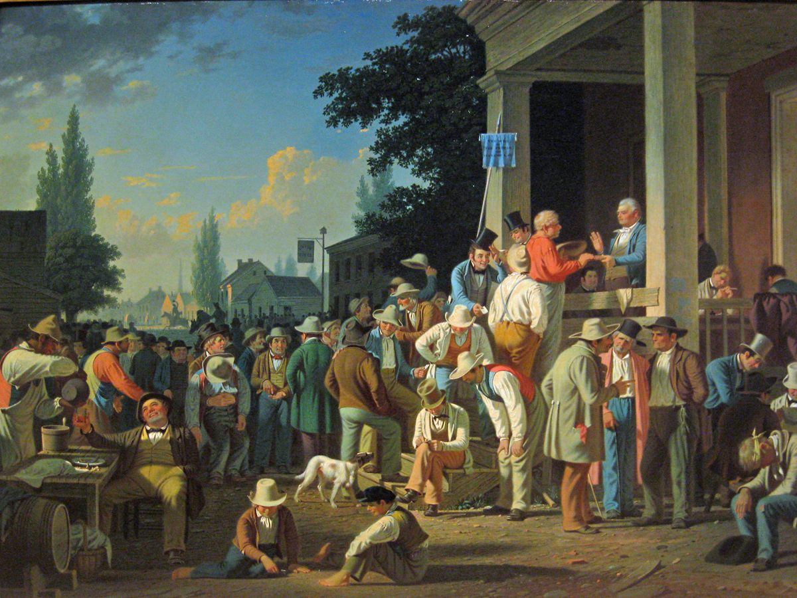
The County Election 1852 by George Caleb Bingham

Slide 7
The County Election 1852 by George Caleb Bingham
George Caleb Bingham’s “The County Election” pictures the American democratic progress.
Known as “the Missouri artist”, Bingham presents this raucous voting party as an enactment of democracy, bringing together residents of a rural community to make decisions for the common good.
In his crowded composition, Bingham suggests the inclusiveness of a democracy with representatives of every age and social stratum, except African-Americans, who would not enjoy the right to vote until after the Civil War, and women, whose right to participate would not be recognized for another seventy years.
The painting reveals other irregularities in the electoral system that would not be tolerated today. Because there was no system of voter registration, the man in red at the top of the courthouse steps swears on the Bible that he hasn’t already cast a vote.
Because there was no secret (or even paper) ballot, a voter calls out his choice to the election clerks behind the judge, who openly records it in a ledger.
Because there were no restrictions on electioneering, the well dressed gentleman behind the voter, one of the candidates, is free to hand his card to citizens just before they cast their vote. Yet none of this appears to dull the spirit of the voting process.
The elections sins portrayed by Bingham were meant as criticisms. The scene portrayed was the artist’s perception of an actual election, an election that Bingham lost and the well dressed gentleman, a Mister Sappington won.

Slide 8
Amendments to state constitutions
Each of the fifty states has its own constitution, separate from the national Constitution .
While the national Constitution is difficult to amend, state constitutions are amended frequently. In most cases, this requires the support of the electorate in that state and these decisions are added to the ballot papers at elections.
Often the issues covered are highly technical and of little interest to a majority of the voters. Thus, in Georgia in 2002, there were six proposed amendments to the state constitution, four of which were about changing the property tax regulations in order to promote the building of affordable properties and to encourage developers to clean up land contaminated with hazardous waste.

Slide 9
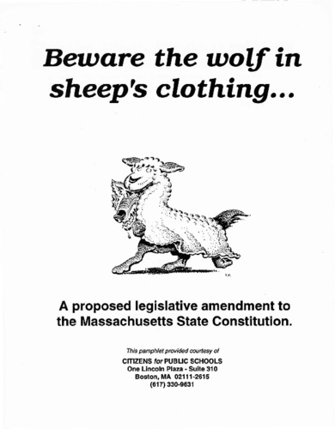

Slide 10
Initiatives, propositions and referenda 1
In twenty-three states and Washington DC, voters may be asked to vote on issues that have not been addressed by the state legislature but that groups of ordinary voters feel strongly about.
These are known as initiatives or propositions. If the required number of signatures can be obtained – from 5 per cent to 15 per cent of the electorate, depending on the state – the initiative will appear on the ballot paper at the next election for the voters to approve or reject. If the initiative is approved, it becomes law. The most-publicised initiatives in recent years have been in California. In 1994, Proposition 187 (entitled the ‘Save Our State’ initiative) was passed, denying all state services to anyone who cannot demonstrate citizenship or legal residency.

Slide 11
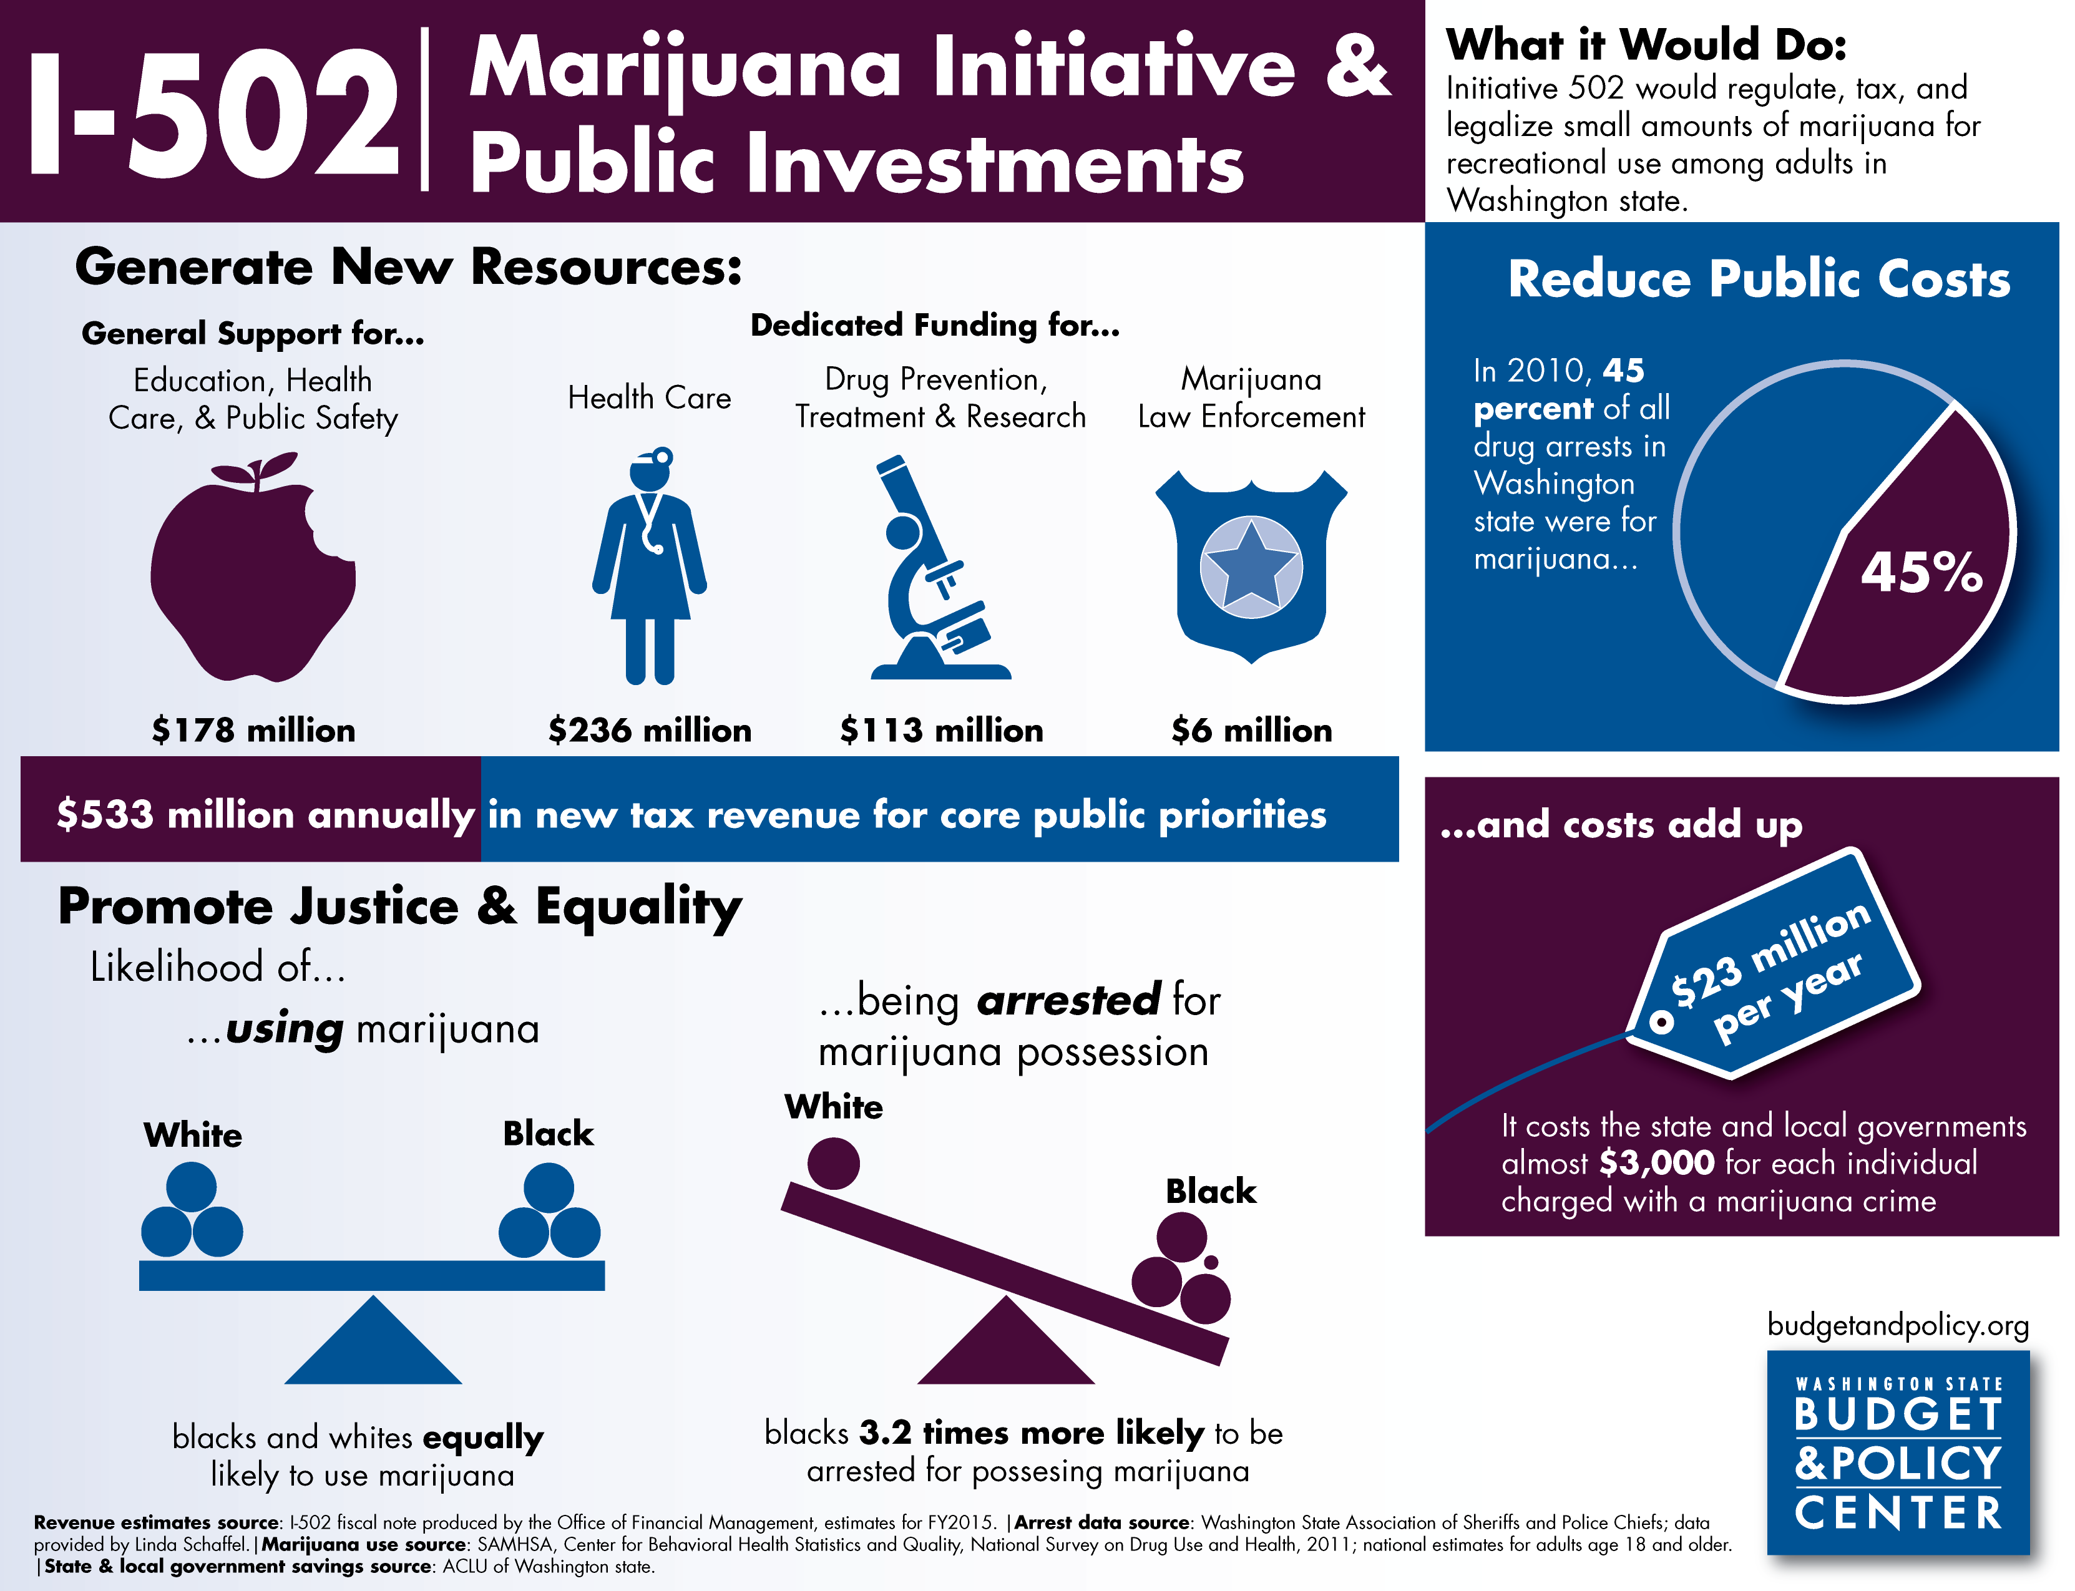

Slide 12
Initiatives, propositions and referenda 2
Referenda are a similar process, but instead of proposed laws being put on the ballot by private citizens, the state legislature offers the voters an opportunity to express a view on a law they have drafted.

Slide 13
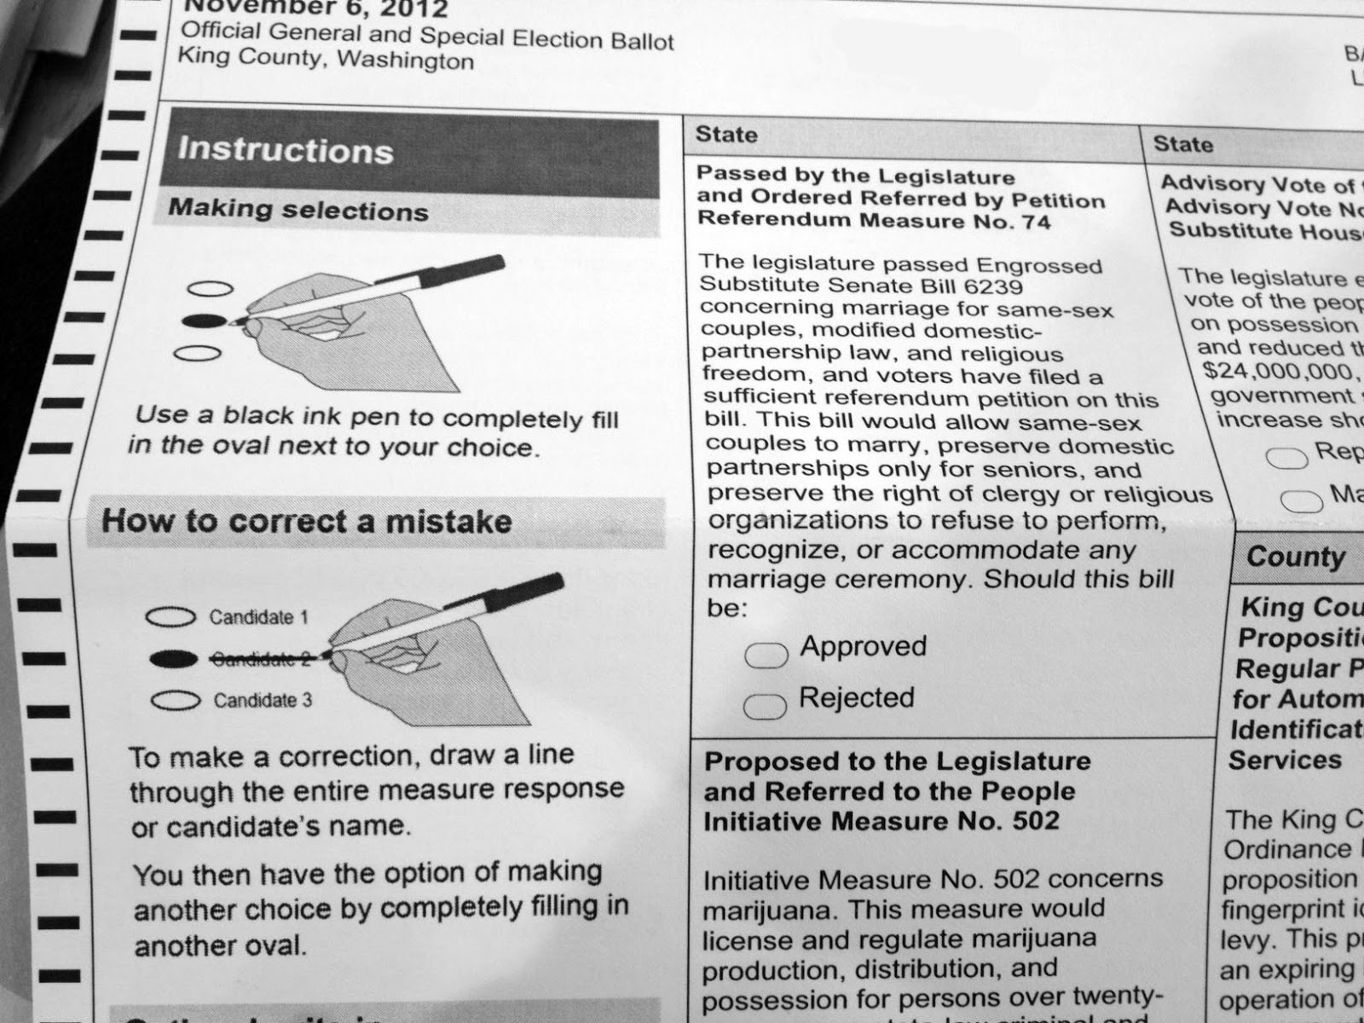

Slide 14
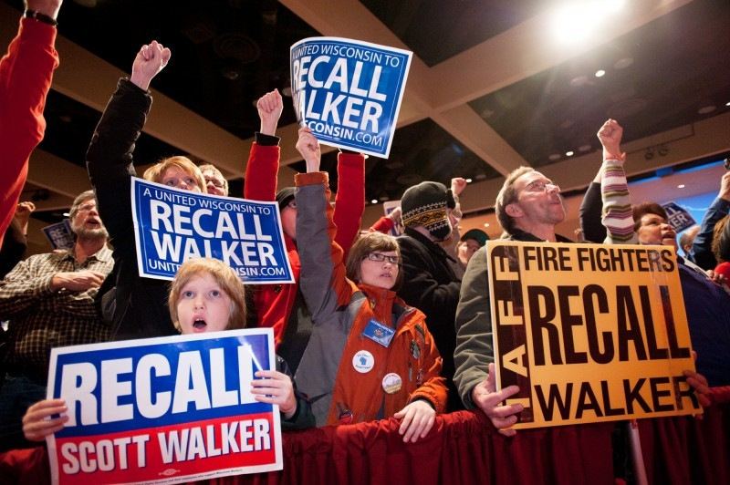
Recall elections are the process (permitted in twenty-six states) for removing officials from public office before their term has expired.

