Slide 1
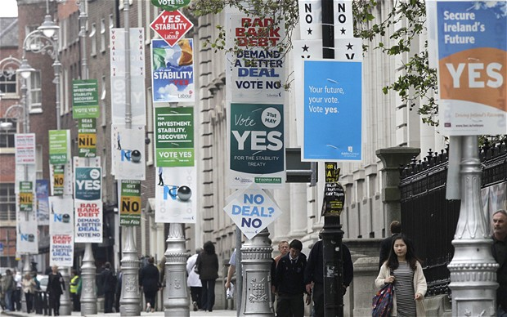
Referendums
By
Mike Allen

Slide 2
Definition
A referendum (also known as a plebiscite or a ballot question) is a direct vote in which an entire electorate is asked to either accept or reject a particular proposal.
It is a form of direct democracy.

Slide 3
History in UK 1
It was unpopular in the nineteenth and first half of the 20th century.
It became more popular from the 1970’s.
1973 Northern Ireland Border Poll
98.9% in favour on a 58.7% turnout. The nationalist parties campaigned for an abstention.
1975 EEC Membership endorsed staying in the EEC by 67.2% to 32.8% on a 64.5% turnout.
1979 Devolution for Scotland and Wales
Scotland voted in favour of devolution by 52% to 48% - but only 32.9% of the electorate had joined the majority not fulfilling the requirement of 40% of the electorate.
In Wales the vote was against devolution, by 80% to 20%.

Slide 4
History in UK 2
The Housing Act of 1985 allowed for the transfer of local government housing to housing associations and private landlords by a vote of the tenants. This was controversial because it effectively counted non voting tenants as voting Yes.
1997 Devolution for Scotland and Wales
In Scotland 74.3% were in favour turnout 60.2%
In Wales 50.3% turnout 50.1%
1998 Northern Ireland Good Friday Agreement referendum
Yes 71.1% No 28.9% Turnout 81.1%
The referendum in the Republic of Ireland on the same day, rather than seeking approval of the Agreement itself, sought endorsement of constitutional amendments required by the Agreement, and produced an overwhelming Yes vote

Slide 5
History in UK 3
1998 London Mayor
72% in favour turnout 34.1%.
2004 North East Regional Assembly
rejected by 77.9% on a turnout of 49%
Elected mayors in England and Wales
Thirty-seven local referendums have taken place in local authorities to establish whether there is support for directly elected mayors.
Thirteen received a "Yes" majority and twenty-four a "No" majority.
The highest turnout was 64% in Berwick-upon-Tweed (held alongside the 2001 general election) and the lowest was 10% in Ealing. On average, the turnout was similar to that of local elections.

Slide 6
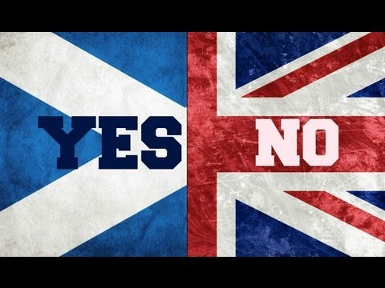
History in UK 4
2011 March Wales devolution extra powers
65% in favour turnout 36%
2011 May change of electoral system
No vote 67.9% Yes vote 32.1% turnout 41%.
2014 Scottish independence No 2,001,926 (55.3%) Yes 1,617,989 (44.7%) Turnout of 84.6% the highest recorded for an election or referendum in the United Kingdom since the introduction of universal suffrage.

Slide 7

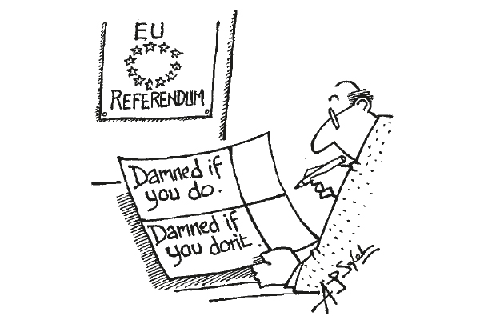
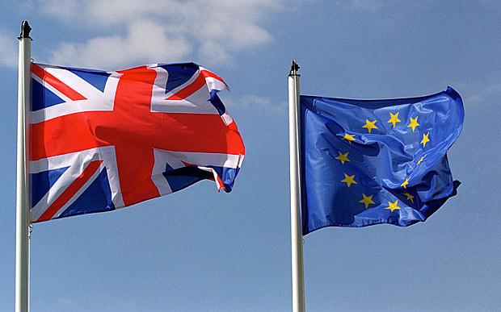
History in UK 5
European Union 2016 June

Slide 8
Arguments put forward in favour of referendums 1*
They are a very real form of direct democracy
They increase political participation; voting does not take place just every five years.
referendums can be a check on "elective dictatorships" during a government's 5 years span.
referendums provide a clear answer to a question the government might be 'asking'.
Referenda deal with a flaw in the mandate theory as voters can voice an opinion on a major issue. If the government listens to the people, it is likely to be gaining public approval and support.
Referenda can unite a divided party.
Referenda can provide a mandate for controversial policies.
Referenda legitimise important constitutional issues such as devolution.
* These arguments are from http://www.historylearningsite.co.uk/referendums.htm

Slide 9
Arguments put forward against the use of referendums 1
Referendums might result in "the tyranny of the majority". If the majority votes for it, does the government go ahead with it ? What about the wishes of the minority? How are these safeguarded?
They can be problems with the manipulation of the question.
People may vote for or against the Government rather than on the question.
Referenda are inconsistent with the belief in parliamentary sovereignty.
Issues might be too complex for a mere yes/no vote or for the public to understand.
The regular use of referenda could lead to apathy among the public.

Slide 10
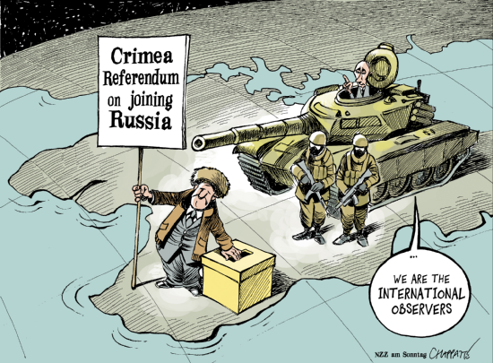
Arguments put forward against the use of referendums 3
There are effective alternatives : opinion polls and by-elections.
A low turnout can distort results. Only 34% of those who could have voted in the “Do you want a Mayor for London?” actually voted. 72% of these voted ‘yes’, 28% voted ‘no’. But 66% of Londoners failed to vote at all. This low turn out clearly favoured the supporters of the Mayor.
The results of a referendum might not be decisive. For Welsh devolution there was a 51/49 split.
Funding differences can affect results as government money can pour into a referendum and the group on the other side may well be not so well financed.
They may be used to justify dictatorial regimes

