Slide 1
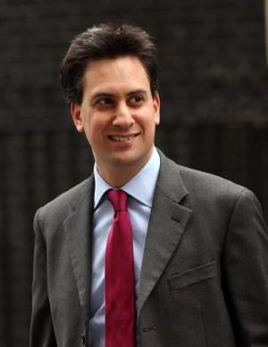
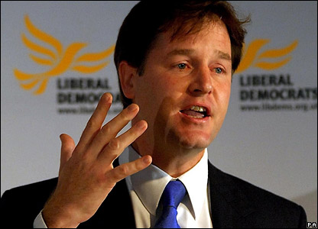
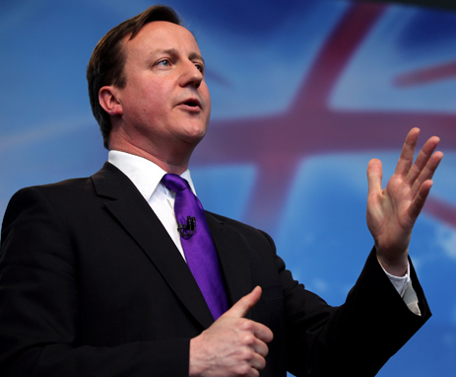
Political Parties
By
Mike Allen

Slide 2
Definitions 1
"A political party may be defined as an organised and recognisable group which puts itself forward as a unity and seeks support in order to gain power to govern the society in which it operates.“ Jim Cordell 'Essential Government and Politics‘
Political parties are organisations which have the aim of power in order to run a state according to agreed principles and policies.
However some small parties have no real hope of gaining power and contest elections more in the hope of influencing events.
Note that in contrast to pressure groups parties have the aim of political power - of being the government, or at the local level of running the council.

Slide 3
Definitions 2
"... a body of men united for promoting by their joint endeavours the national interest upon some particular principle in which they are all agreed“ Edmund Burke in “Thoughts on the causes of the Present Discontent” in Works II 1770.
But this would include all factions, it leaves out the idea of organisation.
“Party is the madness of many, for the gain of a few.” Jonathan Swift 1711

Slide 4
Development of Parties in the UK 1
Parties are a relatively new phenomena. They do not exist in ancient history.
Modern Political Parties are a development which stems from the development of representative government and the development of the franchise.
In the 18th century what were called parties we would now see as factions – loose groups of like minded people centred around particular personalities. These were the Whigs and the Tories.
These developed into the Liberals and the Conservatives in the 19th century.

Slide 5
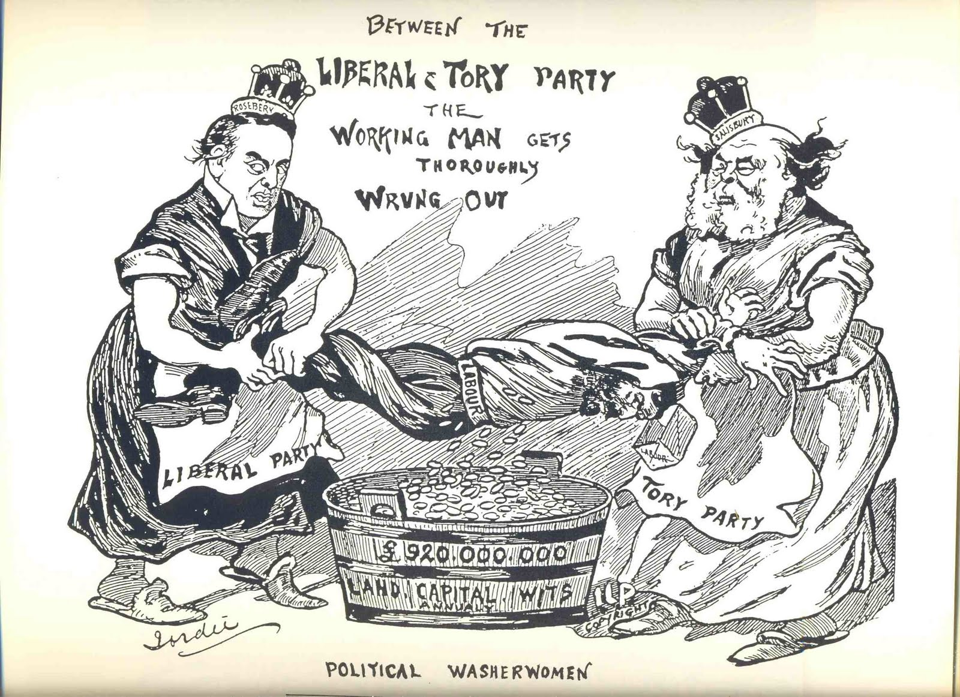
Development of Parties in the UK 2
The Labour Party was created outside Parliament by the Trade Union movement in order to gain parliamentary representation.

Slide 6
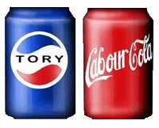
Types of Political parties 1
The Catch-all Party
This is a party that seeks to appeal to the widest possible range of voters. It would try to attract a wide range of opinions and groups.
Advocates believe that people with a broad variety of political approaches and viewpoints can unite within a single party to advance shared core issues, even if they disagree in other areas.

Slide 7
Types of Political parties 2
The Programmatic Party
Programmatic parties base their work on specific party programs.
They mobilize voters along social divides and issues. The aims and policy proposals outlined in those platforms draw from a certain set of ideological values (e.g. conservative, liberal, socialist, communist, or religious values).
The features of their respective programs are easily seen and the voter can easily choose between parties.
British political parties are a combination of both types.
The Labour party moved away from a programmatic base with the New Labour project in the 90s with the abandonment of Clause IV of its constitution in 1995.
It could be argued that the Conservative party has become more ideological since Mrs Thatcher.

Slide 8
The Differences between Programmatic and Catch-All Parties
Programmatic | Catch-All Parties
Ideological | Pragmatic
Long-term goals | Short term popularity
Fixed values | Flexible values
Shape public opinion | Follow public opinion
Traditional policies | Policy renewal
Class-based support | Classless support
Strong activist base | Weak activist base
From Essentials of UK Politics by Andrew Heywood

Slide 9
The functions of Parties 1 - What are they for?
Parties provide for representation. They allow the voter to make a choice between candidates. It is difficult for voters to know what individual candidates stand for, whereas a voter can become familiar with the positions of the main parties. It also enables a voter to vote for a government of their choice.
However¹ –
The electorate is not always well informed and rational in choosing between parties – the party image and the personality of its leader may be as important as its policies.
FPTP means a party needs only 35-40% of the vote to win a general election.
¹ The criticisms of the functions of parties are drawn from Essentials of UK Politics by Andrew Heywood.

Slide 10
The functions of Parties 2
To form a government In a parliamentary system of a government needs a majority of MPs in the Parliament in order to sustain it office and to pass its legislation. "I believe that without party, parliamentary government is impossible." Benjamin Disraeli 1872.
However the decline in party unity since the 1970s has weakened the majority party’s control of the Commons.

Slide 11
The functions of Parties 3
To provide an opposition The largest party not in the government forms the official Opposition (normally the second largest party). This acts as a check and a challenge to the government. Other parties not in government also provide opposition.
However the decline in support for the 2 major parties has divided the opposition.

Slide 12
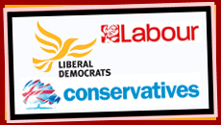
The functions of Parties 4
Parties recruit leaders They are a vehicle to select MPs and future governments.
However they rely on a relatively small pool of talent
Party activities may be poor training for running large government departments.

Slide 13
The functions of Parties 5
Policy formulation Parties develop programmes for government through such things as party forums, annual conferences and manifestos.
However it has been argued that the parties are tending to follow public opinion rather than trying to shape it.

Slide 14
The functions of Parties 6
Participation and mobilization They provide opportunities for citizens to join political parties and shape policy. They help to educate and mobilize the electorate through such things as canvassing, public meetings, advertising and party political broadcasts.
However-
Voter loyalty to parties has declined in 1964 44% had a strong attachment to a party compared to 10% by 2005.
Turnout in general elections has declined markedly since 1997. Only 59% in 2001 and 65% in 2010 – about 10% below the historical trend.
The membership of political parties has fallen from 3M in the 1960s to 800,00 in the early 2000s.

Slide 15
The functions of Parties 7 Conclusion
The only political systems that have no parties are ones where they are suppressed by force e.g. military dictatorships.
For all their faults they are the only means by which citizens can make an effective choice in a mass democracy.

Slide 16
The changing Party System 1 Types of Party system
A two-party System
There is a domination by two major parties
Power alternates between the parties.
A multi party system
No single party has sufficient support to win power alone.
Governments tend to be coalitions.
Governments may change between elections.
A dominant party system
One party has the majority of electoral and parliamentary support and tends to be in power for most of the time.
Examples are the Congress party in India 1948-1989. Fianna Fail in Eire 1932-2011.

Slide 17
The changing Party System 2 The UK
The Conservatives were the dominant party for much of the 20th century particularly in the interwar period.
A two party system existed between 1945 and 1970 between Labour and the Conservatives which took around 90% of the vote and over 90% of MPs.

Slide 18
The changing Party System 3
The 2 party system started to break down from 1974.
February 1974 saw a minority Labour Government.
October 1974 produced a miniscule Labour Parliamentary majority which only lasted to 1976 when Labour once more became a minority government and it was defeated on a vote of No Confidence in 1979.

Slide 19
The changing Party System 4
Although the Conservatives were in power from 1979-1997 it was partly because of Labour’s weakness and their national vote declined at each election. The 1992 election saw an overall majority of 21 which was reduced by election defeats and defections so that it became a minority government by December 1996.
The Social Democratic party was formed out of a breakaway group from Labour in 1981 it merged with the Liberal Party in 1988 to form the Liberal Democrats and produced further increases in support for the third party.

Slide 20
The changing Party System 5
The Labour Party was in power from 1997-2010. However this was achieved partly because of the weakness of the Conservatives and on a historically low vote. In 2005 Labour gained an overall majority of 66 on only 35% of the vote.

Slide 22
The changing Party System 6
Devolution has transformed the party situation with PR in use. In both Scotland and Wales there are multi party systems.
In Scotland the Scottish National Party has increased its support.
It has had continuous representation in the UK parliament since 1967 and currently has 6 seats.
It has improved its position in the Scottish Parliament and in the 2011 Scottish Parliament Election gained 45.4% and 69 seats (including 53 First Past the Post seats) and formed the first Scottish government with an overall majority.

Slide 23
The changing Party System 7
In Wales the Welsh nationalists Plaid Cymru have had less success than the SNP in Scotland.
It first won a parliamentary seat in 1966 and has had continuous representation in the UK parliament since 1974 and currently has 3 seats.
It gained 28% of the vote in the 1999 Welsh Assembly but its vote has since declined and in 2011 it gained 19% of the vote.

Slide 24
The changing Party System 8
Northern Ireland
The Unionist party dominated Northern Irish politics from 1922 to 1970 and won every election to the old Stormont Parliament. It won 10 or 11 of the then 12 NI seats in the UK parliament and its MPs took the Conservative whip.
It gradually lost its support and has been supplanted by the Democratic Unionist Party as the principal protestant party. The DUP currently has 9 UK seats.
Sinn Fein increased its support from the Catholic community and has 5 UK seats.
It has replaced the Social Democratic and Labour Party as the main catholic party but this still has 2 UK seats.
The non sectarian Alliance Party has 1 UK seat as has an independent unionist.

Slide 25
The changing Party System 9
The 2010 election saw 85 MPs from parties other than Labour or Conservative as opposed to 38 in 1974.
PR at European elections has enabled small parties to gain representation and this has given them greater credibility in UK parliamentary elections.
Thus the Green party gained its first MP in 2010 and UKIP emerged as the 4th party even though it did not gain a UK parliamentary seat.

Slide 26
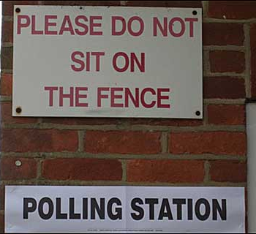
The changing Party System 10
Thus we have a much more multi party system in the UK than previously.
The electoral system has disguised this trend to some extent but it appears that it will continue.
A politician is a person with whose politics you don't agree; if you agree with him he is a statesman - David Lloyd George

