Slide 1
Party Ideas and Policies 2
By
Mike Allen

Slide 2
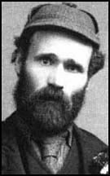
Labour Party Formation
The Labour Party was formed in 1900 by some of the trade unions and some small socialist parties.
Throughout its history there have been divisions between those on the left of the party who believe in some form of socialism and the moderates or right wingers who believe more generally in reform.
“Socialism is an ideology that covers beliefs ranging from revolutionary communism to reformist social democracy). The central idea of socialism is that people are social creatures who are bound together by a common humanity. The defining values of traditional socialism are:
Fraternity — literally, brotherhood; bonds of sympathy and comradeship between people.
Cooperation — a preference for people working together rather than competing with one another.
Equality — the desire to abolish or at least reduce class divisions.”
Essentials of British Politics Andrew Heywood 2011

Slide 3
Labour Ideas and Policies 1
Clause IV of the Labour party constitution 1918 stated that the aim of the Labour Party was the common ownership of the means of production distribution and exchange.
This has led the party to nationalise major industries, particularly in the 1945-51 period.
Traditional Socialists are opposed to the vast inequalities of wealth and income that exist in a capitalist society such as Britain.
They believe that the root cause of this is the ownership of capital (or industry and business) that is concentrated in the hands of the rich who then use their power to exploit the poor and the working classes.
Their solution was to transfer the ownership of capital to the people and to centrally plan the economy.

Slide 4
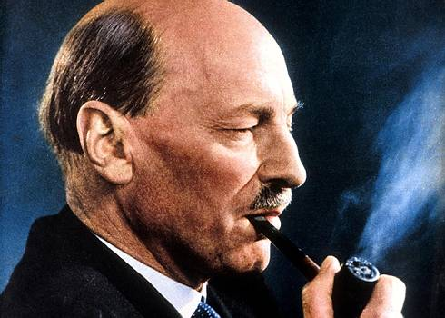
Labour Ideas and Policies 2
In practice the Labour Party has never been in favour of a totally state owned and directed economy and at the most talked about nationalising the commanding heights of the economy, i.e. the main industries.

Slide 5
Social democracy
Became associated with 3 key policies
A mixed economy partly private, partly publicly owned
Economic Management – an economy run and managed by the government. They were particularly influenced by the ideas of John Maynard Keynes who argued that governments could achieve full employment by reflating the economy through higher public spending.
Comprehensive Social Welfare – the establishment of the welfare state 1945-51

Slide 6
Labour Ideas and Policies in the 50s and 60s
In the 50s and 60s the Labour Party accepted the mixed economy and only advocated a little more nationalisation, though a minority on the left of the party wanted much more.
In the 50s these were led by Aneuran ("Nye") Bevan and were called Bevanites or fundamentalists.

Slide 7
Labour Ideas and Policies in the 50s and 60s
In the 50s Nationalisation had become much less popular in the country and within the Labour party and some saw it as a major reason why Labour had lost 3 successive elections.
Some in the party wanted to change the interpretation of what socialism meant.
Particularly important amongst this group was Anthony Crosland and his book "The Future of Socialism" published in 1956.
They were known as "Revisionists" because they wanted to revise ideas about socialism. They also are opposed to inequalities and argued that combating inequality was what socialism was about.

Slide 8
Labour Ideas and Policies in the 50s and 60s
However they did not see the ownership of capital as the only cause of inequality.
Crosland argued that control of business was more important than ownership for a Labour Government intent on redistributive policies in favour of the poorer sections of society.
Revisionists hoped to achieve higher rates of economic growth for Britain by economic planning in order to be able to get increased revenues from taxation without having to raise taxes. This could then be used to fund increased spending on social services.

Slide 9
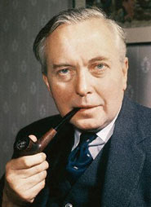
Labour Ideas and Policies in the 50s 60s and 70s
Hugh Gaitskell made an attempt to revise Clause 4 of the Constitution in 1958 but abandoned the attempt in the face of wide spread opposition within the party.
The moderate revisionist policies largely became the programme of the Labour Party in the 50s and 60s.
They followed policies along these lines when in government in 1964-70 and 1974-79 but were largely unsuccessful in getting higher rates of economic growth.
They tended to favour direct taxation such as income tax over indirect taxation on the grounds that the former was fairer because it is based on the principle that the more you earn the more you pay in tax.

Slide 10
Labour
They increased public spending on social services when in power and passed anti discrimination laws e.g. the Race Relations Acts 1965,68 and 76, and the Equal Pay Act 1970, and the Sex Discrimination Act 1975.
In the 60s and 70s they also introduced comprehensive education into most state secondary schools. There were a variety of reasons for this but the most important was the argument that it was fairer to have all school pupils in the same type of school rather than to split them at the age of 11 and concentrate resources on the top 20% academically.

Slide 11
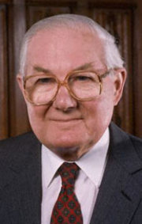
The Labour Government of 1974-79
Came into power with quite left wing policies in the manifesto including a long list of industries to be nationalised, a wealth tax, and government and company planning agreements.
In practice the government only nationalised aircraft and shipbuilding, and British Leyland when it became bankrupt and did not introduce a wealth tax.
They also introduced policies that the left wing opposed such as an Incomes policy 1975-79 and public spending cuts in 1976. This was due to the economic problems that Britain was facing.
The Labour Government ended in disarray after a series of damaging strikes known as "the winter of discontent" against the incomes policy, and it was finally defeated on a Vote of No Confidence in 1979 which precipitated the May 1979 general election which was won by the Conservatives.

Slide 12
1979-83
After 1979 the moderates in the party were eclipsed and the left wing led by Tony Benn were in the ascendancy.
They were determined to change the constitution of the Labour Party to put the leadership of the party more under the control of the party outside parliament. They were successful in getting a change to the election of the party leader to include the TUs and CLPs as well as the MPs, and compulsory reselection of MPs was also adopted. They failed to get a change in the way the manifesto is written.
More left wing policies were adopted.
These include renationalisation of all the privatised industries, opposition to the sale of council houses, withdrawal from the European Community, selective import controls,
a unilateral nuclear disarmament policy and a massive £10 Billion programme of public spending to reduce unemployment.
The years of the early 80s saw great divisions in the party between left and right, and in 1981 part of the right wing of the party broke away to form the Social Democratic Party. This severely weakened the party. The left right divisions did not cease however.

Slide 13
1983-92
The party was very badly defeated in 1983 with its worst result in the post war period.
This led to the election of Neil Kinnock as leader (1983-92). He sought to reorganise the party machine to make it better at campaigning for elections and to change party policies to make the party more moderate and more attractive to voters.
A challenge by Tony Benn for the deputy leadership in 1982 saw the left divide with the Hard Left or Bennites supporting Benn and traditional left wing socialism, and the Soft Left who were not willing to support Benn and who later supported Kinnock in his attempts to make the party more electable.
The Hard Left increasingly marginalised in the Labour party. When Benn challenged Kinnock for the leadership in 1988 he only got 11% of the vote to Kinnock's 89% and the Campaign group of hard left MPs had only about 30 members.

Slide 14
Policies under Kinnock 1983-92
Kinnock also changed the policies of the party. Opposition to the European Community, the sale of council houses, import controls and the pledge to wholesale renationalisation were all dropped before the 1987 election. The plan for increased spending to create employment was scaled down from $10B to £6B.
Kinnock was a lifetime unilateralist but even this policy was changed after the defeat of 1987 and the Labour policy review of 1987-9 saw Labour move back to acceptance of the nuclear deterrent and to accepting Trident.
Kinnock and Hattersley issued a statement of Democratic Socialist Aims and Values in 1988 which accepted the principle of the market though they emphasised its limitations and the need to remedy these deficiencies.

Slide 15
John Smith 1992-4
Kinnock resigned after the defeat for Labour in 1992 and John Smith became leader (1992-4). He continued the reforms of the party, backing the introduction of one member one vote for the selection of parliamentary candidates and the abolition of the block vote.
He was very cautious in policy but committed the party to full employment and to a Bill of Rights.

Slide 16
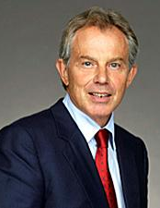
Blair
Tony Blair was elected leader in 1994.
He moved to reform Clause IV of the Labour party constitution and a new Clause IV was adopted in 1995. This reads:-
The Labour party is a democratic socialist party. It believes that by strength of our common endeavour we achieve more than we achieve alone , so as to create for each of us the means to realise our true potential and for all of us a community in which power, wealth and opportunity are in the hands of the many not the few, where the rights we enjoy reflect the duties we owe, and where we live together, freely, in a spirit of solidarity, tolerance and respect.
Essentially this means the abandonment of the old fashioned style of socialism.

Slide 17
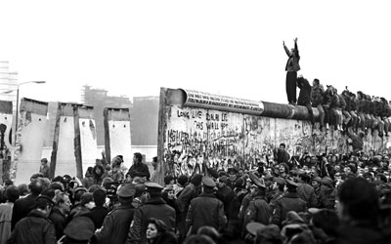
Collapse of Communism
The collapse of communism in eastern Europe in 1989-90 has undermined the position of the left.
Soviet state ownership with state planning served as an alternative model to capitalism.
Its collapse, together with the revelation that the true situation on these economies was worse than the official propaganda, meant that no credible alternative exists and has lead many socialists to try to come to terms with the market.

Slide 18
New Labour 1
It sought to blend market orientated economic policies with support for public services.
Market economics - they accepted privatization, reduced power for Trade unions and deregulation. The Bank of England was made semi independent in setting interest rates.
A big increase in spending on health and education after 2001.
Constitutional Reform - devolution, House of Lords, Bill of Rights, Freedom of Information Act Greater London authority. Though electoral reform was dropped.

Slide 19
New Labour 2
“Third way” Welfare
Blair believed that public services should be more market orientated and consumer responsive. This produced more targeted benefits and public-private partnerships in
Community
This counteracts the individualism of the new right and avoids collectivism whilst relating to fraternity and cooperation.
Community values suggest an unselfish concern for others, an inclusive interest for all rather than the divisions of class, and suggests small scale decentralised participation. It is similar to wet Conservative notions of 'one nation conservatism'.

Slide 20
New Labour 3
He also used the concept of a stakeholder society and a stakeholder economy.
This seems a fairly vague concept meaning that society needs to be inclusive of all members of the community to strive together for a better society and more successful economy in which all can share. There is also an emphasis not only upon rights but also on the responsibility of people to others.

Slide 21
Old Labour and New Labour
Old Labour | New Labour
Ideological | Pragmatic
Working Class | “Big Tent” politics
Managed Economy | Market Economy
Social Justice | Social Inclusion
Universal Benefits | Targeted Benefits
Cradle to grave welfare | Welfare to Work
Traditional constitution | Constitutional reform

Slide 22
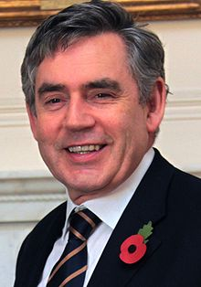
Labour under Brown 2007-10
This was dominated by the financial crisis beginning in 2008.
The government put £37B into HBOS, the Royal Bank of Scotland and Lloyds TSB which were partly nationalised.
Interest rates were reduced – a monetary stimulus

Slide 23
Labour under Brown 2007-10
Spending was dramatically increased – a fiscal stimulus. The idea was to stimulate demand and promote growth – the idea is that the deficit will shrink as tax revenues are increased.

Slide 24
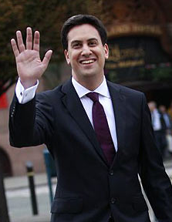
Labour under Miliband 1
A return to Keynesianism Labour argues that the coalition’s cuts are to hard and to harsh and that there should be a fiscal stimulus to the economy to promote growth.
It appears that New Labour is on the wane.
a Mansion Tax on properties worth more than £2 million to fund the NHS.
an Income Tax cut for 25 million workers by halving the lowest rate of Income Tax to just 10%

Slide 25
Labour under Miliband 2
Bring back the 50p rate for High Earners.
No more borrowing to pay for day to day spending & this will be enshrined in tough new fiscal rules.
Repeal the Tory NHS Act of 2012 that accelerated NHS privatisation & subjected the NHS to EU Competition Laws.
A law making Private Health, and other firms subject to the Freedom of Information Act.
More powers to Local Councils.
Tax breaks to firms who pay the Living Wage.
Minimum Wage to have its value restored.

Slide 26
Labour under Miliband 3
Build 200,000 homes, with a special focus on Social Rentals, a year by 2020.
cap rail fares by preventing Rail Fares rising more than 1% above inflation
Repeal the Bedroom Tax.
Freeze fuel prices.

Slide 27
Labour under Miliband 4
Tougher stance on immigration.
1. “Action to ensure that when people cross our borders they are counted – in and out – so we know who is here, who has gone home and who has stayed so we can deal with illegal immigration.”
2. “Introduce a law to make it a criminal offence to exploit workers, wherever they come from, with the aim of illegally undercutting wages or conditions here.”
3. “Tackle specific problems, for example, introducing laws preventing recruitment agencies hiring only from abroad and those that allow them to exploit loopholes to undercut directly employed staff.”
4. “Make sure opportunities are available for our young people here…a Labour government will require any large employer who hires a skilled worker from outside the EU to train apprentices here.”
5. “People also want to know that when people come here, they will play a full part in our society. It’s good for all of us… a Labour government would ensure that public sector workers in public-facing roles have minimum standards of English.”

Slide 28
Conclusion
Fundamentally the modern Labour party resembles a moderate European Social Democratic Party. It has no commitment to nationalisation.
There is a tendency for the Labour party to become more left wing after a period in office – where some disappointed by what was achieved gain more influence.
However since changes have made the conference less powerful and increased the power of the leader this may be less prevalent.
It is less ideological and more of a catch all party.

