Slide 1
Party Finance
By Mike Allen

Slide 2
Sources of Party Finance
Subscriptions
Fund raising activities
Donations
  Individual
  Corporate
  Trade Unions

Slide 3
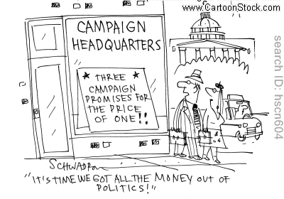
Problems of Party Finance 1
Membership of political parties has dropped with only about 1% being members of political parties compared to 3.5% in the 50s.
This has led to the Conservative party being dependent on large business and private individual donations.
Labour has always been heavily dependent on Trade Union finance. Affiliated Trade Unions pay affiliation fees and also give donations particular towards election times.

Slide 4
Problems of Party Finance 2
New Labour successfully sought donations from wealthy individuals and reduced its dependency on Trade Unions to 64% however that left it also dependent a relatively few individuals.
The Liberal Democrats are less dependent on donations but even they are relatively dependent for that income on a few individuals.

Slide 5
Restrictions on Parties
The Political Parties, Elections and Referendums Act 2000 was an act that established the Electoral Commission and required all political parties to register with it, set down accounting requirements for political parties, and introduced controls on donations.
Parties are only allowed to accept donations in excess of £500 from "permissible donors", defined as either individuals on the electoral register, or political parties, companies, trade unions or similar organisations that are registered in the UK.
Donations over £1,500 to an accounting unit (such as a constituency party) must be reported to the Electoral Commission.
or over £7,500 to a central party, must be reported to the Electoral Commission.

Slide 6
Limits on Party Spending in Elections
£25,000 plus 7p for each elector in a county constituency and 5p in a borough constituency.
General Election £19.5m.

Slide 7
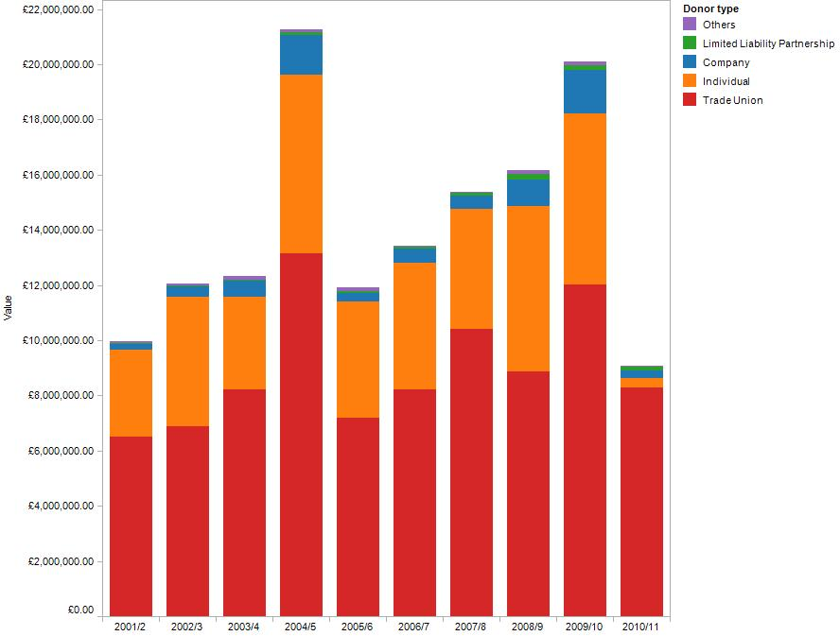
Labour Party Finances
Trade union funding now accounts for 91.3% of cash and non-cash donations to the party’s central office, up from 59.9% last year

Slide 8
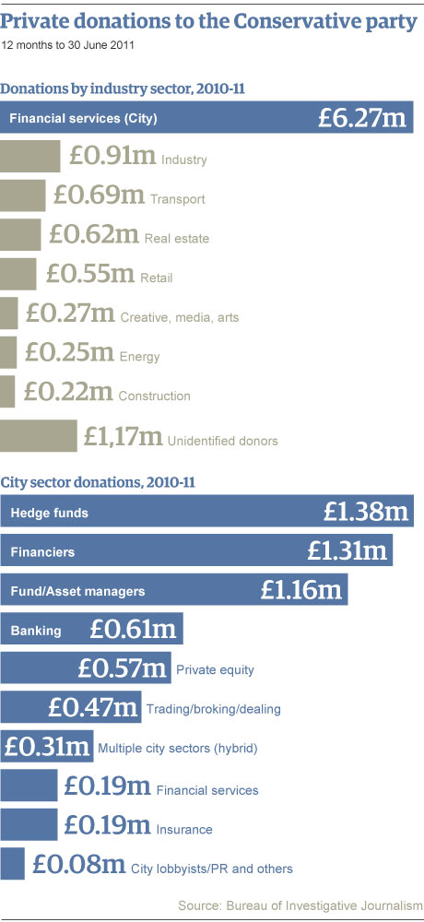
Breakdown of Conservative donations

Slide 9
The significance of donations over £250,000 for the main three political parties, from January 2001 to June 2010
 | Total no of donations | No of donations over £250,000 | Total value of all donations (£million) | Total value of donations over £250,000 (£million) | % Share of donations over £250,000 by value (%)
Labour | 10,190 | 151 | 150.2 | 80.7 | 54
Conservatives | 8,050 | 65 | 142.4 | 39.9 | 25
Liberal Democrats | 4,760 | 8 | 25.6 | 4.1 | 16
Total | 23,000 | 224 | 318.2 | 124.7

Slide 10
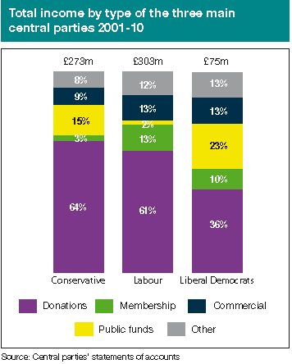

Slide 11
Donations and public funds received by political parties Q1-4, 2014
 | Party | Donations (£'s) | Public Funds | Total
 | Conservative | 28,950,917 | 152,663 | 29,103,580
 | Labour | 18,523,701 | 7,541,143 | 26,064,844
 | Lib Dem | 8,096,689 | 492,198 | 8,588,887
 | Scottish National Party | 3,772,594 | 352,854 | 4,125,448
 | UKIP | 3,500,570 | - | 3,500,570
 | Green Party | 648,660 | 63,356 | 712,016
 | Plaid Cymru | 184,584 | 79,221 | 263,805
 | BNP | 155,414 | - | 155,414
Source: Electoral Commission

Slide 12
State financing of Political Parties 1
Since 1974 the so called Short money has been paid to opposition parties in the Commons to help them with their parliamentary work.
Since 1996 the similar Cranborne money has been paid to opposition parties in the Lords to help them with their parliamentary work.

Slide 13
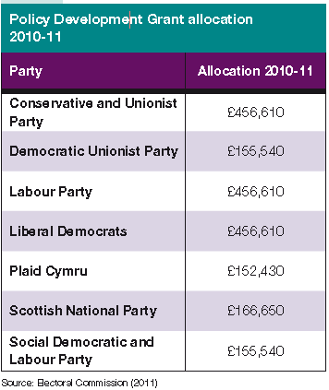
State financing of Political Parties 2
The Political Parties, Elections and Referendums Act 2000 provided for policy development grants for policies to be included in the manifesto.
Currently limited to £2M

Slide 14
State financing of Political Parties 3
The salaries of the Leader of the Opposition and Opposition Chief Whip and their counterparts in the Lords are paid from public funds.
Unusually among developed states, the UK has a ban on paid political advertising on radio and television. Political parties do not have to pay for the air time they obtain for party political broadcasts.
The cost of this indirect subsidy to political parties has been estimated to be in the region of £68m in an election year and £16m in a non-election year.
Candidates are allowed free postage for one election communication to every address or elector within the relevant electoral area for parliamentary elections and European parliamentary elections.
The cost of free post for general elections was in the region of £20m
The Representation of the People Act 1983 also provides for candidates to have free use of public buildings – schools or any other building maintained by public money – for public meetings during campaigns for parliamentary elections, local elections, European Parliamentary elections, and by-elections.

Slide 15
Possible Reforms 1
A change from opting out to opting in to the political fund. This was the case between 1927 and 1946 and the Labour Party lost about 30% of its trade union income. It would place it at a further disadvantage to the Conservatives.

Slide 16
Possible Reforms 2
A cap on donations. Sir Philip Hayden was given the job of reviewing the area and reported in 2007. He suggested a cap of £50,000 but distinguishing between trade union affiliation payments which would not be subject to the cap and other TU donations which would.
Various other caps have been suggested particularly £10,000.
The problem is that it would reduce the parties income and impair their ability to carry out their work.

Slide 17
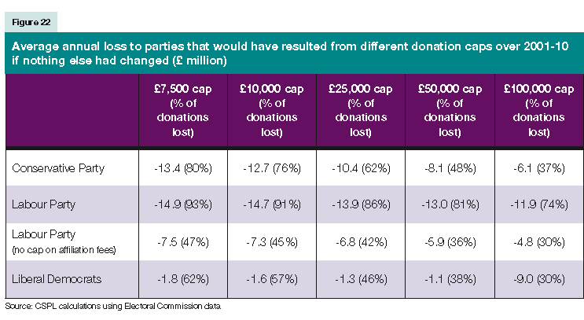

Slide 18
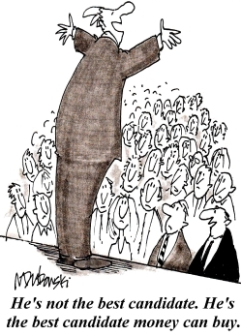
Greater State financing of Parties – Arguments For 1
Political parties are an integral part of the democratic process and governance and as such, a state will have to financially support it if it is to see a productive democracy. In essence, the tax payer should pay for the democracy he enjoys, just as he would pay for any social infrastructure and service.
It helps curb corruption.
To compensate parties for limits on private funding.

Slide 19
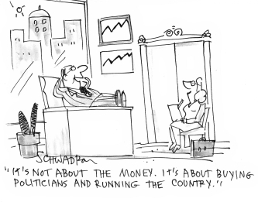
Greater State financing of Parties – Arguments For 2
Another argument is that since these parties are there to offer alternatives to what the party in power offers, there needs to be a fair chance for the parties not in power to contest with the incumbent party.
Our political parties all face long-term financial instability because of the rising costs of their business.

Slide 20
Greater State financing of Parties – Arguments For 3
Funding from traditional sources goes down and yet demand for better and more sophisticated policy research increases . This would lead to parties becoming substandard and unable to adequately run either themselves or the country.
Another argument for state funding is the fact that in a country where the voting system is already stacked against minority parties it is unfair that the funding of parties mirrors this. The Liberal Democrats who at the last election had just over half as much of the vote as the Conservatives raised over 10 times less than them at the last election (£42.5m-£3.8m). Supporters of state funding argue that this is a deeply unfair democratic deficit, one of many in our system and something that should be put right.

Slide 21
Greater State financing of Parties
A system which involves state funding is one employed in the USA and Germany by which the state will match private donations. This means that the donator in giving to their chosen party knows that their money will be partially or wholly matched by the state. The party will be encouraged to really go on funding drives and hopefully increase public awareness about politics at the same time while knowing that they will benefit from all money given which the state will match.

Slide 22
Greater State financing of Parties – Arguments Against 1
People may be unhappy with funding parties which they do agree with. Many people would be opposed to funding the campaign of the British National Party.
Contrary to those in favour of a system of state funding could in fact make it more difficult to break in to the British political system particularly if funding was decided on the party's performance at the last election.
It would be unfair to independents.
Parties might no longer make such strenuous efforts to raise money at the grassroots level. Local party member activities would be stopped which would discourage membership of political parties and therefore reduce the amount of political participation by normal citizens and cause the political process to become further alien to the electorate and perhaps reduce turnout further.

Slide 23
Greater State financing of Parties – Arguments Against 2
Parties should not be funded out of the public purse when there are so many other pressing concerns, such as education and healthcare.
It is a right for anyone to be able to make a donation to a cause they strongly believe in, and to curtail this right is to curtail liberty.

Slide 24
Conclusion
It seems unlikely that further state funding will be undertaken because it is deeply unpopular.

