Slide 1
Lord John Russell
By
Mike Allen

Slide 2
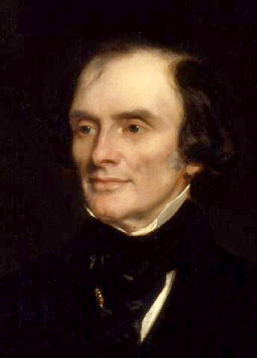
Lord John Russell 1792- 1878¹
Sketch
“In person diminutive and rickety, he wriggled round, played with his hat, and seemed unable to dispose of his hands or his feet; his voice was small and thin, but notwithstanding this, a house of five hundred members was hushed to catch his smallest accents. You listened, and you felt that you had heard a man of mind, of thought, and of moral elevation.” Charles Sumners 1838.
1853
¹ adapted from http://spartacus-educational.com/PRrussell.htm

Slide 3
Lord John Russell 1
He was the younger son of the 6th Duke of Bedford
He was a premature baby and was often ill.
He briefly attended Westminster school but was mostly educated at home.
He went to Edinburgh university.
In 1812 he became an MP. He was also granted the courtesy title, Lord Russell.
In the House of Commons Russell supported the Whigs and in 1817 he made a passionate speech against the decision by Lord Liverpool and his government to suspend Habeas Corpus. Russell also took an active part in the campaign for parliamentary reform.
For the next twelve years Russell was the leader of the Whig campaign in the House of Commons for parliamentary reform.
When he proposed the motion for an investigation into parliamentary representation in 1822, the motion was defeated by 105 votes.
An attempt by Lord Russell to introduce a bill to reduce bribery at elections also ended in failure

Slide 4
Lord John Russell 2
In February 1828 he proposed a bill that would repeal the Test and Corporation Acts. Russell was totally opposed to this law under which no Catholic or Protestant Non-conformist could hold public office. Supported by Robert Peel, Lord Palmerston and William Huskisson the bill was passed with a majority of forty-five.
The following year Lord Russell led the successful campaign for the Catholic Relief Bill. As a result of these measures Catholic Emancipation was finally achieved.
After the Duke of Wellington resigned in November 1830, Lord Grey formed a Whig administration and Russell was offered the post of postmaster-general. the government's proposals for changing the electoral system.
Lord Russell introduced the Electoral reform bill in the House of Commons in March 1831. After it was rejected by the House of Lords he reintroduced it on December 1831. As a result of Lord Russell's perseverance the Reform Act was finally passed on 7th June, 1832.

Slide 5
After the general election for the new reformed House of Commons, the Whig government had a majority of 315. Earl Grey and his colleagues were now in a position to try and introduce a series of reforms. Russell was one of the most important figures in this campaign for change. In 1834 he introduced the Dissenters' Marriage Bill and the Irish Tithe Bill.
In November, 1834 Lord Althorp, the leader of the House of Commons, succeeded to the peerage on the death of his father. William IV objected when the post was offered to Lord Russell and took the opportunity to dismiss the Whig government.
Sir Robert Peel was invited by the king to form a Tory government.
After Peel lost a vote on 3rd March, 1835 concerning the Irish Church, he resigned and was replaced by Lord Melbourne as prime minister.

Slide 6
Lord John Russell 3
Lord Russell became the Home Secretary in Melbourne's new Whig government. Russell's first reforming measure concerned the reform of local government. For many years most English towns had been under the control of a self-elected body of aldermen and councillors. Under the terms of the Municipal Corporations Act, these men now had to be elected by the whole body of ratepayers.
In 1835 he married Lady Adelaide Ribblesdale, a widow, who died in 1838. In 1841 Russell married the twenty-five year old Lady Frances Anna Maria Elliot-Murray-Kynynmound, daughter of the second Earl of Minto. From his two marriages Russell had three daughters and three sons.
In 1836 Lord Russell was responsible for several new reforms including the establishment of the civil registration of births, marriages, and deaths, and the legalisation of the marriage of dissenters in their own chapels.
Lord Russell was able to steer bills establishing reformatories for juvenile offenders and new Irish Poor Law through parliament.
Lord Russell had for a long time been a advocate of reforming the Corn Laws. This eventually became the policy of Lord Melbourne's government. However, when the proposed changes were defeated by thirty-six votes on 18th May, 1841, the government resigned. The following general election resulted in Sir Robert Peel becoming prime minister.

Slide 7
Lord John Russell 4
Although Lord Russell was opposed to most of Peel's policies, he fully supported his plans to reform the Corn Laws. In a speech he made on 22nd November 1845, Russell called for a total repeal of the corn laws. Peel was also coming to the same conclusion and with Whig support, the corn laws were finally abolished on 26th June 1846.
When Sir Robert Peel resigned the following month, Lord Russell was asked to form a new government. Russell immediate problem was to deal with the potato famine in Ireland. Russell attempted to help by allocating £10 million to be spent on public works in Ireland. Russell also vigorously supported John Fielden in his campaign for factory reform. This resulted in the passing of the 1847 Factory Act. The following year he managed to persuade parliament to accept his government's Public Health Act that gave municipalities powers to set up local boards of health.
His government’s asttempt to deal with the Irish Famine was a failure.
In December 1851 Lord Russell sacked his foreign minister, Lord Palmerston, after he had recognised the government formed by Napoleon III in France without consulting with his fellow cabinet ministers. Palmerston gained revenge by proposing an amendment to the Militia Bill that was carried by eleven votes. As a result of this defeat Russell resigned and was replaced by the Earl of Derby.
Russell returned to the government when Lord Aberdeen became prime minister in 1852. In December Russell brought before the cabinet a new parliamentary reform bill. Many members of the cabinet, including Lord Palmerston, disagreed with the measure and threatened to resign. Disappointed by the lack of support from his colleagues, Russell decided to leave office. For the next four years Russell concentrated on writing books about his political hero, Charles Fox.

Slide 8
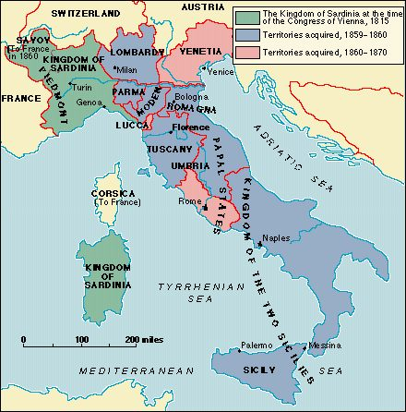
Lord John Russell 5
In 1859 Russell became foreign secretary in Lord Palmerston's government.
The following year Russell introduced a new parliamentary reform act into the House of Commons. The bill which included reducing the qualification for the franchise to £10 in the counties to £6 in towns was not supported by Lord Palmerston and did not become law.
He supported Italian unification 1859-60.

Slide 9
Lord John Russell 6
Like many of the British elite he was sympathetic to the South in the American Civil War.
In July 1861 he was raised to the peerage as Earl Russell. He continued to hold the office of foreign secretary and when Lord Palmerston died in October, 1865, Russell once again became prime minister. One of his first decisions was to try again to persuade parliament to accept the parliamentary reform proposals that had been rejected in 1860. The majority of the MPs in the House of Commons were still opposed to further reform and after the government was defeated on a vote on 18th June 1866, Earl Russell resigned.
After leaving office Russell continued to attend the House of Lords where he supported and voted for the 1867 Parliamentary Reform Act. He was also one of the main campaigners for the 1870 Education Act. Earl Russell died on 28th May 1878

Slide 10
Lord John Russell 7
Russell had a terrible memory for faces and was thus apt to ignore his political supporters when he met them outside of Parliament. After a long conversation with a Whig at a country house, Lord John told the young man he should enter Parliament, only to be informed that he had been in Parliament, supporting Russell for ten years.
Matters were not helped by Russell's "aristocratic drawl" and archaic pronunciation, a way of speaking fairly common among the upper classes in the early nineteenth century. but not appropriate in the more liberal atmosphere of the midcentury.
Lord John Russell: A Biography by Paul Scherer.

Slide 11

Pembroke Lodge

Slide 12
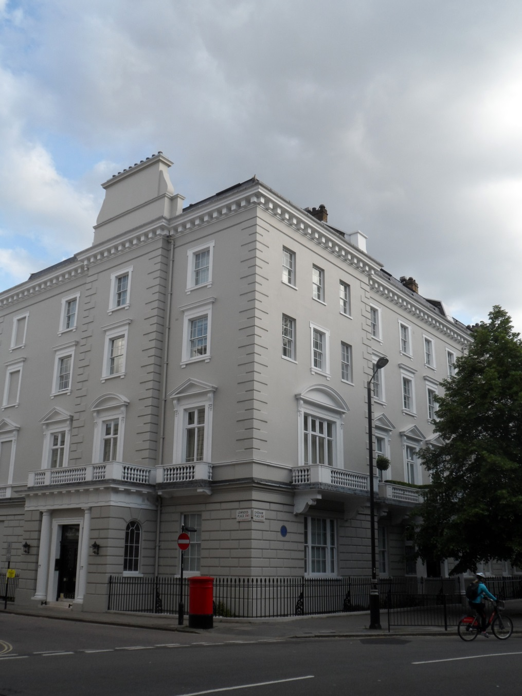
37 Chesham Place, Belgravia

