Slide 1
Local Government
By
Mike Allen

Slide 2
The history of Local Government in the UK 1
Local government has a long history in the Uk.
Shires were used in Anglo Saxon times and developed into counties.
Before the nineteenth century Lord Lieutenants had some responsibilities but most functions were carried out by justices of the peace.
Some towns were given charters with self governing status from the eleventh century onwards.
These were usually governed by self perpetuating Town corporations.

Slide 3
The history of Local Government in the UK 2
This was reformed in the 19th century.
The Municipal Corporations Act 1835 reformed most of the charter towns and gave the councils elected by ratepayers.
The Local Government Act 1888 created County Councils and parish councils in some rural areas. Municipal Corporations became either County Boroughs (independent of the county) or Municipal Boroughs (a second tier under the county.
Local Government Act 1894 created County districts and Urban Districts below the Counties.
Similar legislation was passed for Scotland.
London Government Act 1899, divided the new County of London into districts known as Metropolitan Boroughs.

Slide 4
The history of Local Government in the UK 3
The London Government act 1965 created The Greater London Council and London boroughs. This included the old London County, Middlesex, and parts of Hertfordshire, Essex, Kent and Surrey. The ILEA was created on the old LCC area.
The Local Government Act 1972 reformed the rest of England and Wales. Some new counties were created and Rutland disappeared as a county. It created Counties and County Districts. It created 6 new Metropolitan Counties with Metropolitan Districts. The old County boroughs (charter towns) disappeared.
Scotland had a similar system with Regional Councils and District Councils with 3 Island Councils.

Slide 5
The history of Local Government in the UK 4
In 1986, the metropolitan county councils and Greater London were abolished.
The Local Government Act (1992) established the Local Government Commission for England make recommendations on where unitary authorities (UAS) should be established.
1995 - 2009
55 unitary authorities have been created which include the Isle of Wight, the city of York, the historic county of Rutland, Hereford, Cornwall, County Durham, Northumberland, Shropshire and Wiltshire.
2011 - Plans to create two new Unitary Authorities in Exeter and Suffolk were revoked by Parliament.
The government had plans to create 9 regions but the rejection of in a referendum of a proposed North-East Assembly in 2004 meant that they scrapped those plans.
The Greater London Authority Act 1999 created the GLA with an elected mayor (see later) and a London Assembly elected by the additional member system using the List system. It is the only example of regional devolution in England.

Slide 6
The history of Local Government in the UK
The Scottish Local Government 1994 Act created 29 new unitary local government areas, which completely replaced the regions and districts and the islands council areas continued in use so that, Scotland now has 32 council areas.
Local Government (Wales) Act 1994 a new unitary system of 22 counties and county boroughs was established and the eight local government counties and 37 districts that had been formed in 1974 were abolished .
STV was introduced for Scottish Local Government in 2004 as part of the coalition agreement between Labour and the Liberal Democrats of 2003 for the Scottish government.

Slide 7
1899-60’s
County Councils
Municipal Boroughs
County Boroughs
Rural districts
London County Council
Metropolitan Boroughs
Urban Districts
Some Parishes

Slide 8
1972-1986
Greater London Council
London Boroughs
County Councils
County Districts
Metropolitan Counties
Metropolitan Districts
Some Parishes

Slide 9
Present Position
County Councils
Greater London Authority
Metropolitan Districts
Unitary Authorities
London Boroughs
County Districts
Some Parishes

Slide 10
Scotland
1974
1994
Regional Councils
Island Councils
Unitary Authorities
District Councils
Community Councils
Community Councils

Slide 11
Wales
1974
1994
County Councils
Counties
County Boroughs
County Districts

Slide 12
Responsibilities | County | London |  | Metro- politan | District | Unitary | N. Ireland | Scotland | Wales
 |  | GLA | LB
Education | • |  | • | • |  | • |  | • | •
Housing |  |  | • | • | • | • |  | • | •
Planning Apps |  |  | • | • | • | • |  | • | •
Strategic Planning | • | • |  | • |  | • |  | • | •
Transport Plan’g | • | • |  | • |  | • |  | • | •
Passenger Transport | • | • |  |  |  | • |  | • | •
Highways | • |  | • | • |  | • |  | • | •
Fire | • | • |  | • |  | • |  | • | •
Social Services | • |  | • | • |  | • |  | • | •
Libraries | • |  | • | • |  | • |  | • | •
Leisure |  |  | • | • | • | • | • | • | •
Waste Collection |  |  | • | • | • | • | • | • | •
Waste Disposal | • |  | • | • |  | • | • | • | •
Environ’l Health |  |  | • | • | • | • | • | • | •
Revenue Collect’n |  |  | • | • | • | •
Electoral Admin |  |  | • | • | • | • |  | • | •
Police |  | •

Slide 13
Unitary versus 2 tier
Pros
Potential cost savings: the new Shropshire Council, for example, talks of saving £30m. Services are duplicated.
There is the confusion of the two-tier structure.
There are strategic benefits. Having just one voice for an area should mean stronger leadership, more joined-up services, and clearer representation with other public agencies.
Cons
The unitary authorities are too big and remote from the people.
Less democratic control unitary authorities typically have 50% less councillors.
Not all of the new unitaries are large e.g. Rutland – providing services there will be expensive.
The strength of the 2 tier system is that strategic planning and big services can be provided at the county level while Districts cater for local needs.

Slide 14
Local Government Organisation 1
From the 19th century up until 2000 local government was organised with a committee structure.
Each major policy area had a committee with a number of sub committees
So the Committees might include: education, social services and housing.
The sub committees of the Education Committee might include Primary education, Secondary education, Further education and Special education.
The idea was that a division of Labour would save time and report back to the higher committee and the higher committee would report to the Council.
However there was a feeling that this was a very slow and cumbersome system.

Slide 15
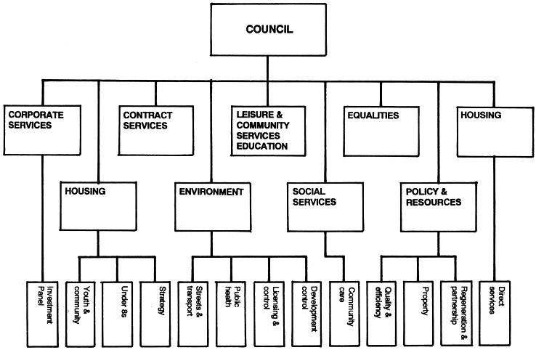
Camden Council Committee Structure 1998

Slide 16
Local Government Organisation 2
Local Government Act 2000 required councils to move to an executive-based system with three options.
A mayor elected by the electorate, with a cabinet of nine councillors appointed by the mayor
An elected mayor (as above) with an officer appointed by the council known as a council manager.
An elected leader, elected by the council, with a cabinet of nine councillors either selected by the leader or the full council
An elected mayor was subject to approval by a referendum and 16 mayors have been established with 30 referendums.
There is a small exception to this whereby smaller district councils (population of less than 85,000) can adopt a modified committee system.
Most councils are using the council leader and cabinet option, while 52 smaller councils have been allowed use a modified committee system.
In this case committees have been converted into scrutiny committees.
The Localism Act 2011 allows councils to return to a committee structure.

Slide 17
Local Government Reform 1
The ‘Northern Powerhouse’ was first introduced in June 2014 by the Chancellor of the Exchequer, George Osborne, in a speech in Manchester.
He made the case that the lack of economic and physical connections between the cities and city regions of the North of England was holding back their growth, with significant implications for the national economy. In the Chancellor’s own words: “the whole is less than the sum of its parts…so the powerhouse of London dominates more and more.”
The Northern Powerhouse is “not one city, but a collection of northern cities - sufficiently close to each other that combined they can take on the world.” The city regions of Liverpool, Manchester, Leeds, Sheffield, Hull and the North East.
Since the Chancellor’s initial speech, a raft of interventions have been announced to help turn the rhetoric of a Northern Powerhouse into reality – including the Greater Manchester Devolution Deal, Transport for the North, and the Northern Transport Strategy.

Slide 18
Local Government Reform 2
From 2017 a new, directly elected Mayor of Greater Manchester will receive the following powers: • Responsibility for
Transport
Strategic planning
Housing
The role currently covered by the Police and Crime Commissioner.
The Greater Manchester Combined Authority (GMCA) will receive the following powers:
devolved business support budgets,
Control of the Apprenticeship Grant for Employers in Greater Manchester and Further Education (FE). Programme.
Integration of health and social care across Greater Manchester, based on control of existing health and social care budgets.
Further powers may be agreed over time and included in future legislation.
The Greater Manchester Combined Authority (GMCA) established 2011 is made up of 10 members (indirectly elected councillors) derived from the councillors of Greater Manchester's constituent authorities, each council nominates one member and one stand-in member in the case of absence. They will be responsible for agreeing much of the budget for the mayor
However in 2015 the upgrade to railways in the area was ‘paused’.

Slide 19
Arguments For Elected Mayors
1. Stronger Leadership
Various reports on directly-elected mayors have shown that, on the whole, directly elected mayors have proven to be stronger and more effective leaders.
2. Better Leadership
Instead of being a political figure, an elected mayor is a community leader. An elected mayor would have to appeal to the whole electorate rather than the current system where they only have to campaign in their constituency. The mayor would have to be more entrepreneurial, charismatic and ambitious in order to appeal to all voters (the strong point of Boris Johnson’s campaigning). When few people can even name the current head of Bristol Council, improvements in voter awareness can only be a good thing.
3. Accountability
Under the old system the leader of the council is not elected by the people but by councillors, making them less accountable to the people.
There is more of an opportunity for bad mayors to be removed under the new system where directly-elected mayors will be able to be voted out after four years or by a council vote of no confidence before then.

Slide 20
Arguments Against elected Mayors
1 Cost
Election costs £173k or £608k
Additional Salary costs of Elected Mayor £378k
Salary costs of Mayor’s Assistant £184k
Additional Overhead costs £449k (figures for Bristol)
2 Do the people want this?
If turn-out for the referendum is low there “real danger of having elected mayors imposed on an area by a tiny minority of enthusiasts”. Would it be right to create such an expensive and powerful position with such a small democratic mandate?
3 Mayors have too much power.
4 Could lead to more corruption.

Slide 21
Arguments for the Cabinet system vs the committee system in local government
The committee system is slow and cumbersome. The cabinet system would make for quicker and more efficient decision making
Real decision making took place off-stage in cabals run by the party bosses.
The cabinet structure would provide clear lines of accountability.
Overview and scrutiny committees would hold the executive to account for implementation.

Slide 22
Arguments against the Cabinet system vs the committee system in local government
The system creates a division between councillors with those not in the executive being relegated to backbench councillors with little influence.
The Cabinet makes just about all the major financial decision apart from the council’s budget, and Councillor’s allowances. Ten councillors will make most of the decisions affecting the whole of the area.
The Cabinet members becomes more influenced by Local Government Officers.
The committee system involved all councillors. Counter argument – to be effective the committee would need to make the final decision so not all councillors would be involved.
In practice scrutiny is ineffective.
The committee system is more transparent to the public.

Slide 23
Local Government Finance 1
The main sources of income for local authorities are
council tax 15%
government grants 61%
user charges (in particular, rents on council-owned properties) 13%
interest receipts
capital receipts
borrowing 7%
Local authorities cannot sell assets or borrow deliberately to finance current spending, and some grants from central government may only be used for capital spending.
Income from business rates appears to be included in Central government grants.
Other sources using a narrower definition use the figure of 25% for Council Tax.
4%

Slide 24
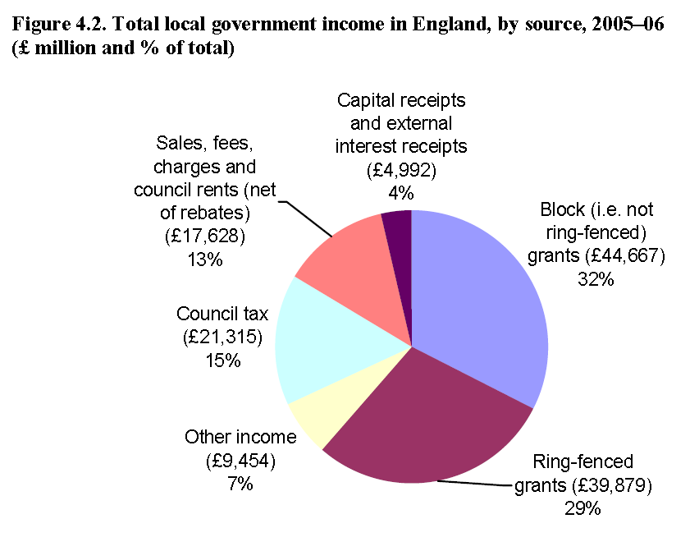
Source: Table 2.1a of Department for Communities and Local Government, Local Government Finance Statistics England No. 17, 2007

Slide 25
The Merits of the Council Tax
It is simple and easily understood by the taxpayer,
It is fairly convenient to pay.
It is fairly cheap to collect and is a stable source of income for the local authority.
It may encourage people to occupy only the accommodation that is needed.
It is the only major independent source of a local authority's income and gives it some discretion in its spending

Slide 26
The Problems of the Council Tax
Property values are not evenly distributed. Often those areas with low property values are the areas of greatest need. These areas will thus be more dependent on central government grants.
Local government expenditure has tended to grow quickly because of the high proportion of labour costs. However, the yield from the Council Tax cannot grow as quickly since new property or reconstruction is much smaller than the growth of services
It is regressive i.e. it bears no relation to a person’s ability to pay.
It bears no relation to a person's use of a Council's services.
It may deter people from improving their property since to do so increases the council tax burden.
Agriculture being exempt is an anomaly - it is a hidden subsidy for our farmers.
It is a highly unpopular tax.
The tax bands favour the rich.
Capping reduces local government independence.

Slide 27
Possible Alternatives to the System of the Council Tax 1
Increased charges for services
However most services are provided free or at a nominal price. Thus to make such a change would mean a major change in local government thinking It would also be very unpopular. It would also increase the cost of living and thus the inflationary pressures.
Assigned Revenues This would give the l.a.'s a fixed percentage of some national tax However the Central Government would still determine the %age so that it would not be much different from a grant.
Tax Agricultural Land - would give a windfall to rural authorities but nothing to urban areas. It would also increase the price of food and thus conflict with Government anti-inflationary policy.

Slide 28
Possible Alternatives to the System of the Council Tax 2
Replace part or all of the Council Tax with other taxes
  Motor Fuel Duty This would produce sufficient revenue to replace 10% of the rates. It would however produce economic distortions and would significantly reduce the Chancellors control of the economy.
  Road Fund Duty is collected centrally and could be given to local authorities.
  Local Income Tax Would produce sufficient revenue, but would mean much administrative and a great lessening of central control of the economy.
  Local Entertainments Tax would not produce very much revenue and runs counter to l.a.'s supporting the arts.
  Local Sales Tax The national sales tax i.e. Purchase Tax has been abolished in favour of the Value Added Tax. Since this is an E.E.C. policy it could not be reintroduced at the local level. A local V.A.T. is impossible because of the severe administrative problems it would present.
Lotteries produce a high yield in other countries but in Britain would face fierce competition from the National lottery.

Slide 29
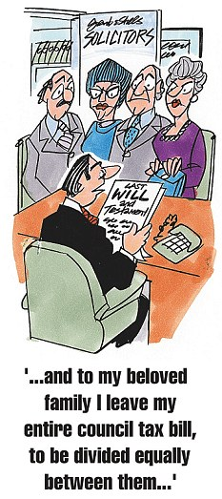

Slide 30
