Slide 1
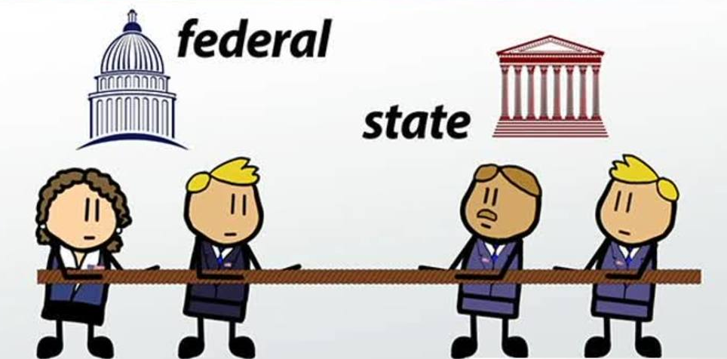
Federalism in the United States
By
Mike
Allen

Slide 2
Types of State
There are 2 types of state:- unitary and federal.
Unitary states
  There is one supreme set of institutions for political decision taking which can overrule any subordinate authorities.
  Most states in the world are unitary.
Federal States
  In a federal system power to take decisions is divided between central and state authorities.
  In a federal state there is a division of power and decentralization of power between central government and regional, provincial or state governments.
  It implies a rigid constitution and central government cannot intervene, overrule or take away the powers of the state or provincial governments without a change in the constitution.
  The United States, Mexico, Australia, Germany, Brazil and India are federations

Slide 3
Federalism and devolution
A Unitary State may have devolution.
Devolution like federalism involves a decentralization of power to regional government but the central government retains the power to intervene and take action in any area it wishes. Any powers given to the regional government are removable.
E.g. The suspension and subsequent abolition of the Northern Ireland Stormont government in 1972.
In theory a Federal government may not take the powers of a State or regional government away.
Not all countries that are called federations adhere to this. For example in India the central government may impose direct rule on a state.
In the civil war in the US the conquered confederate states had their powers taken away and military rule imposed.

Slide 4
Federal and Confederal states
In the 18th century the 2 terms were roughly synonymous and meant a loose association of states.
In the 19th century and after, Federal states came to mean a decentralised system with a strong central government whilst a confederation remained the same. One of the reasons why the Confederates States lost the civil war was that it was fought on localised lines without a central plan for defence and offence.

Slide 5
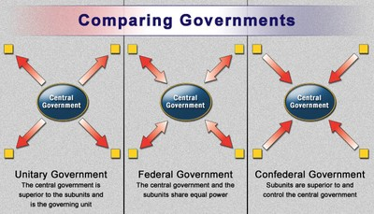

Slide 6
US Federalism and the Constitution 1
The United States started as 13 separate colonies with up to 150 years of separate development and traditions. During the War of Independence they operated under the Articles of Confederation.
However the extreme weakness of the central government was shown in its inability to cope with the debt incurred during the Revolution and particularly in Shay’s Rebellion 1786-7.
In 1786, Shays' Rebellion occurred in western Massachusetts as a protest to rising debt and economic chaos. However, the national government was unable to gather a combined military force amongst the states to help put down the rebellion.
This lead to the Constitutional Convention of 1787 and the adoption of a new constitution with a stronger central government.

Slide 7
US Federalism and the Constitution 2
The term federal is not used in the constitution, however many powers are defined.
Like the President and Congress these are a mixture of expressed or enumerated powers and implied powers.
Powers given to the states¹
Article I, Section 9 of the Constitution listed powers that could be exercised by the states but not Congress. These included, at the time-
  the right to trade in slaves and the right to raise an income tax.
  Both of these limitations were later removed
  Others, such as not allowing Congress to tax goods that move from one state to another, remain.
Article IV provided that any law, government action or court decision in one state would be recognised in all of the other states.
Article V gave the states a role in deciding whether the Constitution should be amended. Three quarters of the states (thirty-eight of the fifty states) need to ratify an amendment.
The 10th Amendment gave the states power over all matters which were not given specifically to the Federal government. These are known as reserved powers.
¹ This section down to The division of powers table is adapted from US Government & Politics by William Storey

Slide 8
US Federalism and the Constitution 3
Powers given to the national government
Article I, Section 8 of the Constitution listed seventeen powers that only Congress could exercise.
Crucially, the eighteenth clause gave Congress the right to pass any laws required to fulfil their powers.
Known as the ‘elastic clause’, it has been used by Congress, controversially, to extend their powers to intervene in matters which were formerly the responsibility of the states.
Section 10 listed the areas the states cannot interfere with, for example, foreign affairs.
Article II outlined the powers and duties of the President.
Article III outlined the powers and duties of the Supreme Court.
Article VI, Section 2 was the ‘Supremacy Clause’, which established that when state and Federal governments were in conflict, the Federal government was supreme.
The Federal government also has implied powers, such as the power to set up a diplomatic service to manage foreign relations.

Slide 9
US Federalism and the Constitution 4
Powers shared between the states and the national government
Both the Federal and state legislatures have always had the right to pass laws that define crimes and appropriate punishments.
Since the 16th Amendment 1913 allowing a Federal Income Tax, both Federal and state governments have had the right to tax individuals.
These shared powers are known as concurrent powers.
The Supreme Court was the final arbiter.

Slide 10
The Division of Powers
National Government | Shared Powers | State Governments
Foreign affairs | Raise taxes | Regulate trade within the state
Defence of the nation | Borrow money | Administer elections
Resolving disputes between states | Spend money for the, welfare of the population | Protect the public’s health, welfare population and morals
Regulating trade between the states | Pass and enforce laws
Managing the economy

Slide 11
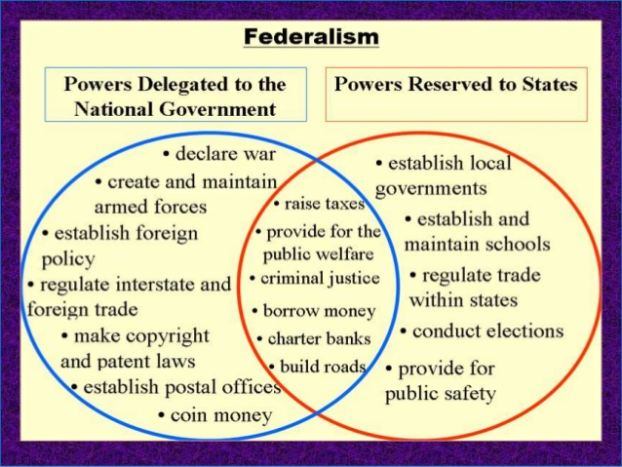

Slide 12
The Changing Federal-State Relationship
This has changed as the US has developed.
There has been an increased role for Federal Government.
Reasons
Westward expansion.
Growth of population.
Industrialisation – with a need for more regulation.
Improvement in communications
The Great Depression – a need for Federal action to counteract.
Foreign policy – after 1945 The US became a superpower.

Slide 13
The reasons for the increased role of Federal government
Supreme Court decisions. E.g. McCulloch v. Maryland
Constitutional amendments
  The 14th Amendment 1868 –
    State and federal citizenship for all persons regardless of race both born or naturalized in the United States was reaffirmed.
    No state would be allowed to abridge the "privileges and immunities" of citizens.
    No person was allowed to be deprived of life, liberty, or property without "due process of law."
    No person could be denied "equal protection of the laws."
  The 16th Amendment 1913 – Federal Income Tax

Slide 14
Phases of Federalism 1
Dual Federalism 1780’s – 1920’s
State governments exercised most power. There was a focus on “states rights”
The federal government was limited to money, war and peace.
The Wall Street crash and the great depression changed this.
Cooperative Federalism 1930’s - 1960’s sometimes called marble cake Federalism.
Federal and State governments cooperated to solve problems – poverty, health, education, transport and national security.
Federal government increased significantly.
It was typified by categorical grants – schemes specifying how Federal aid should be spent.

Slide 15
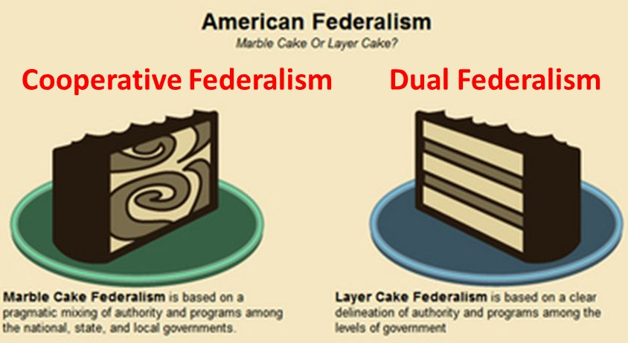

Slide 16
Phases of Federalism 2
The New Federalism 1970’s – 2000’s
Nixon and later Republican presidents put the emphasis on decentralization, reducing Federal intervention.
Reasons
  A belief that Federal Government programmes were not successful and too wasteful.
  A belief that Federal Government failed to tackle certain problems.
  Growing distrust of Washington.
  Republican presidents.
It was characterized by an increase in block grants to States which they could spend as they saw fit.

Slide 17
Phases of Federalism 3
George W Bush 2001-9
There was a 33% increase in spending under Bush.
Reasons
War in Iraq
Homeland security
Expansion of Medicare and education programmes. – with strings attached.
The Wall street and banking collapse of 2008
So something of a return to Cooperative Federalism
Barack Obama 2009 – 2017
There was a return to categorical grants under Obama.

Slide 18
State Law
State Laws cover most areas that affect the individual citizen.
The most common example is that for those who drive a car, ride a motorcycle, or operate a truck, each state has its own license requirements and traffic laws that must be followed.
Each state has its own set of laws addressing criminal conduct. What is a crime in one state may or may not be a crime in another, and these actions may also be punished completely differently.
Similarly, each state has a multitude of civil laws dealing with everything from taxes and business laws, to health codes and family laws.

Slide 19

Marriage
Generally the minimum marriage age is 18 but in some states in special circumstances younger people can get married.
In Connecticut minors under 16 may be allowed to marry with parental consent and consent of probate judge.
New Hampshire 13 for females, 14 for males in cases of "special cause" with parental consent and court permission.

Slide 20
Different State laws
Divorce
This varies between states . Several states require that the couple must live apart for several months before being granted a divorce. However, living apart is not accepted as grounds for a divorce in many states.
Drivers licensing laws
The minimum age to obtain a restricted driver's license in the United States varies from 14 years, three months in South Dakota to as high as 17 in New Jersey.

Slide 21
Gun Laws
Some states and localities require that a person obtain a license or permit in order to purchase or possess firearms.
Some states and localities require that individual firearms be registered with the police or with another law enforcement agency.
All states allow some form of concealed carry, the carrying of a concealed firearm in public.
Many states allow some form of open carry, the carrying of an unconcealed firearm in public on one's person or in a vehicle.
Some states have state pre-emption for some or all gun laws, which means that only the state can legally regulate firearms. In other states, local governments can pass their own gun laws more restrictive than those of the state.
Some states and localities place additional restrictions on certain semi-automatic firearms that they have defined as assault weapons, or on magazines that can hold more than a certain number of rounds of ammunition.
Some states have enacted castle doctrine or stand-your-ground laws, which provide a legal basis for individuals to use deadly force in self-defence in certain situations, without a duty to flee or retreat if possible.

Slide 22
Taxes
States use a different combination of sales, income, excise taxes, and user fees. Some are levied directly from residents and others are levied indirectly.
There are currently seven states that do not collect any income taxes: Alaska, Florida, Nevada, South Dakota, Texas, Washington, and Wyoming.
California has the highest state income tax 13.3%.

Slide 23
Health
Health care in the United States is provided by many distinct organizations.
Health care facilities are largely owned and operated by private sector businesses.
58% of US community hospitals are non-profit.
The Federal government funds Medicare, Medicaid, the Children's Health Insurance Program, and the Veterans Health Administration.
Other patients under 65 must provide their own health care insurance.
Emergency Medical Treatment and Active Labor Act (EMTALA)
EMTALA, enacted by the federal government in 1986, requires that hospital emergency departments treat emergency conditions of all patients regardless of their ability to pay and is a "safety net" for the uninsured.
The Patient Protection and Affordable Care Act (Obama care) provided for more insurance for the uninsured but is likely to be abolished.
State governments maintain state health departments, and local governments (counties and municipalities) often have their own health departments, usually branches of the state health department.
The US Health system is the most expensive per capita in the world and does not cover all of its people. About 11% are uninsured.
42% of all US bankruptcies are due to health debt.

Slide 24
Consequences of Federalism
Legal consequences –
  Different state laws
Political consequences
  Elections are state based and state run
  Political parties are state based parties
Economic consequences
  Federal grants to states
  Complex tax system with different income taxes, sales taxes and property taxes.
Regionalism

Slide 25
Federalism conclusion
It remains an issue in the US with States Rights vs interventionist Federal government.
The Republicans tend to be more for states rights, though George W Bush was an exception.
Donald Trump’s policies on jobs imply more Federal Government intervention.

