Slide 1
Disraeli
By Mike Allen

Slide 2
Two Portraits Benjamin Disraeli
One of the greatest Victorian prime ministers.
Conservatives have seen him as a reforming Tory who improved the lot of the poor. He legalised picketing, widened suffrage and made the state more active in areas of public health and housing.
Always something of a dandy, he arrived at a dinner party wearing 'green velvet trousers, a canary coloured waistcoat, low shoes, sliver buckles, lace at his wrists and his hair in ringlets...' [Henry Bulmer]
He had affairs with married women until he married.
He liked younger men, but not sexually.
He loved the company of women, who he found more sympathetic and interesting than men; ‘I live for Power and the Affections’, he declared.
A powerful orator he was also a great wit.
Reply to a taunt by the Irish nationalist Daniel O'Connell.
“Yes, I am a Jew, and when the ancestors of the right honourable gentleman were brutal savages in an unknown island, mine were priests in the temple of Solomon.”
“There are three types of lies -- lies, damn lies, and statistics.”
“He was distinguished for ignorance; for he had only one idea, and that was wrong.” Sybil 1845

Slide 3
Two Portraits William Gladstone
Four-times Liberal prime minister of Great Britain, Gladstone was one of the dominant political figures of the Victorian era and a passionate campaigner on a huge variety of issues, including home rule for Ireland.
A great orator, and a towering intellect, a double first at Oxford, he was not good at social interrelationships with cabinet colleagues and backbenchers.
He moved from being a high Tory opposing any change to the Anglican church in Ireland and to electoral reform, to championing electoral change and Home Rule for Ireland.
He was deeply religious and a lay preacher.

Slide 4
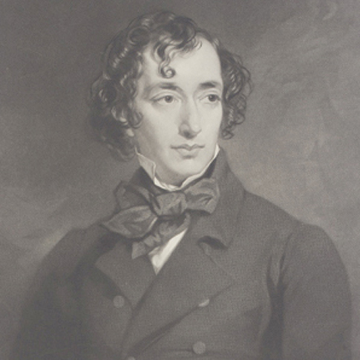
Benjamin Disraeli 1804-81 ¹
Born to Italian-Jewish parents, in 1817 Disraeli's father baptised his children as Christians. With Jews excluded from parliament until 1858, this enabled Disraeli to pursue a career that would otherwise have been denied him.
Early business ventures failed, leaving him heavily in debt. He had a breakdown but later decided to pursue a political career. After four attempts, in 1837 he was elected as Tory candidate for Maidstone.
Disraeli's maiden speech in the House of Commons was poorly received and after a great deal of barracking ended with the words: "though I sit down now, the time will come when you will hear me."
Disraeli was now a progressive Tory and advocated triennial parliaments and the secret ballot. He was sympathetic to the demands of the Chartists and in one speech argued that the "rights of labour were as sacred as the rights of property".
In 1839 Benjamin Disraeli married the extremely wealthy widow, Mary Wyndham Lewis. The marriage was a great success. On one occasion Disraeli remarked that he had married for money, and his wife replied, "Ah! but if you had to do it again, you would do it for love."
¹ Adapted from http://spartacus-educational.com/PRdisraeli.htm

Slide 5
Benjamin Disraeli 2
The Conservative leader, Sir Robert Peel, encouraged Disraeli, but, when in 1841, Peel became prime minister, Disraeli was not given office in the cabinet. He was mortified at the rebuff, and his attitude toward Peel and his brand of Conservatism became increasingly critical.
In 1842 Disraeli helped to form the Young England group. Disraeli and members of his group argued that the middle class now had too much political power and advocated an alliance between the aristocracy and the working class.
Disraeli suggested that the aristocracy should use their power to help protect the poor. This political philosophy was expressed in Disraeli's novels Coningsby (1844), Sybil(1845) and Tancred (1847). In these books the leading characters show concern about poverty and the injustice of the parliamentary system.
Disraeli favoured a policy of protectionism and strongly opposed Peel's decision to repeal the Corn Laws. This issue split the Conservative Party and Disraeli's attacks on Peel helped to bring about his political downfall.

Slide 6
Benjamin Disraeli 3
In 1852 Lord John Russell, the leader of the Whig government, resigned. Lord Derby, the new Prime Minister, appointed Disraeli as his Chancellor of the Exchequer. This period of power only lasted a few months.
Lord Derby became Prime Minister again in 1858 and once again Disraeli was appointed as Chancellor of the Exchequer.
He also became leader of the House of Commons and was responsible for the introduction of measures to reform parliament.
In February, 1858, Disraeli proposed the equalization of the town and county franchise. This would have resulted in some men in towns losing the vote and was opposed by the Liberals.
An amendment proposed by Lord John Russell "condemning this disfranchisement" was passed by 330 to 291.

Slide 7
Benjamin Disraeli 4
In 1859 Lord Palmerston, became Prime Minister.
It was not until 1866 that Disraeli returned to the cabinet. Once again, Lord Derby appointed Disraeli as his Chancellor of the Exchequer and leader of the House of Commons.
Some members of the Liberal Party, including William Gladstone, had been in favour of legislation that would have extended the franchise. His attempts to obtain parliamentary reform failed.
Disraeli was convinced that if the Liberals returned to power, Gladstone was certain to try again. Benjamin Disraeli argued that the Conservatives were in danger of being seen as an anti-reform party. In 1867 Disraeli proposed a new Reform Act. Lord Cranborne (later the Marquis of Salisbury) resigned in protest against this extension of democracy.
In the House of Commons, Disraeli's proposals were supported by Gladstone and his followers and the measure was passed.
The 1867 Reform Act gave the vote to every male adult householder living in a borough constituency. Male lodgers paying £10 for unfurnished rooms were also granted the vote. This gave the vote to about 1,500,000 men.

Slide 8
Benjamin Disraeli 5
In 1868 Lord Derby resigned and Benjamin Disraeli became the new Prime Minister.
He commented “Yea, I have climbed to the top of the greasy pole”.
However, in the1868 General Election that followed, the Liberals were returned to power with a majority of 170.
Disraeli and the Conservative Party won the 1874 General Election. It was the first time since 1841 that the Tories in the House of Commons had a clear majority.
Social reforms passed by the Disraeli government included: the Artisans Dwellings Act (1875), the Public Health Act (1875), the Pure Food and Drugs Act (1875).
Disraeli also introduced measures to protect workers such as the 1874 Factory Act and the Climbing Boys Act (1875).
Disraeli also kept his promise to improve the legal position of trade unions. The Conspiracy and Protection of Property Act (1875) allowed peaceful picketing and the Employers and Workmen Act (1878) enabled workers to sue employers in the civil courts if they broke legally agreed contracts.

Slide 9
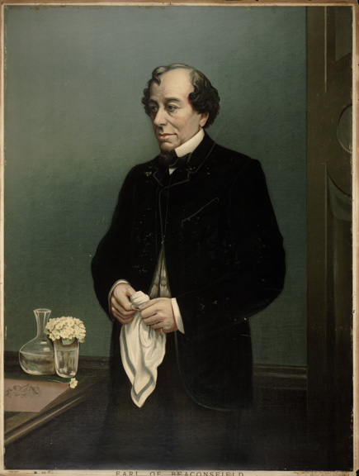
Benjamin Disraeli 6
Unlike William Gladstone, Disraeli got on very well with Queen Victoria. She approved of Disraeli's imperialist views and his desire to make Britain the most powerful nation in the world. In 1876 Victoria agreed to his suggestion that she should accept the title of Empress of India.
In August 1876 Queen Victoria granted Disraeli the title Lord Beaconsfield. Disraeli now left the House of Commons but continued as Prime Minister and now used the House of Lords to explain his government's policies. At the Congress of Berlin in 1878 Disraeli gained great acclaim for his success in limiting Russia's power in the Balkans.
The Liberals defeated the Conservatives in the 1880 General Election and Disraeli decided to retire from politics.
Disraeli hoped to spend his retirement writing novels but soon after the publication of Endymion (1880) he became very ill.
Benjamin Disraeli died on 19th April, 1881.
1880-1

Slide 10
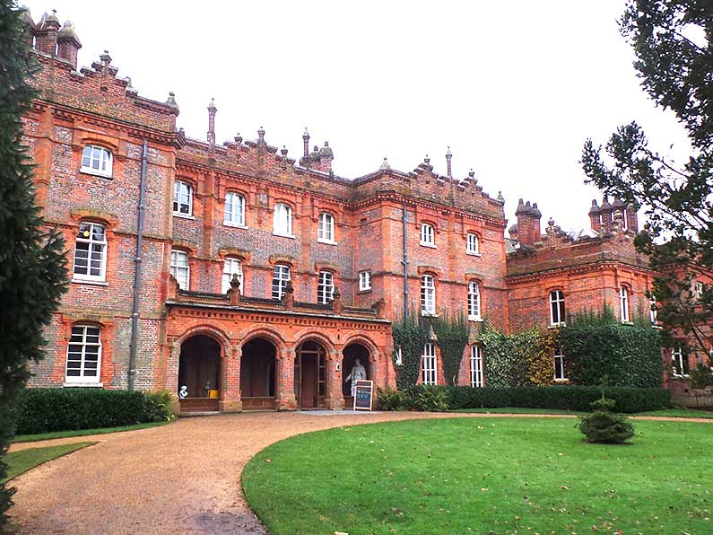
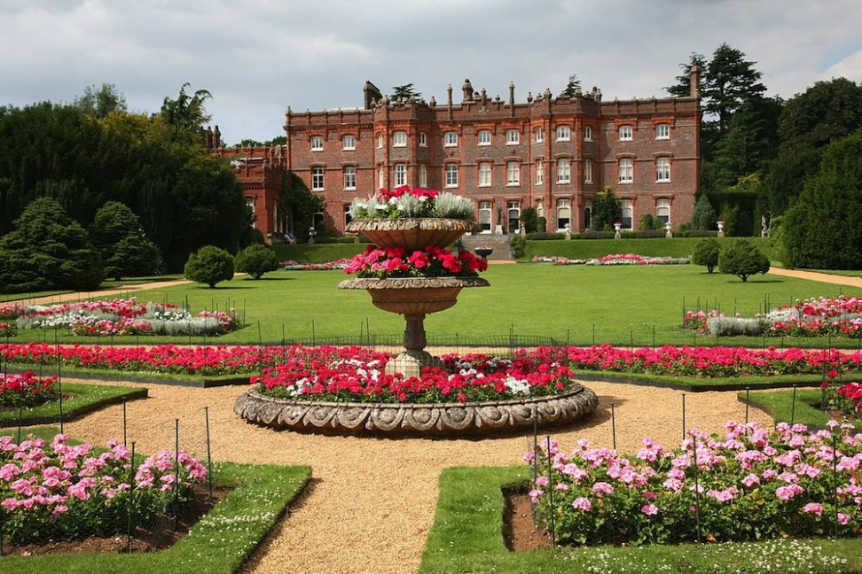
Hughenden Manor
Hughenden Manor is a Grade I listed building in the Chilterns.
Benjamin Disraeli purchased the original stuccoed Georgian house, extended from an earlier medieval manor, in 1848.
Once he had the resources, he had the building completely remodelled in 1860-63 by Edward Buckton Lamb (1806-69). The listing text describes the resultant large, imposing country home in this way: "Red and vitreous brick, slate roofs, diagonal brick chimney shafts with cogged pyramidal caps."
Now a National Trust property, Hughenden Manor is in the Chilterns at Hughenden Park, High Wycombe, Buckinghamshire.
Disraeli lived here until 1881, and he and his wife are buried close to the house, in the family tomb adjoining Hughenden Church, St Michael and All Angels.
Text from http://www.victorianweb.org/art/architecture/lamb/9.html

