Slide 1
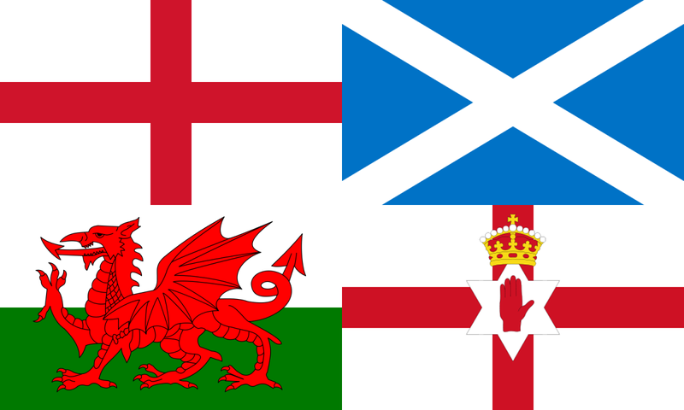
Devolution
By
Mike Allen

Slide 2
Terminology 1
Federalism and devolution.
In a federal state there is a division of power and decentralization of power between central government and regional, provincial or state governments.
It implies a rigid constitution and central government cannot intervene, overrule or take away the powers of the state or provincial governments without a change in the constitution.

Slide 3
Terminology 2
Devolution like federalism involves a decentralization of power to regional government but the central government retains the power to intervene and take action in any area it wishes. Any powers given to the regional government are removable.
Strictly speaking local government is a type of devolution though the term is only used in terms of regional government or Scotland, Wales, Northern Ireland and England of the UK.

Slide 4
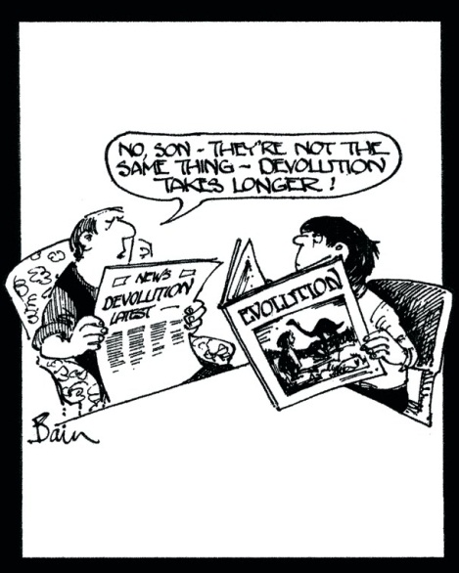
Types of devolution 1
Legislative devolution
This where provincial assemblies are given powers to determine policy and make laws on a selected range of subjects.
It implies a prime minister and cabinet for the area. Westminster retains the power to legislate on any matter.
This is the system now in place in Scotland, Wales and Northern Ireland.
The various channel Islands and the Isle of Man also have legislative devolution

Slide 5
Types of devolution 2
Executive devolution
Provincial assemblies would be given powers to decide the implementation of policies on a selected range of subjects. All laws would be made by Westminster. This was the type of devolution Wales had 1997-2011.
Administrative devolution Policies are administered in a regional context. The Scottish Office was established in 1895, the Welsh Office in 1964, and the Northern Ireland Office in 1972. All functions of government not devolved to the assemblies/parliament are administered through these offices.

Slide 6
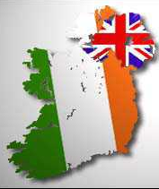
Historical Background 1
Ireland had English involvement from the 12th century but full rule was not attempted until the 16th century.
The Act of Union of 1801 unified the parliaments – abolishing the Irish parliament.
Ireland was partitioned in 1922 with Southern Ireland becoming independent and later taking the name of Eire. Northern Ireland remained part of the UK.

Slide 7
Historical Background 2
Wales was conquered by the British in the 13th century. Wales was formally brought into the Union by two acts passed in 1536 and 1542. English law was imposed on Wales.
Scotland was never conquered by England and was united with England by the union of Crowns in 1603 when James IV of Scotland became James I of England, Wales and Ireland.
The Act of Union of 1707 unified the Parliaments with the Scottish parliament voting it self out of existence.

Slide 8
Devolution as an issue 1 Scotland and Wales
National feeling began to grow more strongly in the 50s and 60s. It was a general feeling that Scotland and Wales were separate entities with their own cultural and historical heritage
In Wales there was a revival of interest in the Welsh language.
The revival of national feeling was not converted into support for the nationalists suddenly.
Plaid Cymru won a by election at Carmarthen in 1966 and the Scottish National Party at Hamilton in 1967. Both were from Labour at a time when the Labour government were highly unpopular.
This made devolution an issue in British politics and Wilson set up a Royal Commission.
Both by election victories were lost in 1970 but the SNP won a seat in the Western Isles.

Slide 9
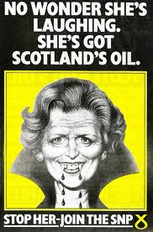
Devolution as an issue 2
The situation was changed by the discovery of North Sea oil in 1970 and 1971.
The SNP exploited this with the slogan “Its Scotland's Oil”.
It made an independent Scotland an economic viability.
In February 1974 the SNP won 7 seats with 22% of the Scottish vote and PC won 2 seats on 11% of the Welsh vote.
The Labour Party adopted the policy of devolution for Scotland and Wales for the October 1974 election.
In October 1974 the SNP won 11 seats with 30% of the Scottish vote and PC won 3 seats on 11% of the Welsh vote.

Slide 10
Devolution as an issue 3
The Labour government tried to implement its manifesto promise.
2 acts were to give legislative devolution to Scotland and executive devolution to Wales with referendums to be held before the schemes were put into place.
Opponents of the bills passed amendments that 40% of the electorate had to vote in favour for devolution to be put into operation.
1979 March 2nd Referendums
Scotland YES 1,230,937 (32.9% of the electorate) turnout 64% NO 1,153,502 (30.8% of the electorate)
Wales YES 243,048 (11.9% of the electorate) turnout 59% NO 956,330 (46.9% of the electorate)
The Labour government could not go ahead with Scottish devolution. The SNP withdrew its support for Labour and voted against the government on the vote of No Confidence in 1979 which produced the 1979 general election and a Conservative government.

Slide 11
Devolution as an issue 4
The Conservatives have been a Unionist party since the 19th century and fairly consistently opposed devolution, though in 1968 Heath gave a pledge to investigate devolution for Scotland but nothing was done during his administration 1970-74.
The Conservatives were opposed to devolution 1979-1997
Labour kept the policy of devolution throughout the Conservative governments 1979-97.
After their victory in 1997 the Labour government implemented their policy. They held referendums for Scotland and Wales
The Scottish Referendum on devolution took place on 11 September 1997. The turnout was 60.4% of the electorate, 74.3% of voters voted for a Scottish Parliament and 60.2% voted for tax raising powers.

Slide 12
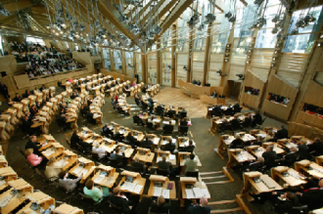
Devolution in Scotland
The Scotland Act 1998 created a Parliament of 129 members, comprising 73 constituency members and 56 regional members.
Constituency Members are elected using the standard First Past the Post System(FPTP)
Regional members are elected using the Additional Member System (AMS) form of proportional representation, which uses closed party lists to elect members in addition to Constituency Members
Scotland has a Parliament and a Prime Minister and Cabinet.

Slide 13
Devolution in Scotland
The Scottish Parliament can make primary and secondary legislation in areas not reserved to Westminster
Devolved subjects include:
health
education and training,
local government
social work, housing
planning, tourism
economic development and financial assistance to industry
some aspects of transport, including the Scottish road network, bus policy and ports and harbours
law and home affairs, including most aspects of criminal and civil law, the
prosecution system and the courts
the police and fire services
the environment
natural and built heritage
agriculture, forestry and fishing
sport and the arts
statistics, public registers and records
They can also increase or decrease income tax by 3p in the £ but have never used the power.
Notes:
Reserved areas
the constitution
defence and national security
fiscal, economic and monetary system
trade and industry, including competition and customer protection
transport (not particular to Scotland) including railways, transport safety and regulation
social security
medical ethics: abortion; human fertilisation and embryology; genetics;
xenotransplantation and vivisection.
broadcasting
foreign affairs
the civil service
immigration and nationality
energy: electricity, coal, oil, gas, nuclear energy
employment
equal opportunities

Slide 14
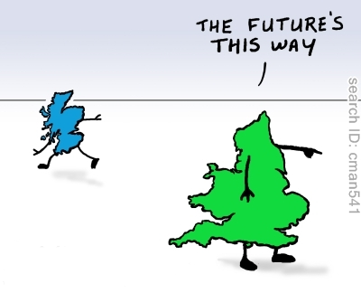
Devolution in Scotland
The SNP victory in 2011 brought independence to the fore as an issue. The SNP secured a mandate to hold the referendum.
A deal was agreed between Prime Minister David Cameron and First Minister Alex Salmond.
The UK government, which has responsibility over constitutional issues, will grant limited powers to the Scottish Parliament to hold a legal referendum.
This paved the way for a vote in autumn 2014, with a single Yes/No question on Scotland leaving the UK.
It also allowed 16 and 17-year-olds to take part in the ballot.

Slide 15
Devolution In Scotland
The Scottish Referendum 18 September 2014
The question was “Should Scotland be an independent country?”
 | Votes | %
NO | 2,001,926 | 55.30
YES | 1,617,989 | 44.70
Electorate 4,283,392 Turnout 84.59% Rejected ballots 3,429
The polls unexpectedly showed a surge in support for independence. Gordon Brown conducted a spirited campaign for a No vote largely credited with swaying the result, together with a pledge by all the major parties for further major powers for the Scottish parliament.

Slide 16
Devolution In Scotland
key points set out by the Smith commission,
The Scottish parliament will have complete power to set income tax rates and bands.
• Holyrood will receive a proportion of the VAT raised in Scotland, amounting to the first 10 percentage points of the standard rate (ie with the current standard VAT rate of 20%, Scotland will 50% of the receipts), but cannot influence the UK’s overall UK rate.
• It will have increased borrowing powers, to be agreed with the UK government, to support capital investment and ensure budgetary stability.
• UK legislation will state that the Scottish parliament and Scottish government are permanent institutions. The parliament will also be given powers over how it is elected and run.
• Holyrood will have power to extend the vote to 16- and 17-year-olds, allowing them to vote in the 2016 Scottish parliamentary election.
• It will have control over a number of benefits including disability living allowance, the personal independence payment, winter fuel payments and the housing elements of universal credit, including the under-occupancy charge (bedroom tax).

Slide 17
Devolution In Scotland
The Scottish parliament will also have new powers to make discretionary payments in any area of welfare without the need to obtain prior permission from department for work and pensions.
It will have all powers of support for unemployed people through employment programmes, mainly delivered at present through the Work Programme.
It will have control over air passenger duty charged on people flying from Scottish airports.
Responsibility for the management of the crown estate’s economic assets in Scotland, including the crown estates’s seabed and mineral and fishing rights, and the revenue generated from these assets, will be transferred to the Scottish parliament.
The licensing of onshore oil and gas extraction underlying Scotland will be devolved to the Scottish parliament.
The Scottish government will have power to allow public sector operators to bid for rail franchises funded and specified by Scottish ministers.

Slide 18
Devolution In Scotland
The block grant from the UK government to Scotland will continue to be determined via the operation of the Barnett formula.
MPs representing constituencies across the whole of the UK will continue to decide the UK’s budget, including income tax.

Slide 19
Devolution In Scotland
The Scotland Bill 2015 has been introduced into the Commons to implement these pledges.
The SNP has criticised the bill as being deficient in every way. It argued that the draft bill gave the UK government a veto on key Scottish welfare policies – such as abolishing the bedroom tax.
After the referendum Cameron announced that Scottish MPs would not be able to vote on English only laws. This will be implemented in the coming Parliament.

Slide 20
Devolution in Wales
The referendum on devolution in Wales was held on 18 September 1997, one week after the referendum in Scotland. Turnout was low at 50% and the ‘yes’ campaign won by a very narrow margin: 50.3% of voters voted yes giving a majority of 0.6% of those voting, or 6,721 votes. As there was no threshold vote, a simple majority vote was considered enough to provide a mandate for devolution.

Slide 21
Devolution in Wales
The Government of Wales Act
The Act provided for an Assembly of 60 members consisting of 40 constituency representatives and 20 members for regional seats.
Regional members are elected, as in Scotland, from the AMS closed party list system to ensure a level of proportional representation.

Slide 22
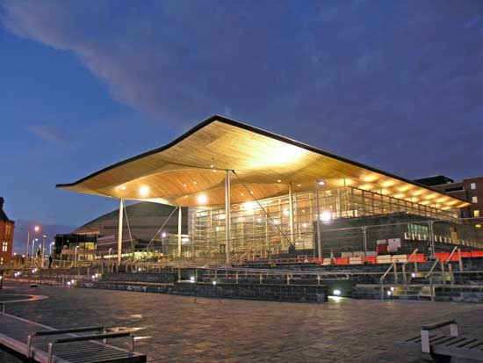
Devolution in Wales
Devolution in Wales was granted in the form of executive devolution. The powers of the Secretary of State were transferred to ministers of the National Assembly for Wales. However, the devolved body was not granted full law making powers and could not initiate primary legislation.
Notes:
Reserved areas
the constitution
defence and national security
fiscal, economic and monetary system
trade and industry, including competition and customer protection
transport (not particular to Scotland) including railways, transport safety and regulation
social security
medical ethics: abortion; human fertilisation and embryology; genetics;
xenotransplantation and vivisection.
broadcasting
foreign affairs
the civil service
immigration and nationality
energy: electricity, coal, oil, gas, nuclear energy
employment
equal opportunities

Slide 23
Devolution in Wales
The devolved powers are
agriculture and fisheries
culture
economic development
education and Training
environment
health
highways
housing
industry
local government
social services
sport
tourism
town and country planning
transport
water
the welsh language

Slide 24
Devolution in Wales
The Government of Wales Act 2006 reformed the National Assembly for Wales and allows further powers to be granted to it more easily. The Act creates a system of government with a separate executive drawn from and accountable to the legislature.
The Act created an executive body — the Welsh Assembly Government (known since May 2011 as the Welsh Government) - that is separate from the legislative body, that is, the National Assembly for Wales. The Welsh Government was therefore altered from being a committee of the National Assembly to being a distinct body
provided for a referendum for further legislature powers.
The Coalition government for Wales between Labour and Plaid Cymru 2007 had the policy of further law making powers for Wales and this led to the Welsh referendum of 2011.

Slide 25
Devolution in Northern Ireland 1
Northern Ireland was divided from the rest of Ireland in 1922 and remained part of the UK.
In the 60s there were approximately 1 million Protestants and ½ million Catholics in NI.
In 2011 the total had risen to 1.8 M with 43.76% Catholic 790,00, and 53.13% Protestant 960,00.
Politics is dominated by the religious divide.
Protestants vote for Unionist parties.
Catholics vote for Nationalist parties (in favour of a united Ireland).

Slide 26
Devolution in Northern Ireland 2
The Government of Ireland Act 1920 provided for a Parliament for Northern Ireland elected by FPTP. The Unionist party won every election between 1922 and 1970 and dominated the Parliament and were in continuous power.
They used their power to discriminate against Catholics and in favour of Protestants particularly in housing and jobs.
The troubles began in 1968 when the Northern Ireland Civil Rights Association began a series of marches and demonstrations in favour of better treatment for Catholics.
The reaction of Protestants was to attack many of these marches and there were attacks on property.
Violence increased and British troops were sent in in 1969.
In February 1971 the IRA the first British soldier.
Subsequently Protestant paramilitaries began killing Catholics.

Slide 27
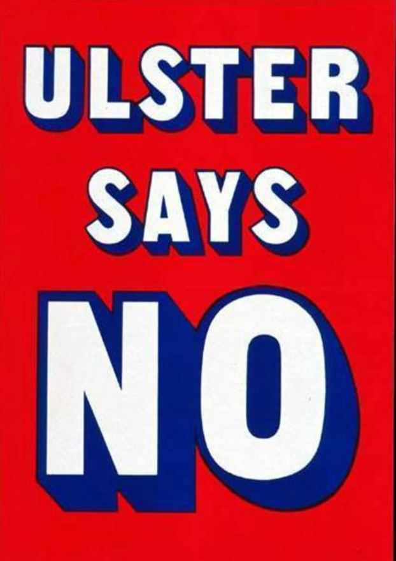
Devolution in Northern Ireland 3
The NI government was unable to contain the violence and unwilling to make concessions to the Catholics.
It was abolished and direct rule was imposed in 1972.
Direct rule was seen as a temporary measure, with a power-sharing devolution preferred as the solution.
Elections to this and subsequent Assemblies Have been by STV.
The Sunningdale Agreement 1973 resulted in a brief, power-sharing Executive, of the Official Unionists, the SDLP and the Alliance, which was ended by the Ulster Workers' Council strike on 28 May 1974.
The Northern Ireland Constitutional Convention (1975-1976) and Northern Ireland Assembly (1982-1986) were unsuccessful in restoring devolved government. They contained Unionist anti power sharing majorities.

Slide 28
Devolution in Northern Ireland 4
The old Unionist Party had split over power sharing and it was gradually superseded by the intransigent Democratic Unionist of Ian Paisley though not until 2003.
The Maze prison hunger striker Bobby Sands won the Fermanagh and South Tyrone by election in 1981 and this led to Sinn Fein to fight elections and they gradually replaced the SDLP as the main Catholic Party though not until 2003.
Following the Belfast Agreement (also known as the Good Friday Agreement) on 10 April 1998, devolution returned to Northern Ireland on 2 December 1999.
On 22 May 1998 referendums were in held in both Northern Ireland and in the Republic of Ireland which produced majorities in favour

Slide 29
Devolution in Northern Ireland 5
Ulster Unionist party leader David Trimble became First Minister of Northern Ireland. The Deputy Leader of the SDLP, Seamus Mallon, became Deputy First Minister of Northern Ireland. Sinn Fein also had ministers in the executive.
The DUP was opposed to the agreement.
The Official Unionists withdrew from the executive in 2002 because of suspicions that the IRA were not decommissioning arms and their involvement in a spying scandal.
The Northern Ireland Executive was suspended on 15 October 2002 and direct rule returned until devolution was restored on 8 May 2007.

Slide 30
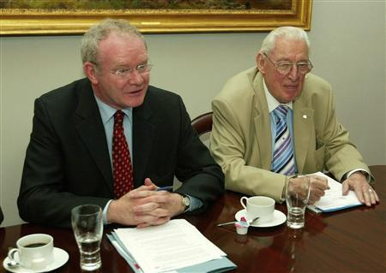
Devolution in Northern Ireland 6
The Assembly elections of 2003 saw Sinn Féin and the Democratic Unionist Party (DUP) emerge as the largest parties in each community, which made a restoration of the devolved institutions more difficult to achieve. The 2005 British general election saw the DUP make sweeping gains.
On July 28, 2005, the IRA made a public statement ordering an end to the armed campaign and instructing its members to dump arms and to pursue purely political programmes.
On October 13, 2006 there was an agreement at St. Andrews in Scotland, Sinn Féin would fully endorse the police in Northern Ireland, and the DUP would share power with Sinn Féin. All the main parties in Northern Ireland, including the DUP and Sinn Féin, subsequently formally endorsed the agreement.
On 8 May 2007, devolution of powers returned to Northern Ireland. DUP leader Ian Paisley and Sinn Féin's Martin McGuinness took office as First Minister and Deputy First Minister, respectively.

Slide 31
Devolution in Northern Ireland 7
The areas transferred to the Assembly include the following:
finance and personnel
health, social services and public safety
education
agriculture and rural development
enterprise, trade and investment
environment
culture, arts and leisure
learning and employment
regional development
social development

Slide 32
Devolution in Northern Ireland 8
subjects which could be transferred at a later date, if there is cross-community consent.
criminal law
policing
prisons
civil aviation
navigation
the Post Office
disqualification from membership of the Assembly
emergency powers
civil defence
consumer protection
telecommunications
Some reserved matters, principally policing, security, prisons and criminal justice currently remain within the responsibility of the Secretary of State for Northern Ireland.
The Belfast Agreement envisages that in time these will be transferred to the devolved administration in Northern Ireland.
Notes:
the Crown
• parliamentary elections, and Assembly elections including the franchise
• international relations
• defence of the realm
• honours
• nationality
• national taxation
• appointment and removal of judges
• registration of political parties
• coinage etc
• national security
• nuclear energy and installations
• regulation of sea fishing outside Northern Ireland
• provisions dealt with in the Northern Ireland Constitution Act 1973
• the subject matter of the Northern Ireland Act 1998 with specified exceptions

Slide 33
Arguments in Favour of Devolution
It would involve more people in the governmental process and bring it closer to the people.
It would relieve an overworked Westminster.
It was necessary to avoid independence and preserve the unity of the UK.

Slide 34
Arguments against Devolution
It would prove to be a step towards independence.
There is no satisfactory division of powers between Westminster and an assembly.
The lack of tax gathering powers means that the Assemblies are spending bodies and have no responsibility for raising taxes.
Another level of government is unnecessary.

