Slide 1

Congressional
Elections
Mike Allen

Slide 2
Congressional Elections
Congressional elections are held every two years. There are elections for 1/3rd of the Senate (who sit for six years) and for all of the House of Representatives who all stand for re-election after two years. These are held mid-way (two years) through a president’s term in office and are called mid-term elections.
Mid-terms can be used as an indicator of what the electorate think about the president’s performance and “their results can be of critical importance to the incumbent president.” (Vile)
From C N Trueman "Congressional Elections"
historylearningsite.co.uk. The History Learning Site, 27 Mar 2015. 16 Aug 2016.

Slide 3
Candidate requirements
ELIGIBILITY FOR CONGRESS
 | House of Representatives | Senate
Minimum Age | 25 | 30
Minimum Length of Citizenship | 7 years | 9 years
State Residency | Yes | Yes

Slide 4
Selection
It is very rare for 3rd parties to win a seat in Congress.
To be successful a candidate needs to be selected by one of the 2 major parties.
Congressional primaries are held between May and November. The winner of a Congressional primary automatically becomes the party candidate.
Incumbents have an advantage but it is possible for incumbents to be defeated in a primary.

Slide 5
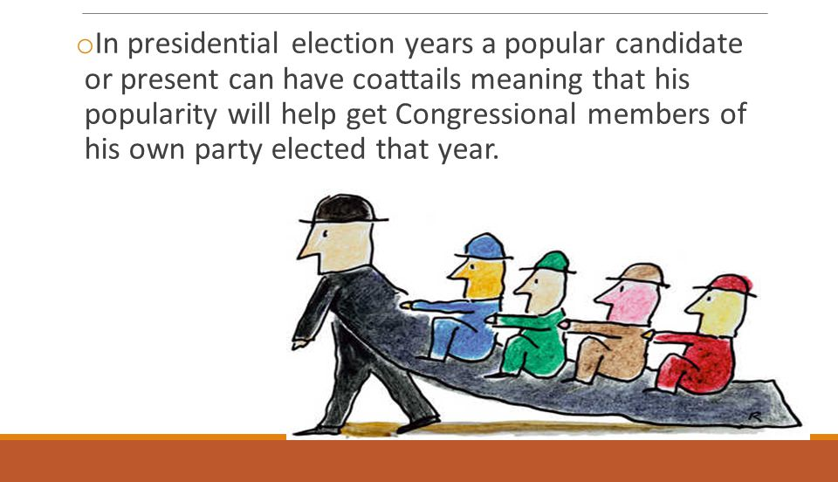
Trends in Congressional elections 1
Coattail effect
The term refers to the power of a popular candidate to gather support for other candidates running on the same party ticket.
Winning candidates are said to have coattails when they drag candidates for lower office along with them to victory.

Slide 6
US Presidential Coattails
Year | President | Party | House Shift | Senate Shift
1960 | Kennedy | D | -22 | -2
1964 | Johnson | D | +37 | +1
1968 | Nixon | R | +5 | +6
1972 | Nixon | R | +12 | -2
1976 | Carter | D | +1 | 0
1980 | Reagan | R | +33 | +12
1984 | Reagan | R | +14 | -2
1988 | Bush (G) | R | -2 | 0
1992 | Clinton | D | -9 | 0
1996 | Clinton | D | +3 | -2
2000 | Bush (GW) | R | -1 | -4
2004 | Bush (GW) | R | +3 | +4
2008 | Obama | D | +21 | +8
2012 | Obama | D | +2 | +8

Slide 7
Trends in Congressional elections 2
Split-ticket voting some voters will vote for a presidential candidate from one party but a House of Representative candidate from another party.
There is some evidence that voters think in terms of divided government.
There is strong support for incumbents. In the House re-election rates have been 95% or higher in the last 7 elections.
There has been a decline in competitive seats in House elections. This has been because of gerrymandering. There is no impartial administration of elections in the US.
This may be behind the decline in bi-partisanship.

Slide 8
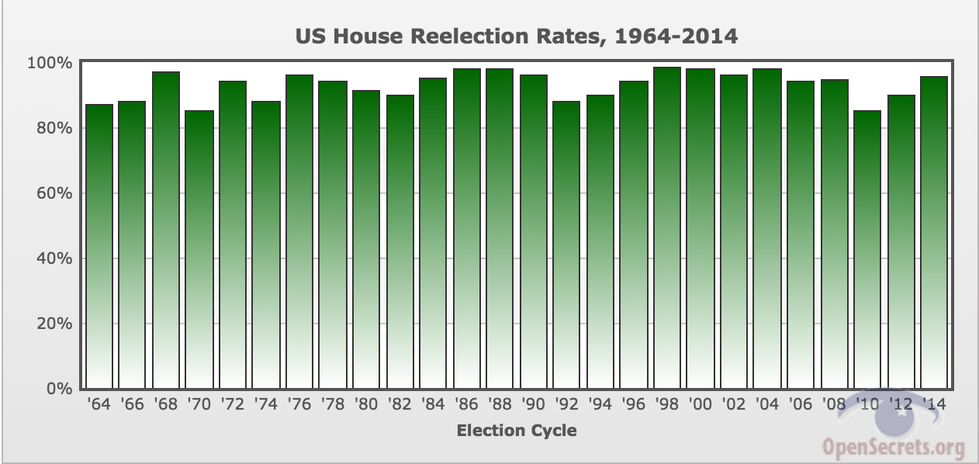

Slide 9
Voting Behaviour
Studies tend to concentrate on Presidential elections.
Local issues are important. Farm subsidies are important in farming states such as Kansas and Iowa. Illegal immigration is important in Texas and New Mexico.
However national issues are also important, particularly economic issues.

Slide 10
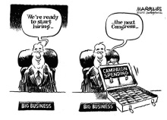

Slide 11
Mid Term elections
These come 2 years after Presidential elections – all of the House and one third of the Senate.
The president’s party normally loses seats in both houses.
Voters often see mid term elections as a way of expressing disapproval with a President.
For Example in 1994 when Clinton failed to deliver health care reform.
Turnout has been about 40% for recent mid-term elections. – lower than for Presidential elections.

Slide 12
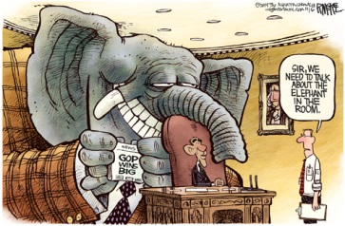
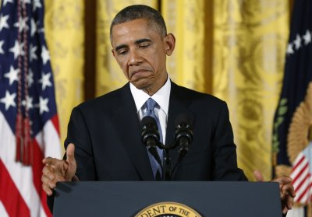
2014 Mid-term elections

