Slide 1
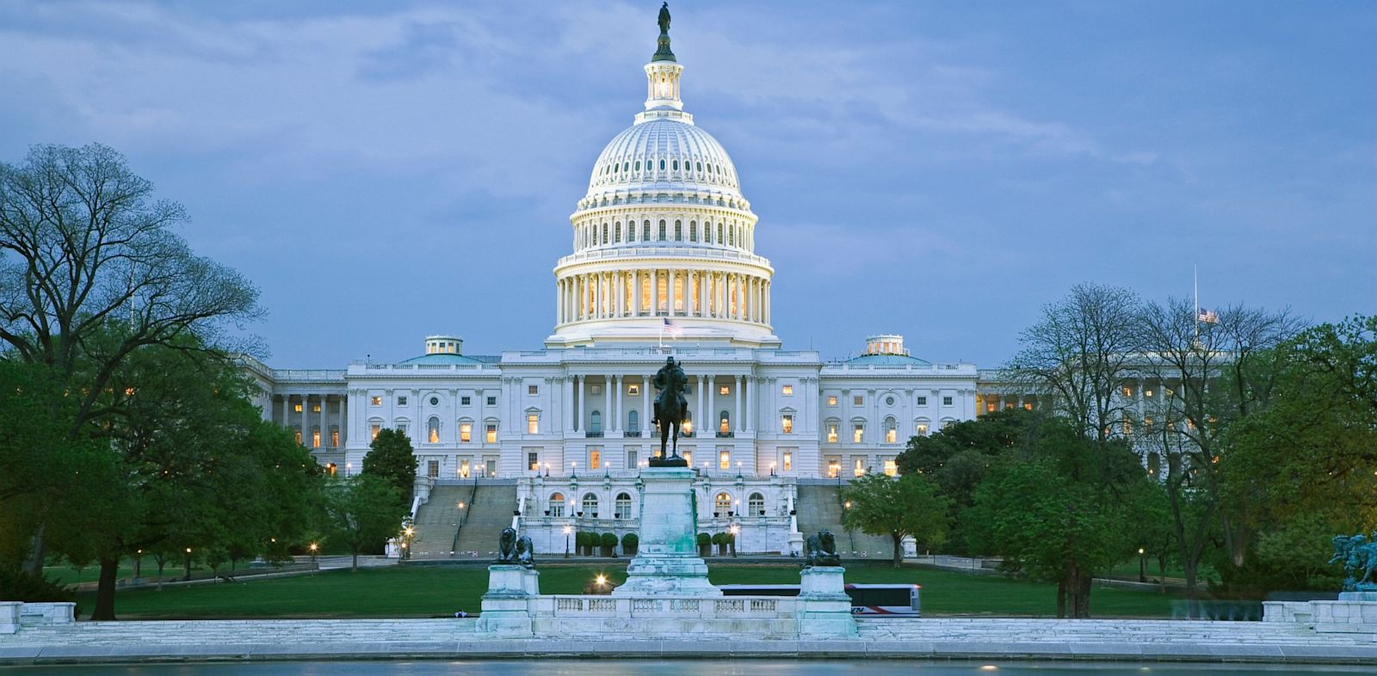
Congress
By
Mike Allen

Slide 2
The Structure 1¹
The Founding Fathers saw Congress as the most important branch of government.
Congress is bicameral : meaning its made up of two houses (the House and the Senate) – this was a compromise made by the Founding Fathers.
The House would be represented proportionally to their population (pleasing large states) and the Senate would be represented equally (pleasing the small states)
The House today is made up of 435 members – this is decided upon in regards to their population. Eg. 2016 – California had 55 and New York had 29.
The Senate today – each of the 50 states have 2 Senators – meaning the Senate is made up of 100 Senators.
¹ The next 5 slides are from Congress.pptx The Student Room

Slide 3
The Structure 2
Congressmen – they all must be at least 25 years old, been US citizens for at least 7 years and be residents of the states from which they are elected. They serve two year terms (mid-term elections). They represent districts within a state.
Senators – they all must be at least 30 years old, been US citizens for at least 9 years and be residents of the state electing them. They serve six year terms, with one third of the Senate being elected ever two years (the two Senators from each state are not up for election at the same time). They represent a state.

Slide 4
Powers of Congress (enumerated powers) 1
Exclusive powers of the House –
They are able to initiate money bills : when Congress first started, the House was the only directly elected chamber – the Founding Fathers believed that the directly elected representatives should have the first say in spending the people’s money.
The most important power – Impeachment – this is the power to formally accuse any member of the executive and judiciary branch. This has been used 17 times since 1789. Eg. 1998 they impeached President Clinton.
Lastly if the Electoral College was in deadlock – and no candidate wins an absolute majority – the House then has to elect the President. This has only been used twice – 1800 and 1824.

Slide 5
Powers of Congress (enumerated powers) 2
Exclusive powers of the Senate – these are seen as more prestigious than those of the House and two of them in particular give them more power than the House.
They have the power by a simple majority to confirm many of the president’s appointments. Eg. this includes all to the Federal judiciary and a majority (but not all) to the executive branch.
They also have the power to ratify – again by a super-majority (2/3rds – 67) – all treaties negotiated by the president must be approved by the Senate. This means that the president needs to keep the Senate fully informed to avoid the Senate refusing to ratify the finished treaty.
The Senate also has the power to impeach – this is different to the House’s power – after the House has formally accused the member – the Senate has to hear the trial and find the person guilty or not guilty. This is done by a vote – they need a super-majority vote. If found guilty the member is removed from office. In 1998 Clinton was found not guilty.
The Senate also has the power of electing the vice-president if the Electoral College reaches deadlock.

Slide 6
Powers of Congress (enumerated powers) Concurrent Powers 3
Although the Senate’s exclusive powers of significant – it is important to remember that the two chambers are co-equal - they have five concurrent powers.
Most importantly the two chambers are equal in the passage of legislation – all bills must pass through stages in both Houses. Neither chamber can override the other. Both chambers must agree on the same version of the bill before it goes to the president.
Both chambers must vote – with super-majorities (2/3rds – 67) to override a president’s veto. Eg. in 2007 – Congress voted to override Bush’s veto of the Water Resources Development Bill.
A constitutional amendment must be approved by super-majorities (2/3rds – 67) in both chambers of Congress before it is sent to the states for ratification.
Both chambers must agree on a declaration of war – this has happened five times. Eg. in 1941 when America declared war on Japan.

Slide 7
Powers 4²
The 25th Amendment gave both chambers the power to confirm a newly appointed vice-president. This has happened twice (1973 and 1974).
The final enumerated power is known as the ‘elastic clause’, which gives Congress the right to make all ‘necessary and proper’ laws to carry out its responsibilities.
It is called the ‘elastic clause’ because it allows Congress to stretch its powers to respond to situations the Founding Fathers could never have anticipated.
Constitutional amendments affecting Congress
This balance of powers and restraints has remained largely unchanged since the Constitution was ratified in June 1788. Only three significant changes have occurred since, namely:
The 17th Amendment, passed in 1913, so that Senators were directly elected by the people instead of by state legislatures.
The number of representatives in the House was set at 435 in 1929.
The 20th Amendment, passed in 1933, laid down that Congress would start its new session on January 3rd, after each Congressional election.
² US Government and Politics William Storey pp235-6

Slide 8
The Powers of Congress
Nature of Powers | House of Representatives | Senate
Exclusive Powers | Initiate Money Bills Impeachment Elect President if Electoral College is deadlocked | Confirm appointments Ratify Treaties Try cases of impeachment Elect Vice President if Electoral College is deadlocked
Concurrent Powers | Pass legislation Override President’s veto Initiate Constitutional amendments Declare War Confirm a newly appointed Vice President

Slide 9
Is the Senate more prestigious than the House? 1³
Yes :
Senators represent more people & bigger areas = states rather than districts.
Senators serve six year terms (longer than Congressmen).
Senators are 1 out of 100 = meaning they have more chance of making a difference.
Senators are more likely to chair a committee or sub-committee or hold some leadership position.
Senators are more well-known – state-wide and nationwide.
The Senate is seen as a ‘recruiting pool for presidential and vice-presidential candidates’ – the majority of candidates come from the Senate.
They hold more prestigious exclusive powers.
House members often seek election into the Senate never the other way round.
3 The next 34 slides are from Congress.pptx The Student Room

Slide 10
Is the Senate more prestigious than the House? 2
No :
Both chambers are equal in terms of passing legislation – this is Congress’s main function.
Both chambers must approve constitutional amendments.
Both Senators and Congressmen receive the same salaries.
The House is more important in finance.

Slide 11
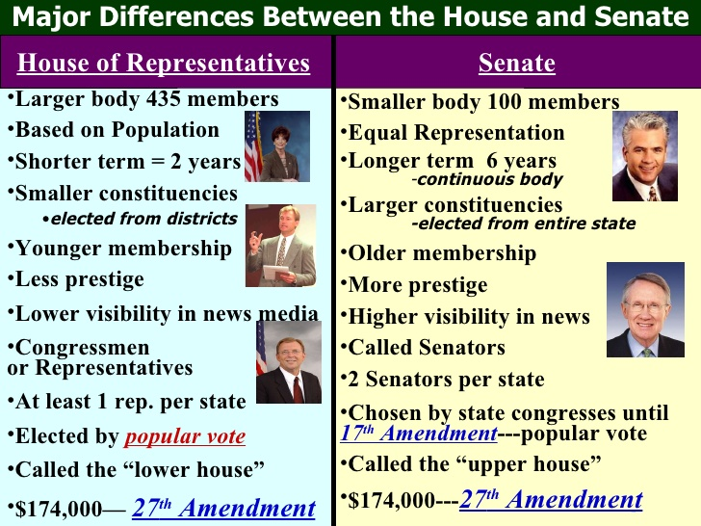

Slide 12
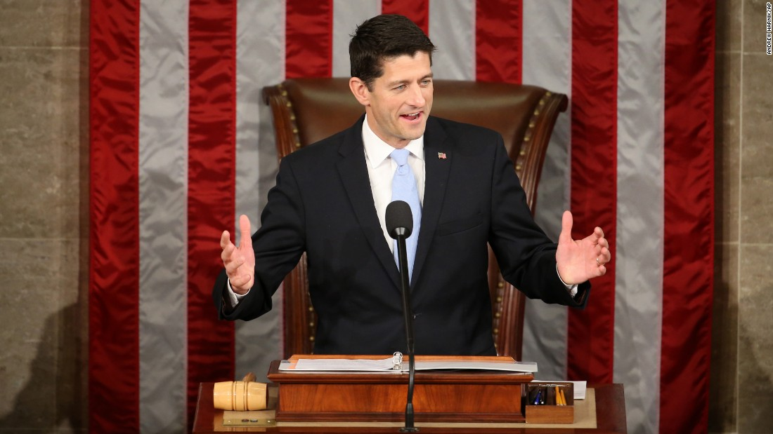
Congressional Officials 1
The House Speaker :
This is an elected administrative officer – he or she is elected by the whole House membership at the start of each new Congressional year (every 2 years) – because of this method the Speaker is usually the majority party leader.
The Constitution does not require the Speaker to be a member of the House but they usually have been.
They can serve for four consecutive Congresses – they are third in line for the presidency after the vice- president.
If the House Speaker is absent – they are replaced by a Speaker pro tempore – they can sit for up to three legislative days without approval from the House. They are usually from the majority party as well.
Paul Ryan 2015–

Slide 13
Congressional Officials 2
The House Speaker’s powers :
They act as the presiding officer of the House.
They interpret and enforce the rules of the House and decide on points of order.
They can refer bills to standing committees.
They appoint select committee and conference committee chairs.
They appoint the majority of party members of the House Rules Committee.

Slide 14
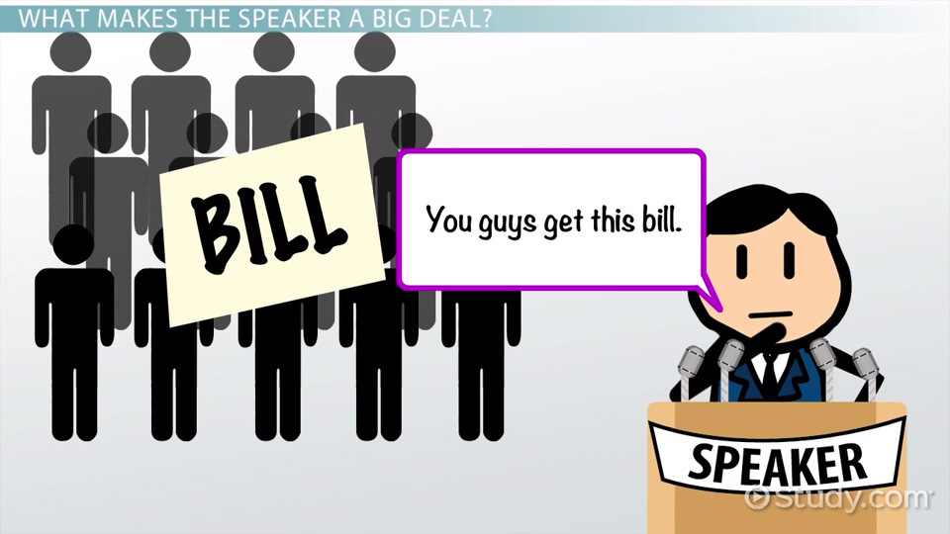
Congressional Officials 3
The House Speaker’s influence –
They can exert a lot of influence on the flow of legislation through the House.
When the presidency and Congress are of different parties – the Speaker acts as a ‘leader of opposition’ – acting as a spokesmen for the party not in the White House. Eg. Newt Gingrich had this role under Clinton (1995-1998) and Nancy Pelosi during the last two years of Bush’s presidency.

Slide 15
Congressional Officials 4
The Majority and minority leaders :
Overall – there joint duties are :
Act as day-to-day ‘directors of operations’ on the floor of their chamber.
Hold press briefings to talk about their party’s policy agenda.
Act as a liaison between the House/Senate and the White House.

Slide 16
Important Roles -
The Majority and minority leaders :
Majority leaders – they are found in both the House and the Senate and are the party’s chief strategists. They work to strengthen the influence of the party.
The Majority leader in the House is elected every two years by secret ballot of his party. The act as a ‘number two’ role to the Speaker.
The Majority leader in the Senate is elected at the start of each Congress by a majority vote of the Senators in the majority party. They play a key role in bringing bulls for debate to the Senate floor.
They are assisted by the Majority whips whose role is to secure party unity.

Slide 17
Congressional Officials 5
The Majority and minority leaders :
They are found in each chamber of Congress.
There roles are very similar to those of the Majority Leader.
In the Senate – more business is done through agreement between the majority and minority groups – the leaders must therefore cooperate with each other.
They are assisted by the Minority Whips.

Slide 18
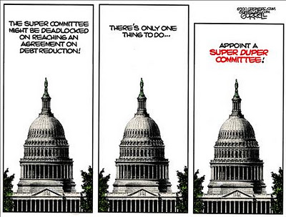
Congressional Committees -
There are several committees within Congress –
Standing Committees : they exist in both chambers and are permanent policy – specialist bodies. Most standing committees are divided into sub-committees.
In the House, standing committees are made up of around 40-50 members
Those in the Senate are made up of around 18 members. The party balance in these committees is the same proportion as is in that chamber of Congress. Eg. in the 114th Congress (Jan 17) the Republicans had majorities in both chambers and this was reflected in the Standing Committees.

Slide 19
Congressional Committees -
Standing Committees :
House and Senate members seek assignment on committees that are closest to the interests of their district or state. Eg. both Senators from Iowa (Tom Harkin and Charles Grassley) are on the Senate Agriculture Committee.
Some standing committees are more prestigious than others. Eg. Judiciary, Armed Services and Appropriations.
Standing Committees have two functions – the first and most important is to conduct the committee stage of the legislative process. The second function is to conduct investigations within the committee’s policy area.
In the Senate, the committees have a third function – to begin the confirmation process for presidential nominations.

Slide 20
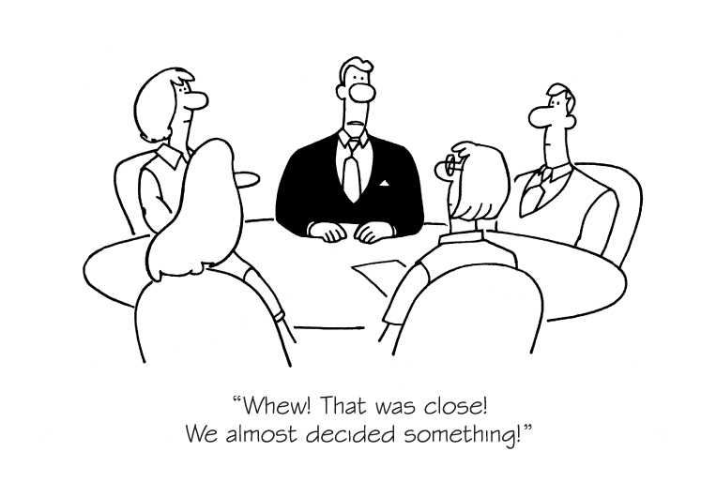
Congressional Committees -
House Rules Committee :
This is one of the standing committees in the House – but it performs a different function.
It is responsible for prioritising bills coming from the committee stage on to the House floor for their second readings.
There is a large number of bills waiting for a second reading and therefore the House Rules Committee plays a vital role.
Membership to the committee is much smaller and lent more towards the majority party. Eg. 2017 : it had just 13 members, nine Republicans and 4 Democrats.

Slide 21
Congressional Committees -
Conference Committee :
They are needed because of two characteristics of the legislative process.
First – both chambers have equal power and
Second – because a bill goes through both chambers concurrently rather than consecutively.
When a bill has finished in the House and Senate – it is usually in two different versions – if these differences cannot be solved in the third reading – a Conference Committee is set up.
Membership is made up of both members of the Senate and of the House and their sole function is to reconcile the differences between the House and the Senate bills.
They are important because they are likely to draw up what will become the final version of the bill.
Their power is checked by the House and Senate’s ability to refuse to sign up to their compromise.

Slide 22
Congressional Committees -
Select committees –
There are sometimes known as ‘special’ or ‘investigative’ committees. They are usually always set up to investigate a particular issue.
They are set up when an investigation either: does not fall within the policy area of one standing committee; or it is so time-consuming that a standing committee would be tied up with it and therefore preventing the standing committee from fulfilling its other functions. Eg. there have been a number of high profile select committees in recent years – the House select Committee on political assassinations and a joint select committee on both the Iran-Contra affair and the events of 9/11.

Slide 23
The Committee Chair -
Chairpersons are always chosen from the majority party in that chamber. Eg. during 2017, all standing committees were chaired by the Republicans. The seniority rule states that the chair of the committee will be the member of the majority party with the longest continuous service on that committee.
There is a six year term limit on the chair (introduced by the Republicans in the 1990s).

Slide 24
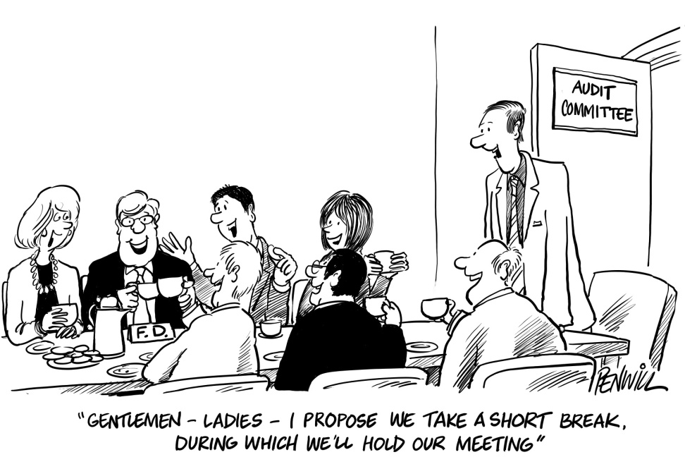
The Committee Chair -
Powers –
They control the committee’s agenda (deciding what is discussed and when).
They decide when the committee will meet.
They control the committee’s budget.
They influence the membership, meetings and hearings of the sub-committees.
They supervise the committee staff.
They serve as a spokesperson on the committee’s policy area within Congress, to the White House and the media.
They make requests to the House Rules Committee and the party leadership (in the Senate) for scheduling of legislation on the House Floor.
They report legislation to the floor of their respective chamber on behalf of the full committee.

Slide 25
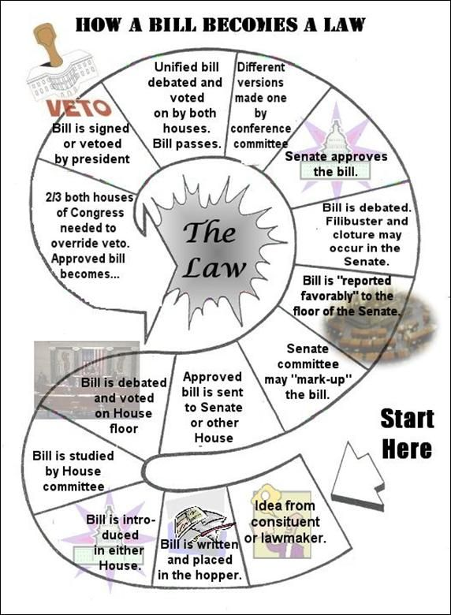
The Legislative Process –
Bills are introduced to both the House and the Senate at the same time and are considered concurrently not consecutively as in the UK.
There are several stages :
First reading
Committee Stage
Second reading
Third reading
Conference stage (not always)
Presidential action

Slide 26
The Legislative Process –
First reading –
This is purely a formality – there is no debate and no vote.
(in the House) It involves nothing more than placing a copy of the bill in a ‘hopper’ (a tray on the clerk’s desk).
(in the Senate) this involves reading out the title of the bill on the Senate floor – bills are then numbered, printed, circulated and sent on to the appropriate standing committee.
There is a lot of legislation introduced to Congress at this point – in a typical Congress between 10,000 and 14,000 bills are introduced – only around 3-5% of these actually make it to law. The main reason for this is the long and complex process.

Slide 27
The Legislative Process –
Committee stage –
This is considered the most important stage of the process – more bills fail here than at any other stage. Hundreds of bills are referred to each of the standing committees in both chambers – this is more than they can handle.
A significant number are pigeon-holed (put to one side, no action taken)
Those with a good deal of support, eg. from members of Congress, the White House, the administration or interest groups – are given hearings either in the full committee or in sub-committees.
This stage is early on in the process – the full House and Senate have not debated the bill.
They are regarded as policy specialists and have full power of amendment – meaning they can add anything or change anything.
⁴ Hearings will be held, in which experts and pressure groups will testify on the advantages and disadvantages of the bill.
At the end of this process, the committee will mark up the bill, including any amendments they decide are appropriate.
The committee will then report out the bill to the whole chamber. Ideally, from the point of view of its sponsors, it will leave with a positive recommendation, but it can be reported out without a recommendation.
⁴ This section to …recommendation is from US Government and Politics William Storey pp252

Slide 28
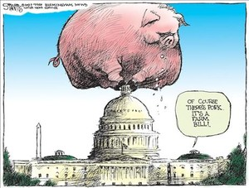
The Legislative Process
“Pork-barrel politics
Clearly, it is advantageous to a bill if the Speaker and other key members of Congress support its aims and objectives. They may also find a bill attractive, however, if it provides Federal funds for projects in their districts.
Many bills, therefore, have such proposals added to them to aid their passage. This is known in political circles as pork-barrel politics. An example of how this works can be illustrated by the experience of Congressman Bill Young, who represents the 10th District of Florida. He had been bypassed in 1994 as committee chairman for not having a sufficiently conservative voting record.

Slide 29
The Legislative Process –
He was somewhat less moderate in the following years and was rewarded with the chairmanship of the Appropriations Committee in 1998.
In the 108th Congress, between 2002 and 2004, he saw $80 million allocated to his district for military projects and another $30 million allocated to his state, Florida, to rebuild eroded beaches.
In the previous Congress, he secured $116 million for Florida projects.”
US Government and Politics William Storey pp254
Second reading –
This is the first opportunity for both chambers to debate the bill.
In the House most are debated in the ‘Committee of the Whole House’ – allowing as many members as possible to take part.
In both chambers – more amendments can be made.
Votes are then taken on the amendments and then on the bill as a whole. Super-majorities are needed (two-thirds).
During this stage – filibuster can take place in the Senate. This is when a individual senator or group of senators can attempt to talk a bill to death by using delaying tactics.
A filibuster can be ended by 60 votes.

Slide 30
The Legislative Process –
Third reading –
This is the final opportunity to debate the bill – this is if serious amendments occurred and/or the final vote was close.
There would be another substantial debate at this stage.
At the end – a further vote is taken.

Slide 31
The Legislative Process –
Conference committee –
This only takes place when a bill is passed in a different forms by the House and the Senate and the differences need to be resolved.
This is not as common as it once was .
However, it did hold some significance because they would usually decide on the final version of the bill.
When there are majorities for the same party in both Houses they nowadays agree amongst themselves the final version of the bill.

Slide 32
The Legislative Process
Presidential Action –
He has three options when it comes to legislation being passed on to him :
1) he may sign the bill into law – this will be done when he fully supports a bill and wishes to claim some credit for it. Eg. Bush signed the Homeland Security Bill in 2002.
2) he can also pocket veto legislation – this is done by leaving it to one side and taking no action – this is only effective at the end of a Congressional session – if the bill is not signed within ten days – then it has to begin the process again. However – if this is not done at the end of the Congressional year – after ten days it will become law anyway. The president will use this if his has not got an opinion on the bill or if he knows that his public veto will be overridden.
3) he can publically veto a bill – this must be done within ten days of him receiving the bill – he will send it back to the chamber of origin and explain why he is vetoing the bill. He will do this only if he strongly opposes a bill. In this situation Congress can either put the wrongs right that the president highlighted (unlikely), they can attempt to override the veto (two-thirds majority vote) or they can accept his decision and the process for the bill will have to start from the beginning (likely option).
President Obama 12 vetos 0 pocket vetoes 1 overridden.
The Justice Against Sponsors of Terrorism Act The legislation permits courts to waive a claim of foreign sovereign immunity when an act of terrorism occurs inside US borders. Thus it allow families of the victims of the September 11 terrorist attacks to sue Saudi Arabia. Obama was afraid of reciprocal action.

Slide 33
Strengths and Weaknesses of the Legislative Process -
Strengths –
The long and complex system allows for detailed scrutiny – more debate, questioning.
It fulfils the ideals of the Founding Father’s – they wanted this process – to protect the rights of the individual – stop tyranny.
If only some bills get through – laws are of a high quality – better bills.
This system has worked for the USA for it’s existence – no need for change.

Slide 34
Strengths and Weaknesses of the Legislative Process -
Weaknesses –
The overall process is very long (taking anything to two years to complete) – it’s also very complicated, many different stages.
There are several ways in which bills can be hindered – pocket veto at committee stages/presidential action, filibustering in the Senate ect.
There is a need at several stages of the process for super-majorities (two-thirds) – these are incredibly hard to achieve – dooming legislation. A lot of support is needed for the bill to be successful (committees, senators, the president).
A lot of power is left with the committees and their chairs. Is this democratic?

Slide 35
Voting in Congress -
Congress have to vote many times a year – Eg. 2007 – the House had to vote 1,186 times. They might be voting on budgets, amendments to bills, second or third readings, bills from conference committees, constitutional amendments or in the Senate (only) on treaties or appointments. There are six main factors that influence how Congressmen or Senators will vote.

Slide 36
Voting in Congress -
Political Party – for some members, on some issues this may be the most important factor. This is usually when the issue is an ideological issue. Eg. Civil rights, abortion, gun control, taxation. Votes in the Senate on presidential nominations can also be partisan. A party vote in Congress is simple a vote in which the majority of one party votes against the majority of the other. Eg. 1995 – the Republicans voted to push their ‘Contract with America’ while the Democrats voted to oppose that.
Partisanship has increased in Congress however, it is by no means binding on members.

Slide 37
Voting in Congress -
Constituents – House and Senate members place a high premium on representing the interest of their constituents. Failing to support their constituents can prove a problem – Eg. two House members from Maryland – Republican Wayne Gilchrest and Democrat Albert Wynn – were both defeated in their congressional primaries (2008) because their constituents felt they were out of touch with what they wanted. Pork Barrel Politics is a good example of this!

Slide 38
Voting in Congress -
The administration – this refers to the members of the executive branch including the president – most legislation is initiated by the administration - Cabinet members, heads of executive departments – want legislation passed that will benefit their policy area – therefore they will keep in contact with Congress members.

Slide 39
Voting in Congress -
Colleagues and staff – Congress members cast a huge number of votes because of this they cannot know the details of every single one. They rely on others to help them decide how to vote. Members may turn to fellow members in their chamber, or same party, or who share the same philosophy and views. – senior members may act as ‘mentors’ and thus influence.

Slide 40
Voting in Congress -
Personal beliefs – on certain votes – Congressmen or Senators may vote according to their own personal beliefs. Eg. abortion, capital punishment, taxation and defence spending.
Could be said that this would be slightly influenced by party standing though?

Slide 41
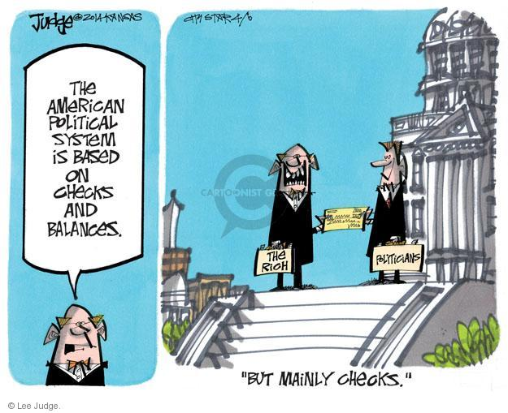
Oversight of the
Executive Branch -
This is another important function that Congress carries out – the Constitution does not explicitly give this power – however, they can make laws and over the years oversight of the executive has become an implied power. To carry out this function, Congress has given itself a number of powers –
They can subpoena witnesses (to summon/make appear in front of Congress) documents and testimony
Hold individuals in contempt if they do not comply with Congress’s demands for information
And they make it illegal to lie to Congress

Slide 42
Oversight of the
Executive Branch -
Most of the oversight takes place in the committee rooms – mainly because of separation of powers. ‘Question time’ is not possible in Congress because the executive are not allowed in the legislature.
Members of the executive are questioned in the committee rooms. This is effective because the committees are policy specialists.

Slide 43
How effective is Congress?
Yes (it is effective)
Congress has the permanent protection of the Constitution to make sure that no president can take it’s power. Eg. the Watergate affair – Congress showed it’s dominance over the president.
They hold the ‘purse strings’ – presidents can do little without funding. Eg. Bush was hindered with his education and social security bill because Congress wouldn’t give him the money. Obama also had this problem with his health care reforms.
When Congress uses it’s full strength – the president is no match for it.
Congress functions efficiently in both representation and legislation. Eg. the impeachment of Clinton (1998). Members of Congress are encouraged not to move to Washington but to stay close to their constituents.
It still has an important role in scrutinising and legislating. It ensures unpopular policy is blocked. Eg. Clinton’s Health Care bill in 1993.
It is still effective in confirming/rejecting presidential nominations. Eg. by 2003 – the Senate had refused to accept 30 judicial appointments.
There is a high incumbency rate within Congress – showing the success of most Congressmen and Senators;.

Slide 44
How effective is Congress?
No (is not effective) –
There has been a rise in the executive – undermining the importance of Congress.
Congress has become split because of the overuse of committees – it is not capable of making speedy decisions required.
The rise in party organisation has undermined the authority as of the body as a whole – Congress is much more partisan than before.
Separation of powers makes the process of law-making slow and complex – this isn’t effective in today’s world.
Congress is powerless against a popular president. Eg. Clinton and Bush.
The failure of Clinton’s impeachment – showed how split Congress is – partisanship has made scrutiny less effective. Eg. During Bush’s time, it was almost non-existent.
Congress is not popular with the public.
Personality politics undermines Congress – many people don’t know their Congressmen.
There is little Congress can do against a presidential veto.
Congress has encouraged more devolution of power to the states – undermining their authority.
The make-up of Congress does not reflect society = is this really representative?

