Slide 1
Architecture in Europe 1815-1914
By
Mike Allen

Slide 2
The Battle of the Styles 1 Neo-Classicalism
19th century architects made reference to many earlier styles of architecture.
However there were 2 main styles thast contended with each other.
The first was the neo-classical style which started in the middle of the eighteenth century and continued into the 19th century and even into the modern era.
Neoclassicism was a desire to return to the perceived "purity" of the arts of Rome, to the more vague perception ("ideal") of Ancient Greek arts.

Slide 3
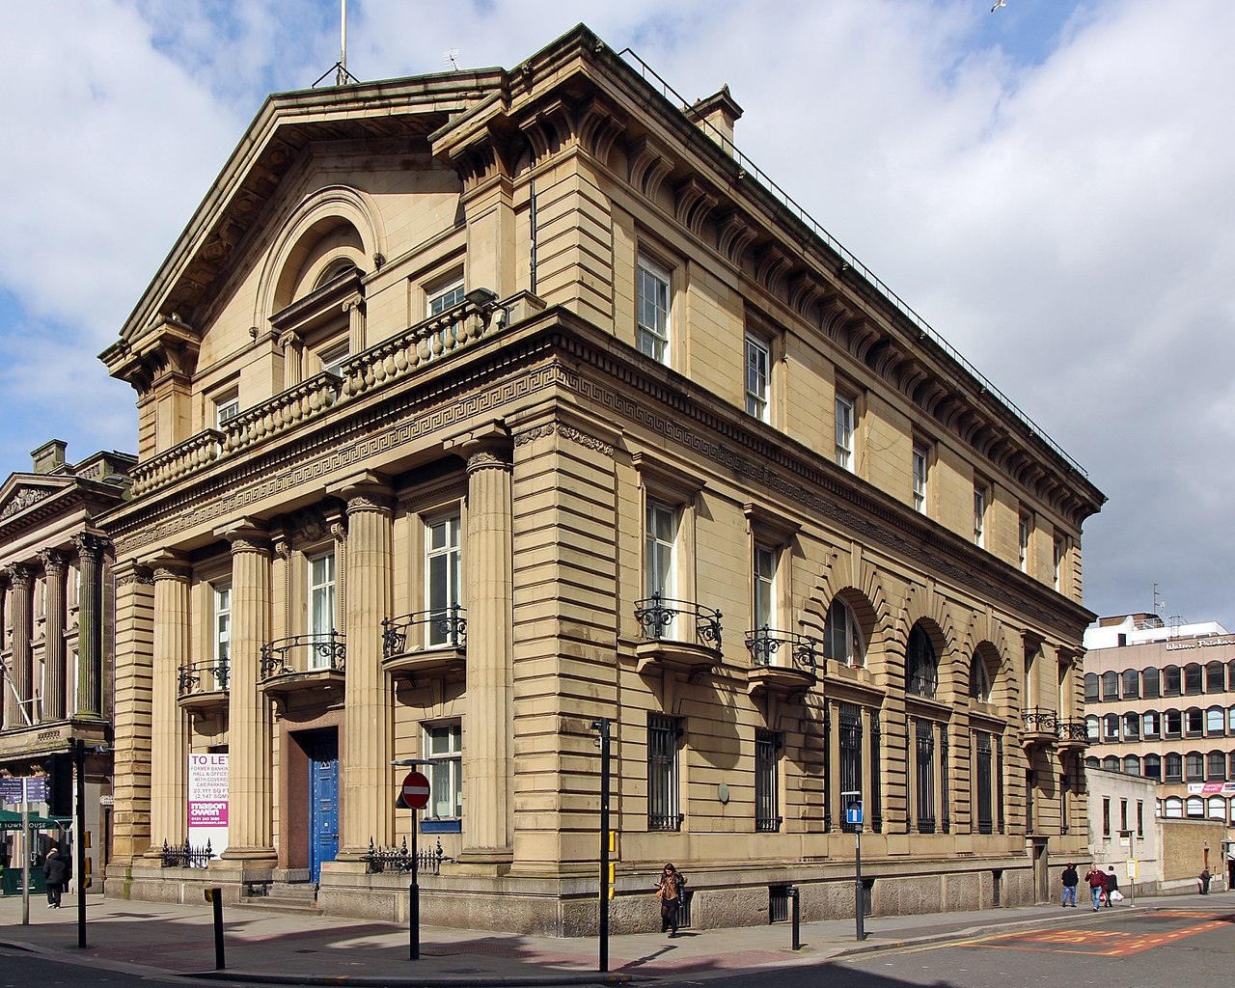
Bank of England Building Liverpool 1845

Slide 4
The Battle of the Styles 2 Neo-Gothic
The Neo-Gothic style was based on the medieval Christian style - virtuous, worthy and romantic.
Early churches had been Romanesque in style with rounded arches.
The Gothic style discovered the pointed arch which enabled higher and more elegant windows and vaulted arches so buildings could be taller

Slide 5
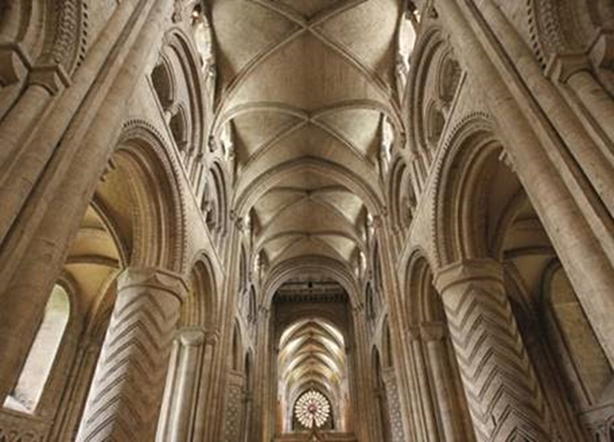
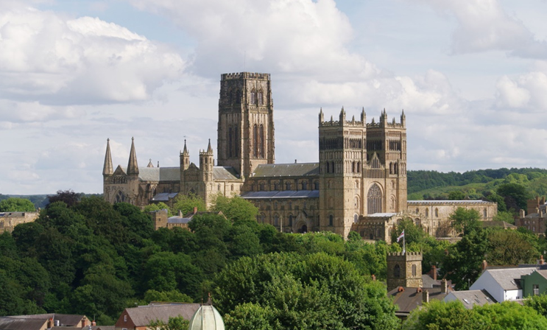
Durham Cathedral Opened 1133

Slide 6
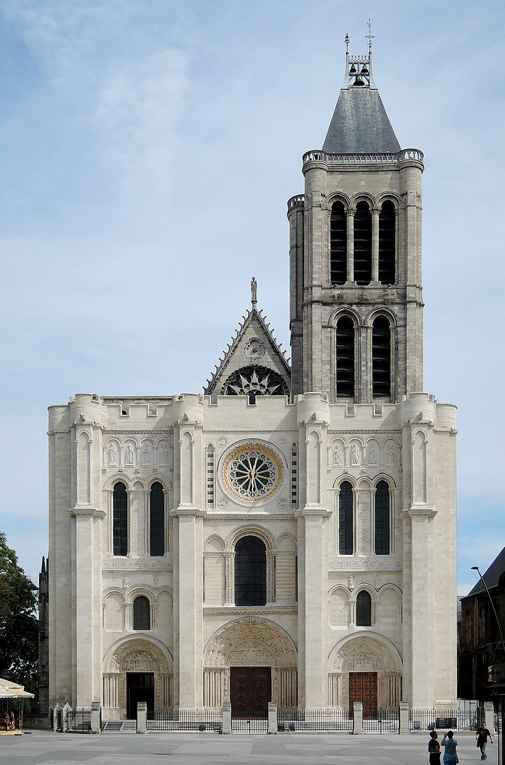
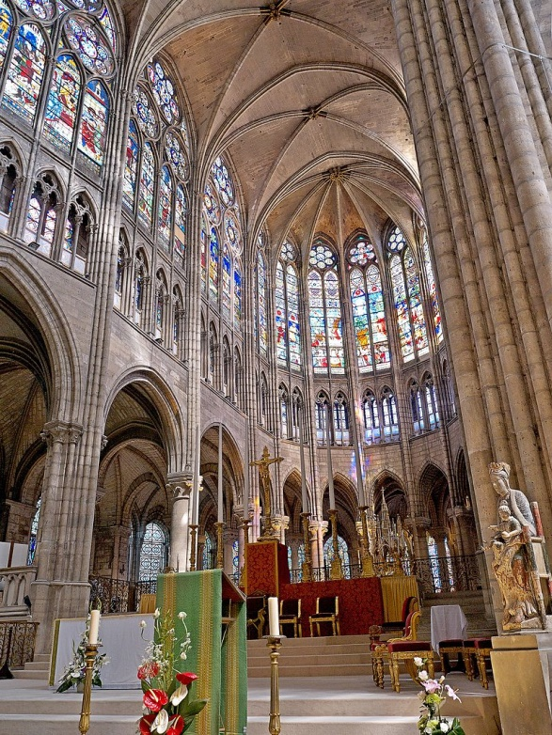
The Basilica of Saint-Denis
The Choir of St.Denis 1144 The first building to use gothic style architecture..

Slide 7
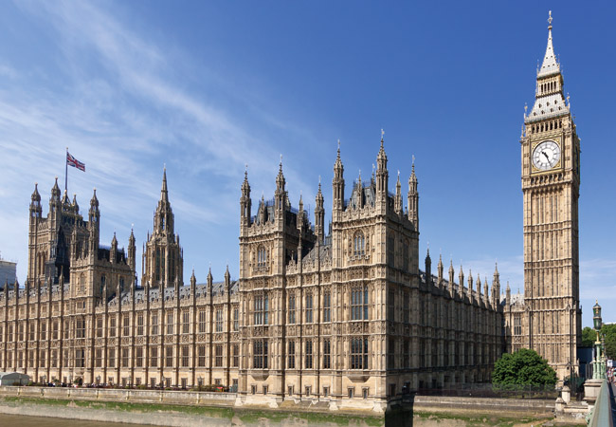
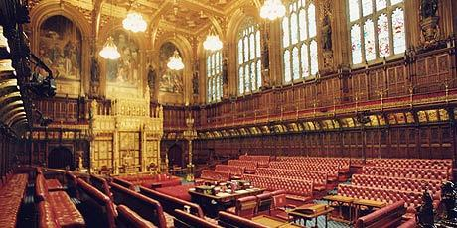
Augustus Welby Pugin
Pugin argued for a return to Gothic forms. The Palace of Westminster was burned down in 1834, and a competition was held for the design of its replacement.
Sir Charles Barry designed Westminster palace and employed Pugin to design the interiors which he did in an opulent Gothic style.
The House of Lords interior

Slide 8
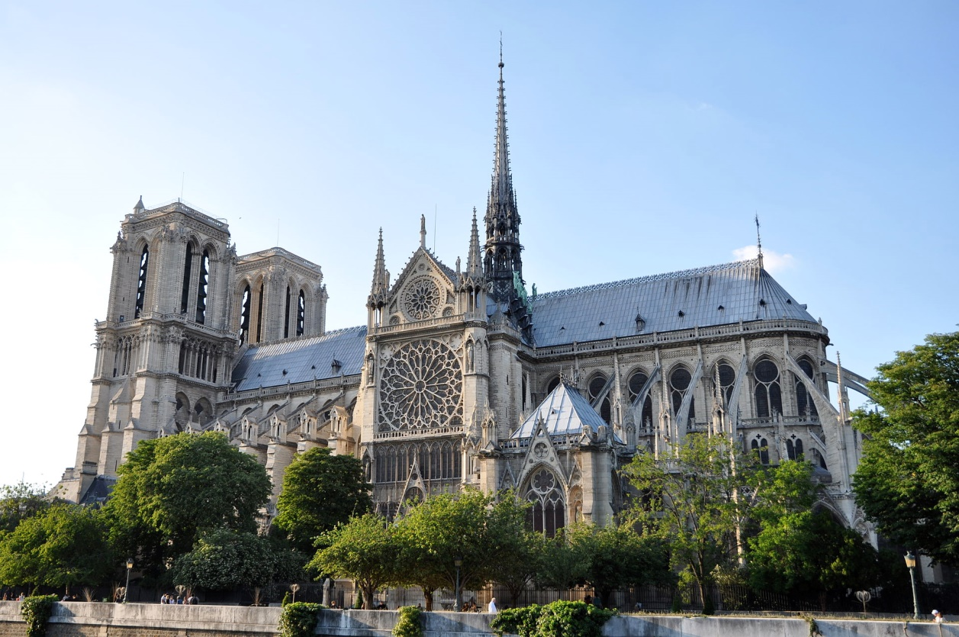
Eugène Viollet le Duc
In France, Viollet le Duc patched, restored and wrote with great medievalist vigour. Many buildings had been damaged or destroyed during the French revolution. He restored many buildings throughout France. He restored the Notre Dame de Paris
The Notre Dame de Paris 2010 before the 2019 fire.

Slide 9
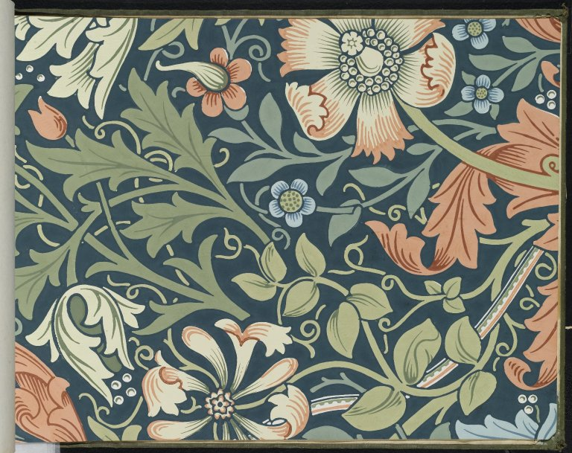
The Arts and Crafts movement
The Arts and Crafts movement was an international trend in the decorative and fine arts that developed earliest and most fully in the British Isles and subsequently spread across the British Empire and to the rest of Europe and America.
Initiated in reaction against the perceived impoverishment of the decorative arts and the conditions in which they were produced,[3] the movement flourished in Europe and North America between about 1880 and 1920.
William Morris. Wallpaper Sample, c.1917

Slide 10
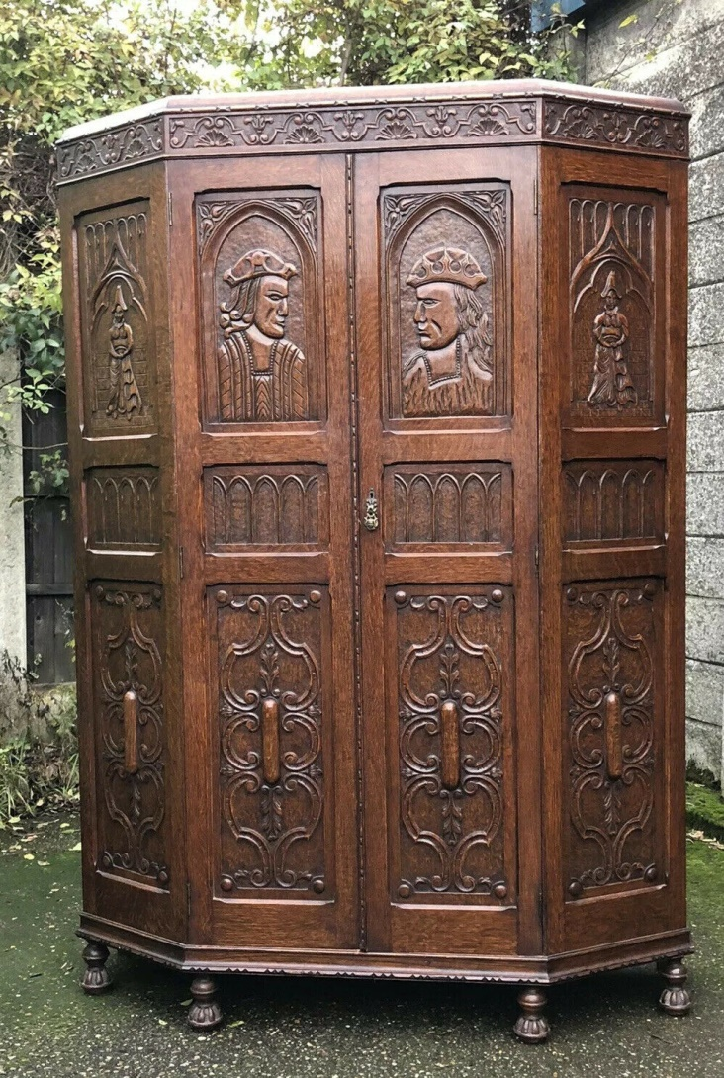
The Arts and Crafts movement 2
It stood for traditional craftsmanship, and often used medieval, romantic, or folk styles of decoration. It advocated economic and social reform and was anti-industrial in its orientation.
It was inspired by the ideas of architect Augustus Pugin, writer John Ruskin, and designer William Morris. In Scotland it is associated with key figures such as Charles Rennie Mackintosh.
Arts & Crafts Wardrobe

Slide 11
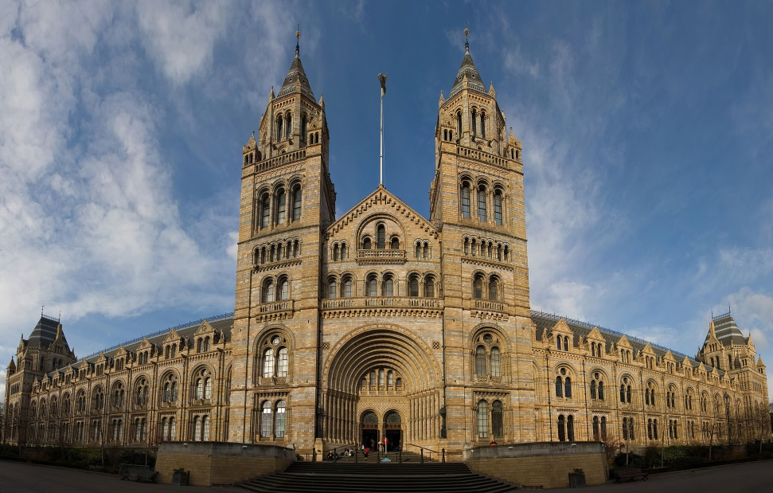
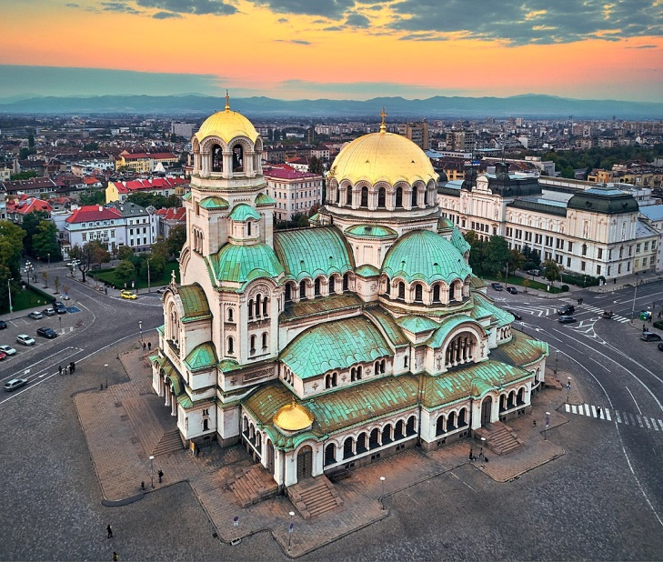
Eclecticism 1840-1890
This period was called Eclecticism, which is sometimes claimed to be the style of the 19th century. The name originates from a Greek word, which means choosing according to quality. The architects were choosing between the styles, and sometimes they also mixed different elements. It is also sometimes called revivalist.
The Natural History Museum established 1881. Romanesque revival
Byzantine Revival - The Alexander Nevsky Cathedral from Sofia (Bulgaria), built between 1882 and 1912

Slide 12
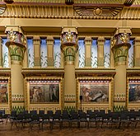
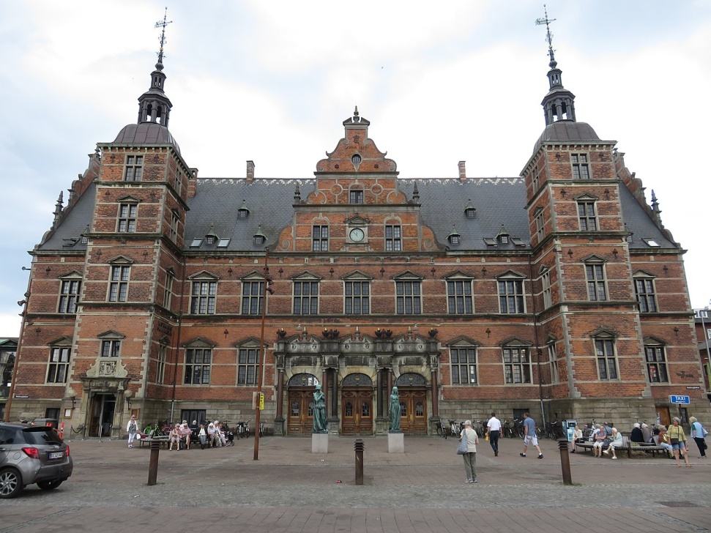
Revivalist
Egyptian Revival - Interior of the Temple maçonnique des Amis philanthropes in Bruxelles (Belgium) 1869-79)
Renaissance Revival - The Helsingør station in Helsingør (Danemark), opened on 24 October 1891

Slide 13
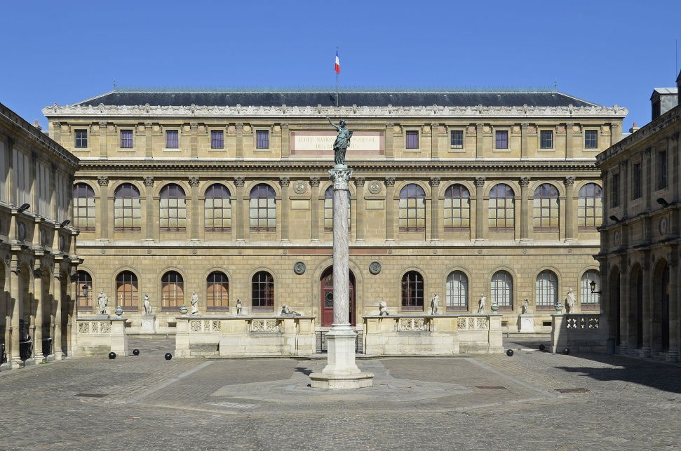
Beaux-Arts architecture
Beaux-Arts architecture was the academic architectural style taught at the École des Beaux-Arts in Paris, particularly from the 1830s to the end of the 19th century. It drew upon the principles of French neoclassicism, but also incorporated Gothic and Renaissance elements, and used modern materials, such as iron and glass. It was an important style in France until the end of the 19th century.
The École des Beaux-Arts in Paris begun by François Debret then finished by Félix Duban. This institution gave its name to the Beaux-Arts style

Slide 14
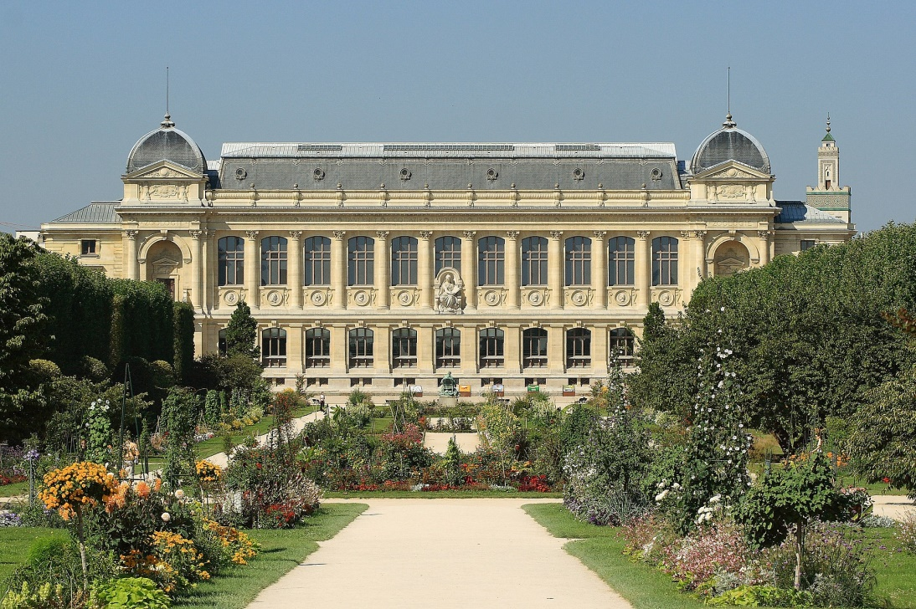
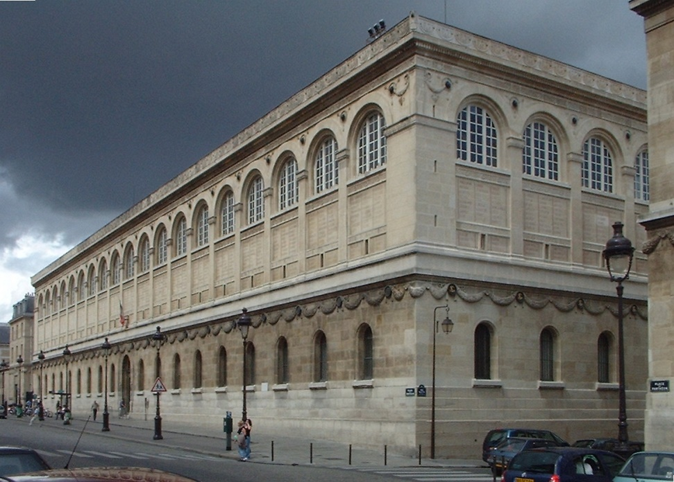
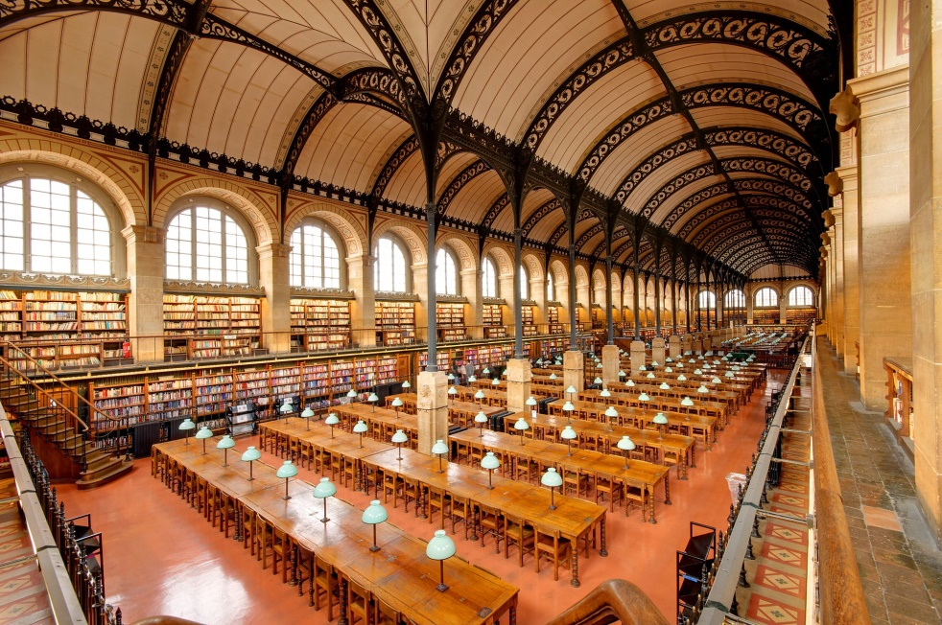
Beaux-Arts architecture 2
Museum of Natural History, Paris by Louis-Jules André (1877–1889)
The Sainte-Geneviève Library by Henri Labrouste (1844–50) with its interior

Slide 15
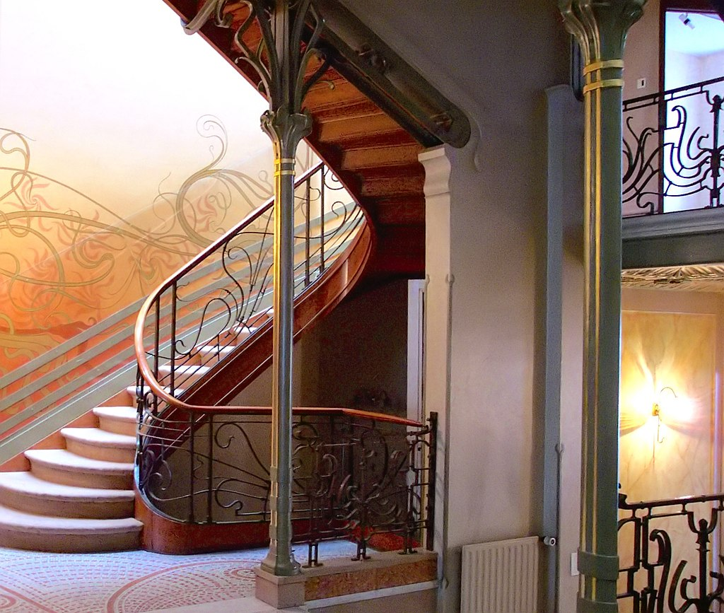
Art Nouveau
Around 1900 a number of architects around the world began developing new architectural solutions to integrate traditional precedents with new social demands and technological possibilities, being inspired by natural forms and structures, particularly the curved lines of plants and flowers.
The work of Victor Horta and Henry van de Velde in Brussels, Antoni Gaudí in Barcelona, Otto Wagner in Vienna and Charles Rennie Mackintosh in Glasgow, among many others, can be seen as a common struggle between old and new.
Interior of the Hôtel Tassel built between 1892 and 1893 by Victor Horta, in Bruxelles (Belgium)

Slide 16
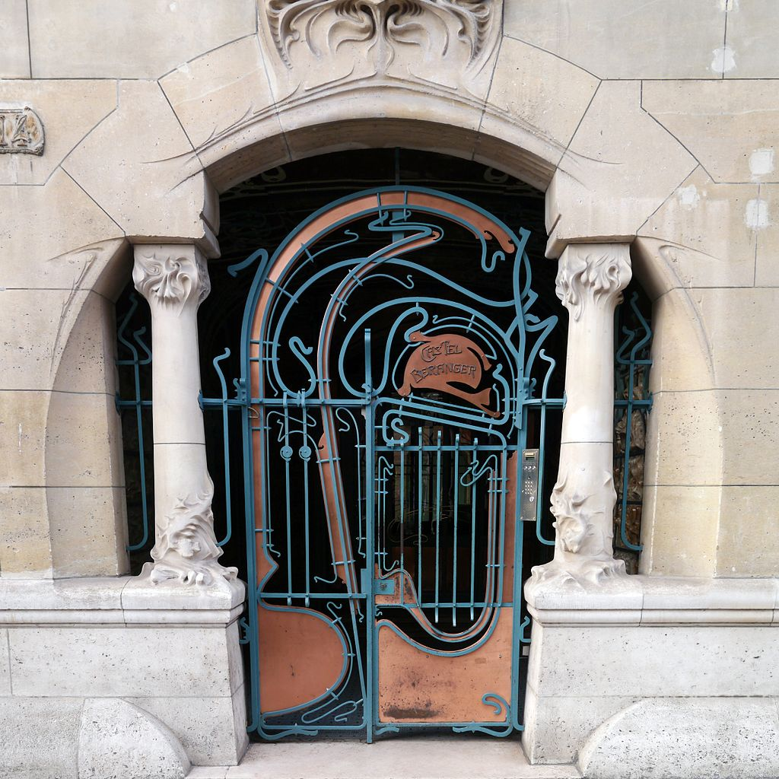
Art Nouveau 2
Art Nouveau architecture was a reaction against the eclectic styles that dominated European architecture in the second half of the 19th century. It was expressed through decoration: either ornamental (based on flowers and plants, e.g. thistles, irises, cyclamens, orchids, water lilies, etc.) or sculptural.
While faces of people (or mascarons) are referred to ornament, the use of people in different forms of sculpture (statues and reliefs) were also typical for Art Nouveau. Façades were asymmetrical, and often decorated with polychrome ceramic tiles. The decoration usually suggested movement; there was no distinction between the structure and the ornament.
The whiplash motif, adapted from vegetal forms, was widely used.
Entrance of the Castel Béranger in Paris, by Hector Guimard

Slide 17
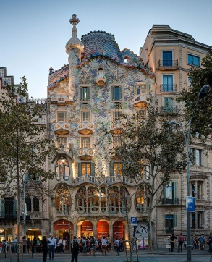
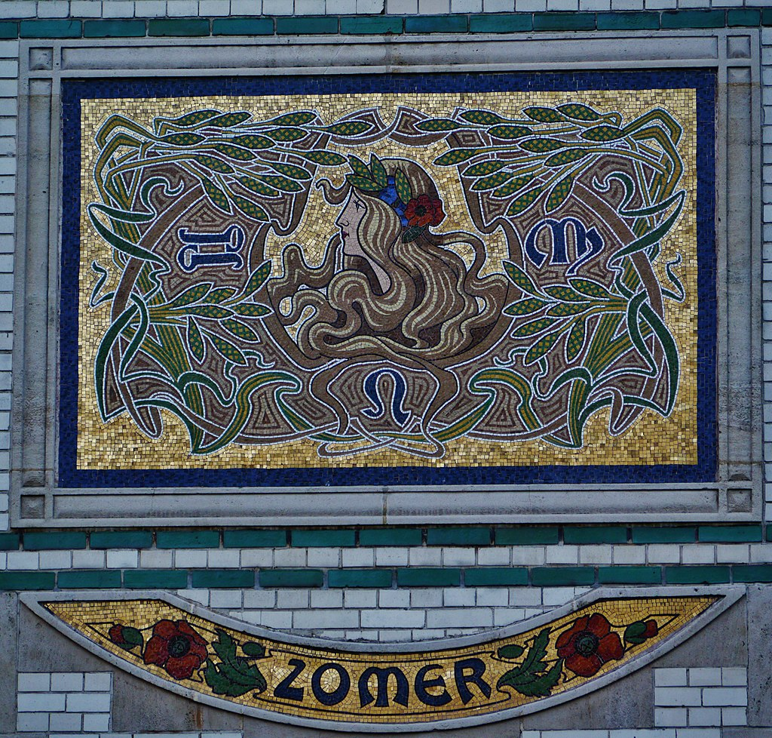
Art Nouveau 3
The Casa Batlló by Antoni Gaudí in Barcelona (Spain), an iconic Art Nouveau masterpiece
Mosaic representing summer, on a house from Antwerp (Belgium)

Slide 18
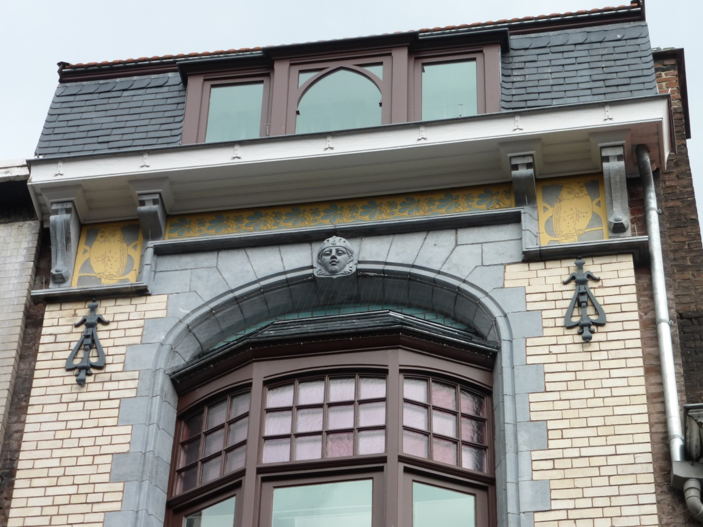
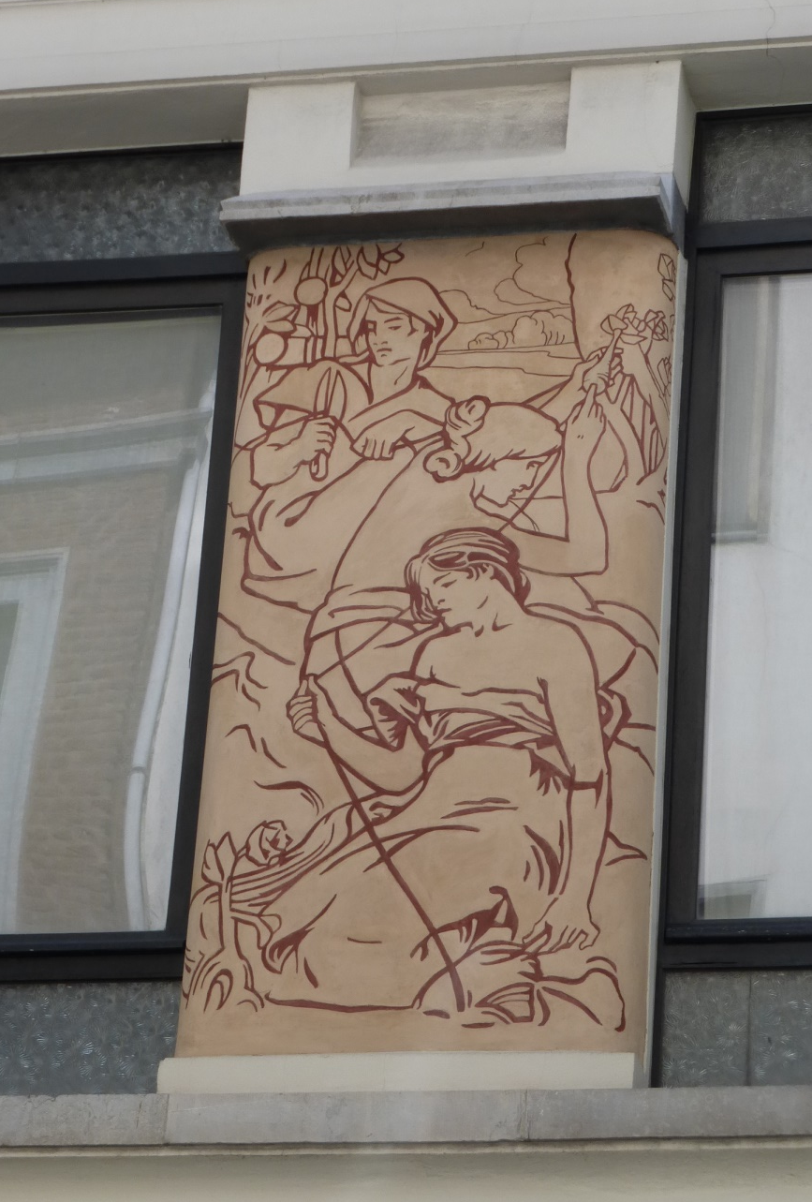

Slide 19
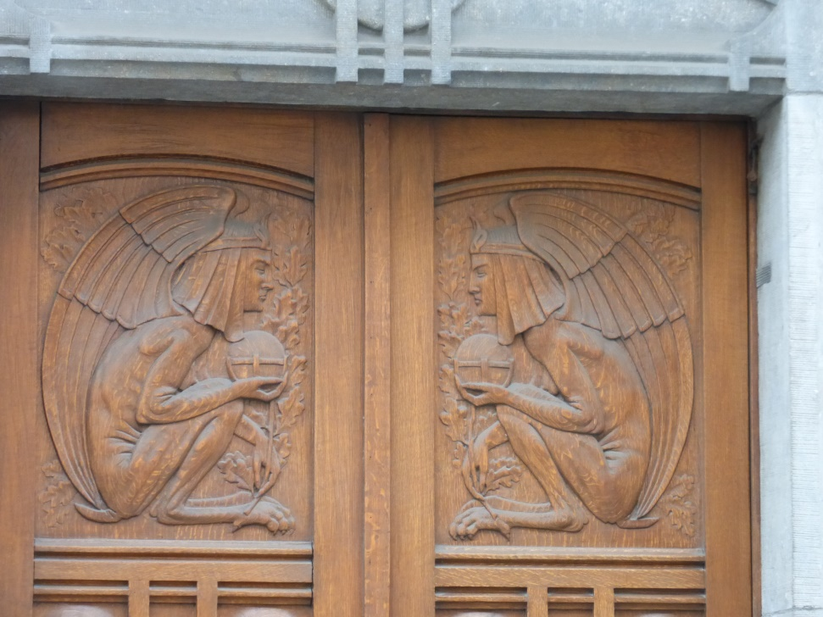
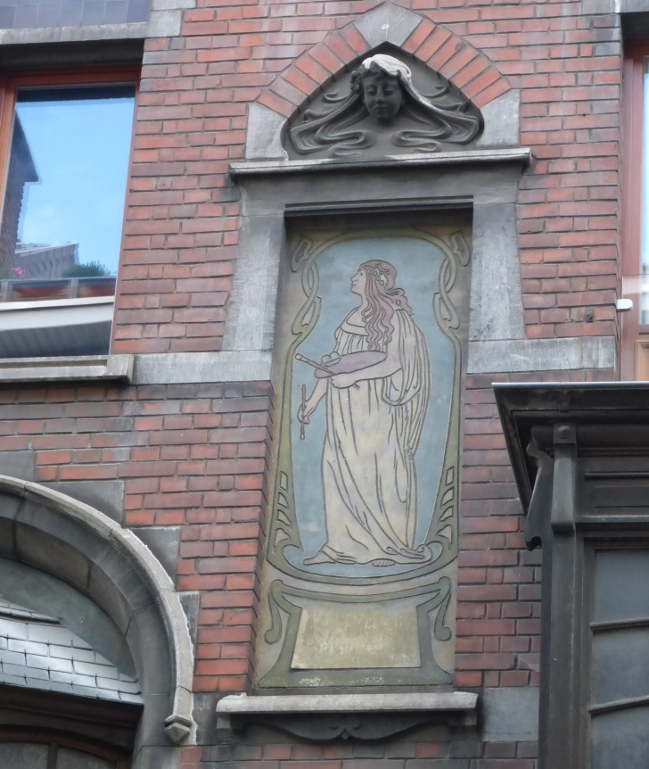
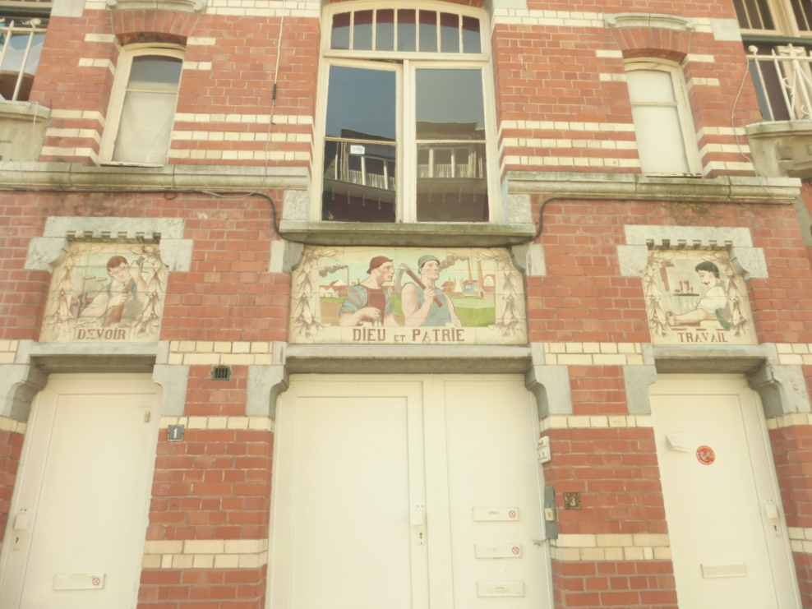
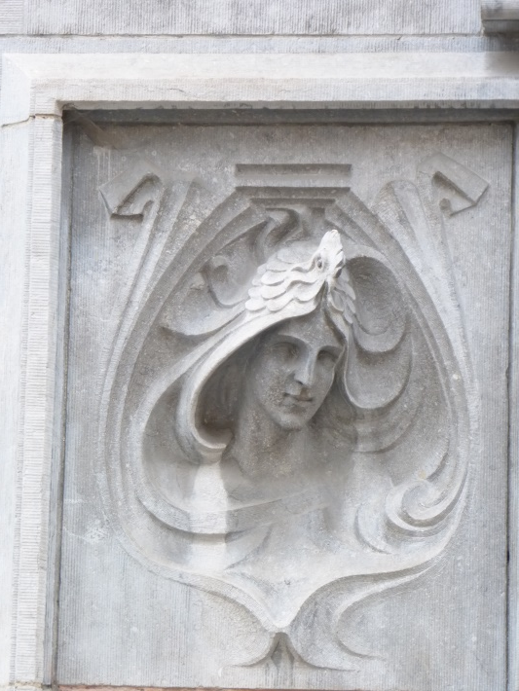
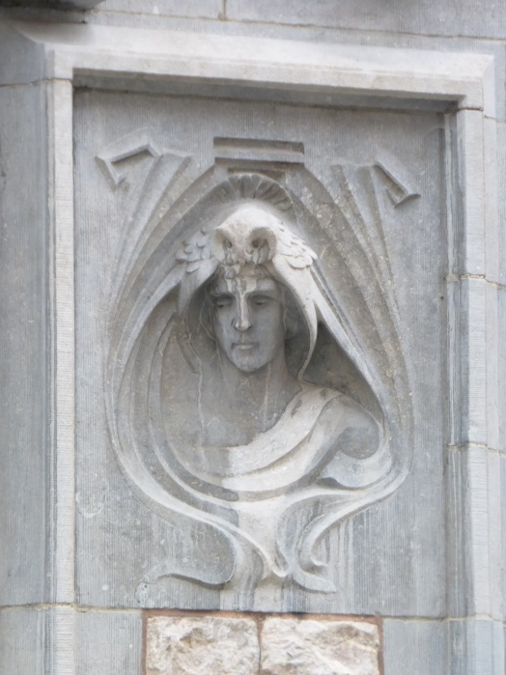

Slide 20
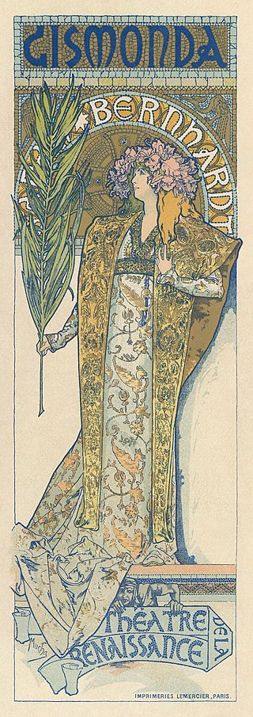
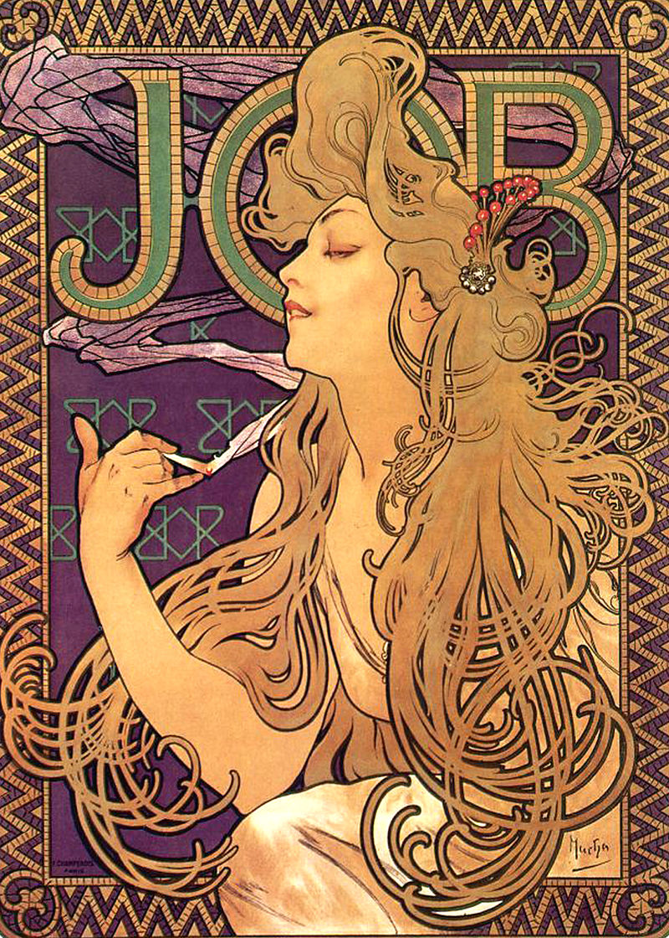
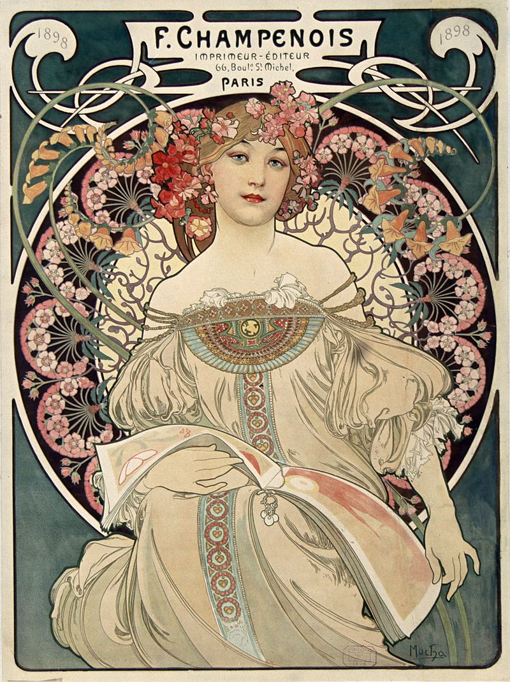
Art Nouveau is much associated with the work of Alphonse Mucha
Reverie, poster for the publishing house Champenois (1897)
Poster of Sarah Bernhardt as Gismonda (1895)
Poster for JOB cigarette papers (1898)

Slide 21
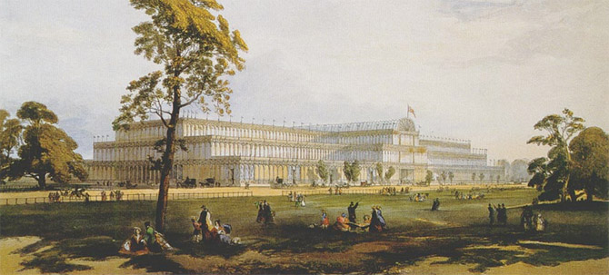
New Materials
Crystal Palace 1851
Mass production became possible in glass, iron and later steel. The machine tool industry introduced a precision in manufacture which, when applied to building, enabled the erection of large and safe structures built from uniform components.
The demands for factories, storage and transport led to new types of utility buildings in manufacturing cities and ports.

Slide 22
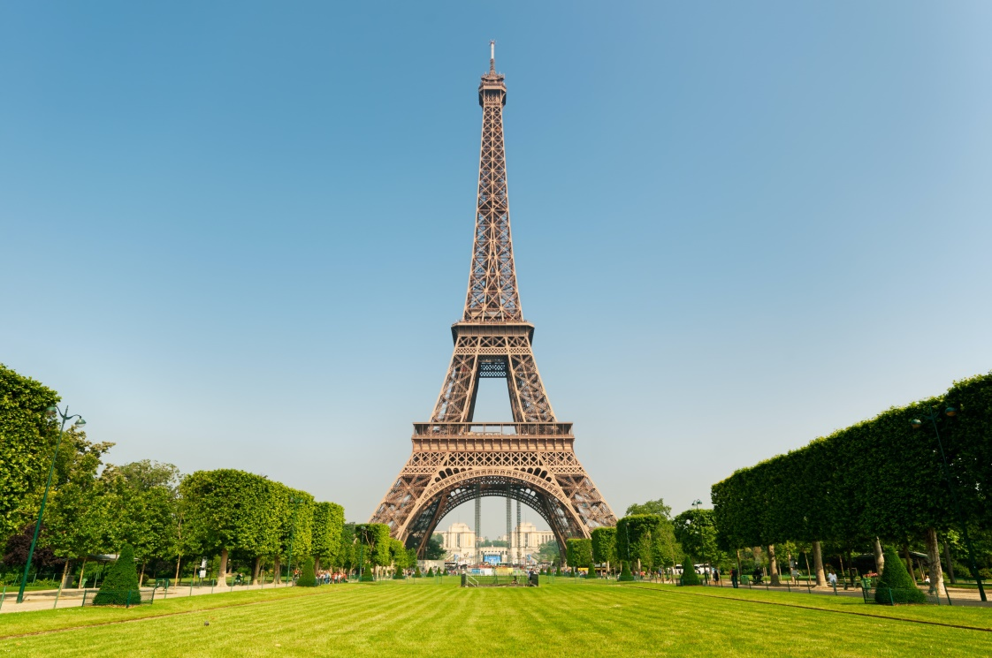

New Materials 2
Gustave Eiffel
Eiffel Tower
The first digging work started on the 28th January 1887and it was completed on the 31st March 1889.
Ponte Eiffel, Viana do Castelo – 1878

Slide 23
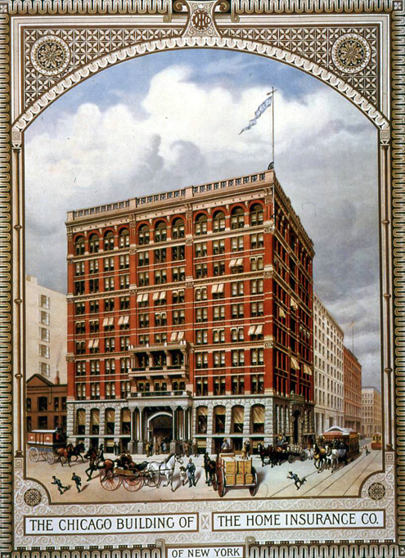
New Materials 3
During the second half of the 19th century in the United States, it was the possibilities of cast iron and steel in the building of multi-storey unit constructions that were most effectively exploited.
The Home Insurance Building was a skyscraper that stood in Chicago from 1885 to 1931. Originally ten stories and 138 ft (42.1 m) tall, it was designed by William Le Baron Jenney in 1884 and completed the next year.

Slide 24
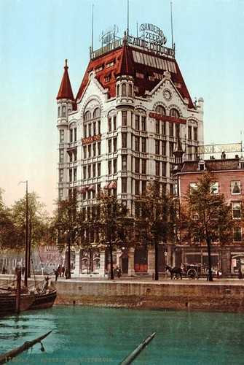
New Materials 4
Witte Huis - Rotterdam First highrise building in Europe. It was built in 1898, just 13 years later than the world's first high-rise, the Home Insurance Building in Chicago. It is 43m/141ft tall, with 11 floors and was designed by the architect Willem Molenbroek.

Slide 25
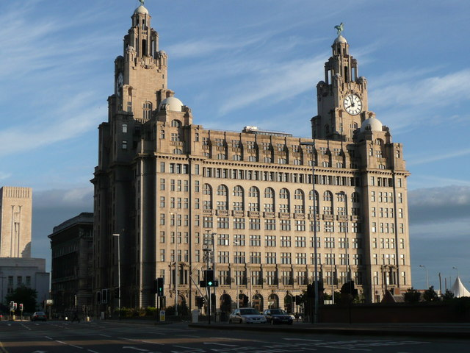
New Materials 5
The Royal Liver Building is a Grade I listed building in Liverpool, England.
Opened in 1911, the building is the purpose-built home of the Royal Liver Assurance group, which had been set up in the city in 1850 to provide locals with assistance related to losing a wage-earning relative.
One of the first buildings in the world to be built using reinforced concrete, the Royal Liver Building stands at 98.2 m (322 ft) tall to the top of the spires, and 50.9 m (167 ft) to the main roof.
Once one of the tallest buildings in the country, the Royal Liver Building is now only the joint-fifth tallest structure in the City of Liverpool.

Slide 26
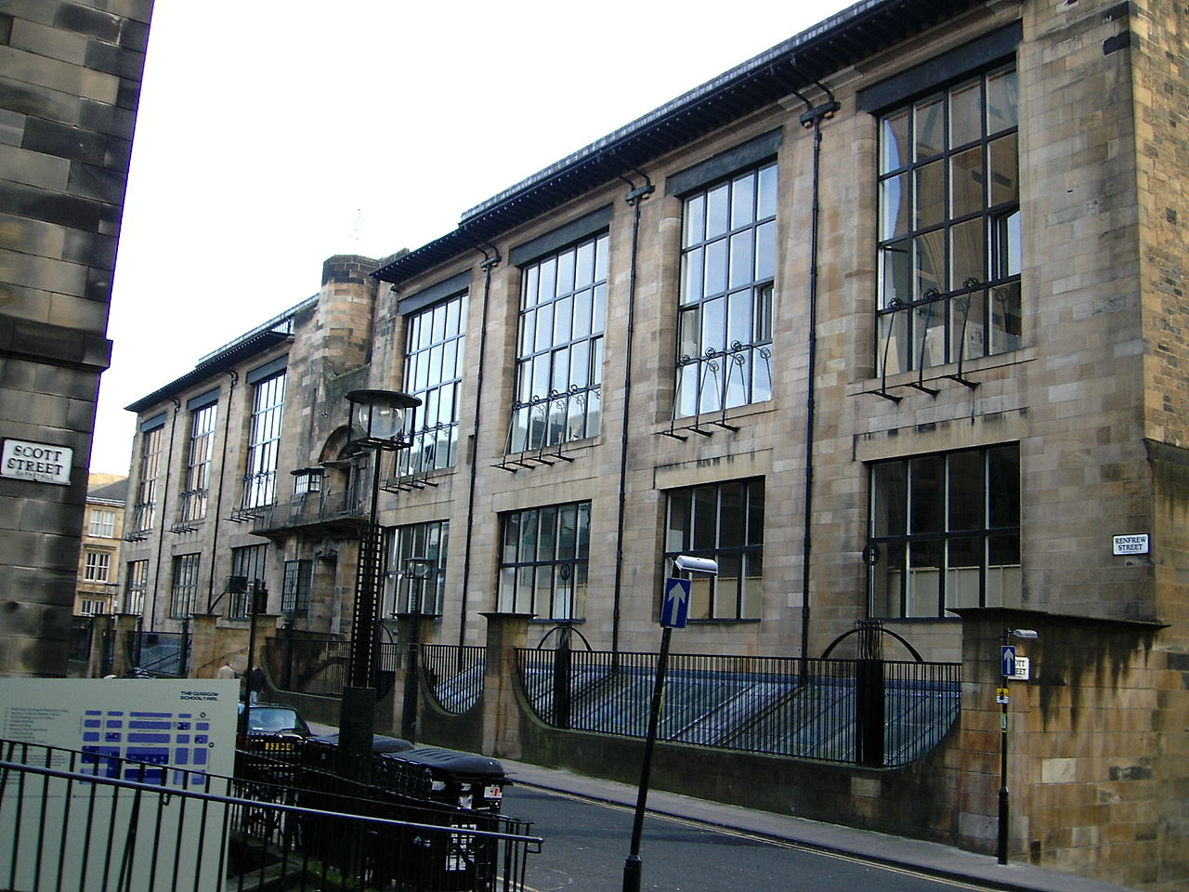
Modern architecture
Modern architecture, or modernist architecture, was an architectural style based upon new and innovative technologies of construction, particularly the use of glass, steel, and reinforced concrete.
It has the idea that form should follow function (functionalism); an embrace of minimalism; and a rejection of ornament.
It emerged in the first half of the 20th century and became dominant after World War II until the 1980s, when it was gradually replaced as the principal style for institutional and corporate buildings by postmodern architecture
The Glasgow School of Art by Charles Rennie Mackintosh (1896–99)

Slide 27
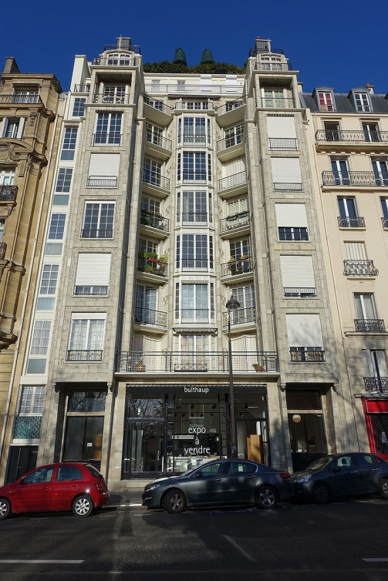
Modern architecture 2
Architects also began to experiment with new materials and techniques, which gave them greater freedom to create new forms. In 1903–1904 in Paris Auguste Perret and Henri Sauvage began to use reinforced concrete, previously only used for industrial structures, to build apartment buildings. Reinforced concrete, which could be molded into any shape, and which could create enormous spaces without the need of supporting pillars, replaced stone and brick as the primary material for modernist architects.
The first concrete apartment buildings by Perret and Sauvage were covered with ceramic tiles.
But in 1905 Perret built the first concrete parking garage on 51 rue de Ponthieu in Paris; here the concrete was left bare, and the space between the concrete was filled with glass windows.
Reinforced concrete apartment building by Auguste Perret, Paris (1903)

Slide 28
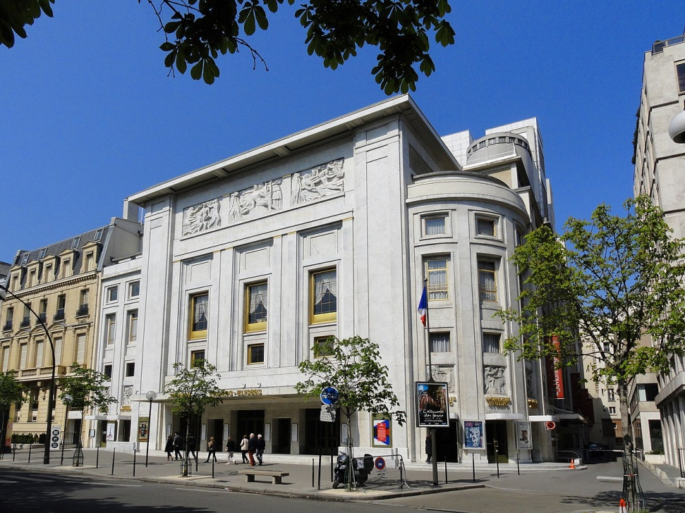
Modern architecture 3
Between 1910 and 1913, Auguste Perret built the Théâtre des Champs-Élysées, a masterpiece of reinforced concrete construction, with Art Deco sculptural bas-reliefs on the facade by Antoine Bourdelle. Because of the concrete construction, no columns blocked the spectator's view of the stage.
The Théâtre des Champs-Élysées in Paris by Auguste Perret (1911–1913)

Slide 29
Conclusion
Modern architecture had begun to emerge before 1914 and went on to become a major style of architecture.
However many different styles have continued to flourish.

